Slide 1
Trill
--Trillions of events per day
A Streaming Engine in Microsoft
-- Wenshuang

Slide 2
场景
Bing Service
广告主网站
广告主1
Bing.com
Users
广告主2
广告主2
Data
UET Conversions

Slide 3
什么是Trill
Microsoft StreamInsight
  Data Model
Trill is a fast in-memory streaming analytics engine
支持Real-time 和 Offline的计算
可以集成到任何.Net的应用程序中
StreamScope (Version 1) => USQL-Streaming (Version 2)

Slide 4
对比
Spark Streaming
  mini-batch模式的Streaming技术
  http://spark.apache.org/docs/latest/streaming-programming-guide.html
Flink
  Event Stream模式的Streaming技术
  https://ci.apache.org/projects/flink/flink-docs-release-1.5/
  Performance (Spark, Flink, Trill)
    Trill号称性能是目前已存在Streaming 技术的2-4倍

Slide 5

Data Model
Time
  Wall clock time – current real time
  Application (system) time – current time of the query
  Event time – time associated with the event (before adjustment, if any)
Events
  Lifetime – events are active for some amount of time $\left[\left.v_{s},v_{e}\right)\right.$
  Sync time – timestamp used for ordering; usually $v_{s}$
  Kind
    Insert – data event
    CTI (current time increment) – indicates time without data
  Shape
    Point – an event that occurs at a single point in time
    Interval – an event with a known lifetime
    Start edge – an event with a (currently) unknown lifetime
    End edge – the end of the lifetime of a start edge event
  Payload – data associated with the event
_EventStartTime | _EventEndTime | _EventType | Payload
2018-06-10 12:00:00 | 2018-06-10 12:00:01 | 0 | Byte[]
2018-06-10 12:00:03 | 2018-06-10 12:00:03 | 64 | null
2018-06-10 12:00:05 | 2018-06-10 12:00:05 | 0 | Byte[]
2018-06-10 12:00:10 | 2018-06-10 12:00:10 | 192 | null

Slide 6
Data Model
Windows
  Tumbling Window
  Hopping Window （Sliding Window）
  Snapshot Window
Shuffle (Repartition)
  根据需要对数据进行repartition，保证同一个key的数据在一个work上被处理
Checkpoint （恢复机制）
  Metadata checkpoint
  Data checkpoint

Slide 7
操作
  Time
    AlterEventStartTime – move start without moving end
    AlterEventEndTime – move end without moving start
    AlterEventLifetime – move start and end
    ShiftEventTime – move start and end by the same amount
  Payloads
    Select – projection
    SelectMany – unrolling
    Where – filtration

Slide 8
Joins
Equijoin on one or more keys
Outputs are defined only when lifetimes overlap
Many join types produce edge events
State size proportional to input lifetimes
 |  | t₀ |  | t₁ |  |  | t₂ |  | …
Left input
Right input
Inner join
Full outer join
Left outer join
Right outer join
Left anti join
Right anti join

Slide 9
Aggregations
Group on one or more keys
Values change when time advances to event start or end
Two logical kinds of aggregation
  Snapshot
  Windowed (hopping, tumbling)
Aggregations often produce edge events
State size proportional to input lifetimes
 |  |  | 1
 |  |  |  | 2
 |  |  | 4
 |  |  |  |  |  | 1
 |  |  |  |  |  |  | 3
 |  |  |  |  |  |  | 3
COUNT |  | 1 | 3 | 2 | 2 | 2 | 3 | 1
SUM |  | 1 | 7 | 3 | 3 | 4 | 7 | 3

Slide 10
挑战——数据载入
数据不一定是严格有序
  服务太多
  时间不同步
  机器异常（宕机 => 恢复）
解决方案
  Disorder policy (adjust, drop, throw)
  CTI injection policy (none, count, time)

Slide 11
挑战-内存占用
Code优化
  自定义Serialization协议
  将某些String进行hash计算，减少存储

Slide 12
挑战——Mapping Data
数据更新 （增 删 改）
  利用Edge Event的特性解决

Slide 13
Example
在Event Stream中对events进行Dedup操作
尝试对下面的四个EventStream进行dedup操作。最后，只保留第一个event
_EventStartTime | _EventEndTime | _EventType | Payload
2018-06-10 12:00:00 | 2018-06-10 12:00:00 | 0 | Byte[]
2018-06-10 12:01:00 | 2018-06-10 12:01:00 | 0 | Byte[]
2018-06-10 12:02:00 | 2018-06-10 12:02:00 | 0 | Byte[]
2018-06-10 12:03:00 | 2018-06-10 12:03:00 | 0 | Byte[]
2018-06-10 12:04:00 | 2018-06-10 12:04:00 | 0 | Byte[]
2018-06-10 12:05:00 | 2018-06-10 12:05:00 | 0 | Byte[]

Slide 14
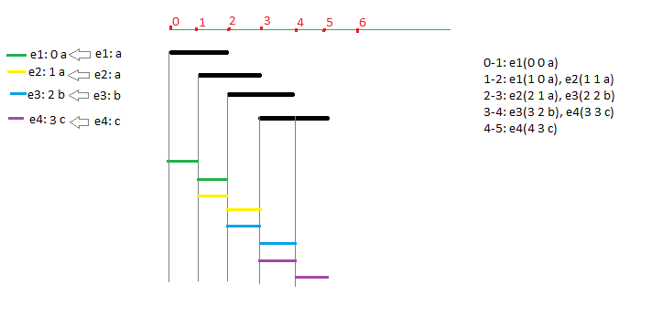
Dedup
inputStream
.AlterEventDuration(TimeSpan.FromMinutes(2))
.Select(TimePayloadPair.Create)
.SnapshotWindow()
.GroupBy(x => x.Payload)
.First((k, v) => v)
.Select(TimePayloadTriple.Create)
.Where(x => x.OriginalTime == x.NewTime)
.Select(x => x.Payload)

Slide 15
Thanks
Q&A

