Slide 1
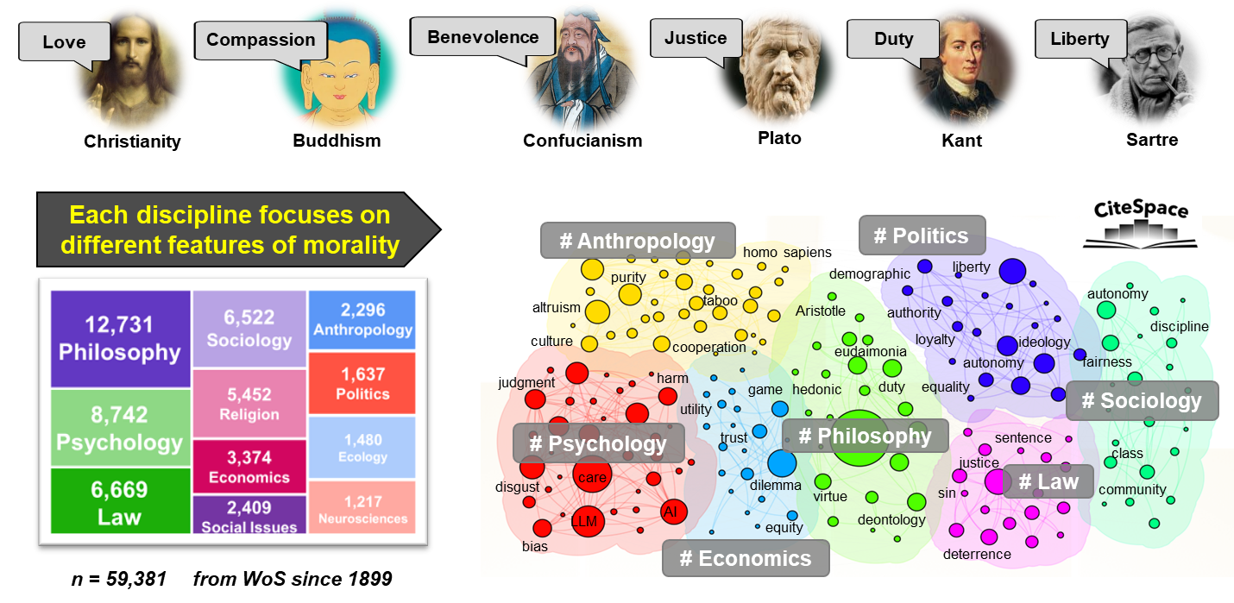
Introduction
Data
Our SOS framework
Central topic of humanity and social sciences

Slide 2
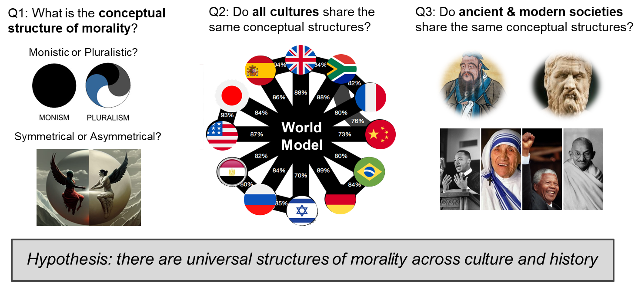
Introduction
Data
Our SOS framework
Three key scientific questions

