Slide 1
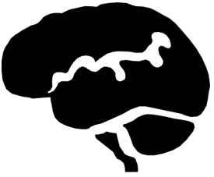
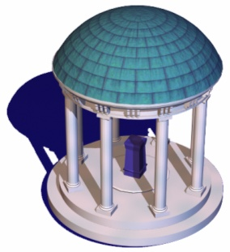


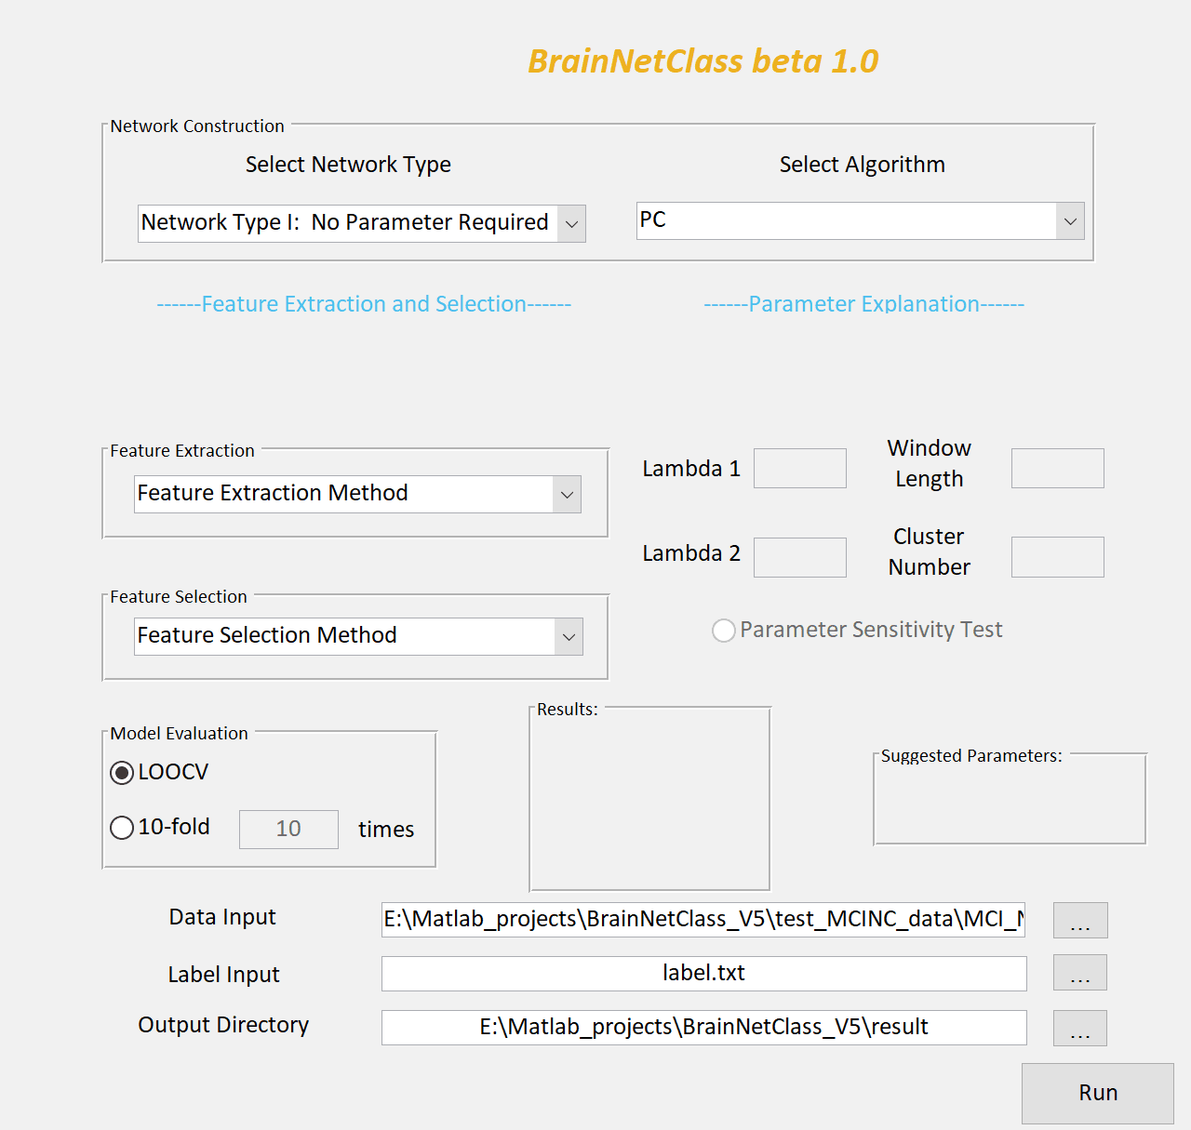
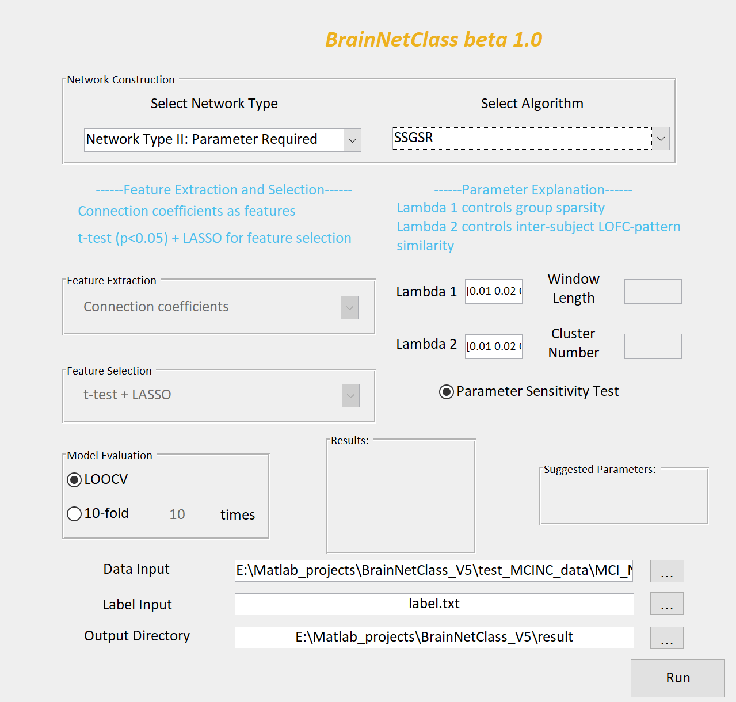
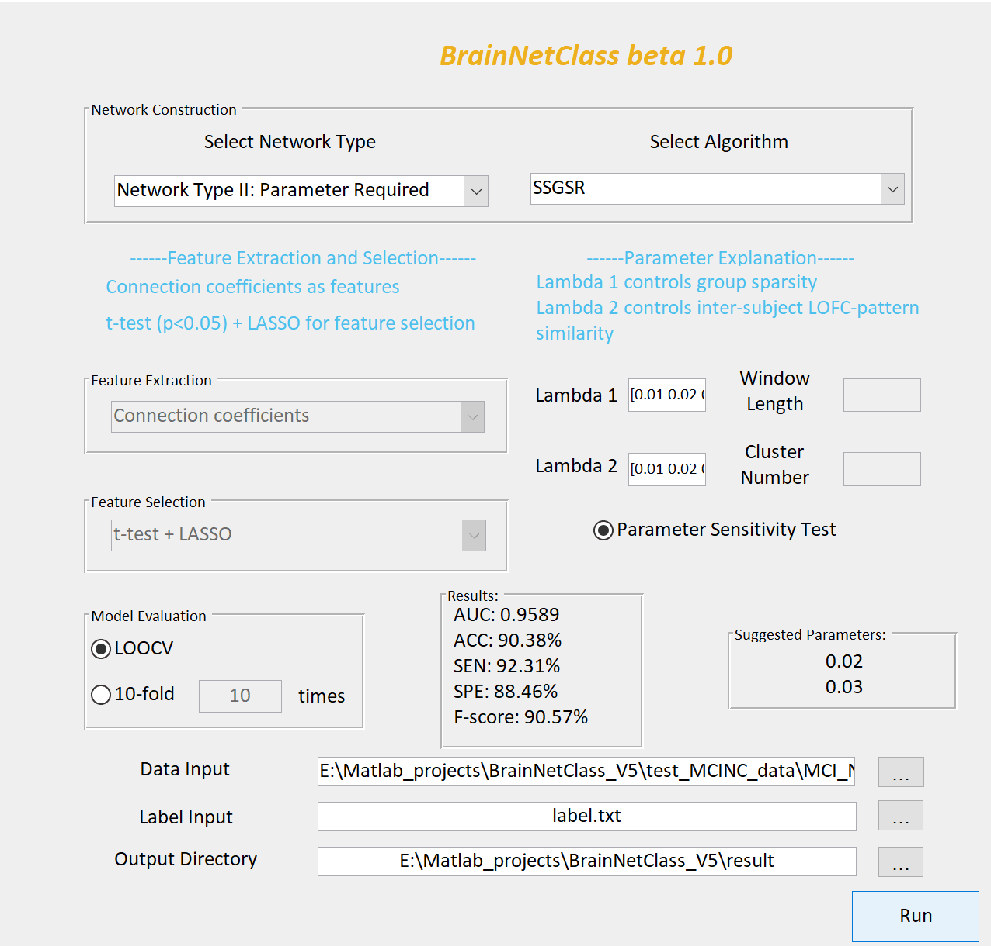
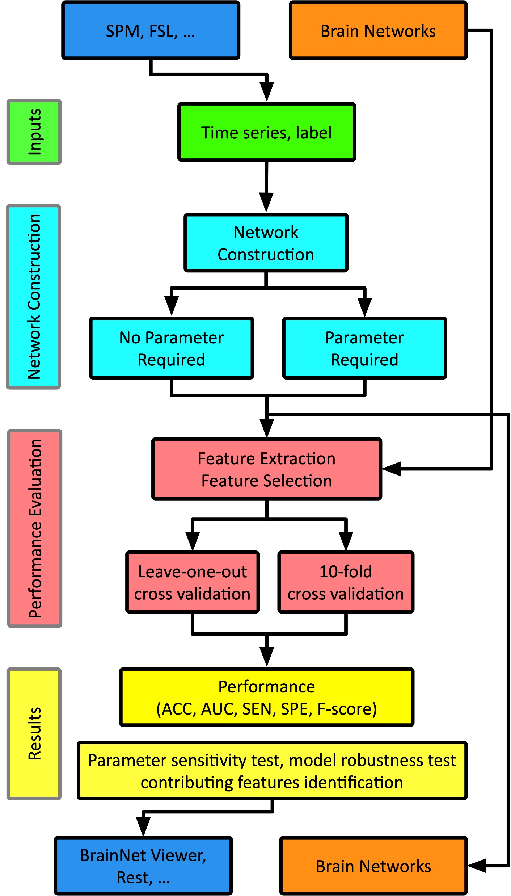
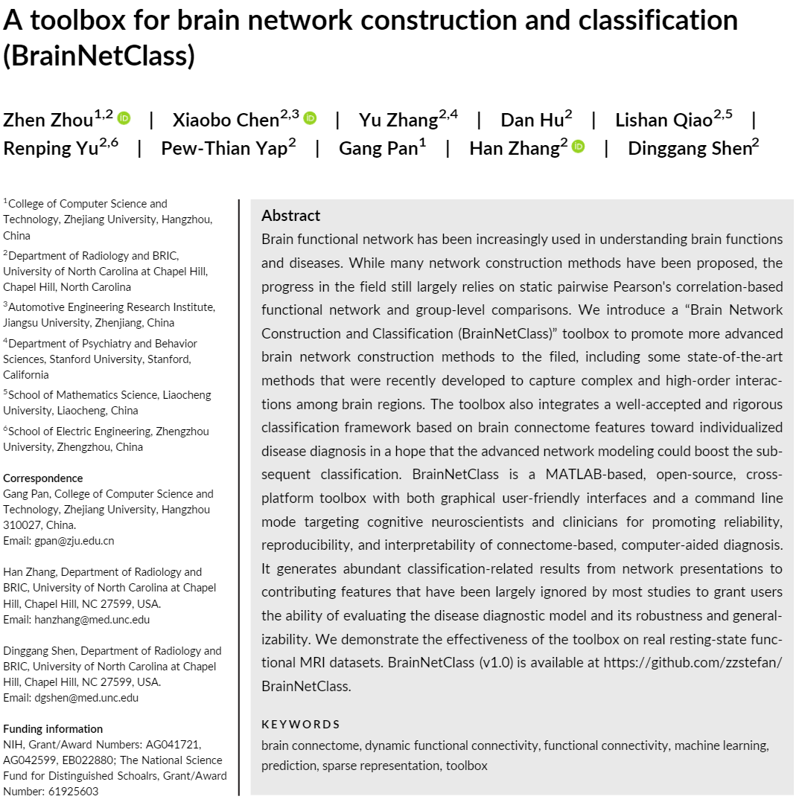
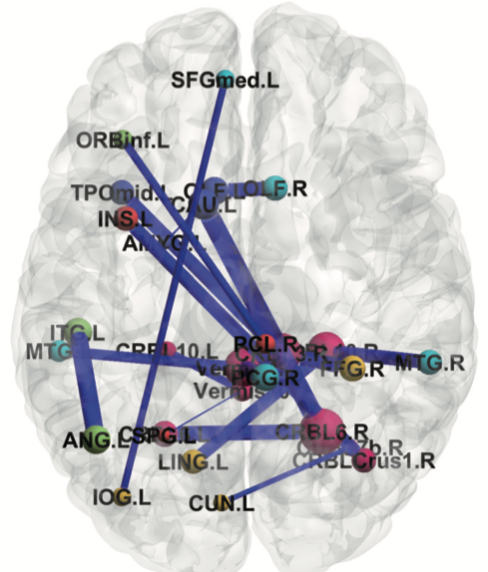
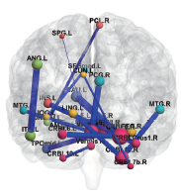
Brain Network Construction and Classification Toolbox (BrainNetClass v1.1)
Department of Radiology and Biomedical Research Imaging Center (BRIC)
University of North Carolina at Chapel Hill, NC 27599
Step 1: Setup input time series
Step 2: Select network construction method, feature extraction & selection method, setup parameter ranges and cross validation strategy
Step 3: Result display on panel
Included algorithms:
Pearson’s correlation-based functional connectivity (FC)
Topological high-order FC (HOFC)
Associated HOFC
Dynamics-based HOFC
Sparse representation (SR)
Group SR
Weighted SR
Sparse group representation (SGR)
Weighted SGR
Strength and similarity guided SR
Sparse low-rank representation
Features:
Easy-to-use, pipelined, GUI interface.
Work well with other software.
State-of-the-art brain functional network construction methods.
Comprehensive interpretable results for model assessment.
Basic and clinic neuroscience application orientated.
Flexible for user to save brain networks built.
Batch mode provided.
Rigorous machine learning.
Generalizability and robustness evaluation functions.
Extensively tested with many datasets.
Schematic diagram: BrainNetClass receives regional rs-fMRI time series from many preprocessing toolboxes. After model training, performance and the resultant brain networks can be saved for further interpretations and can be visualized.
Contributive connectivity links: Example of one result generated for early Alzheimer’s disease detection based on the brain networks estimated by SSGSR (a group sparse representation method). The contributing links are visualized. Thickness of links represent connectivity strength.
Software download: https://github.com/zzstefan/BrainNetClass
Manual, testing datasets, demo, batch, code (Matlab)
Journal paper: https://onlinelibrary.wiley.com/doi/full/10.1002/hbm.24979
Cite: Zhou et al. (2020) A Toolbox for Brain Network Construction and
Classification (BrainNetClass). Human Brain Mapping. DOI: 10.1002/hbm.24979
Han Zhang
hanzhang@med.unc.edu
Zhen Zhou
zzstefan@email.unc.edu

