Slide 1
Toolbox for Brain Network Construction and Classification (BrainNetClass v1.1)
Aims:
Combining state-of-the-art brain network construction algorithms developed recently into a Matlab toolbox.
Developing an easy-to-use classification toolbox for neuroscientists and clinicians to use.
Making all the network construction algorithms publicly available and promote advanced brain functional network construction for disease classification.

Slide 2
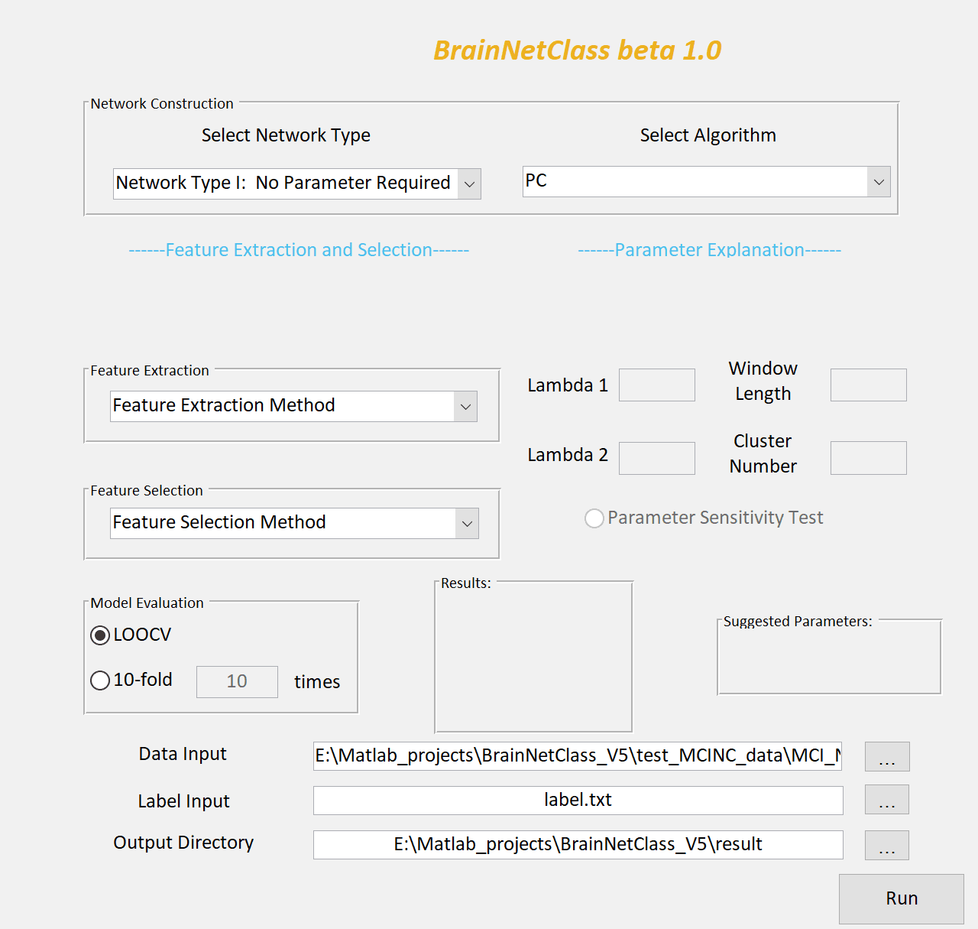
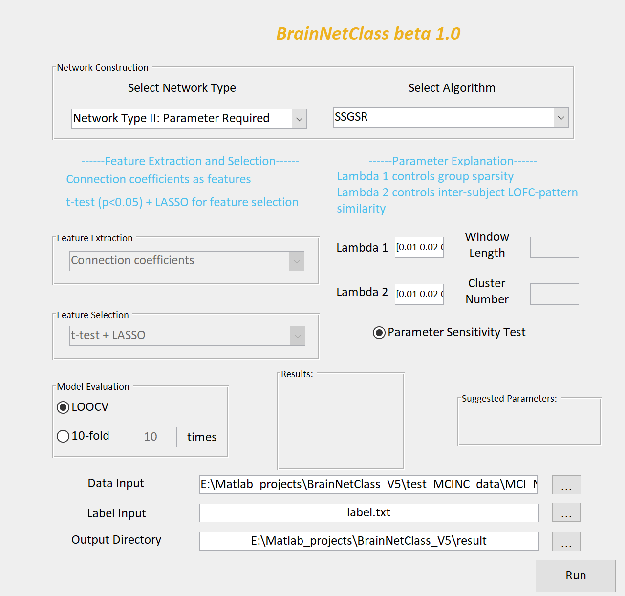
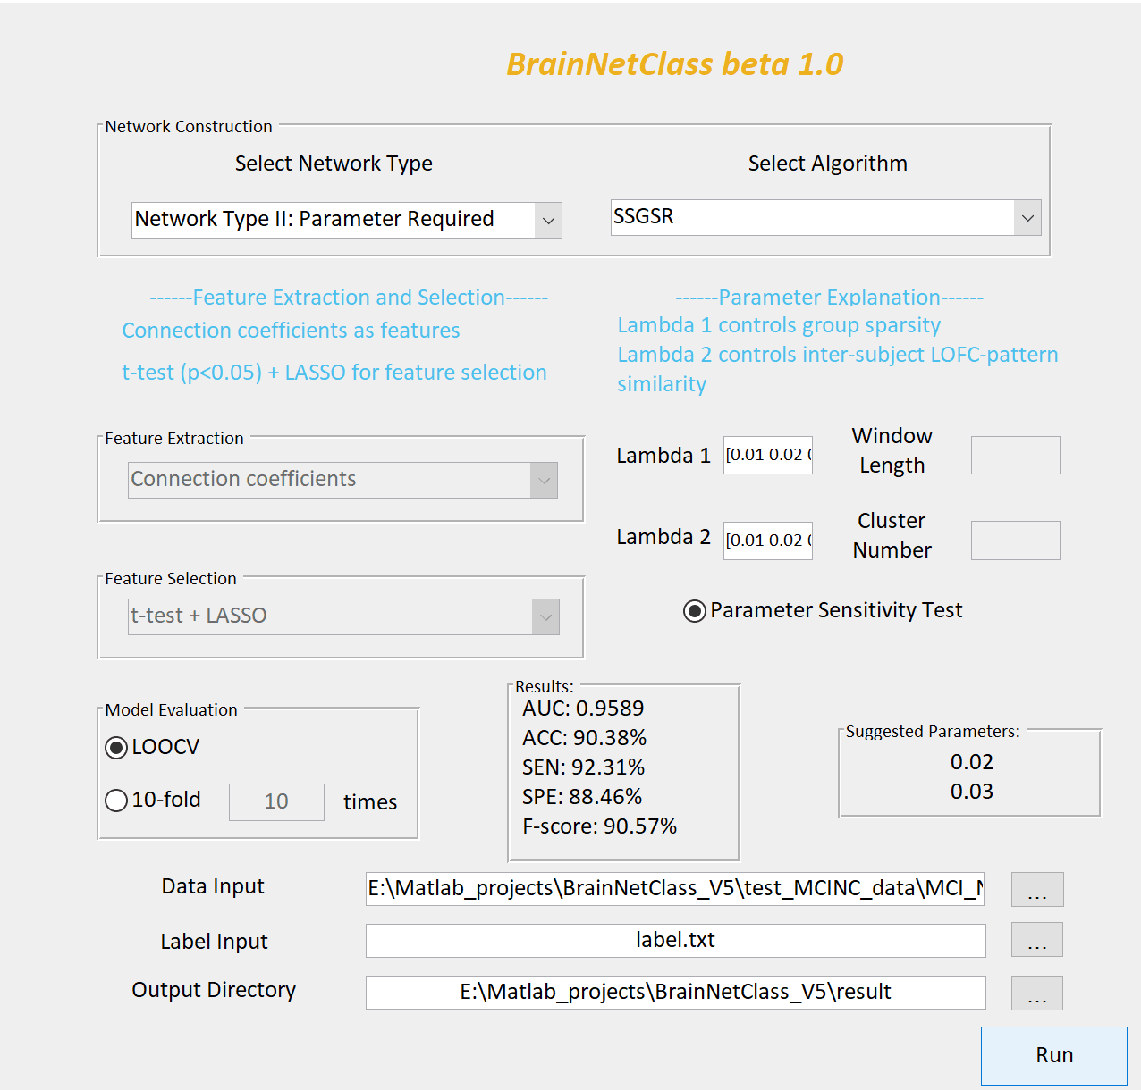
Major steps of using BrainNetClass GUI
Step 1
Step 2
Step 3
(a)
(c)
(b)
(d)
Specify region-averaged rs-fMRI time series data of all subjects and a text-formatted label file containing a column of the labels of all subjects in the same order. Specify output directory.
Choose network construction method
Specify the involved parameters
Select feature extraction and feature selection methods
Choose a cross-validation strategy
Once finished, performance metrics will be shown on the panel with the suggested parameters (if applicable) for result evaluation.

Slide 3
Major scripts for using BrainNetClass (batch mode)
param_select_demo.m This is the main batch-process function for all network-based classification that requires parameter optimization.
no_param_select_demo.m This is the main batch-process function for all network-based classification that does not require parameter optimization.
save_BrainNet.m Users can use this script to generate brain networks for each subject and save them for future use (e.g., to perform statistical comparisons).
input_BrainNet.m Users can use this script to perform network-based classification using their own brain networks generated by other methods or toolboxes.

Slide 4
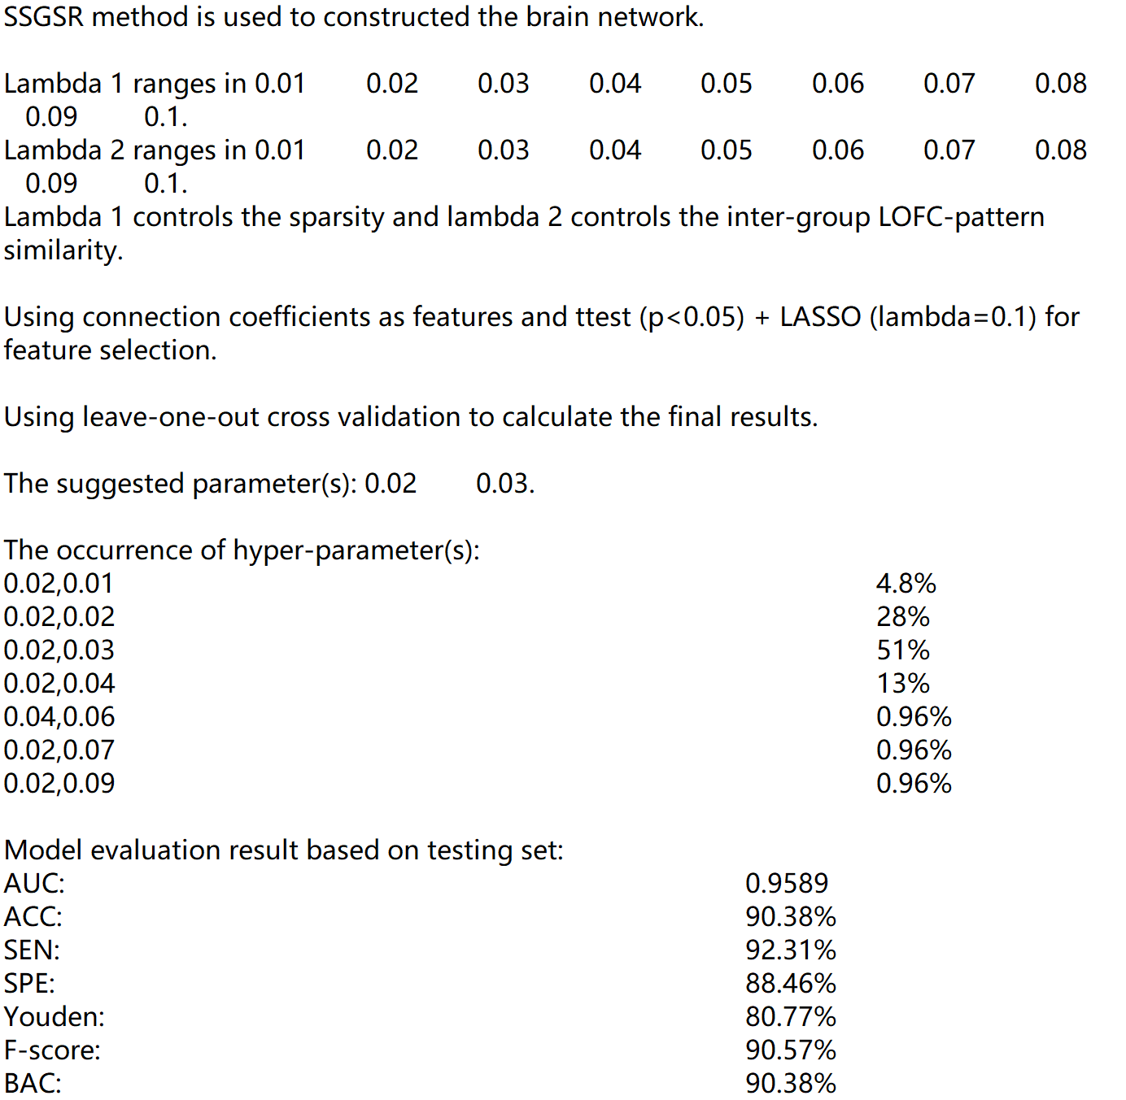
Comprehensive results generated for model evaluation: log file
BrainNetClass automatically generates a log file containing model specifications, optimized parameters, classification performance, etc.
Network construction method selected
Parameter range specified and parameter functions
Feature extraction and selection methods
Cross-validation method selected
The suggested parameters
The occurrence of the optimal parameters (those with the highest occurrence are the suggested parameters in e)
Model performance metrics
(a)
(b)
(c)
(d)
(e)
(f)
(g)

Slide 5
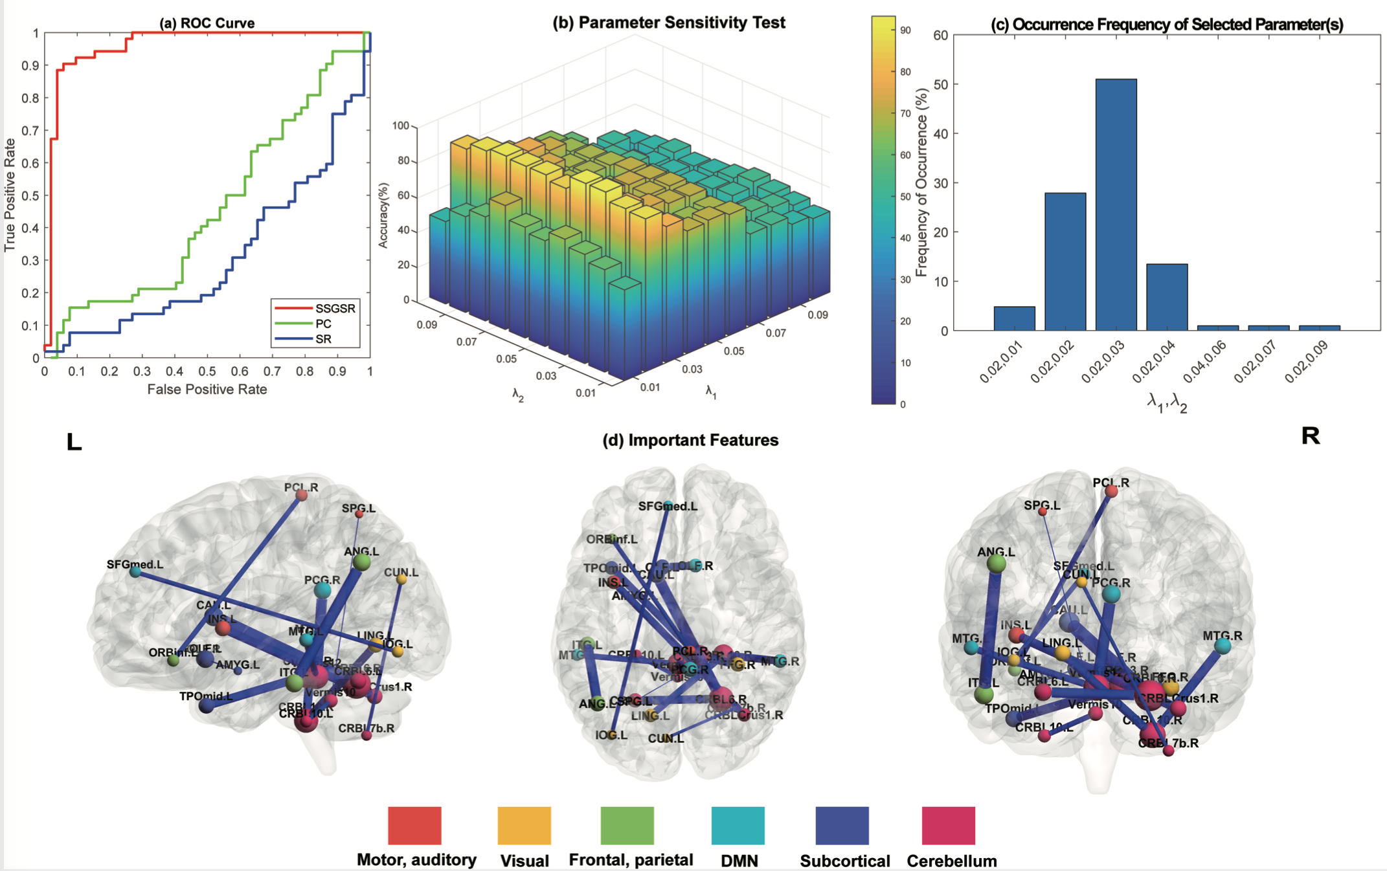
Comprehensive results generated for model evaluation: a demo
ROC curve comparisons between the three methods (red: main method, green and blue: baseline methods)
Parameter sensitivity testing result (showing how classification is sensitive to different parameters)
Model robustness evaluation (showing which parameters generate the most robust result)
Contributing features selected based on the most frequently selected features (visualized using BrainNet viewer)
This is a demo showing results generated by BrainNetClass in a task of early Alzheimer’s disease detection

Slide 6
Summary
An easy-to-use pipelined brain network construction and classification toolbox.
Options from many state-of-the-art brain functional network construction methods (totally 11 methods).
Comprehensive interpretable results for classification model assessment.
Basic and clinic neuroscience application-orientated without losing machine learning rigor.
Matlab-based, GUI interfaced, easy to be integrated with many existing neuroscience tools.
Software, demo, sample data, code, batch, manual download at:
https://github.com/zzstefan/BrainNetClass
For more information, please see our journal paper (Zhen et al., 2020, Hum Brain Mapp)
https://onlinelibrary.wiley.com/doi/full/10.1002/hbm.24979
Funding support: EB022880, AG042599, AG041721

