Slide 1

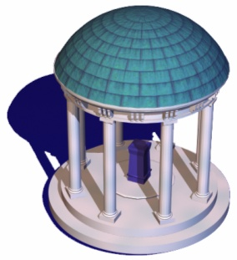


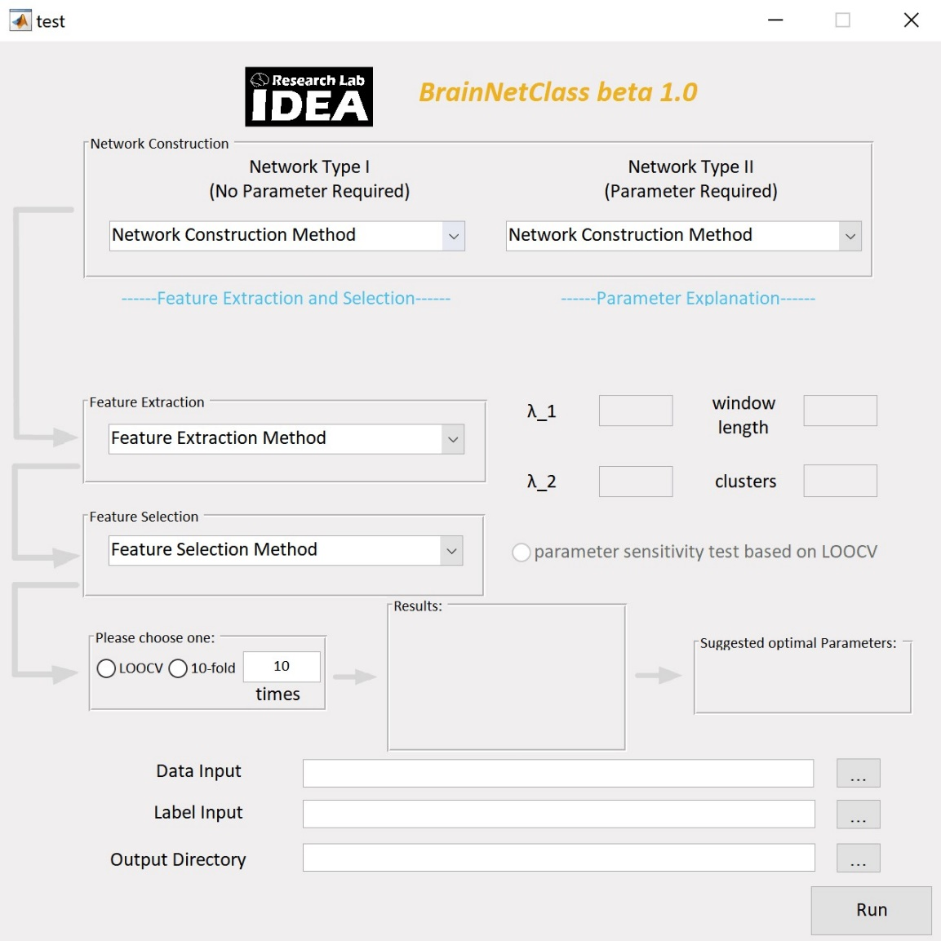
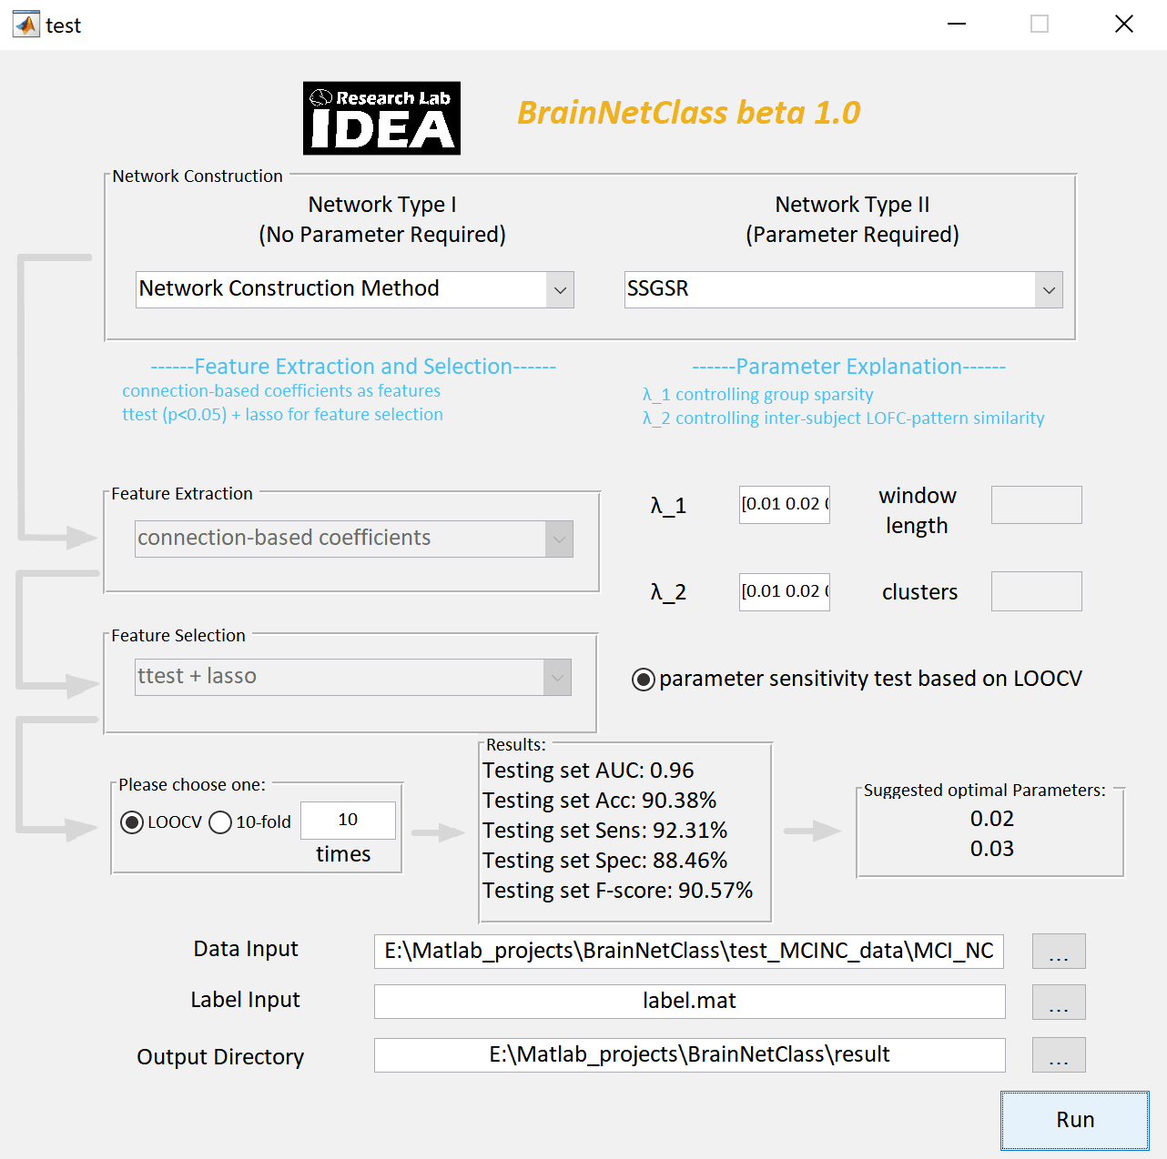
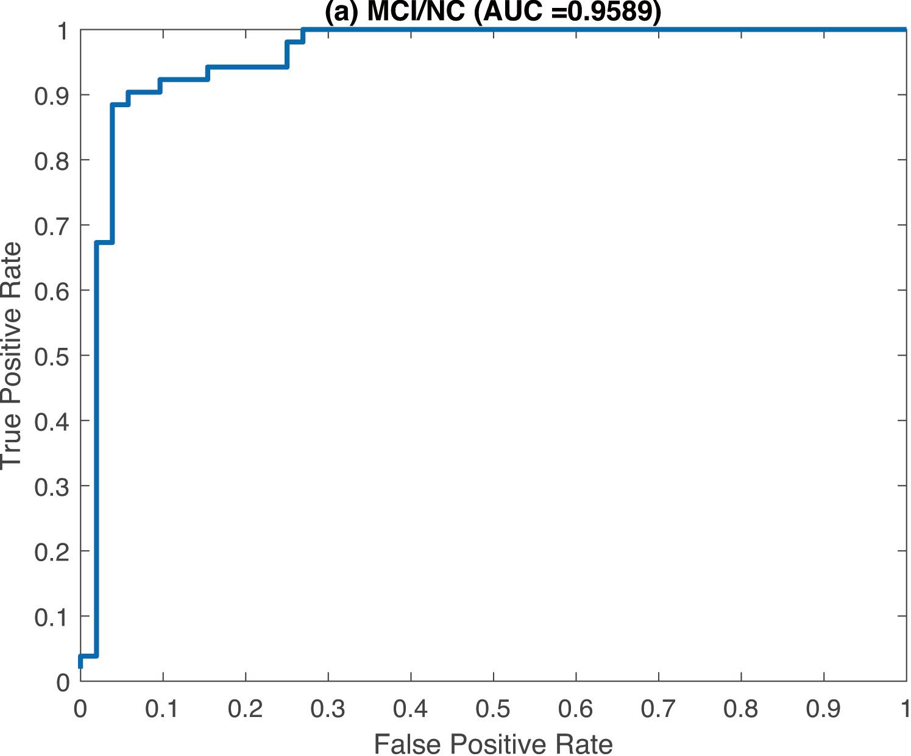
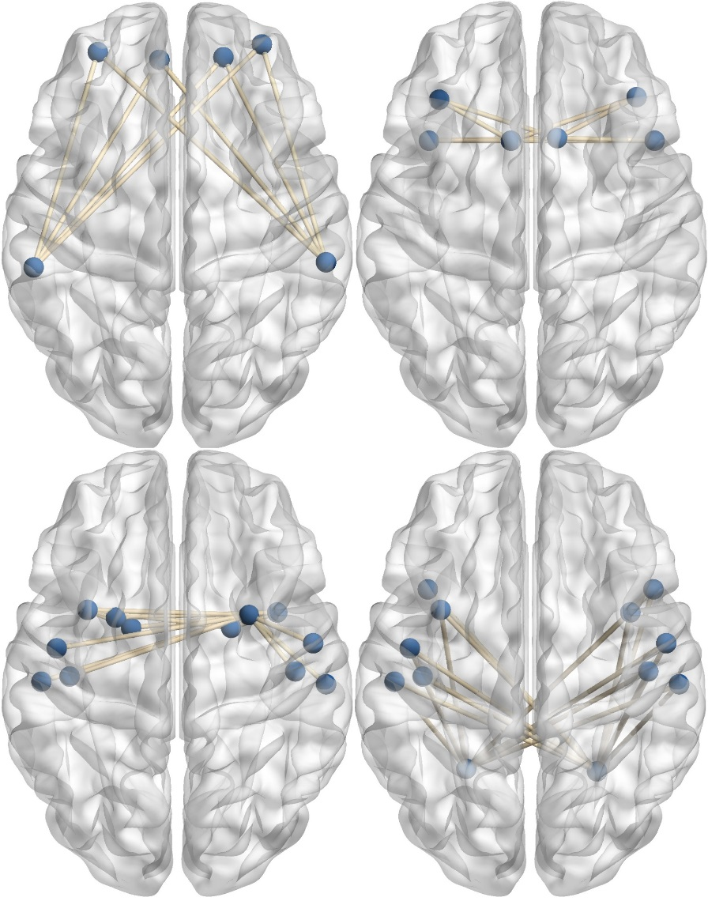
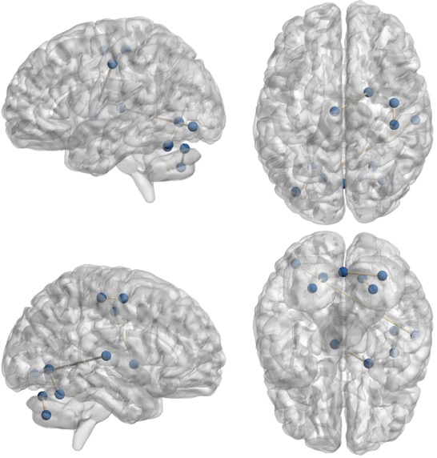
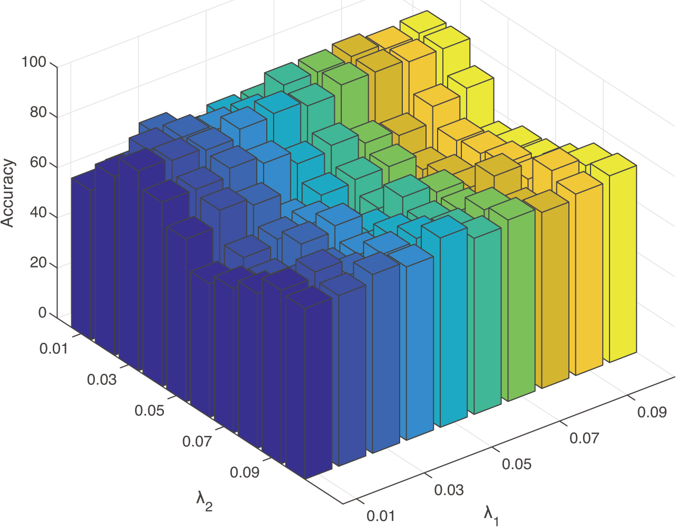
Computational Toolbox for Dynamic and High-Order Functional Connectomics
Han Zhang, Pew-Thian Yap, and Dinggang Shen
Department of Radiology and Biomedical Research Imaging Center (BRIC)
University of North Carolina at Chapel Hill, NC 27599
Background
Network Construction Algorithms
A GUI-based user-friendly MATLAB toolbox, BrainNetClass (beta 1.0), for dynamic and high-order functional connectomics.
Pair-wise correlation-based (PC, tHOFC [1], aHOFC [2], dHOFC [3])
Sparse representation-based (SR, GSR [4], WSR [5], WSGR [6], SGR, SSGSR [7], SLR [8])
PC: Pearson’s correlation, FC: functional connectivity, HOFC: high-order FC, tHOFC: topological profile-based HOFC, aHOFC: associated HOFC, dHOFC: dynamic information-based HOFC, SR: sparse representation, GSR: group SR, WSR: weighted SR, SGR: sparse group representation, WSGR: weighted SGR, SSGSR: strength and similarity guided GSR, SLR: sparse low-rank representation
Pipeline and modules
toolbox Modules
%GSR: Group sparse representation
%SSGSR: Strength and similarity guided GSR
SSGSR method is used to constructed the brain network.
lambda_1 ranges in 0.01 0.02 0.03 0.04 0.05 0.06 0.07 0.08 0.09 0.1
(it controls the controlling group sparsity)
lambda_2 ranges in 0.01 0.02 0.03 0.04 0.05 0.06 0.07 0.08 0.09 0.1
(it controls the controlling inter-subject LOFC-pattern similarity)
Using connection-based coefficients as features and
t-test (p<0.05) + LASSO (lambda=0.1) for feature selection
Using leave-one-out cross validation to calculate the final results
The optimal parameter(s): 0.02 0.03
Testing set AUC: 0.95895
Testing set ACC: 90.38%
Testing set SEN: 92.31%
Testing set SPE: 88.46%
Testing set F-score: 90.57%
Main GUI
After selection of data and methods
Detailed results in a log file
Example Applications
MCI/NC: MCI (mild cognitive impairment, N=52) vs. NC (normal controls, N=52) classification for early detection of Alzheimer’s disease (AD) with SSGSR.
BD/MDD: BD (bipolar disorder, N=52) and MDD (major depressive disorder, N=73) classification for discriminating diseases with similar symptoms based on dHOFC.
Performance of the three experiments
 | AUC | ACC | SPE | SEN | F-score
MCI/NC | 0.9545 | 90.38% | 92.31% | 88.46% | 90.20%
EC/CO | 0.8886 | 79.79% | 85.11% | 74.47% | 78.65%
BD/MDD | 0.7900 | 72.00% | 65.38% | 76.71% | 76.19%
Performance evaluation is based on LOOCV, area under receiver operating characteristic curve (AUC), accuracy (ACC), specificity (SPE), and sensitivity (SEN).
Contributing connections
Nested cross validation
ROC curve
 | PyMVPA | Scikit-learn | PRoNTo | GraphVar | BrainNetClass
Inputs | Numpy arrays, txt, NIFTI, EEP | Numpy arrays, metadata | MRI/fMRI beta map (NIFTI) | Time series, connectivity matrix (.mat) | Time series (.txt)
Language | Python | Python | Matlab | Matlab | Matlab
Voxel/network | Voxel | Voxel/network | Voxel | Network | Network
Interfaces | Command line | Command line | GUI, batch, Command line | GUI | GUI, batch
Static/dynamic | Static | Static | Static | Static | Dynamic
Result display | No | No | Yes | Yes | Yes
Brain Network construction | No | No | No | No | Yes
EC/CO: EC (eyes open) vs. EO (eyes closed) classification (N=47, each subject had 2 scans, one with EC, the other with EO) with SGR.
REFERENCES
[1] Zhang H, et al. Journal of Alzheimer's Disease, 2016, 54(3): 1095-1112.
[2] Zhang Y, et al. Scientific reports, 2017, 7(1): 6530.
[3] Chen X, et al. Human brain mapping, 2016, 37(9): 3282-3296.
[4] Wee C Y, et al. Brain Structure and Function, 2014, 219(2): 641-656.
[5] Yu R, et al. Pattern Recognition, 2019, 90: 220-231
[6] Yu R, et al. Human Brain Mapping, 2017, 38(5): 2370-2383.
[7] Zhang Y, et al. Pattern Recognition, 2019, 88: 421-430.
[8] Qiao L, et al. NeuroImage, 2016, 141: 399-407.
Contributing connections
Parameter sensitivity

