Slide 1
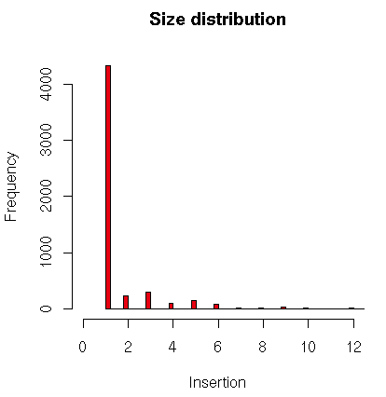
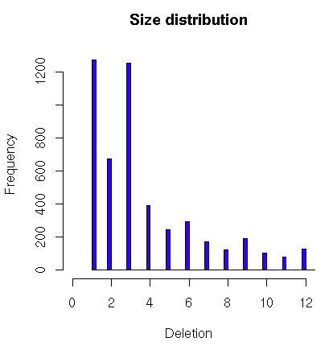
Indels (117 cases vs 210 TCGA controls)
Called using GATK
Joint calling from multiple samples (-glm INDEL).
filtered as recommended by GATK
 | Insertion | Deletion
Total Number | 5544 | 5492
In-frame (% among coding) | 348 (8%) | 1706 (39%)
Frame-shift | 4015 | 2649
Median quality score | 507 | 1098

