Slide 1
Why I Fell in Love with Tavern
(and why I'm staying)
PyCon Thailand 2018

Slide 2
About me
TLDR: tester by day, cat at night
QA Engineer at engageSPARK
https://medium.com/@bnx05

Slide 3
Expectations from this workshop
Written with beginners in mind
Participants will actually write tests
Two-way interaction
Everyone participates
Feedback is welcome :)

Slide 4
Goals
Brief intro about APIs
Why Tavern
How to get started with Tavern
How to start writing basic tests
How to use variables
How to save values and reuse them
How to reuse requests

Slide 5
What is an API?
Application Programming Interface
allows a product/service to talk to another product/service
set of clearly defined methods of communication between various software components
software-to-software interface that enables two applications to exchange data among each other
Notes:
- many types of APIs: RESTful, SOAP (Simple Object Access Protocol)
- further reading: https://medium.com/@tyteen4a03/how-apis-work-an-analogy-for-dummies-ac6ee1d1671b

Slide 6
RESTful API
RESTful – interpretation of the REST architechtural style
REST - approach to designing a web service to allow a user to retrieve and update information about "resources"
Uses HTTP protocol – HTTP methods are available (GET, POST, PUT, DELETE)
Notes:
- RESTful – interpretation of the REST architechtural style, which provides standards between computer systems on the web, making it easier for systems to communicate with each other

Slide 7
What is API testing?
type of software testing that involves testing application programming interfaces (APIs) directly and as part of integration testing to determine if they meet expectations for functionality, reliability, performance, and security

Slide 8
Why test APIs?
determine whether APIs return the correct response (in the expected format) for a broad range of feasible requests, react properly to edge cases such as failures and unexpected/extreme inputs, deliver responses in an acceptable amount of time, and respond securely to potential security attacks
Notes:
- browser testing is slow
- catch bugs early

Slide 9
What is Tavern?
pytest plugin, commandline tool and Python library for automated testing of APIs
YAML-based syntax
Notes:
- other popular tools like Postman
- other python libraries like pyresttest

Slide 10
Why Tavern?
pytest plugin
simple YAML-based syntax
supports testing RESTful APIs
Notes:
- supports MQTT based APIs as well

Slide 11
Getting started
Create a github account
Create first public gist
Create github personal access token for gists
Create directory to contain tests
Make a virtual environment
Install tavern
Install pytest

Slide 13
Anatomy of a test
test_name
stages
name
request
response

Slide 14
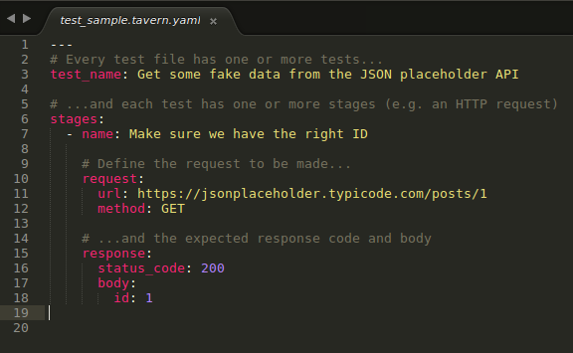

Slide 15
Running tests
pytest
tavern-ci
Notes:
- if using pytest, tests have to be prefixed with “test” and the file name has to have “.tavern.yaml”
- if using tavern-ci, no need to prefix with “test” or add “tavern” to the file name

Slide 18
Goals
Brief intro about APIs
Why Tavern
How to get started with Tavern
How to start writing basic tests
How to use variables
How to save values and reuse them
How to reuse requests

Slide 19
Let’s start creating tests!
Notes:
- open https://any-api.com/github_com/github_com/docs/_gists/GET

Slide 20
Test #1:
Get information about a public gist
html url
owner name
content

Slide 21
(Other) learnings:
A test can have one or more stages
Dot notation

Slide 22
Test #2:
Comment on a public gist
Add two comments

Slide 23
(Other) learnings:
How to use environment variables
How to use request variables

Slide 24
Test #3:
Create a new gist
Create second gist

Slide 25
(Other) learnings:
How to save values from a response
How to use saved values

Slide 26
Test #4:
Edit a gist’s content
Modify the content of a gist

Slide 27
(Other) learnings:
Authentication
How to reuse requests
Notes:
- anchors are actually a feature of YAML
- tavern preserves anchors across the same file

