Slide 1
PeopleSoft Test Framework
PeopleSoft – Procure to Pay

Slide 2
Phase 1 : Current Status for suite

Slide 3
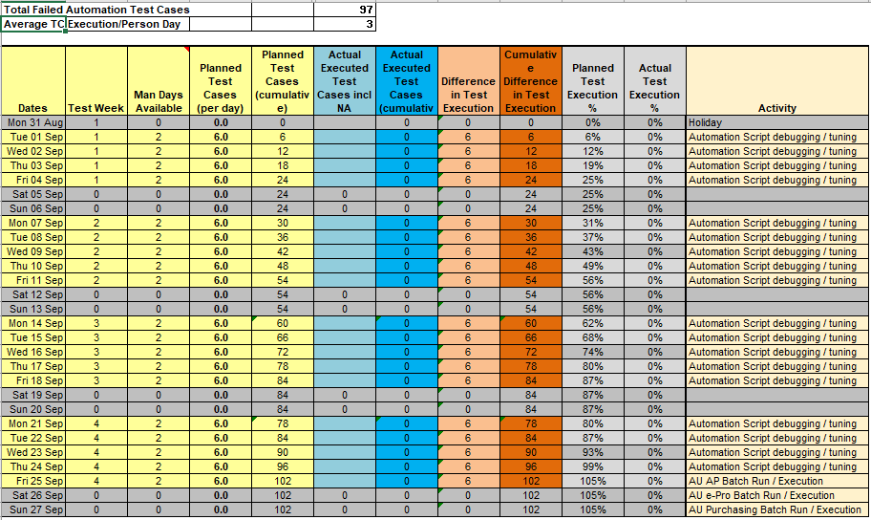
Phase 1 : Plan

Slide 4
Phase 2-Plan – Covering up gap time
The following 3 key functionalities were implemented during gap period and need to be automated
Implementation of Payment request & Credit Note for UK and Thailand- Starts in Sprint4 of PI09
DFA Workflow changes testing- Starts in Sprint4 of PI09
Sanction Screening Changes Testing- Starts in Sprint6 of PI09
By the end of PI09, we will be up to date with all the required test scripts added to the regression suite.

Slide 5
Phase 3 : Progression Automation
All new test cases to be automated starting PI-9
Details pertaining to number of automated test cases and regression is to be included in the Test Summary Report (TSR) starting PI-9
TSR will be shared with Release Lead and PO for approval

