Slide 1

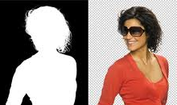


http://academy.telerik.com/student-courses/web-design-and-ui/photoshop/about
Adobe® Photoshop® CS5
Essentials
Selections/Masks/Channels/Paths
Tyanko Yordanov
Telerik Trainer
tyordanov@telerik.com
Telerik Software Academy
academy.telerik.com

Slide 2
Photoshop Settings
Settings
Set Pixel Grid
Performance
Key Shortcuts
Custom Workspace
OK

Slide 3
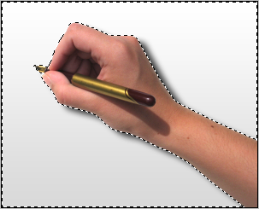

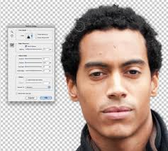
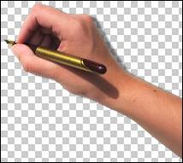
Table of contents
Selections
Masks
Channels
Paths

Slide 4
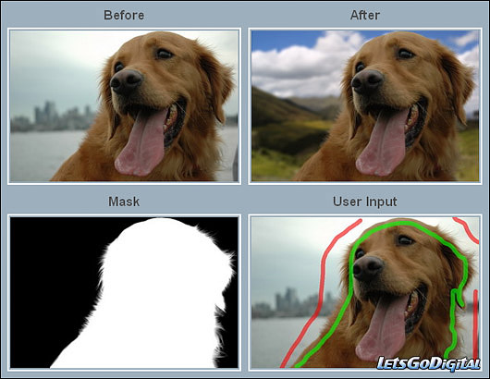

Table of contents
Photoshop Layer Mask
Selections
Masks
Channels
Paths

Slide 5

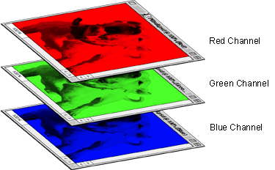
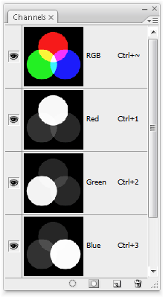
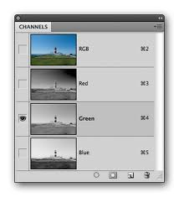
Table of contents
Selections
Masks
Channels
Paths
aa

Slide 6
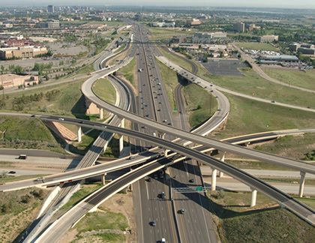
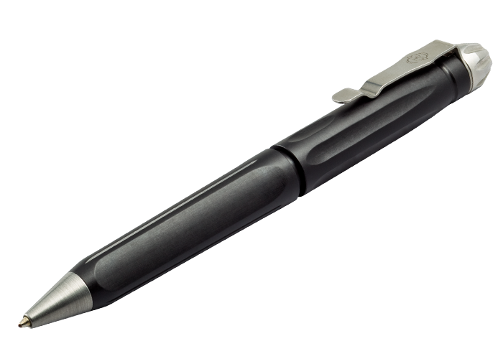
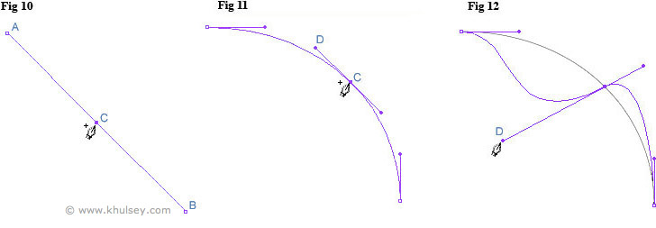
Table of contents
Selections
Masks
Channels
Paths
PHOTOSHOP has a Powerful vector capabilities!
Bezier Curves
Anchor Points
Boolean Functions

Slide 7
Demo - Selections
Selections:
Geometric Selections:
Single Row / column / Elliptical / Rectangular
Free Hand selections:
Lasso / magnetic lasso selection
Stroke Selections:
Quick Selections
Color Selections:
Magic Want / Color Range Selection

Slide 8
Demo - Selections
Transform Selections
Modify
Refine Edges
Quick Mask Mode:
Modify selection - add & subtract
Save / Load Selection

Slide 9
Demo - Masks & Channels
Masks:
Layes Mask - volunteer demo
Vector Mask
Clip Mask
Channels & Channel Masks:
Red-Green-Blue /CMYK/Lab
Calculations… Blend 2 channels
Adjustments - Levels…

Slide 10
Задачи за домашно
Екстракт на:
един сложен обект ( коса, цвете и тн..)
и един по прост обект с ясен контур
от снимки и поставянето им върху друга снимка, с цел получаване на хубав колаж, като се ползват:
Quick Mask
Path – пътечката да бъде запазена
Channels – като се ползват - “Calculation” и “Levels” до получаването на ясен силует/маска, която също да се запази.
Да се нарисува Path, и с негова помощ , да се направи “clip mask” върху един от предходните колажи.

Slide 11
http://academy.telerik.com

Slide 12



Free Trainings @ Telerik Academy
"Web Design with HTML 5, CSS 3 and JavaScript" course @ Telerik Academy
html5course.telerik.com
Telerik Software Academy
academy.telerik.com
Telerik Academy @ Facebook
facebook.com/TelerikAcademy
Telerik Software Academy Forums
forums.academy.telerik.com

