Slide 1

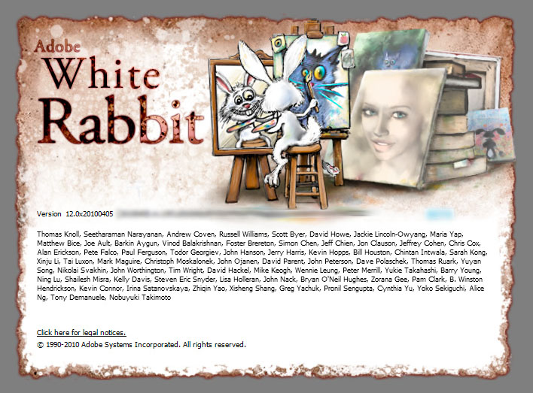
Adobe® Photoshop® CS5 Essentials
http://academy.telerik.com/student-courses/web-design-and-ui/photoshop/about
Adobe Photoshop User Interface
Dilyan Tarashoev
Outside Trainer
dilant@abv.bg
Telerik Software Academy
academy.telerik.com

Slide 2

Table of Contents
Photoshop Resources
Validation of Skills
Photoshop History & Usage
Interface
Workspace & Workflow
Tools Panel
Selecting & Displaying Tools
Managing Document Windows

Slide 3

Table of Contents 2
Enter values in Panels, Boxes & Options Bar
Arranging, Docking & Floating
Pan & Zoom – Hand & Magnifier
Rulers, Guides & Grid
Presets, Plug-ins & Preferences
Undo, History & Snapshots
Memory, Scratch Disks & Purging
Questions?
+

Slide 4

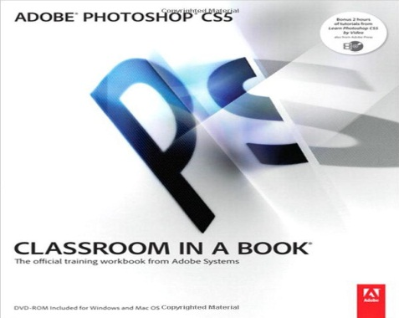
Photoshop Resources
http://helpx.adobe.com/photoshop/archive.html

Slide 5


Validation of Skills
Telerik Certificate
Adobe Certified Associate

Slide 6
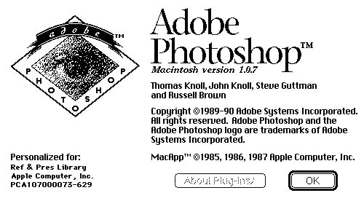
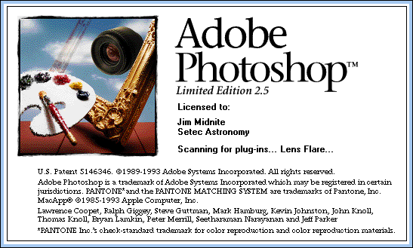
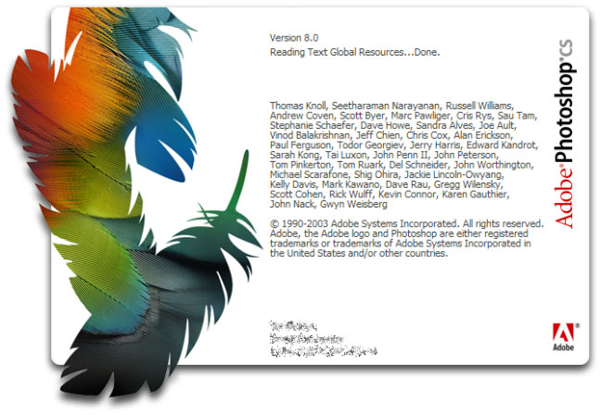
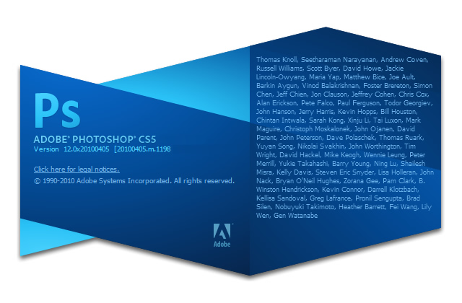
Photoshop History & Usage

Slide 7
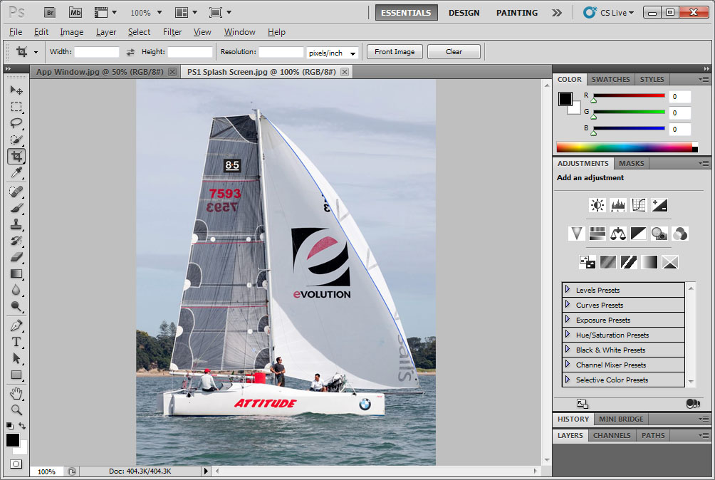
Default Photoshop Workspace
Application
Bar
Document
Window
Menu
Bar
Workspace
Switcher
Collapse
To Icons
Button
Control
Panel
Panel Title Bar
Four
Panel Groups
In Dock
Tools
Panel

Slide 8
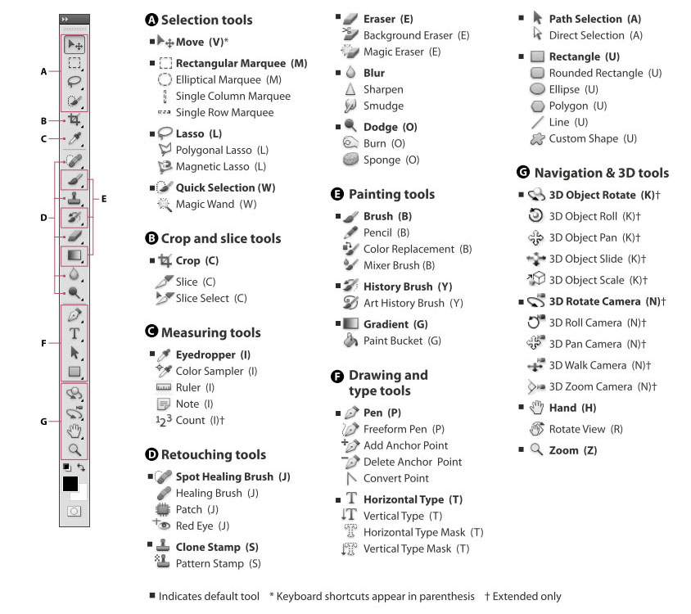
Tools Panel
Tools Panel Overview

Slide 9
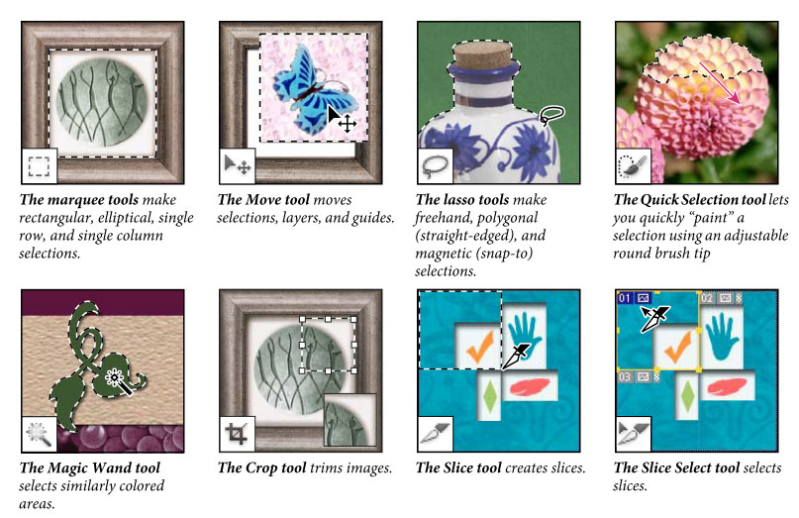
Selection, Crop & Slice Tools

Slide 10
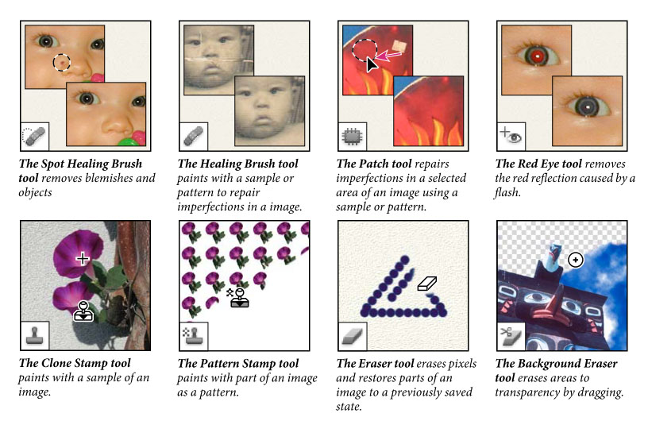
Retouching Tools

Slide 11
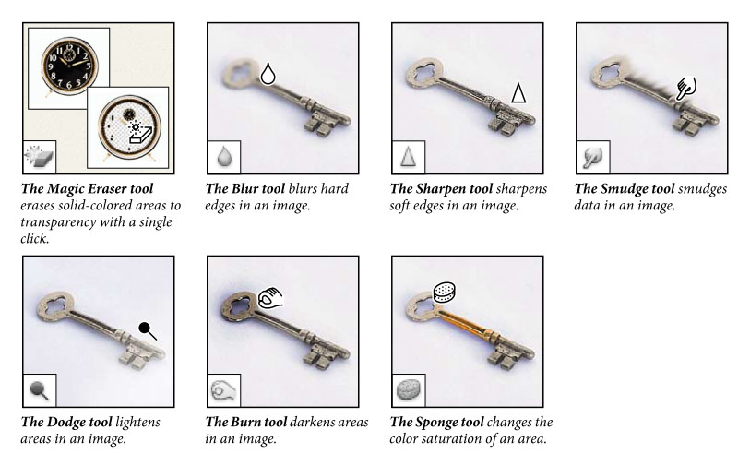
Retouching Tools 2

Slide 12
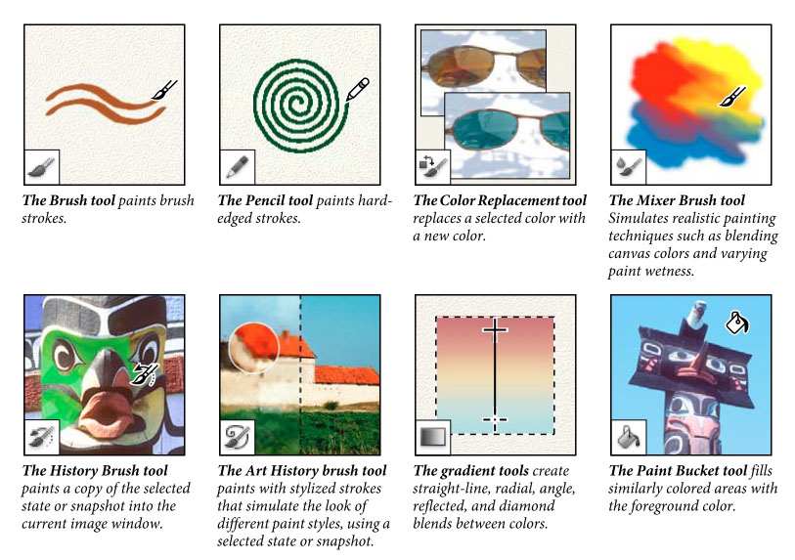
Painting Tools

Slide 13
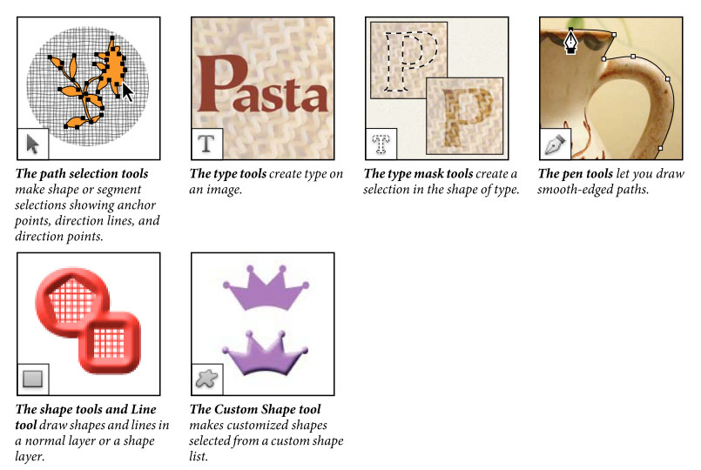
Drawing & Type Tools

Slide 14
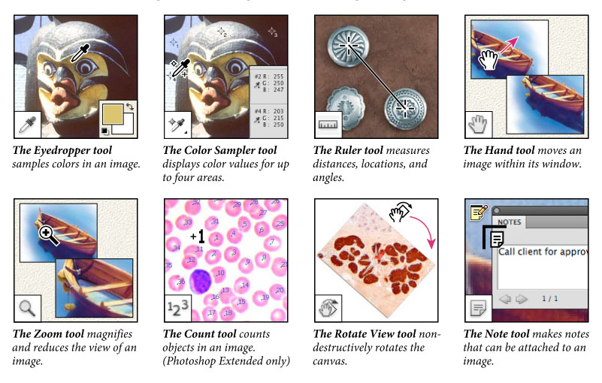
Measuring , Navigation & Notes

Slide 15
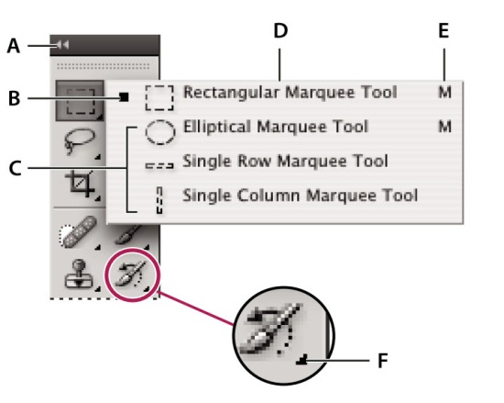
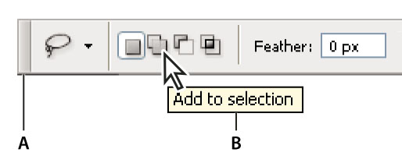
Selecting & displaying Tools
Tools Panel
Active Tool
Hidden Tools
Tool Name
Tool Shortcut
Hidden Tool Triangle
Gripper Bar
Tool Tip

Slide 16
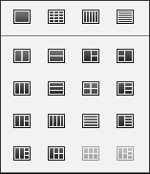
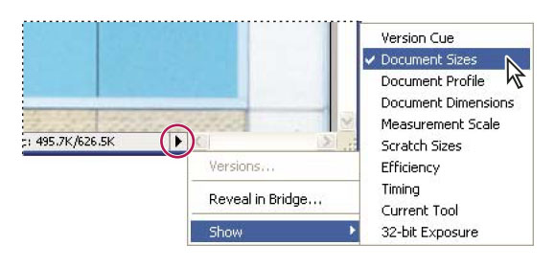
Managing Document Windows
Multi-Document Order
Document Info

Slide 17
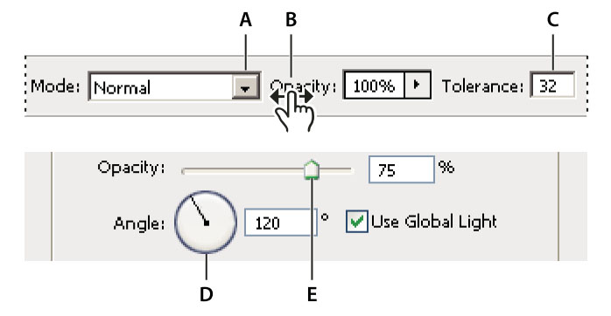
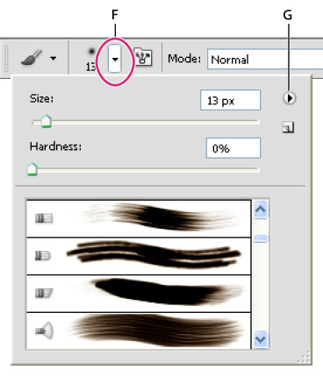
Enter values
Enter values in Panels, Boxes & Options Bar
Drop-down selector
Scrubby Slider
Text box
Dial
Slider
Pop-up Panel
Pop-up Panel Menu

Slide 18
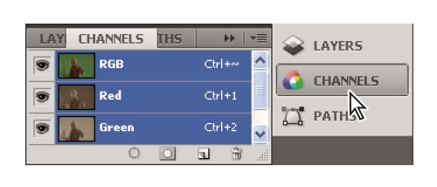
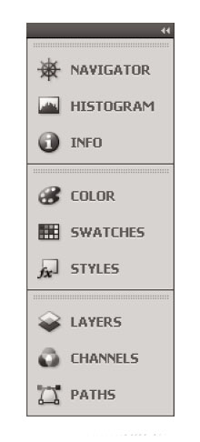
Arranging, Docking & Floating
Expanded Panels
Panels collapsed to icons and labels

Slide 19
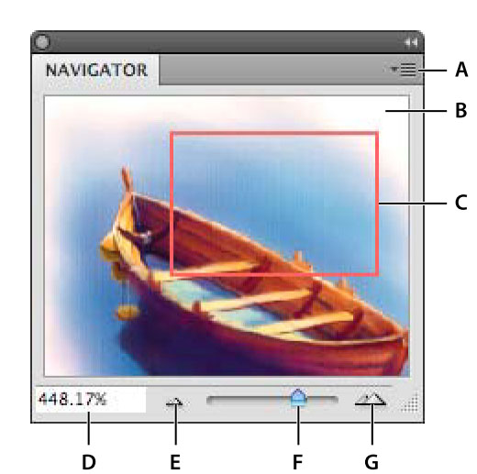
Pan & Zoom – Hand & Magnifier
Panel Menu
Thumbnail Display
Proxy Preview
Zoom Text Box
Zoom Out
Zoom Slider
Zoom In

Slide 20
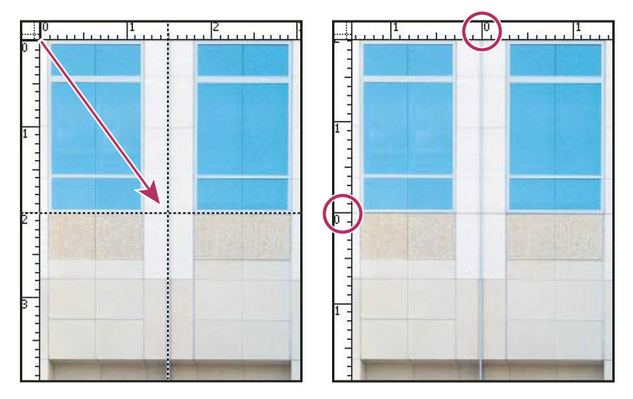
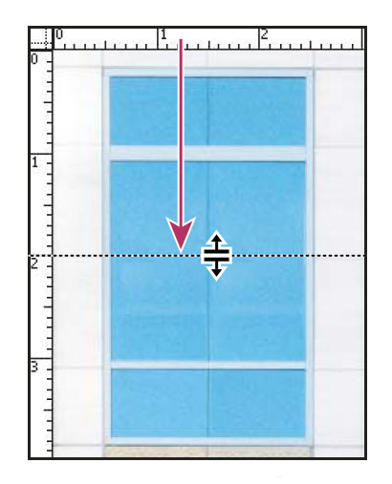
Rulers, Guides & Grid
New Rulers Origin
Drag a horizontal Ruler

Slide 21
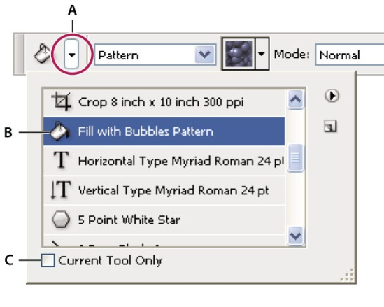
Presets, Plug-ins & Preferences
Tool Preset Piker
Presets Library
Selected Tool only

Slide 22
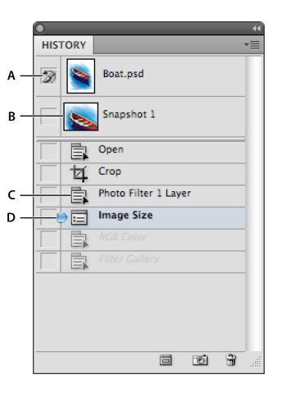
Undo, History & Snapshots
Source for the History Brush
Thumbnail of a snapshot
History State
History State Slider

Slide 23
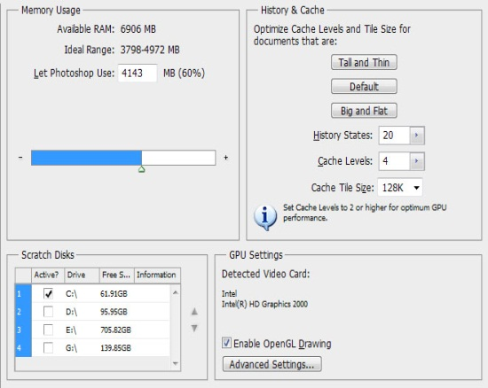
Memory, Scratch Disks & Purging
Performance Preferences

Slide 24
Adobe Photoshop User Interface
http://academy.telerik.com

Slide 25



Free Trainings @ Telerik Academy
"Web Design with HTML 5, CSS 3 and JavaScript" course @ Telerik Academy
html5course.telerik.com
Telerik Software Academy
academy.telerik.com
Telerik Academy @ Facebook
facebook.com/TelerikAcademy
Telerik Software Academy Forums
forums.academy.telerik.com

