Slide 1
Course Intro and Ordinations
BIO 5400: Analytical Methods in Community Ecology
Sept. 2, 2011

Slide 2
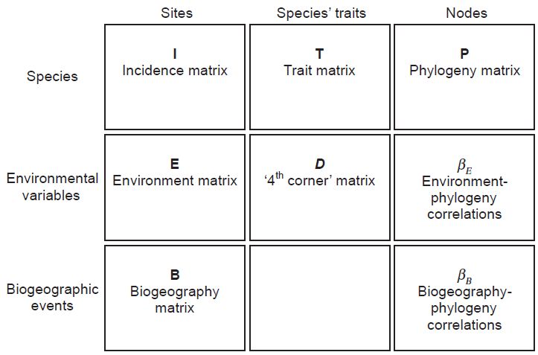
This Course in a Nutshell
Leibold et al. 2010 Ecol Lett

Slide 3
We all Have Species/Sub-species/ Genotype Composition Data
Week 2:
Ordinations
Week 5:
Null models
Week 10:
Network models

Slide 4
Relating Community Composition to Environmental Factors
Week 2:
Ordinations
Gradient analysis
Weeks 3-4:
Structural equation models

Slide 5
Species’ Traits
Weeks 3-4:
Structural equation models
Weeks 6-7:
Biodiversity – Ecosystem Function
Trait-Based Community Assembly

Slide 6
This Course in a Nutshell
Weeks 8-9:
Phylogenetic-Based Community Assembly
Niche Evolution

Slide 7
Week 11: Meta-Communities etc.
Leibold et al. 2010 Ecol Lett

Slide 8
Why Ordinate?
Dimensionality reduction
Pattern visualization
Each observation (sample) contains information on multiple sub-categories (species)
Resemblance (similarity or dissimilarity) matrix analysis (NMDS or PCoA)

Slide 9
Considerations
Gradient length
Linear; not much species turnover/low β diversity
Unimodal; high species turnover/β diversity
Constraints
Unconstrained (aka indirect); no environmental variables included in the ordination (but can be related to the site or species scores later)
Constrained (aka direct); maximize correspondence between species and environmental variables

Slide 10
Ordinations/Gradient Analyses
Unconstrained
Constrained
PCA/PCoA/NMDS
(Principal Components Analysis)
RDA
(Redundancy Analysis)
Linear
(D)CA
([Detrended] Correspondence Analysis)
(D)CCA
([Detrended] Canonical Correspondence Analysis)
Unimodal

Slide 11
Issues
Distance measures matter
Zeros and rare species can have a big impact
Faithful representation of raw data
Distortion
Horseshoe (PCA) and arch (CA, sometimes CCA) effects
Careful consideration of gradient length and detrending are two options

Slide 12
Rules of Thumb
Do a DCA first
Length of first axis (“gradient length”, in standard deviations) is a measure of beta diversity/species turnover
Tells you if its linear or unimodal
Gradient length
<3 SD = linear, do a RDA
3-4 SD, either
>4 SD = unimodal, do a CCA

Slide 13
Resources
http://ordination.okstate.edu/distance.htm
R
principal{psych} or princomp{stats}
vegdist{vegan}: many different distance metrics
adonis{vegan}: PERMANOVA
cca,decorana,decostand{vegan}: one-stop shop for ordinations and transformations!
nmds,nmds.min{ecodist}: simple NMDS code
PC-ORD, CANOCO, PRIMER

Slide 14
Notes
NMDS – maximizes rank-order correlation between distance matrix and ordination distances
PCoA - maximizes linear correlation between distance matrix and ordination distances
PCA – (same as PCoA when using Eucl distance); eigenanalysis (like CCA, RDA, etc.), often used for dimensionality reduction that creates orthogonal axes by rotating the data in order to maximize the primary eigenvalue. Thus, relationships between samples are not altered. Each eigenvalue has an associated eigenvector that provides the location of each sample along that axis. Analysis of covariance matrix (unstandardized data) or correlation matrix (all standardized to SD=1)

Slide 15
Notes
CA – correspondence analysis (correspondence between species scores and sample scores); eigenvalues indicate the correlation between species and sample scores;

Slide 16
Notes
CCA – maximized correspondence between samples and environmental variables (that’s what makes it “canonical”: the correspondence is with some underlying explanatory variable(s))

