Slide 1
Phylo-Based Community Assembly
BIO 5400: Analytical Methods in Community Ecology
Oct. 14, 2011

Slide 2
When to Use Phylogenetics
Surrogate for niche similarity
May be good catch-all if don’t know what traits to measure
Assumes niche conservatism
Test evolution of ecologically relevant traits
When did certain traits evolve?
How has evolutionary history shaped a community?

Slide 3
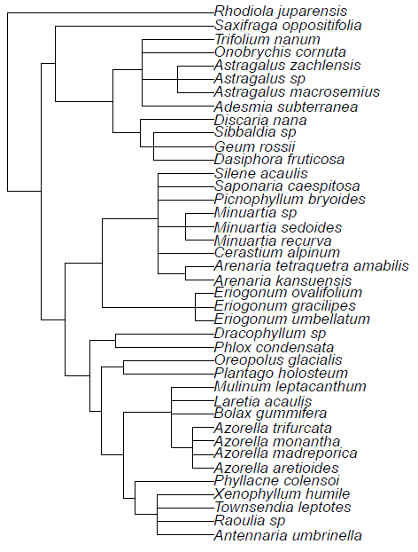
Phylogenetics is All About Distance
Taxon | Trait 1 | Trait 2
A | 1 | a
B | 4 | d
C | 3 | f
D | 6 | b
E | 7 | e
…
N | 2 | x
 | A | B | … | N
A
B | d_{ab}
… | d_{aj} | d_{bj}
N | d_{an} | d_{bn} | d_{jn}

Slide 4
Phylogenetic Community Assembly
Same interpretations as with traits
Phylogenetic distances consistent across species within a community? -> competition
Total phylogenetic distances among species in a community smaller than expected -> env. filter
Randomization tests
Randomly select species from the phylogeny
If have traits, do a “tip shuffle”: randomly assign traits to tips of the phylogeny

Slide 5
Resources
Plant phylogeny construction
Phylomatic (www.phylodiversity.net/phylomatic)
Community assembly and trait evolution
Picante (Phylocom integration, community-analyses, null models, traits and evolution in R)
Format conversions, tree manipulation, visualization and evolutionary simulations
ape (Analysis of Phylogenetics and Evolution)
geiger

