Slide 1
Latent variables and complex structural equation models
BIO 5400: Analytical Methods in Community Ecology
Sept. 16, 2011

Slide 2
Latent variables: From theory to empirical models
Body Size
Terr. Size
after Grace 2006

Slide 3
Indicator Variables
Body Size
Terr. Size
Body mass
Singing range
after Grace 2006

Slide 4
Incorporating Error
0.52
Body Size
Terr. Size
Body mass
0.86
0.69
1.0
Singing range
0.25
0
after Grace 2006

Slide 5
Using multiple indicators to describe a complex concept
Body mass
0.52
0.25
0.86
Body Size
Terr. Size
Wing length
0.86
0.69
1.0
Singing range
0.25
0
Beak length
0.86
0.39
after Grace 2006

Slide 6
Analogous to using factors (principal components) from factor analysis
ζ
δ₁
x₁
x₂
ξ
y
δ₁
δ₁
x₃
after Grace 2006

Slide 7
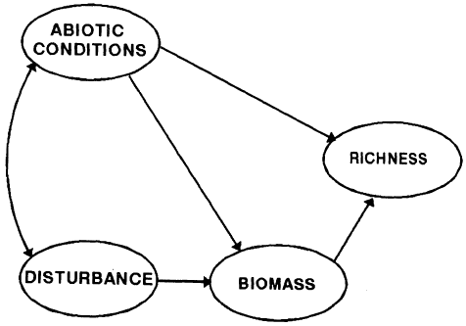
A More Complex Example
Grace and Pugesek 1997 AmNat

Slide 8
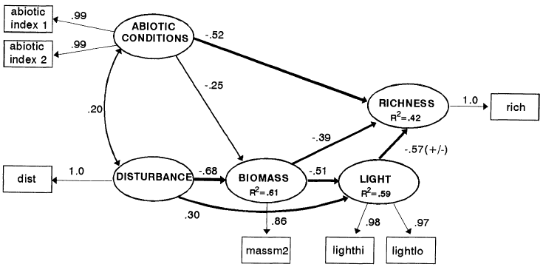
General Model Results
Grace and Pugesek 1997 AmNat

Slide 9
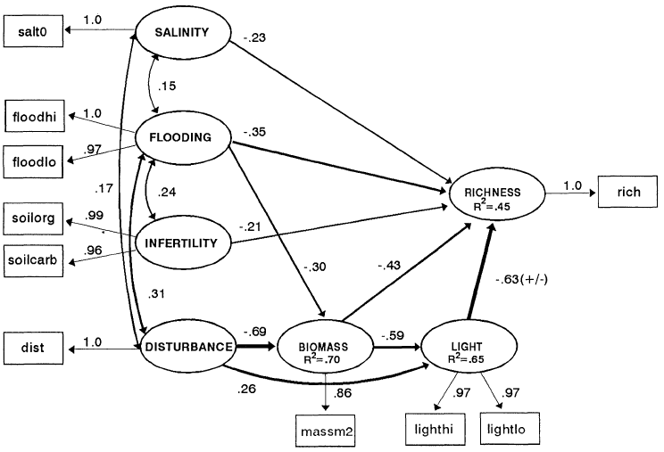
“Specific” Model Results

Slide 10
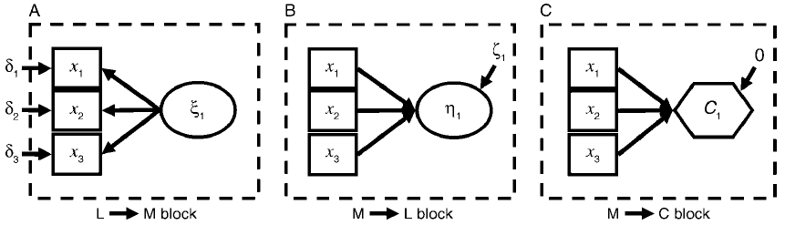
Composites: Indicators have causal effect on the “concept”
Grace et al. 2010 EcolMono

