Slide 1
Niche Evolution and Community Assembly
BIO 5400: Analytical Methods in Community Ecology
Oct. 21, 2011

Slide 2
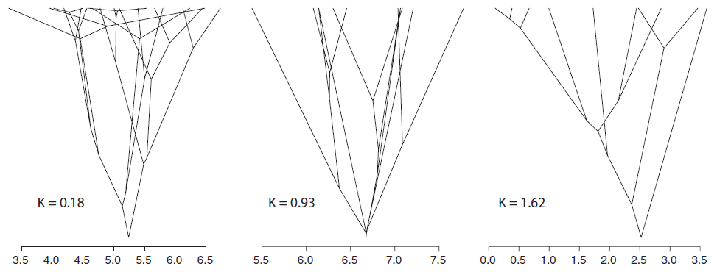
Conservatism vs. Convergence
Convergent
~Brownian-Motion
Conservative
Ackerly 2009 PNAS

Slide 3
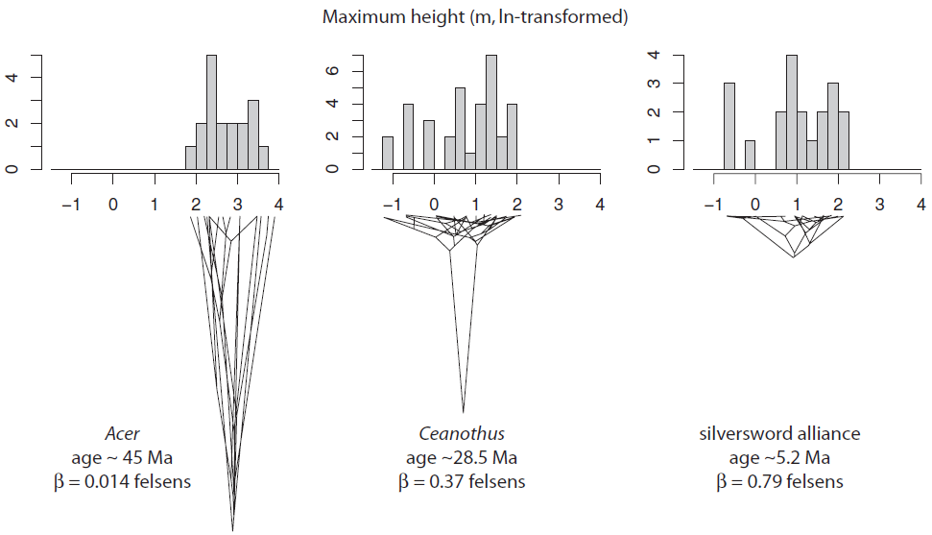
Rate of Evolution
Ackerly 2009 PNAS

Slide 4
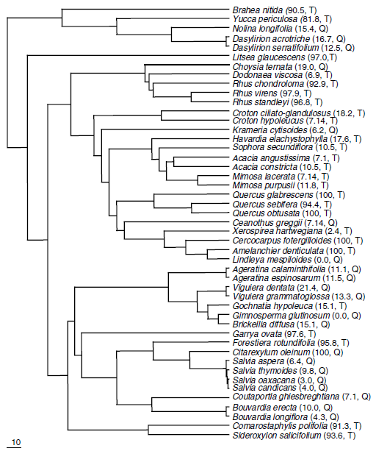
Timing of Niche Evolution
Quaternary species: nurse plants
Tertiary species: beneficiaries
Valiente-Banuet et al. 2006 PNAS

Slide 5
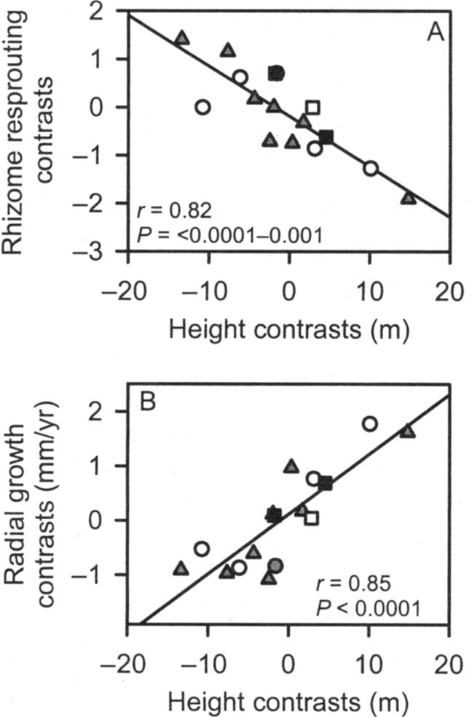
Phylogenetic Independent Contrasts
Controlling for phylogenetic dependence
Divide niche difference between two taxa by their phylogenetic distance
Important for comparative ecology
Correlated trait evolution
Compare contrasts of two or more traits
Assesses whether or not traits evolve in concert
Cavender-Bares et al. 2004 EcoMono

Slide 6
R Resources
Picante
Niche evolution
Ape
Tree manipulation and PIC calculations
geiger
Different evolutionary models, trait evolution rates

