Slide 1
Trait-Based Community Assembly
BIO 5400: Analytical Methods in Community Ecology
Sept. 30, 2011

Slide 2
Functional Traits
Determine how organisms interact with their environment and each other
Indicative of species’ niches
Responses to, and effects on, environmental variation
Can quantify differences among species

Slide 3
Benefits to Trait-Based Community Assembly Models
Species-based information leaves a lot open to interpretation
Do species co-occur due to shared environmental niche or positive interactions?
Are species co-absent because of different environmental niches or competition?
Traits (and phylogenetics) provide more strictly interpretable hypotheses
How to test?
Randomly assign traits to species, species to nodes, or traits to nodes!
Compare to observed

Slide 4
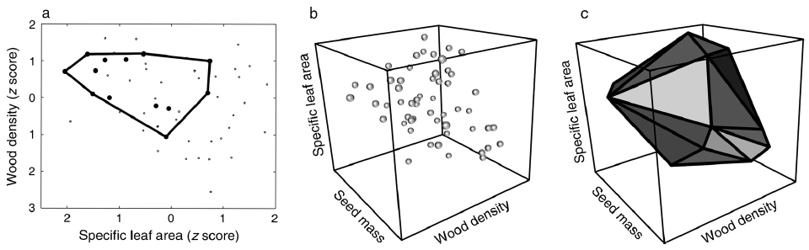
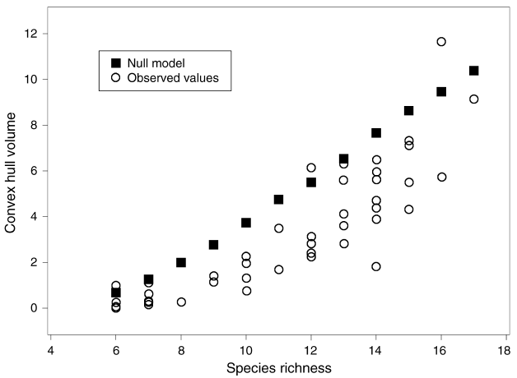
Environmental Filtering
Convex hulls: Quantification of occupied niche volume within communities
Cornwell and Ackerly 2006 Ecology

Slide 5
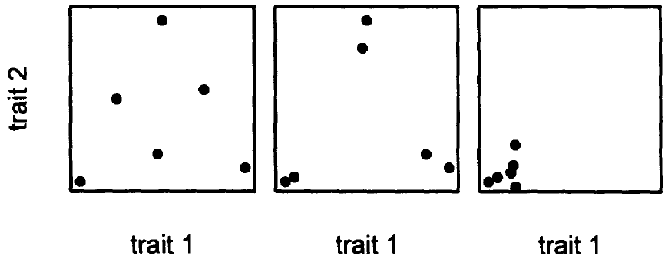
Niche Partitioning and Microhabitat Heterogeneity
Microhabitat Heterogeneity
Environmental
Filter
Limiting Similarity
Weiher et al. 1998 Oikos

Slide 6
Resources
Randomization tests
Picante, bipartite (R libraries)
Specific code
Convex hulls (Matlab or Cornwell and Ackerly 2006 Ecology)
Trait-gradient analysis (Ackerly and Cornwell 2007 Ecology Letters)

