Slide 1
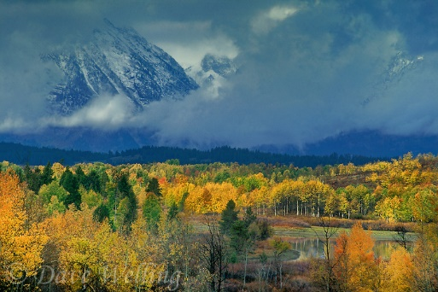
Title
Lindsie Abbott Joseph Gennarelli Jill Peiffer Amy Prince Samuel Skibicki

Slide 2
Basic Theory: Arthropods and Trees have co-evolved.
Here’s what they say (reference)
Possible controversies (references)
Why is it important to study this theory

Slide 3
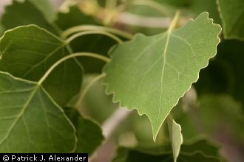
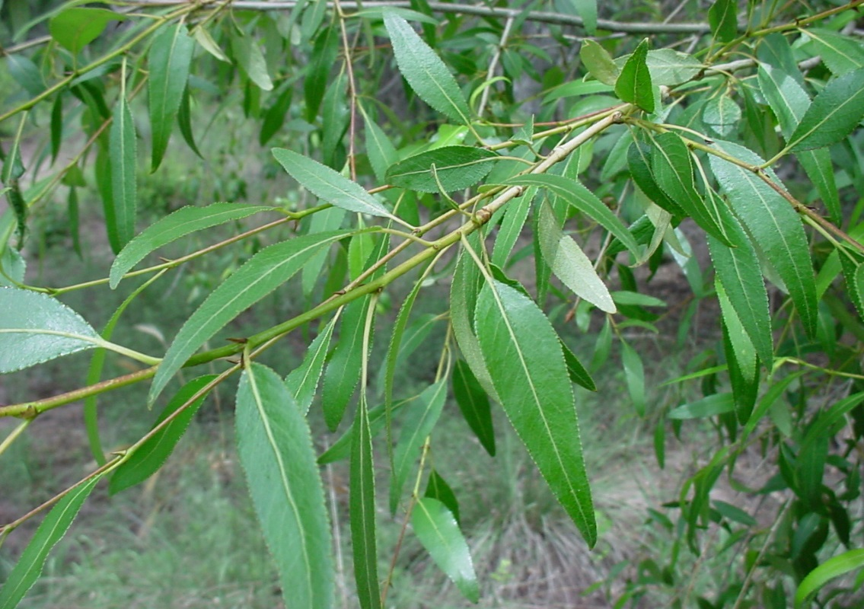
Experimental Design
Key out arthropods to family
Record the variety of tree. Fre, F1, BC, Narr

Slide 4
Questions about community structure.
What are the arthropod communities on each tree varieties?
Is there competitive exclusion among tree varieties?
Are certain arthropod traits non-randomly assorted on different tree varieties?
Study System
Cottonwood trees (Populus), 4 varieties
in one forest stand

Slide 5
Hypotheses 1. What are the arthropod communities on each tree varieties?
H1o, Arthropod communities are similar across all 4 varieties
H1a, Abundance of decomposers, non-insects, pollinators and herbivores are arranged non-randomly across 4 varieties Populus (Sam)
H1b, Richness of decomposers, non-insects, pollinators and herbivores are arranged non-randomly across 4 varieties Populus (Joe)

Slide 6
Non-Random Pollinator and Herbivore Abundances

Slide 7
Richness within groups are similar across tree varieties.

Slide 8
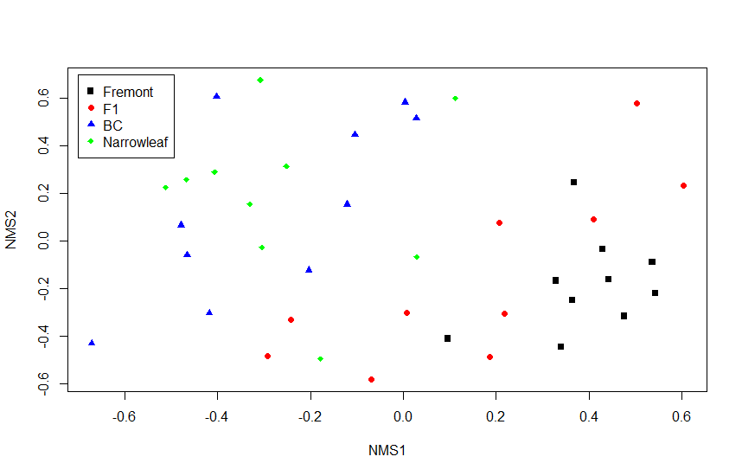
Ordination
Fre/BC= .001, 7.5486, 19
 | All | Fre/F1 | F1/BC | BC/Nar | F1/Nar | Fre/Nar
P-val | .0001 | .003 | .751 | .773 | .001 | .001
F-Val | 4.3425 | 2.8236 | .69115 | .69115 | 4.1469 | 9.6034
Df | 39 | 19 | 19 | 19 | 19 | 19

Slide 9
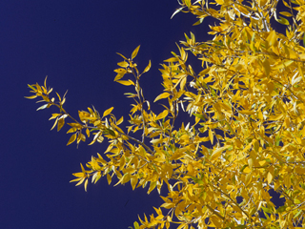
Hypotheses 2. Is there competitive exclusion among tree varieties?
H2o, There is no competitive exclusion.
H2a, There is competitive exclusion.
SIM9, C-scores, recommended by Gotelli (2000)

Slide 10
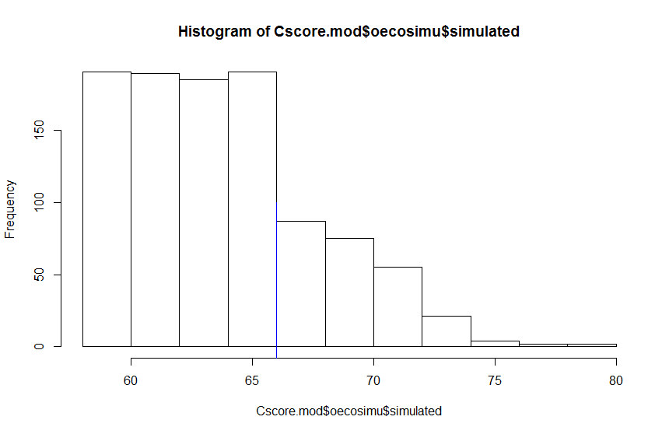
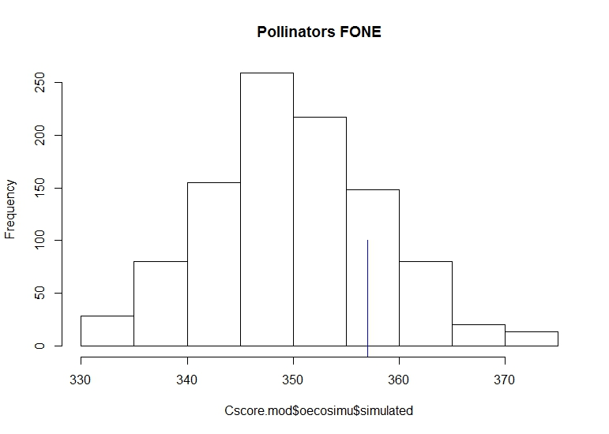
Herbivores: no
All groups combined: no
Pollinators & Non-insects: competition on F-1
Non-insect, F-1
Pollinator, F-1
Competition?
Competition?

Slide 11
Competition does not affect Decomposers
Decomposer, Narr.
Decomposer, F-1
Decomposer, BC
Decomposer, Fre.

Slide 12
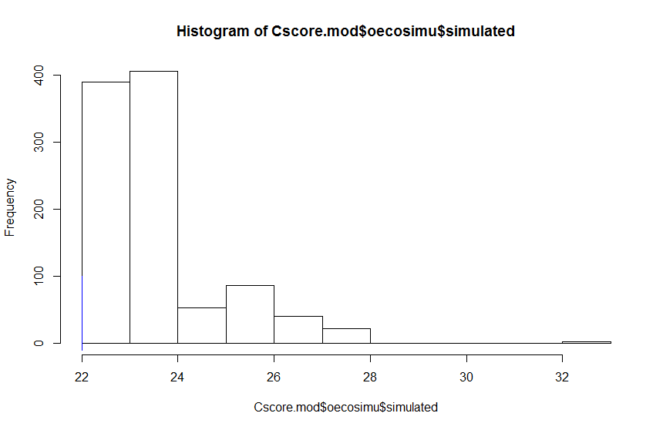
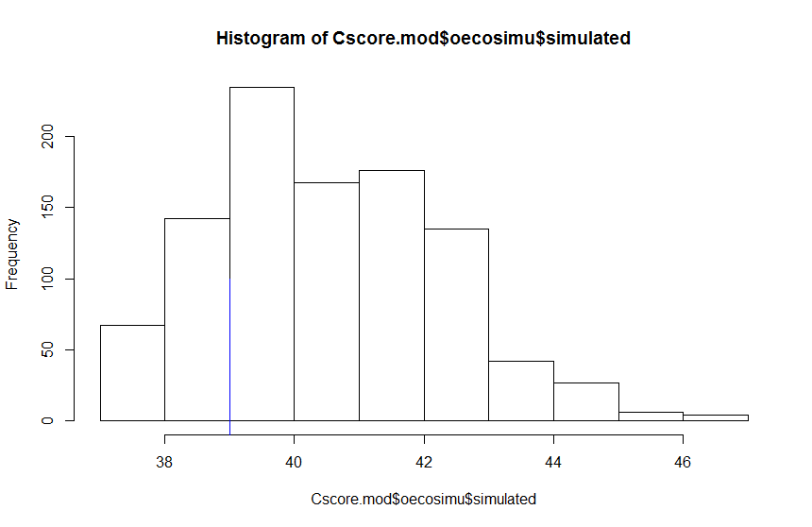
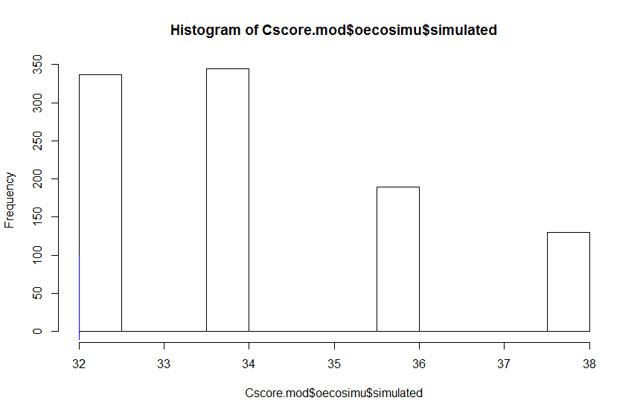
Competition does not affect Non-insects (spiders) on other 3 tree varieties
Non-insect, Narr.
Non-insect, BC
Non-insect, Fre.

Slide 13
Hypotheses 3. Are certain arthropod traits non-randomly assorted on different tree varieties?
H1o,
H1a,
H1b,

Slide 14
Results of Testing H3 (Make this a declaratory statement)

Slide 15
Discussion (again, make this title something meaningful)

Slide 16
Caveats

Slide 17
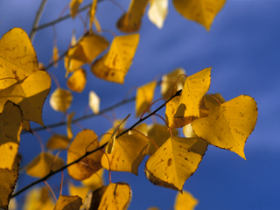
Conclusions

Slide 18
Acknowledgments
Dr. Bradley Butterfield
Lindsie Abbott
Stellar classmates

