Slide 1
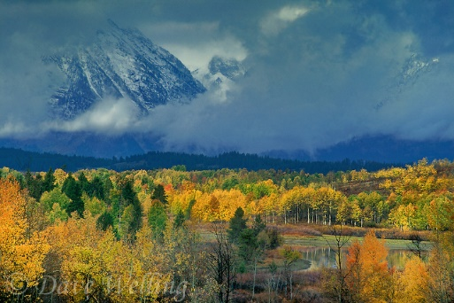
Title
Lindsie Abbott Joseph Gennarelli Jill Peiffer Amy Prince Samuel Skibicki

Slide 2
Basic Theory: Arthropods and Trees have co-evolved. Species are filtered by traits.
Here’s what they say (Lepidoptera caterpillars are out-competing adult herbivores)
Possible controversies (references)
Why is it important to study this theory

Slide 3
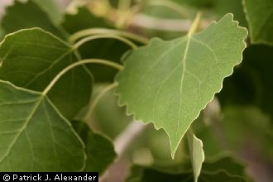
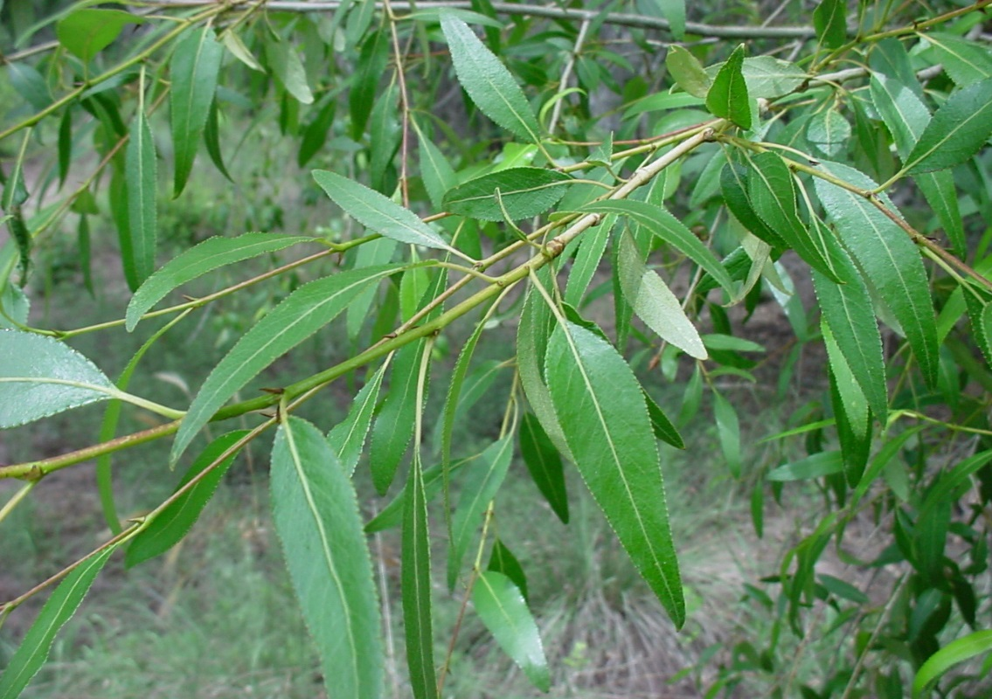
Experimental Design
Key out arthropods to family
Record the variety of tree. Fre, F1, BC, Narr

Slide 4
Questions about community structure.
Are arthropod communities non-randomly assorted on each tree variety?
Is there competitive exclusion among tree varieties?
Are certain arthropod traits non-randomly assorted on different tree varieties?
Study System
Cottonwood trees (Populus), 4 varieties
in one forest stand

Slide 5
Hypotheses 1. What are the arthropod communities on each tree varieties?
H1o, Arthropod communities are similar across all 4 varieties
H1a, Abundance of decomposers, non-insects, pollinators and herbivores are arranged non-randomly across 4 varieties Populus (Sam)
H1b, Richness of decomposers, non-insects, pollinators and herbivores are arranged non-randomly across 4 varieties Populus (Joe)

Slide 6
Non-Random Pollinator and Herbivore Abundances

Slide 7
Richness within groups are similar across tree varieties.

Slide 8
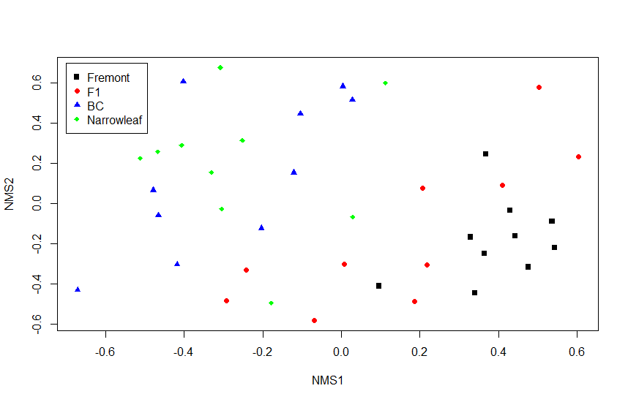
Ordination
 | All | Fre/F1 | F1/BC | BC/Nar | F1/Nar | Fre/Nar
 | All | Fre/F1 | F1/BC | BC/Nar | F1/Nar | Fre/Nar
P-val | .0001
F-Val | 4.3425
Df | 39

Slide 9
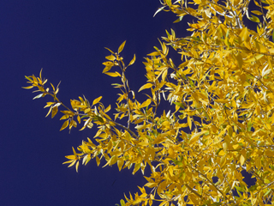
Hypotheses 2. Is there competitive exclusion among tree varieties?
H2o, There is no competitive exclusion.
H2a, There is competitive exclusion.
SIM9, C-scores, recommended by Gotelli (2000)

Slide 10
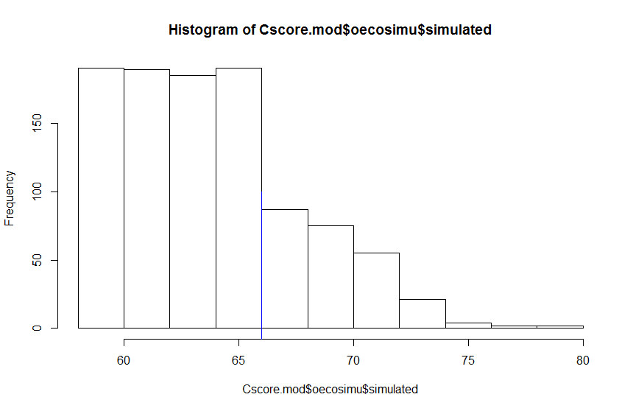
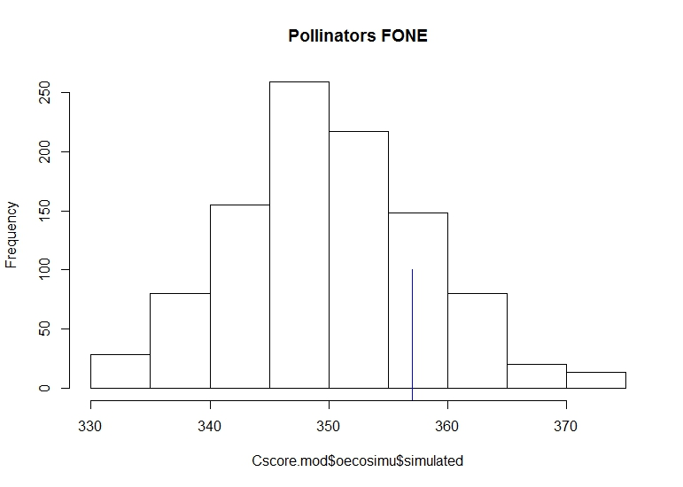
Pollinators & Non-insects: competition on F-1
Herbivores: no; obs within expected
All groups combined: no; obs within expected
Non-insect, F-1
Pollinator, F-1
Competition?
Competition?
Notes:
Line is observation. Curve is expected values by chance. If observation to right of curve, then competition (since all on same tree probably not environmental filtering.) If observation to left of curve, then perhaps facilitation or mutualism.

Slide 11
More Decomposers than Expected
Decomposer, Narr.
Decomposer, F-1
Facilitation/Mutualism?
Decomposer, BC
Decomposer, Fre.
Facilitation/Mutualism?

Slide 12
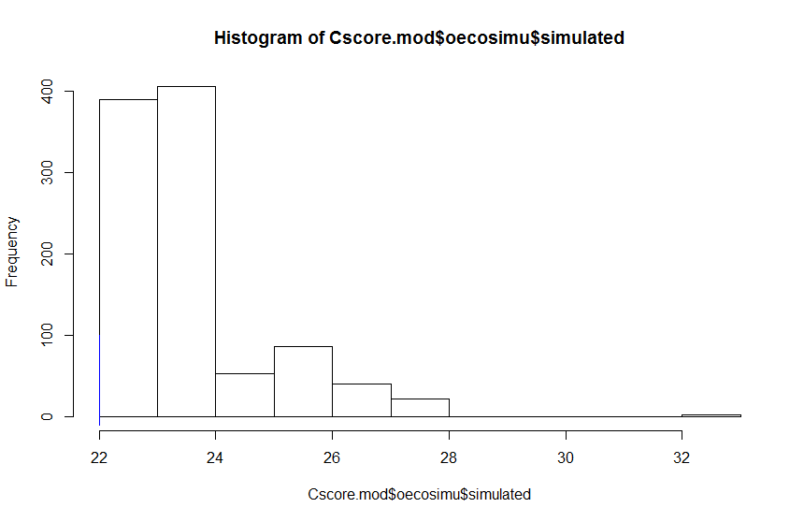
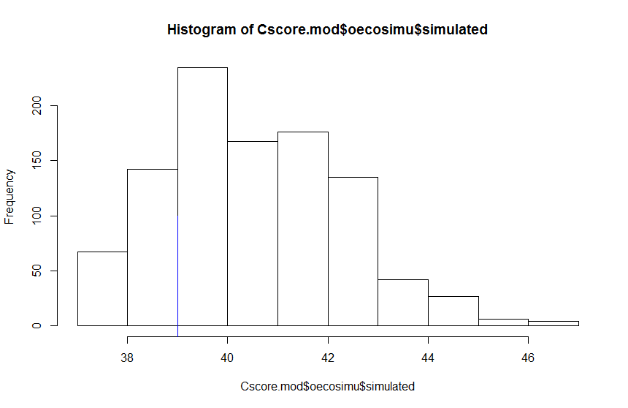
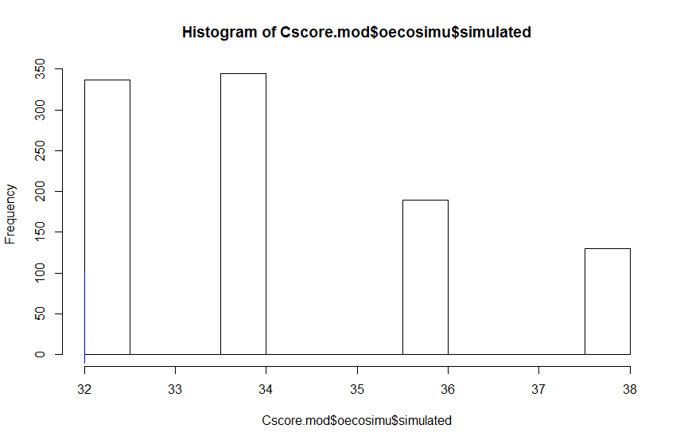
More non-insects (spiders) than expected on other 3 tree varieties
Non-insect, Narr.
Facilitation/Mutualism?
Non-insect, BC
Non-insect, Fre.
Facilitation/Mutualism?

Slide 13
Hypotheses 3. Are certain arthropod traits non-randomly assorted on different tree varieties?
H1o,
H1a,
H1b,

Slide 14
Results of Testing H3 (Make this a declaratory statement)

Slide 15
Discussion (again, make this title something meaningful)

Slide 16
Caveats

Slide 17
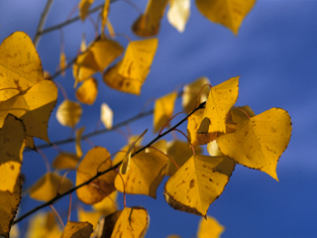
Conclusions

Slide 18
Acknowledgments
Dr. Bradley Butterfield
Lindsie Abbott
Stellar classmates

