Slide 1
Discussion Questions
Do Bertness and Callaway focus on interaction intensity, importance, or both?
Do the findings of Cavieres et al. support the Stress Gradient Hypothesis?
What are the implications of the Bascompte et al. paper for diversity maintenance? Contrast them with the implications of Cavieres et al.

Slide 2
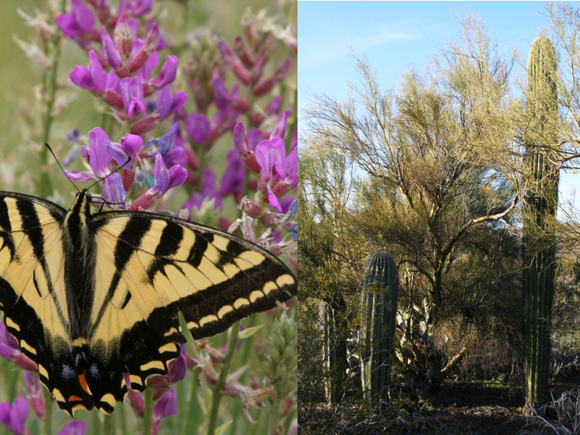
Positive interactions: Mutualism/facilitation
Community Ecology Week 2

Slide 3
Interaction Types
Species B |  | Species A
 |  | + | / | -
 | + | Mutualism | Commensalism | Antagonism
 | / |  | (none) | Amensalism
 | - |  |  | Competition

Slide 4
Sliding Scale
Mutualism can shift toward exploitation
Under stressful conditions (Johnson et al. 1997)
Cheating
Species B |  | Species A
 |  | + | / | -
 | + | Mutualism | Commensalism | Antagonism
 | / |  | (none) | Amensalism
 | - |  |  | Competition

Slide 5
Sliding Scale
Facilitation is typically commensal, but
Can be antagonistic, particularly as the beneficiary grows (Verdu et al. 2009)
Can be mutualistic (Verdu and Valiente-Banuet 2008)
Species B |  | Species A
 |  | + | / | -
 | + | Mutualism | Commensalism | Antagonism
 | / |  | (none) | Amensalism
 | - |  |  | Competition

Slide 6
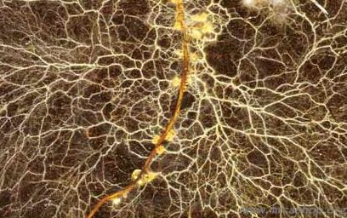
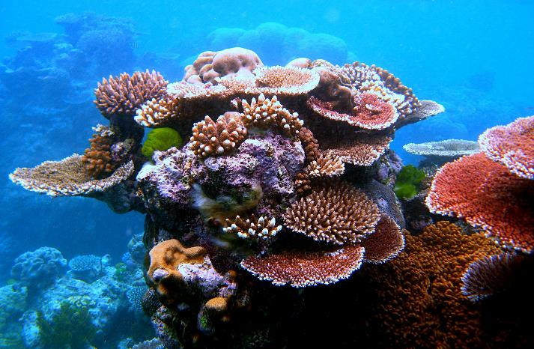
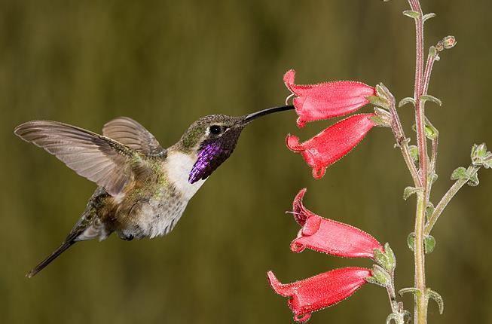
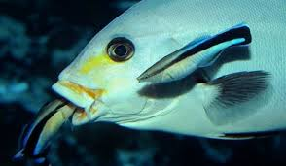

Slide 7
Mutualism and Co-Evolution
Likely occurs within a “diffuse selection environment” (Fenster et al. 2004)
Most mutualists are highly generalized, though specialist interactions certainly occur (e.g. Yucca/yucca moth) (Bronstein et al. 2006)
Examples of tight co-evolution are rare (Thompson 2005)

Slide 8
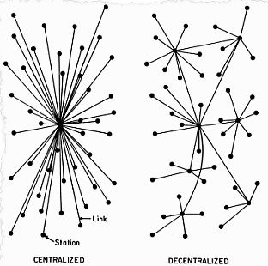
Community Assembly and Dynamics
Tend to be highly nested (Bascompte et al. 2003)
Confers greater redundancy, both at the species and entire community level
Increases stability and diversity maintenance
Contrasts with expectation of compartmentalization with specialization
Would be stable at the community but not species level
Both of the above expectations are more stable than highly centralized networks (e.g. ag systems)

Slide 9
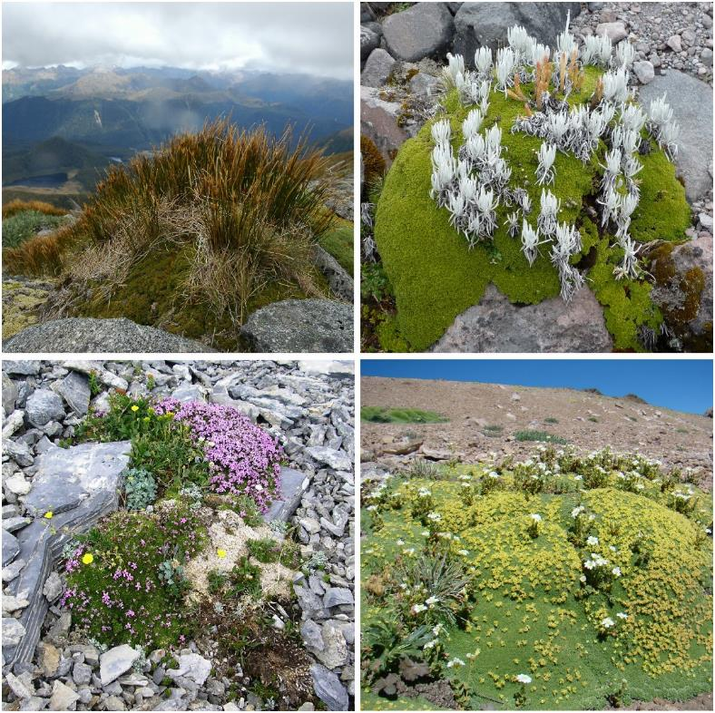
Facilitation: Heresy?
Did not fit in to theory of 1960s-1980s
Driven by simple models of competition
Organisms alter their environment
Ecosystem engineering
Or simply creating habitat heterogeneity
This often leads to positive effects on others
Alpine cushion plants. Clockwise fr. upper left: Raoulia sp. (New Zealand), Azorella aretioides (Ecuador), Azorella madreporica (Chile) and Silene acaulis (Rocky Mountains).

Slide 10
Common Mechanisms of Facilitation (Callaway 2007)
Enhanced soil moisture
Buffering temperature extremes (high/low)
Increased SOM and nutrient availability
Protection from herbivores
Reduced salinity
Buffering from physical disturbance
Attraction of mutualists (pollinators, mycorrhizae)

Slide 11
Stress-Gradient Hypothesis
Balance shifts from competition to facilitation with increasing environmental severity

Slide 12
Arguments Over the SGH
Butterfield 2009 JEcol
Unimodal pattern?
Gradient length and location matter (Lortie and Callaway 2005)
Metric?
Growth, survival or population-level?
Plant functional strategies
Stress tolerators (sensu Grime 1977) species less responsive? (Maestre et al. 2009)
Environmental severity
Maestre et al. 2009
Stress tolerator
Competitor

Slide 13
Facilitation and Competition Occur Simultaneously
Soil moisture (facilitative) and light (competitive) in arid systems (Holmgren et al. 1997)
Protection from herbivores (facilitative) and any resource (competitive) (Schoeb et al. 2010)
We typically measure NET interaction outcomes
Need experiments, e.g. use shade cloth to remove competitive effects or allow predation

Slide 14
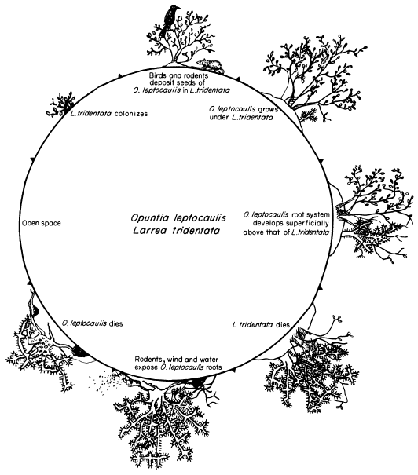
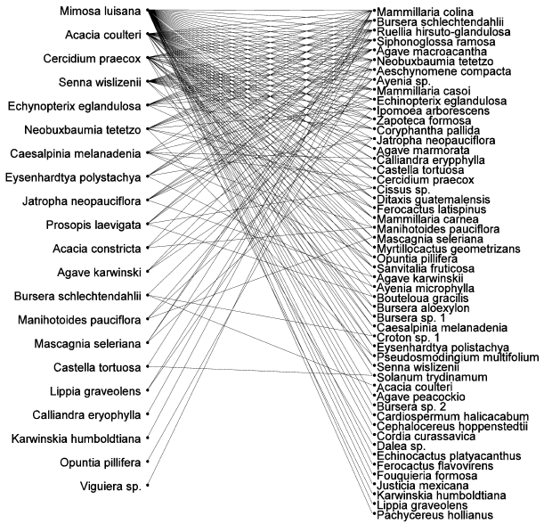
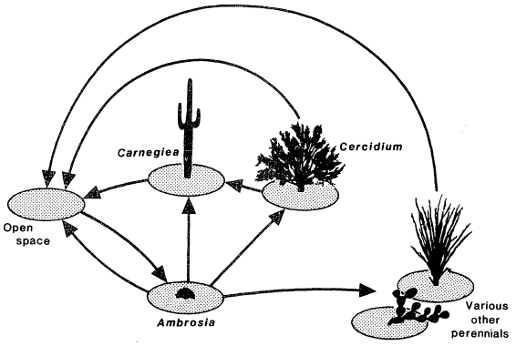
Community Assembly and Dynamics
Nurse
Beneficiary
Verdu & Valiente-Banuet
2008 AmNat
Nested structure
Yeaton 1978 Ecology
Cyclical succession
McAuliffe 1988 AmNat
Keystone nurse species

Slide 15
Community Assembly and Dynamics
Butterfield et al. 2010 Ecology
Positive density- dependence
Buffer env. fluctuations
Drive unexpected population spikes
Dependent upon position along environmental gradient (Butterfield 2009)

