Slide 1
Discussion Questions
Why do Hairston & Hairston say aquatic systems have 4 trophic levels and terrestrial systems have 3 trophic levels?
What are the primary arguments of Polis & Strong against H&H?
Do Carpenter and Kitchell support H&H or P&S? What about the feeding habits of juvenile bass?

Slide 2
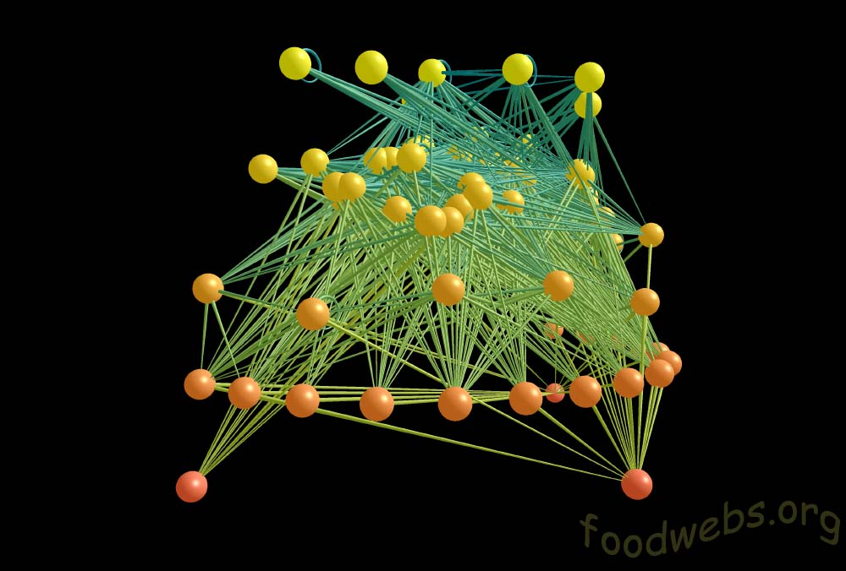
Food Webs
Community Ecology Week 3

Slide 3
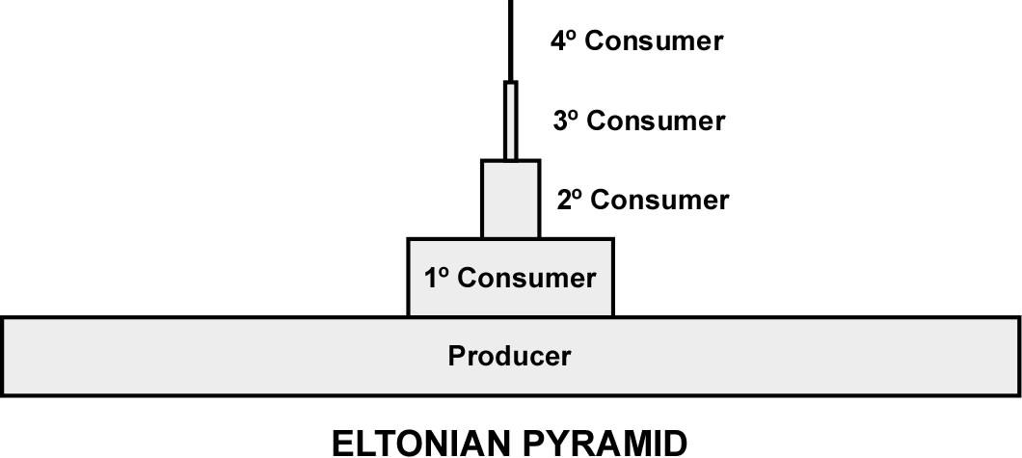
Early Concepts
Elton’s (1927) pyramid of numbers
Focus on energetics; Lindeman 1942:
Increasing energy loss from producers to top consumers
Though efficiency of food usage increases

Slide 4
Bottom-Up vs. Top-Down
Bottom-Up (Elton, Lindeman and so-forth)
Food chain length constrained by energy
Top-Down (Hairson, Smith and Slobodkin 1960; aka “HSS Hypothesis” aka “Why the world is green”)
Top predators reduce the level below them, which allows the next lower to expand, etc. etc.
Odd # trophic levels = green, even # = brown?

Slide 5
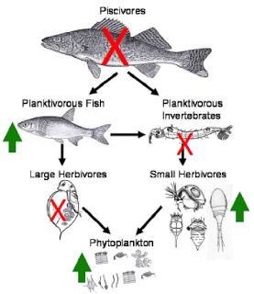
Trophic Structure and Cascades
Top-down dynamics
P&S argue that “receiver control” only happens under very specific conditions
Weakly defended prey
Easy to find prey and rapid growth response of predators
Minimal external perturbations
Etc. etc.
2° Predator
1° Predator
Herbivore
Producer

Slide 6
Trophic Structure and Cascades
Top-down dynamics
P&S argue that “receiver control” only happens under very specific conditions
Weakly defended prey
Easy to find prey and rapid growth response of predators
Minimal external perturbations
Etc. etc.
1° Predator
Herbivore
Producer

Slide 7
Aquatic vs. Terrestrial
The inverted pyramid
Big disparity in longevity in aquatic systems
Less so in terrestrial
H&H
# trophic levels in aquatic = 4, terrestrial = 3
Because fish are gape limited (2 predator levels) and phytoplankton turnover rapidly
Piscivores
Planktivores
Phytoplankton
Carnivores
Herbivores
Plants

Slide 8
Food Webs
Trophic levels may be an over-simplification
Species interact with many others, and across different “levels”
Omnivory is common
Networks of interactions
Nodes
“Links”
Paine 1966 AmNat

Slide 9
Dynamics and Stability
Complexity leads to instability (May 1973)
Links decrease proportional to # of species
Mathematically unstable at equilibrium
Alternatively, weak interactions stabilize complex (highly diverse) food webs (McCann et al. 1998)
Most food webs are comprised primarily of weak interactions
Function to buffer population dynamics from few strong interactions

Slide 10
Network Approaches
Network structure
Building up from modules
Dynamics of networks with different structures
Networks of networks!
Linking consumptive, competitive and positive interactions
Milo et al. 2003 Science
Herbivores
Plants
Pollinators
Fontaine et al. 2013 EcoLetts

Slide 11
R Exercise
Let’s play with some arthropod networks

