Slide 1
Discussion Questions
What are Hurlbert’s indices estimates of, if not diversity?
What should be the scaling factor (x-axis) for rarefaction curves, and why?
How does the Raup-Crick estimate (in Anderson et al.) differ from other beta-diversity indices? How is alpha-diversity incorporated?

Slide 2
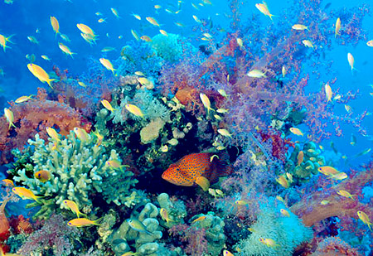
Taxonomic Diversity
Community Ecology Week 4

Slide 3
Alpha Diversity
Species richness: Number of species in a sample
Species evenness or dominance: Combination of number of species and their relative abundances

Slide 4
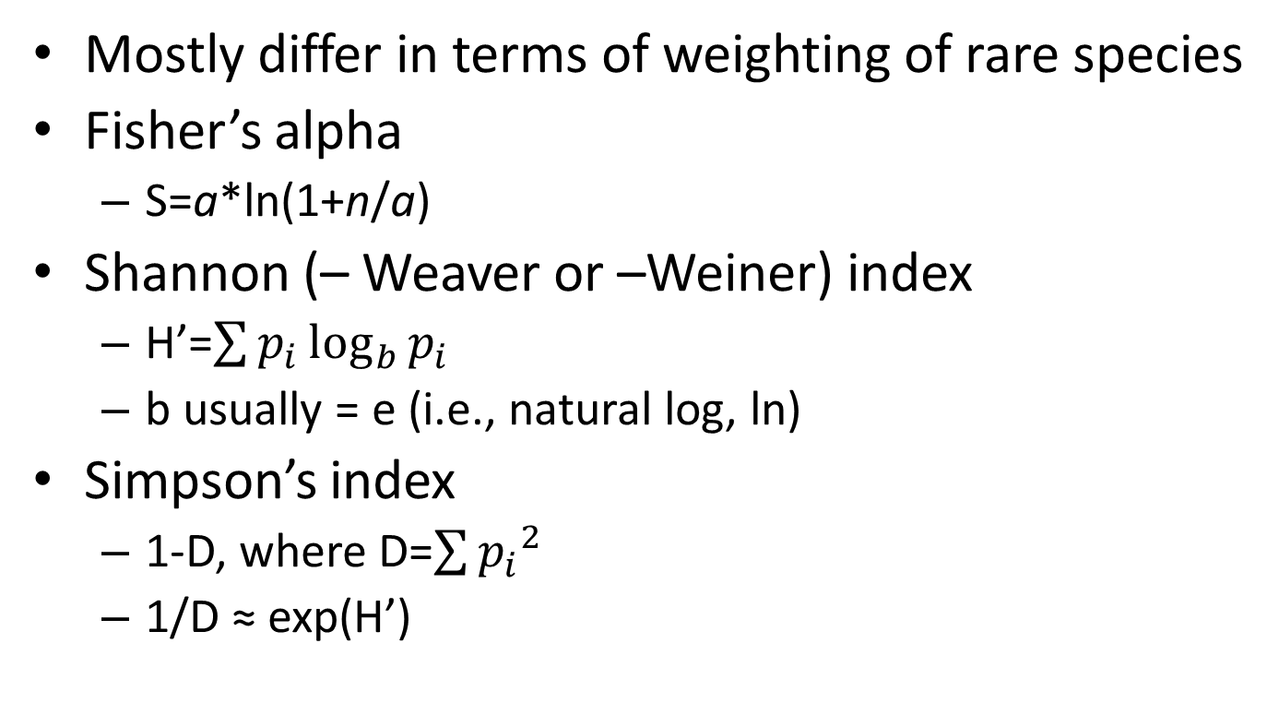
Common Indices
Mostly differ in terms of weighting of rare species
Fisher’s alpha
S=a*ln(1+n/a)
Shannon (– Weaver or –Weiner) index
H’=$\sum{p_{i}\log_{b}{p_{i}}}$
b usually = e (i.e., natural log, ln)
Simpson’s index
1-D, where D=$\sum{{p_{i}}^{2}}$
1/D ≈ exp(H’)

Slide 5
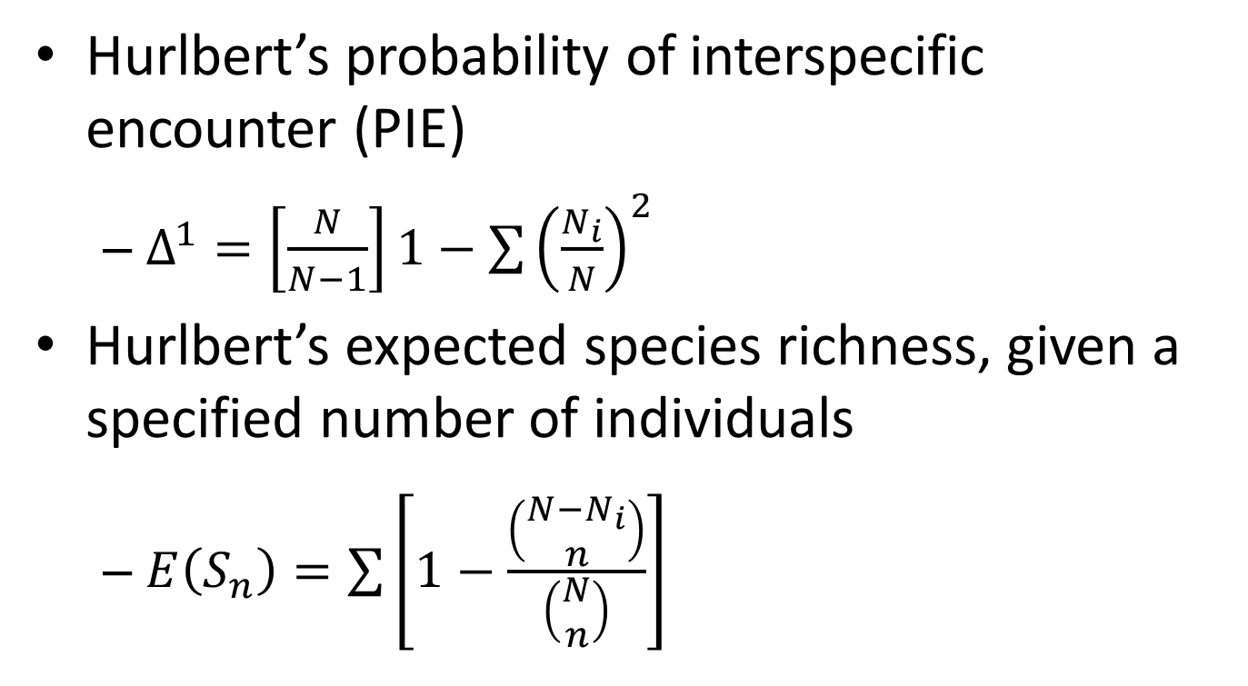
Common Indices (cont’d.)
Hurlbert’s probability of interspecific encounter (PIE)
$Δ^{1}=\left[\frac{N}{N−1}\right]1−\sum{{\left(\frac{N_{i}}{N}\right)}^{2}}$
Hurlbert’s expected species richness, given a specified number of individuals
$E\left(S_{n}\right)=\sum{\left[1−\frac{\left(\begin{matrix}N−N_{i} \\ n\end{matrix}\right)}{\left(\begin{matrix}N \\ n\end{matrix}\right)}\right]}$

Slide 6
Comparisons Among Communities: Rarefaction
Sample, density or individual
Samples include heterogeneity or autocorrelation in sampling that individuals don’t
Density is highly relevant for many issues, but individual-area relationships don’t scale linearly (individuals/area is not constant with increasing area)
Can rarefy by sample or density, then scale by individual
Different from estimating asymptotic species richness
Several methods extrapolate from rarefactions
Based on number of rare species

Slide 7
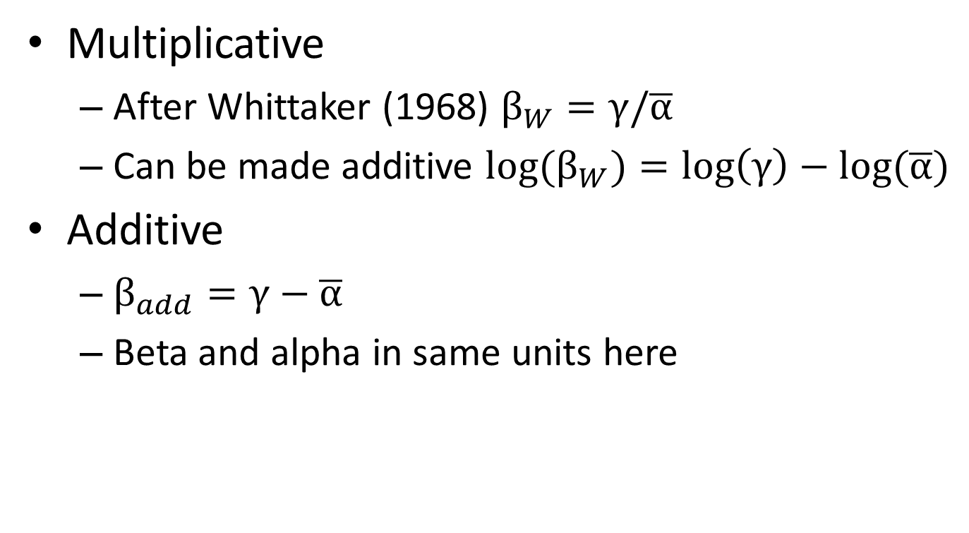
Alpha, Beta and Gamma
Multiplicative
After Whittaker (1968) $β_{W}=γ/\overline{α}$
Can be made additive ${log⁡(β}_{W})=\log\left(γ\right)−log⁡(\overline{α})$
Additive
$β_{add}=γ−\overline{α}$
Beta and alpha in same units here

Slide 8
Beta Diversity Indices
from Anderson et al. 2011 EcoLetts

Slide 9
from Anderson et al. 2011 EcoLetts

Slide 10
Beta Diversity and Permutation Null Models: Raup-Crick Index
Difficult to compare β across studies because can be influenced by variation in α or γ
Estimate expected beta diversity with random draws from species pool
Sample α1+α2 individuals from species pool (many times)
Calculate number of shared species
Compare observed to expected
Chase et al. 2011 Ecosphere

Slide 11
Ordination (Next Week’s Topic)
Species in common across communities can be used to identify which sets of communities are more or less similar to one another
Can compare across treatments as in an ANOVA (PermANOVA, or Adonis in R)
Can compare across continuous gradients (CCA, Decorana, etc. etc.)

