Slide 1
Discussion Questions
What are the critical differences between the 3 models presented by Connell and Slatyer?
Do the findings of Sousa fit any of the models in Connell and Slatyer? If so, which?
What is the likely reason for the increase in linear positive productivity-diversity relationships with increasing scale in Mittelbach et al?

Slide 2
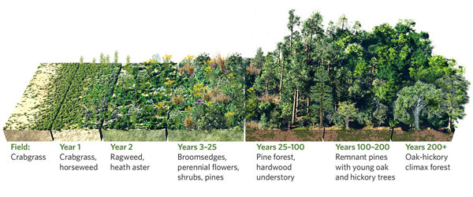
Disturbance & Productivity
Community Ecology Week 5

Slide 3
Disturbance and Succession
Clements and his “super-organism”
After a disturbance, successional trajectories are highly deterministic based on environment, leading to a “climax community”
Communities are coherent units
Gleason and “coincidence”
Chance events influence successional trajectories
Communities are coincidences of species’ independent distributions
Modern perspective
Stochasticity matters, but so too do interactions among species

Slide 4
Intermediate Disturbance Hypothesis
Diversity is maximized at intermediate levels of disturbance (Connell 1978)
Disturbance intolerant species have time to colonize
Superior competitors (late successional species) don’t have time to exclude inferior ones
Not well-supported empirically or theoretically
Big mix of observed patterns (Hughes et al. 2007)
Doesn’t hold up to mathematical scrutiny (Fox 2013)
Impetus for shift toward “non-equilibrium” theories of co-existence

Slide 5
Equilibrium vs. Non-Equilibrium Dynamics
Disturbance may help to explain species co-existence and diversity
Perturbs systems away from equilibrium
Allows for colonization-extinction dynamics
Source-sink dynamics help to reconcile destabilizing effects of stochasticity/non-equilibrium dynamics
(We’ll talk about meta-populations and meta-communities soon)

Slide 6
Colonization-Competition Tradeoffs
Disturbance mediates coexistence via ecological tradeoffs (Tilman 1994)
Inferior competitors are better at dispersing to open patches and reproducing before being competitively excluded
Combines competitive determinism with stochastic disturbances
Connell and Slatyer’s (1977) Model 2, right?
Well-supported by seed mass/number tradeoffs (Westoby et al. 2002)

Slide 7
Productivity-Diversity Relationships
Hump-backed relationship (Grime 1973)
Few species can tolerate low productivity environments
Competitive exclusion reduces diversity in high productivity environments
Pretty well-supported empirically
Grace 1999, Waide 1999, Mittelbach 2001

Slide 8
Scale and Species Pool Size
Positive, linear relationships increase with scale (Mittelbach et al. 2001)
Potential for competitive exclusion decreases at broad spatial scales
Positive, linear relationships are more common in the tropics (Partel et al. 2007)
Productive environments have been around much longer, and are more abundant in the tropics than in temperate zones
Idea that regional processes (i.e. species pool size) determines local diversity, rather than competition

Slide 9
Summary
Disturbance-Diversity
It’s complicated
Importance of source-sink dynamics
Competition-colonization tradeoffs can lead to coexistence
Productivity-Diversity
Hump-shaped relatively well-supported
Could be influenced by regional factors in addition to local interactions

Slide 10
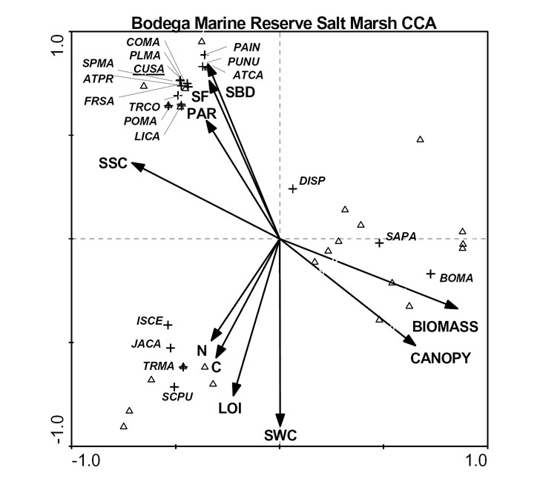
Ordination Primer

Slide 11
Why Ordinate?
Dimensionality reduction
Identifying a few composite environmental variables
Identifying functional “spectra”
Pattern visualization (and tests)
Which communities are more/less similar to one another?
Do certain categories of sample types tend to cluster?
Community-environment relationships

Slide 12
Considerations
Gradient length
Linear; not much species turnover/low β diversity
Unimodal; high species turnover/β diversity
To constrain or not to constrain?
Unconstrained (aka indirect); no environmental variables included in the ordination (but can be related to the site or species scores later)
Constrained (aka direct); maximize correspondence between species and environmental variables

Slide 13
Ordinations/Gradient Analyses
Unconstrained
Constrained
PCA/PCoA/NMDS
(Principal Components Analysis)
RDA
(Redundancy Analysis)
Linear
(D)CA
([Detrended] Correspondence Analysis)
(D)CCA
([Detrended] Canonical Correspondence Analysis)
Unimodal

Slide 14
Issues
Distance measures matter
Zeros and rare species can have a big impact
Faithful representation of raw data
Distortion
Horseshoe (PCA) and arch (CA, sometimes CCA) effects
Careful consideration of gradient length and detrending are two options

Slide 15
Rules of Thumb
Do a DCA first
Length of first axis (“gradient length”, in standard deviations) is a measure of beta diversity/species turnover
Tells you if its linear or unimodal
Gradient length
<3 SD = linear, do a RDA
3-4 SD, either
>4 SD = unimodal, do a CCA

Slide 16
Resources
http://ordination.okstate.edu/distance.htm
R
principal{psych} or princomp{stats}
vegdist{vegan}: many different distance metrics
adonis{vegan}: PERMANOVA
cca,decorana,decostand{vegan}: one-stop shop for ordinations and transformations!
nmds,nmds.min{ecodist}: simple NMDS code
PC-ORD, CANOCO, PRIMER

Slide 17
Notes
NMDS – maximizes rank-order correlation between distance matrix and ordination distances
PCoA - maximizes linear correlation between distance matrix and ordination distances
PCA – (same as PCoA when using Eucl distance); eigenanalysis (like CCA, RDA, etc.), often used for dimensionality reduction that creates orthogonal axes by rotating the data in order to maximize the primary eigenvalue. Thus, relationships between samples are not altered. Each eigenvalue has an associated eigenvector that provides the location of each sample along that axis. Analysis of covariance matrix (unstandardized data) or correlation matrix (all standardized to SD=1)

Slide 18
Notes
CA – correspondence analysis (correspondence between species scores and sample scores); eigenvalues indicate the correlation between species and sample scores;

Slide 19
Notes
CCA – maximized correspondence between samples and environmental variables (that’s what makes it “canonical”: the correspondence is with some underlying explanatory variable(s))

