Slide 1
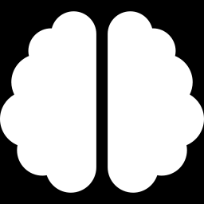
DAY 2 · TUESDAY
How Machines Learn
Inside a neural network — from one neuron to ChatGPT-scale models.
Notes:
Frame the day: by the end you'll understand 'a 70-billion-parameter neural network trained with gradient descent,' every word of it. ~3 hours with lab breaks.

Slide 2
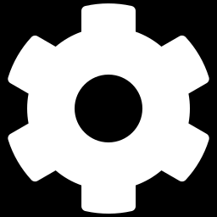
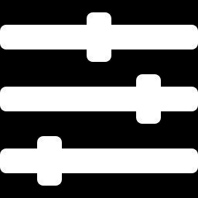
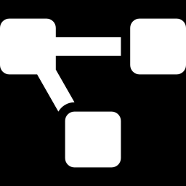
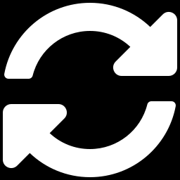
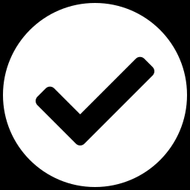
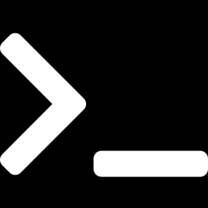
Today's journey
Six ideas, from a single neuron to a CNN.
1. What is machine learning?
2. The neuron
3. Neurons → a network
4. How training works
5. Networks that see
6. Making it work + labs
TUE · NEURAL NETWORKS
2
Notes:
Reassure: abstract terms now, concrete example on the very next slide each time, then the lab makes it real.

Slide 3
The big question
Yesterday you collected photos. Today: how does a computer learn from them?
A computer only does what it's told. So how can it figure out something nobody programmed — like which squiggle is a 7? That's what machine learning answers.
TUE · NEURAL NETWORKS
3
Notes:
Ask them to invent rules for detecting a '7'. Let them feel how brittle hand-written rules are. That failure motivates learning from examples.

Slide 4
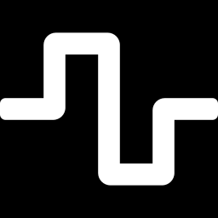
From last week to this
You've done more of this than you think.
Week 1: you trained models
This week: aim it at the world
Linear regression, a small neural net, clustering, even a tiny language model — all learning from examples.
Same machinery, pointed at images — then loaded onto a robot arm that sees, decides, and acts.
TUE · NEURAL NETWORKS
4
Notes:
Quick orientation: most of you trained models last week — regression, a small neural net, clustering, even a tiny GPT. This week we point that same machinery at images, then a robot. New students: you don't need Week 1; we build from the neuron up today.

Slide 5
01
What Is Machine Learning?
Notes:
Ground neural nets inside the bigger ML picture before diving in.

Slide 6
Two ways to make a computer smart
Classic programming: you write the rules
“If two loops are stacked, it's an 8…” Thousands of rules, and it still breaks on messy handwriting.
Machine learning: you show examples
Give it 60,000 labeled digits; it discovers the patterns itself. No rules written by hand.
TUE · NEURAL NETWORKS
6
Notes:
For perception — images, sound, language — we usually can't state the rules ourselves, so we let the machine learn them.

Slide 7
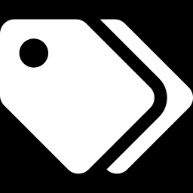
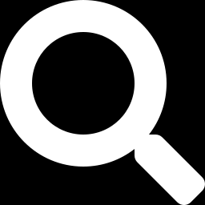
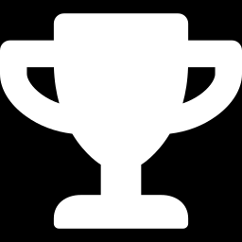
The machine-learning family
Three big styles of learning — we're using the first one.
Supervised
Unsupervised
Reinforcement
Learn from labeled examples (input → known answer). Our digits live here.
No labels — find structure on your own, like grouping similar photos.
Learn by trial, reward, and error — how AIs master games.
TUE · NEURAL NETWORKS
7
Notes:
We do supervised learning all week: labeled photos in, correct name out. Mention unsupervised (clustering) and reinforcement (game-playing) so they know the landscape.

Slide 8
Two supervised tasks
Predict a category, or predict a number?
Classification — which category?
Regression — which number?
e.g., which digit (0–9) — that's us!
house size → predicted price
TUE · NEURAL NETWORKS
8
Notes:
Classification = pick a bucket (our digits). Regression = predict a continuous number (price, temperature). Both are supervised; today is classification.

Slide 9
You've met these two before
Last week's models were exactly these tasks.
Regression (Week 1)
Classification (this week)
Predict a number — like lemonade sales from the temperature.
Predict a category — which digit, which object. Same idea, different answer.
TUE · NEURAL NETWORKS
9
Notes:
Anchor the two task types in something they've seen. Week 1's lemonade predictor output a number (regression); our digit/object models output a category (classification). Same learning loop, different kind of answer.

Slide 10
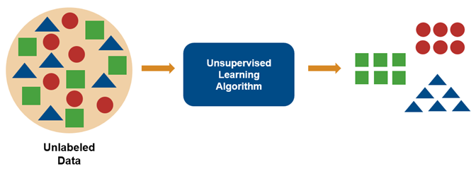
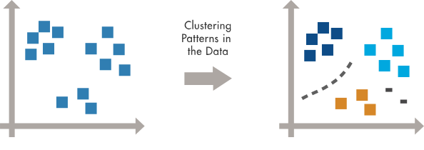
Unsupervised learning
TUE · NEURAL NETWORKS
8
https://www.mathworks.com/discovery/unsupervised-learning.html
Notes:
Classification = pick a bucket (our digits). Regression = predict a continuous number (price, temperature). Both are supervised; today is classification.

Slide 11

Reinforcement learning
TUE · NEURAL NETWORKS
8
https://www.udacity.com/blog/reinforcement-learning-explained-algorithms-examples-and-ai-use-cases/
Notes:
Classification = pick a bucket (our digits). Regression = predict a continuous number (price, temperature). Both are supervised; today is classification.

Slide 12
What “learning” actually means
No magic — just tuning numbers to make fewer mistakes.
1
2
3
4
Guess
Check
Tune
Improve
make a prediction
how wrong was it?
adjust the numbers
repeat, get better
That's the whole game. Even ChatGPT is a giant version of this exact loop.
TUE · NEURAL NETWORKS
10
Notes:
Return to this loop all day. Everything else is machinery that makes each of these four steps work.

Slide 13
Today's dataset: MNIST
The “hello world” of machine learning — handwritten digits.
70,000
28×28
10
labeled images
pixels each
classes: 0–9
Split: 60,000 to learn from + 10,000 kept aside to test honestly (more on why later).
TUE · NEURAL NETWORKS
11
Notes:
Real, famous dataset. Tiny and clean so training takes seconds and ideas stay visible.

Slide 14
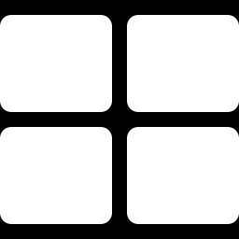
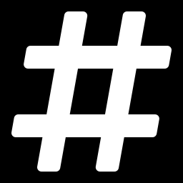
An image is just numbers
Before learning, the picture becomes a list of numbers.
28 × 28 grid
784 numbers in a row
Each pixel has a brightness from 0 (black) to 255 (white).
Flatten the grid into one list of 28×28 = 784 values — the network's input.
Key idea: to a network, an image, a sound, and a sentence are all just lists of numbers.
TUE · NEURAL NETWORKS
12
Notes:
Big unlock: everything becomes numbers, which is why one idea works across images, audio, and text.

Slide 15
02
The Neuron
Notes:
The atom of every neural network.

Slide 16
What is a neuron?
A tiny decision-maker: weigh the inputs, add them up, decide how strongly to react.
output = activation( w1·x1 + w2·x2 + … + bias )
In plain words
Multiply each input (x) by its weight (w), add them up, add a bias, then run the total through an activation function that sets the output.
TUE · NEURAL NETWORKS
14
Notes:
Read left to right slowly. Inputs = pixels; weights = how much each matters. Just 'weighted sum, then a decision.'

Slide 17
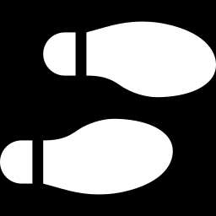
Weights & biases: the knobs
The numbers that learning adjusts.
Weight = importance
Bias = eagerness
Big weight = “this input matters a lot.” Near zero = “ignore it.”
A nudge that makes the neuron fire more or less easily.
Micro-example: inputs 0.9 and 0.2; weights 3 and −1; bias 0. → (0.9×3) + (0.2×−1) = 2.5. Positive, so it fires. Change the weights and it reacts to different things.
TUE · NEURAL NETWORKS
15
Notes:
Do the arithmetic aloud. All of learning is nudging these numbers until outputs are right.

Slide 18
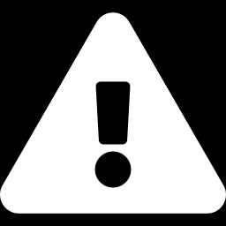
A neuron, worked out
Two inputs, two weights, a bias — one decision.
The arithmetic
inputs 0.9, 0.2 · weights 3, −1 · bias 0 → 0.9×3 + 0.2×(−1) + 0 = 2.5
Positive, so it fires. Flip a weight's sign and the same neuron reacts to the opposite pattern. Training just chooses these numbers.
TUE · NEURAL NETWORKS
16
Notes:
Walk the arithmetic live: 0.9x3=2.7, 0.2x(-1)=-0.2, sum 2.5, positive so it fires. Flip a weight's sign and ask what pattern it now responds to. 'Learning' is just choosing these weights and biases.

Slide 19
Why we need activation functions
Without them, even a deep network is just a straight line.
The problem
The fix
Stacking plain weighted sums gives… another weighted sum. Straight lines only — useless for complex patterns.
Add a non-linear “bend” after each layer. That's what lets networks model almost anything.
TUE · NEURAL NETWORKS
17
Notes:
Analogy: taping rulers end to end only ever makes straight lines. Activations add the curves.

Slide 20
The activation functions, drawn
A few simple shapes do almost all the work.
ReLU — max(0, x)
Sigmoid — squashes to 0–1
TUE · NEURAL NETWORKS
18
Notes:
ReLU: flat for negatives, then a straight climb — the workhorse inside hidden layers. Sigmoid: a smooth S from 0 to 1. Softmax (next relevant slide) turns final scores into percentages.

Slide 21
03
From Neurons to a Network
Notes:
Wire many neurons together.

Slide 22
A neural network, drawn
Neurons in layers, every one connected to the next.
⋮
⋮
⋮
⋮
Input
(784 pixels)
Hidden
(128)
Hidden
(64)
Output
(10 digits)
TUE · NEURAL NETWORKS
20
Notes:
Point along the diagram: pixels enter left, flow through hidden layers, 10 output neurons on the right (one per digit). Every connection carries a weight. The dots mean 'and many more.'

Slide 23
The forward pass
Making one prediction = pushing numbers through, left to right.
1
2
3
4
Pixels
Layer math
Scores
Guess
784 values in
sums + ReLU
10 raw numbers
biggest wins
TUE · NEURAL NETWORKS
21
Notes:
This is 'inference' — what happens every time the model is used, including on the arm Friday.

Slide 24
Forward pass, with numbers
The same four steps, now with real values.
1
2
3
4
Input
Weighted sums
ReLU
Softmax
3 values: 0.2, 0.8, 0.1
each unit adds its weighted inputs
negatives → 0, rest passes
10 scores → 10 percentages
TUE · NEURAL NETWORKS
22
Notes:
Make the forward pass concrete with tiny numbers. Same four steps as the diagram before, just instantiated. Don't dwell — it's the bridge into softmax.

Slide 25
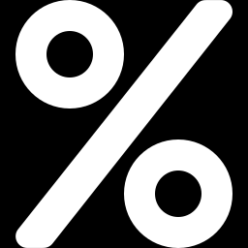
Turning scores into confidence
Softmax makes the 10 output numbers readable as percentages.
It's an 84% 7
The bars sum to 100%. The tallest is the guess; its height is the confidence — what Friday's arm uses to decide ‘is this the target?’
TUE · NEURAL NETWORKS
23
Notes:
The chart is a real softmax output over the ten digits. Low confidence later means 'don't grab.' Ties to Wednesday's threshold + none-class.

Slide 26
Softmax, step by step
How raw scores become confidences.
Raw → exponentiate → share
scores 2.0, 1.0, 0.1 → exp → divide by the total → 0.66, 0.24, 0.10
They add up to 1.00.The biggest score becomes the biggest slice — and that slice is the confidence Friday's arm checks.
TUE · NEURAL NETWORKS
24
Notes:
Do softmax at a high level: exponentiate the scores, divide by their sum so they total 1.00. Biggest score becomes the biggest share — and that share is the confidence Friday's arm thresholds on.

Slide 27
Parameters: counting the knobs
A “parameter” is one learnable number — a weight or a bias.
100,480
8,256
650
input → 128
128 → 64
64 → 10
Total ≈ 109,000 parameters. Training tunes every one automatically — you never set them by hand.
TUE · NEURAL NETWORKS
25
Notes:
Each count = inputs×neurons + one bias per neuron. 'Parameter' is the word they'll meet everywhere in AI.

Slide 28
What “parameter size” means for LLMs
You've heard “7B” or “70B” — now you know what it counts.
~109K
70B
175B+
your digit network
a large open LLM
GPT-3 and beyond
Same kind of knob — just ~600,000× more. An LLM is a giant neural network trained on trillions of words to predict the next one. More parameters ≈ more capacity.
TUE · NEURAL NETWORKS
26
Notes:
Payoff slide. Same kind, different scale + data. 'B' = billion. Caveat: bigger isn't automatically better — data and training matter too.

Slide 29
Check yourself
Cover the screen and think for ten seconds each.
Question 1
Question 2
A neuron's weight is near zero. How much does that input affect its decision?
Softmax says 0.88, 0.07, 0.05. What's the guess — and how sure is the network?
TUE · NEURAL NETWORKS
27
Notes:
Interstitial: let them answer in chat. Q1: a near-zero weight means that input barely matters. Q2: guess is the first class at 88% confidence. Keeps remote students active.

Slide 30
04
How Training Works
Notes:
The actual learning machinery, with concrete examples.

Slide 31
The training loop
Repeat this and random knobs become a working model.
1
2
3
4
Predict
Loss
Gradient
Update
forward pass
how wrong?
which way to fix
nudge the knobs
In the notebook this whole loop is one function: run_epoch. Next we open up each step.
TUE · NEURAL NETWORKS
29
Notes:
Preview the four steps, then take each in turn with an example.

Slide 32
Loss: measuring wrongness
One number for how badly the model is doing right now.
Cross-entropy loss
Low when confident and right; high when confident and wrong. Perfect = 0.
Training's whole goal: make the average loss as small as possible. Gradients, learning rate, and batches all exist to push this one number down.
TUE · NEURAL NETWORKS
30
Notes:
Loss is the scoreboard. Being confidently wrong is punished hardest, nudging the model toward honest confidence.

Slide 33
Loss, worked out
Why confidence and correctness both count.
Confident and right vs confident and wrong
right answer at 90% → small loss (≈0.1). Right answer at 20% → big loss (≈1.6). Confidently wrong → huge loss.
A perfect prediction scores 0. Training pushes this one number down, example after example.
TUE · NEURAL NETWORKS
31
Notes:
Give concrete losses: right at 90% = small loss; right at only 20% = big loss; confidently wrong = huge. Perfect = 0. Motivates minimizing loss rather than just counting right/wrong.

Slide 34
One training step, up close
Watch a single update make the guess better.
Before the update
After one update
TUE · NEURAL NETWORKS
32
Notes:
The true answer is 7. Before, the model leaned '1' (loss high). One nudge of the weights and '7' jumps up. Multiply by thousands of steps → a good model. This is the concrete heart of training.

Slide 35
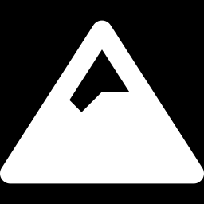
Gradient: which way is downhill?
Picture loss as a valley. We want the lowest point.
Loss vs. one weight
Roll downhill
The gradient is the slope: which way makes the error go up. So we step the other way, toward the bottom, again and again.
TUE · NEURAL NETWORKS
33
Notes:
Blindfolded-hiker analogy: feel the slope, step downhill, repeat. The gradient is that slope, computed for all ~109k weights at once.

Slide 36
Gradient descent & learning rate
The update rule — and the dial for step size.
new weight = old weight − (learning rate × gradient)
Learning rate too big
Too small
Overshoots the valley, bounces around, or blows up.
Crawls — takes forever. We pick a sensible middle.
TUE · NEURAL NETWORKS
34
Notes:
Learning rate is the main knob you set by hand (a hyperparameter); in the lab it's 0.001. Too-big vs too-small is a great live demo.

Slide 37
One step downhill, worked out
The update rule with real numbers.
new = old − (learning rate × gradient)
weight 0.80, gradient +2.0, rate 0.1 → 0.80 − 0.1×2.0 = 0.60
A positive gradient means 'too high,' so the step lowers it. Repeat for all ~109,000 weights, thousands of times, and random knobs become a working model.
TUE · NEURAL NETWORKS
35
Notes:
Work one update: new = 0.80 - 0.1x2.0 = 0.60. Positive gradient means the weight was too high, so we step down. Times ~109k weights and thousands of steps — that's training.

Slide 38
Backpropagation
How the network figures out each knob's share of the blame.
1
2
3
Loss at the end
Work backward
Blame each weight
total error
layer by layer
its slice
You won't code this — the library does it. It's how all ~109k gradients get computed at once.
TUE · NEURAL NETWORKS
36
Notes:
Conceptual only: error flows backward, each weight learns its contribution. This algorithm made deep learning practical.

Slide 39
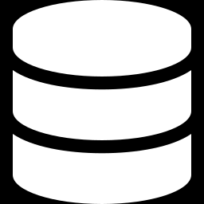
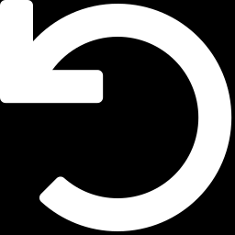
Batches, iterations & epochs
We don't feed all 60,000 images at once — we work in small groups.
Minibatch
Iteration
Epoch
A small group (e.g. 64 images) used for one update. Faster and steadier.
One update from one batch. 60,000 ÷ 64 ≈ 940 per pass.
One full pass over all the data. We'll run several.
TUE · NEURAL NETWORKS
37
Notes:
Define all three precisely — students conflate them. Batch = group; iteration = one update; epoch = one lap through the data.

Slide 40
Watching it learn
Accuracy climbs epoch by epoch — loss slides down.
Test accuracy per epoch (%)
From nothing to 97%
Random knobs, a few epochs, and a tiny network reads unseen digits at ~97%. That's learning.
TUE · NEURAL NETWORKS
38
Notes:
In the lab they watch these numbers print live. Pause to appreciate: pure examples turned random numbers into 97% accuracy.

Slide 41
05
Networks That See
Notes:
Section break. We've built and trained a basic network; now a better architecture for images. Sets up tomorrow's transfer learning.

Slide 42
Flat networks don't see shape
A row of 784 numbers loses the picture.
The problem
What's lost
Flatten a digit and 'where' disappears. Shift it three pixels and every input changes — the network sees something new.
Neighboring pixels form edges and curves. A flat list throws that structure away.
TUE · NEURAL NETWORKS
40
Notes:
Motivate CNNs by the failure of flat nets: flattening destroys spatial layout, and a 3-pixel shift changes every input. Nearby pixels form edges and curves — structure a flat list ignores.

Slide 43
Convolution: a sliding feature-finder
One small filter, checked everywhere on the image.
A tiny filter
Slide it across
Many filters
A 3×3 grid of weights tuned to one pattern — say, a vertical edge.
Run it over the whole image; it lights up wherever that pattern appears.
Different filters catch edges, corners, textures — all learned, not hand-coded.
TUE · NEURAL NETWORKS
41
Notes:
Core idea: a small filter (e.g. 3x3) tuned to one pattern, slid across the whole image, lighting up wherever that pattern occurs. Many filters, all learned automatically. Analogy: a stamp you check everywhere.

Slide 44
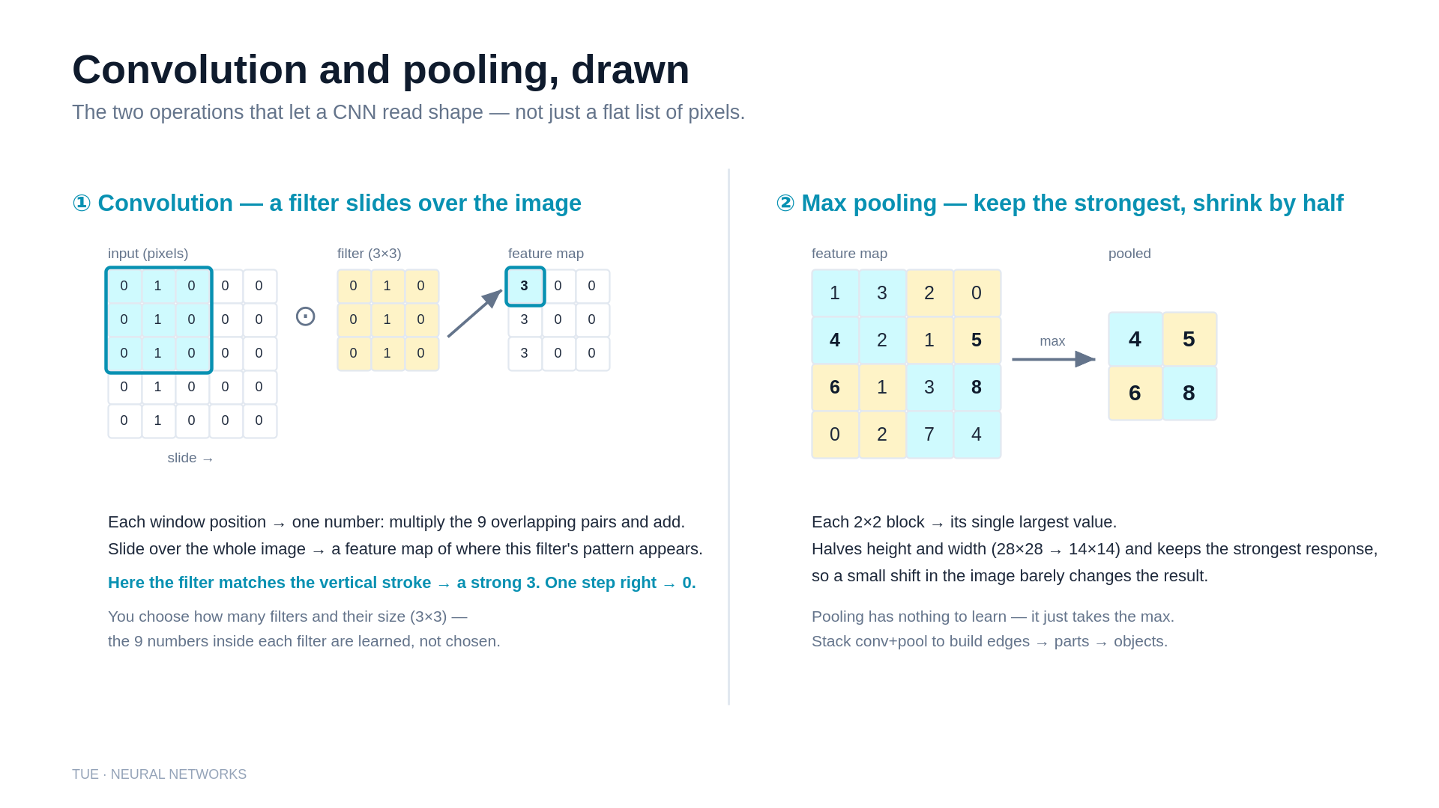
Notes:
Concrete mechanics behind the CNN section. LEFT (convolution): a filter is a small grid of weights slid over the image; at each position, multiply the 9 overlapping pairs and add to get one number, building a feature map. Here the vertical-line filter fires (3) where the stroke sits and drops to 0 one step over -- that's 'this pattern, here.' You choose the number and size of filters; the values inside are learned. RIGHT (max pooling): take the largest value in each 2x2 block, halving height and width and keeping the strongest signal. Term to name: a 'feature map' is one filter's output grid.

Slide 45
Pool, then build up
Zoom out, keep the strong signals, stack the ideas.
Pooling
Layer on layers
Meaning, not pixels
Shrink each region to its strongest response — smaller, and steady against small shifts.
Early layers find edges; later ones combine them into parts, then whole objects.
By the top, the network describes what's in the image.
TUE · NEURAL NETWORKS
42
Notes:
Pooling shrinks while keeping the strongest responses and tolerates small shifts. Stacking layers builds edges to parts to objects. By the top, the network describes content, not pixels.

Slide 46
A CNN, end to end
The path from pixels to a labeled guess.
1
2
3
4
Conv + pool
Conv + pool
Flatten
Classify
find edges, shrink
edges → parts
into a feature list
scores → softmax → guess
TUE · NEURAL NETWORKS
43
Notes:
Tie it together: conv+pool, conv+pool, flatten, classify. Same ending as the MLP (scores to softmax to guess), just a smarter front end. This is the shape of tomorrow's MobileNet.

Slide 47
Why this matters tomorrow
You won't build a CNN from scratch — you'll stand on one.
Transfer learning
So ~50 photos is enough
MobileNet is a CNN already trained on millions of images. You reuse its filters and retrain only the top layer.
The hard part — learning to see edges and textures — is already done. You just teach it your objects.
TUE · NEURAL NETWORKS
44
Notes:
The payoff: MobileNet is a pretrained CNN. Transfer learning reuses its learned filters and retrains only the top, which is why ~50 photos per object is enough. Connect explicitly to Wednesday.

Slide 48
06
Making It Actually Work
Notes:
The difference between a demo and a model that generalizes.

Slide 49
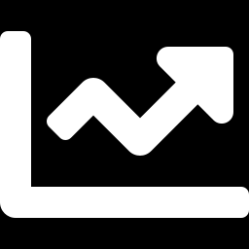
Train / validation / test
Golden rule: never test on data the model studied.
Training set
Validation set
Test set
The examples the model learns from.
Checked during training to tune settings and catch problems.
Untouched until the end — the honest final grade.
TUE · NEURAL NETWORKS
46
Notes:
Studying the exact exam answers vs. actually learning. Held-out data is the only honest measure. Their photos get split this way too.

Slide 50
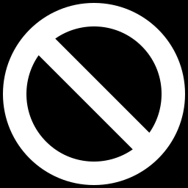
Overfitting vs. underfitting
The two ways learning goes wrong.
Overfitting: memorizing
Great on training data, bad on new data. Tell-tale: training accuracy high, validation accuracy low.
Underfitting: not learning enough
Bad on everything — model too simple or under-trained.
TUE · NEURAL NETWORKS
47
Notes:
Key for Wednesday: with ~50 photos per object, overfitting is the main risk — hence transfer learning + data variety.

Slide 51
Overfitting, seen
The difference between memorizing and understanding.
What you'd see
Why it happens
Training accuracy climbs toward 100% while validation accuracy stalls or slips. That gap is the warning.
The model memorized the exact training images instead of the general pattern.
TUE · NEURAL NETWORKS
48
Notes:
Describe the tell-tale: train accuracy near 100% while validation stalls or drops — that gap is overfitting. Cause: memorizing specific images, not the general pattern. They reproduce this on purpose in Lab 2.

Slide 52
100% on training, 70% on new photos
A situation you'll actually hit this week.
What happened
The model memorized your training set: high train score, low real-world score — classic overfitting.
What to do: Add more varied photos, turn on augmentation, and stop once validation stops improving.
TUE · NEURAL NETWORKS
49
Notes:
Concrete scenario they'll hit: great on training, poor on new photos = memorization. Fixes: more and more-varied data, augmentation, early stopping. Practical, not theoretical.

Slide 53
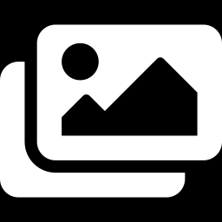
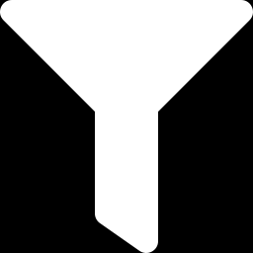
Fighting overfitting
Four tools you'll use this week.
More & varied data
Data augmentation
Angles, lighting, backgrounds
Flip, rotate, recolor for variety
Dropout
Early stopping
Randomly ignore some neurons while training
Stop when validation stops improving
TUE · NEURAL NETWORKS
50
Notes:
Variety and augmentation are what they control most on Friday's results. Dropout and early stopping come built into good training code.

Slide 54
Augmentation: free variety
Make one photo teach several lessons.
Flip & rotate
Recolor & brighten
Crop & shift
A mug is still a mug mirrored, or tilted 15°.
Vary the lighting so the model doesn't lean on your desk lamp.
Move the object around the frame so position doesn't matter.
TUE · NEURAL NETWORKS
51
Notes:
Augmentation as free variety: flips/rotations, lighting/color, crops/shifts — each turns one photo into several lessons and directly fights overfitting. Preview that Wednesday's notebook turns these on.

Slide 55
Knowing when to say 'not sure'
The check that keeps Friday's arm honest.
Threshold
Margin
Only act when the top confidence clears a bar (say 0.60). Below it, the answer is 'no target.'
Also require the top guess to beat the runner-up by a gap, so a 0.34-vs-0.33 near-tie doesn't trigger a grab.
TUE · NEURAL NETWORKS
52
Notes:
Settled design decision for Friday. Threshold: act only above ~0.60. Margin: also require the top guess to beat the runner-up by a gap, so near-ties don't trigger. With a trained 'none' class, this is how the arm reliably says 'no target.'

Slide 56
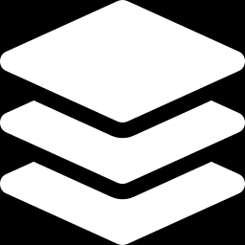
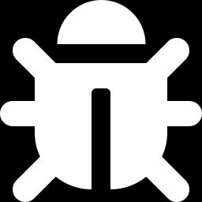
In today's lab
Three notebooks — from your first network to a CNN.
Lab 1 · Build & train
Lab 2 · Go convolutional
Lab 3 · Experiment
Assemble the digit net, train past 97%, inspect its mistakes.
Build a CNN from scratch and break 99%.
Resize the brain, sweep the learning rate, hunt confusions.
TUE · NEURAL NETWORKS
53
Notes:
The notebook mirrors these slides: layers, run_epoch (the loop), predict. Challenges: bigger network, a CNN, confusion hunt.

Slide 57
Key terms to remember
Your cheat-sheet for the rest of the week.
Neuron
Weight
Bias
Weighted sum + activation
How much an input matters
A neuron's eagerness to fire
Activation
Layer
Parameter
The non-linear bend (ReLU)
A row of neurons
One learnable number
Loss
Gradient
Learning rate
How wrong the model is
Which way lowers the loss
Step size for updates
Batch
Epoch
Overfitting
A small group of examples
One full pass over data
Memorizing, not learning
TUE · NEURAL NETWORKS
54
Notes:
Leave up during the lab. They'll hear all twelve terms in any AI article from now on.

Slide 58
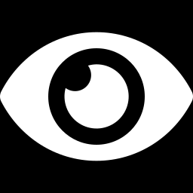
Same recipe tomorrow — your objects.
Next: transfer learning, so a handful of photos is enough.
Notes:
Bridge to Wednesday: same loop and vocabulary, their own photos, a pretrained head-start.

