Slide 1
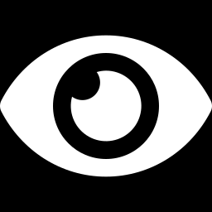
DAY 3 · WEDNESDAY
Teaching a Machine to See
From digits to the objects you photographed.
Notes:
Pairs with the Wednesday classifier notebook. Today: train your own recognizer with transfer learning.

Slide 2
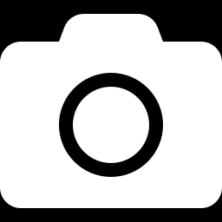
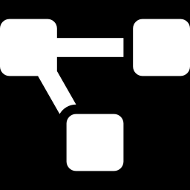
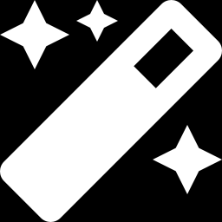
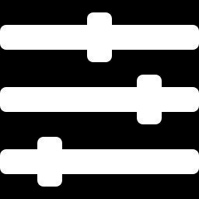
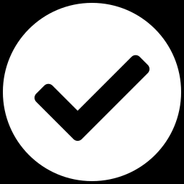
Today's journey
Five ideas, building on yesterday.
1. Why seeing is hard
2. How computers see
3. The trick: transfer learning
4. Your model in practice
5. Make it good + build
WED · COMPUTER VISION
2
Notes:
Yesterday gave the fundamentals; today applies them to real images with a pretrained head-start.

Slide 3
Where we've been
Week 1 built the foundation — this week we teach it to see.
1. Python, data & regression — Day 1
2. Trees, KNN & your first neural net — Day 2
3. K-Means: finding structure — Day 3
4. A tiny GPT you trained — Day 4
5. This week: teach a machine to see
WED · COMPUTER VISION
3
Notes:
For returners: this maps last week onto this week — you already have the training loop, the train/test split, and a neural net. New students: the next slide catches you up.

Slide 4
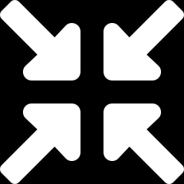
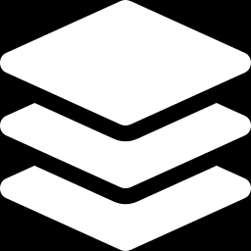
What we’ve covered
A neuron & its weights
A unit that multiplies inputs by weights and adds them up. A network is many of these.
Train / validation split
Learn on some data, test on data it never saw — so you know it really learned.
The training loop
Guess, measure the error, nudge the weights, repeat. Same loop all week.
WED · COMPUTER VISION
4
Notes:
On-ramp for new students; returners can skim. These three ideas are exactly the Week 1 material and are recapped in the prep packet.

Slide 5
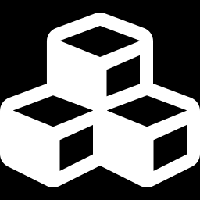
Yesterday digits, today your world
Same recipe as MNIST — but real objects are much harder. Let's see why.
Digits were easy
Real objects vary
Small, clean, centered, grayscale. Not much can change from one 7 to another.
Angle, lighting, distance, background — the same cube looks different every photo.
WED · COMPUTER VISION
5
Notes:
Set up the difficulty; transfer learning will be the answer.

Slide 6
01
Why Seeing Is Hard
Notes:
Build intuition for image difficulty before the solution.

Slide 7
A color photo is a big pile of numbers
Even more than a digit — now with color.
224×224
×3
~150,000
typical input size
red, green, blue
numbers per image
Each pixel is 3 numbers (R, G, B). The network must find meaning in 150,000 numbers that shift with every angle and light.
WED · COMPUTER VISION
7
Notes:
Scale of the input drives home why we need something smarter than the plain network from Tuesday.

Slide 8
Too big for Tuesday's network
A plain fully-connected net needs a mountain of weights before it learns anything.
150,000
~19 million
numbers in one photo
weights in the first layer alone
WED · COMPUTER VISION
8
Notes:
150,000 inputs x ~128 hidden units is roughly 19M weights in the first layer alone. Compare Week 1's lemonade net with a handful of inputs. That explosion is why we need convolution.

Slide 9
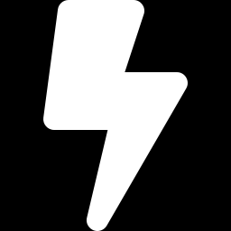
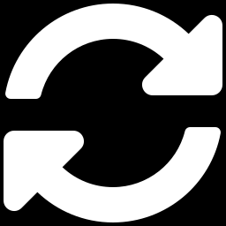
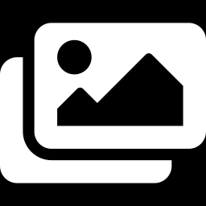
The same object, a thousand ways
All of these must map to one answer.
Lighting
Angle & rotation
Bright, dim, shadows, color casts
Front, side, tilted, upside-down
Distance & scale
Background
Close-up or far away
Cluttered desk or clean table
WED · COMPUTER VISION
9
Notes:
Hand-written rules can't cover this explosion of variation — which is exactly why we learn from examples.

Slide 10
Computer vision in the wild
The same image-in, label-out idea is everywhere around you.
Face unlock
Your phone recognizes you in a fraction of a second.
Medical scans
Models flag tumors and fractures to support doctors.
Self-driving cars
Cameras read lanes, signs, and pedestrians in real time.
WED · COMPUTER VISION
10
Notes:
Quick motivation before the mechanics. Every example is the same 'image in, label out' task the students are building this week.

Slide 11
02
How Computers See
Notes:
The feature idea and convolution.

Slide 12
Recap: yesterday you built a CNN
In Lab 2 you built one from scratch — today you build on it.
You built a CNN
From scratch in Lab 2 — conv layers, pooling, the works.
It read digits at ~99%
A small CNN you trained, beating the flat network.
Today: aim it at YOUR objects
Same machinery, real photographed objects instead of clean digits.
WED · COMPUTER VISION
12
Notes:
Frames the next stretch as review — students built a CNN from scratch in Tuesday's Lab 2, so treat convolution/pooling/ReLU as a quick recap, then pivot to what's new today: transfer learning.

Slide 13
Seeing in layers
A network builds understanding from the ground up.
1
2
3
4
Pixels
Edges
Shapes
Objects
raw colors
lines & corners
parts of things
the whole thing
Early layers spot tiny patterns; later layers combine them into “that's an edge” or “that's a cube.”
WED · COMPUTER VISION
13
Notes:
No one tells it what an edge or a handle is — it discovers this hierarchy from data.

Slide 14

How it finds patterns: convolution
A small filter scans the whole image looking for one pattern.
…building a map of where
that pattern appears.
Feature map
Input image
a small filter slides across…
WED · COMPUTER VISION
14
Notes:
The filter (kernel) is a tiny weight grid slid across the image; a match lights up the feature map. Same filter everywhere = it can find the pattern anywhere. This is a CNN (convolutional neural network).

Slide 15
One step of convolution
Line up the filter, multiply overlapping cells, add them up — that sum is one number in the feature map.
high number = strong match here;
slide over and repeat.
One output number
Patch under the filter
multiply cell-by-cell, then add
Demo https://deeplizard.com/resource/pavq7noze2
WED · COMPUTER VISION
15
Notes:
Walk one position: element-wise multiply the filter with the patch under it, then sum to a single number. High = the pattern is present. Slide across the image to build the whole feature map.

Slide 16
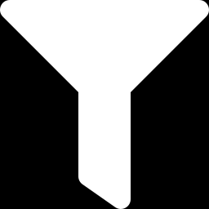
Feature maps: where a pattern shows up
Each filter makes its own map; stack them and one layer sees many patterns at once.
One feature map
Many maps, stacked
A heatmap: bright where that filter found its pattern, dark where it didn't.
A dozen filters → a dozen maps → the next layer combines them into richer patterns.
WED · COMPUTER VISION
16
Notes:
Bridges convolution to depth: one filter makes one feature map; a conv layer outputs a stack of maps that feed the next layer.

Slide 17
What the filters learn
From simple to meaningful, layer by layer.
Early filters
Deep filters
Edges, colors, simple textures — the alphabet of images.
Combinations: wheels, faces, handles — the words and sentences.
WED · COMPUTER VISION
17
Notes:
These filters are learned weights, tuned by the same training loop from Tuesday.

Slide 18
Pooling: shrink, keep what matters
After convolution we downsample — smaller maps, same meaning.
Max pooling
Why shrink?
Slide a small window and keep only its strongest value — the loudest evidence survives.
Fewer numbers to crunch, less fussy about exact position, and faster on a Pi.
WED · COMPUTER VISION
18
Notes:
Max pooling keeps the strongest response in each window and typically halves the map size. Fewer numbers, less position-sensitivity, faster on a Pi — ties to Thursday.

Slide 19
Deeper = more meaning
A CNN repeats convolve-then-shrink; each round the picture gets smaller but richer.
1
2
3
4
Convolve
Pool
Convolve
Pool
find small patterns
shrink the map
combine patterns
shrink again
Stack a few of these blocks and simple edges become whole objects.
WED · COMPUTER VISION
19
Notes:
The conv-then-pool block, repeated. Spatial size shrinks while the number of feature channels grows, so meaning deepens.

Slide 20
Why ReLU? (you met it Tuesday)
A tiny rule between layers that lets the network bend.
Without it
With ReLU
Stacking layers with no bend collapses into one straight line — it can only draw a ruler.
Keep positives, zero out negatives. Now the network can trace curves and corners.
WED · COMPUTER VISION
20
Notes:
Same ReLU from Tuesday's MNIST net. Without a non-linearity, stacked linear layers collapse to one — ReLU is what lets a deep net bend.

Slide 21
Why convolution wins for images
Compared with the plain network from Tuesday.
Finds a pattern anywhere
The same filter scans the whole image — an object works top-left or bottom-right.
Far fewer parameters
Reusing one small filter beats connecting every pixel to every neuron.
Respects the picture
It looks at neighborhoods of pixels, not a scrambled list of numbers.
WED · COMPUTER VISION
21
Notes:
Weight-sharing + locality = the two big wins. This is why every modern vision model is convolutional (or a related idea).

Slide 22
03
The Trick: Transfer Learning
Notes:
The centerpiece of the day.

Slide 23
The problem: you have ~50 photos
Networks like this normally train on millions of images.
~50
millions
photos per object (you)
to train from scratch
WED · COMPUTER VISION
23
Notes:
Make the gap feel real, then reveal transfer learning as the fix.

Slide 24
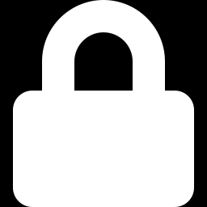
Borrow a network that already sees
Keep its eyes, retrain only its verdict.
Pretrained backbone
New final layer
FROZEN — keeps everything it learned from millions of images (edges, textures, shapes).
LEARNS — the only part you train, on YOUR photos.
That's transfer learning: reuse the hard-won features, teach only the final naming step.
WED · COMPUTER VISION
24
Notes:
Freeze the backbone, replace the head, train the head. This is exactly what the notebook does with MobileNet.

Slide 25
Frozen vs. learning
Two clear jobs.
Frozen (most of the network)
Trained (the new head)
Its weights don't change. It already knows how to see — we don't touch it.
A small fresh layer that maps features to YOUR object names.
WED · COMPUTER VISION
25
Notes:
Only a few thousand parameters train, which is why it finishes in minutes on little data.

Slide 26
Why borrowing works: features are general
The hard-won early features aren't specific to any one object.
Edges & textures are universal
Curves, corners, and textures matter for cats, cars, and your objects alike.
Already knows how to look
A network trained on millions of images has seen every kind of edge and surface.
So your objects reuse them
You only teach the last step: these features → cube, cylinder, panda.
WED · COMPUTER VISION
26
Notes:
The intuition behind transfer learning, and a callback to Week 1's K-Means: similar things share structure, so learned features reuse across tasks.

Slide 27
Why it works
The borrowed features are general.
General features
Fast
Accurate
Edges and textures matter for cats, cars, and your objects alike.
Only a sliver trains, so it's done in minutes.
Strong results from just a handful of photos.
WED · COMPUTER VISION
27
Notes:
Analogy: someone who can already draw learns a new subject fast — they reuse fundamentals.

Slide 28
What's ImageNet?
The dataset that gave our backbone its eyes.
1.2M
1,000
1
labeled images
object categories
network that already sees
MobileNet learned edges, textures, and shapes here. Transfer learning borrows all of that — which is why your ~50 photos are enough.
WED · COMPUTER VISION
28
Notes:
ImageNet is ~1.2M images across 1,000 categories. Pretraining there is why MobileNet's features transfer to your objects with only ~50 photos each.

Slide 29
Our backbone: MobileNet
Pretrained, small, and built to run on modest hardware.
Pretrained on ImageNet
Already learned from over a million labeled images across 1,000 categories.
Designed to be small
Built for phones and edge devices — which pays off on Thursday and Friday.
Easy to fine-tune
Swap the head, train briefly, done.
WED · COMPUTER VISION
29
Notes:
We picked MobileNet deliberately: choosing it now makes the edge deployment later much easier.

Slide 30
Why MobileNet is small
It does the same job as a big CNN with far less math.
Normal convolution
Depthwise-separable
Every filter looks at every channel at once — powerful, but heavy.
Split it into two cheaper steps — nearly the same accuracy at a fraction of the cost, so it flies on a Pi.
WED · COMPUTER VISION
30
Notes:
Depthwise-separable convolution is MobileNet's core trick — same job, far less math. This choice is exactly why Thursday's edge deploy and Friday's arm run smoothly.

Slide 31
How much do you retrain?
A spectrum from cheap-and-fast to powerful-and-hungry.
Feature-extract (today)
Freeze the backbone, train only the new head. Fast, and works on ~50 photos.
Partial fine-tune
Also unfreeze the last block and train it gently. A little more accuracy, more data needed.
Full fine-tune
Retrain everything. Best results — but needs lots of data and time.
WED · COMPUTER VISION
31
Notes:
Today is feature-extraction (head only). The lab stretch task tries partial fine-tuning. Full fine-tune is out of scope here — too data-hungry.

Slide 32
You've started from a checkpoint before
Transfer learning is the same head start you gave your TinyGPT.
Week 1: from zero
Today: from a head start
Your TinyGPT started with random weights and learned everything the hard way.
Begin from a network that already sees — same training loop, far less data and time.
WED · COMPUTER VISION
32
Notes:
Direct returner callback to Week 1 Day 4. The run_epoch loop is the same shape as their TinyGPT training step — only the starting point differs.

Slide 33
04
Your Model in Practice
Notes:
From concept to a working recognizer.

Slide 34
Your training pipeline
Four steps from photos to a working recognizer.
1
2
3
4
Photos
Augment
Fine-tune
Recognizer
your Day-1 data
add variety
train the head
test & export
WED · COMPUTER VISION
34
Notes:
This is the shape of the Wednesday notebook. Each step is a cell or two.

Slide 35
Data augmentation: free variety
Turn each photo into many, so the model sees more angles and lighting.
original
flipped
rotated
brighter
cropped
One photo → many. Flips, rotations, and brightness shifts teach the model what doesn't matter.
WED · COMPUTER VISION
35
Notes:
Augmentation is one of the biggest levers on accuracy with small datasets — essentially free extra data.

Slide 36
Which augmentations help?
Add variety that doesn't change what the object is.
Helps
Be careful
Horizontal flips, small rotations, brightness and contrast shifts — real-world variation.
Flips that change meaning, or crops so tight the object is gone — that teaches the wrong thing.
WED · COMPUTER VISION
36
Notes:
Augmentation is near-free extra data, but only when the label still holds after the transform. Flips/rotations/brightness help; meaning-changing flips and object-erasing crops hurt.

Slide 37
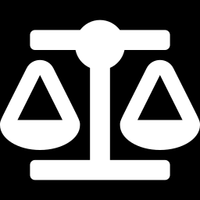
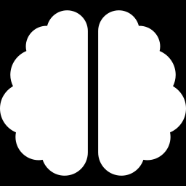
Your model is only as good as your data
The single biggest lever on Friday's success.
Variety wins
Keep it balanced
Angles, distances, lighting.
Roughly equal photos per object.
Garbage in, garbage out
If a photo would confuse you, it'll confuse the model. Fix the data before blaming the model.
WED · COMPUTER VISION
37
Notes:
Most 'the model is bad' issues on Friday trace back to thin or lopsided data.

Slide 38
What makes a good training photo
The single biggest lever on Friday — worth getting right today.
Fill the frame
The object should roughly fill the shot — that matches the crop the arm hands your model.
Vary everything
Angles, distances, lighting, backgrounds — including messy real-table shots.
Keep it balanced
Roughly equal photos per object — plus a none class of empty table + clutter.
WED · COMPUTER VISION
38
Notes:
Reinforces Monday's data rules and the crop-then-classify pipeline. Balance plus a none class is what makes rejection reliable on Friday.

Slide 39
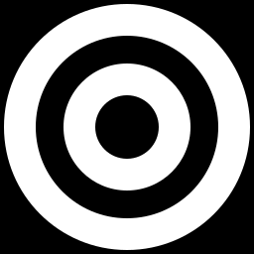
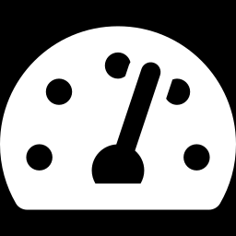
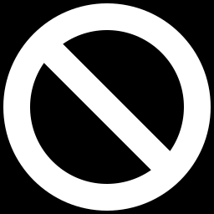
Naming the target
Your model scores every object; you name today's target.
Pick any target
Confidence threshold
It knows all your objects; name one and it finds the match.
Below a cutoff, it says “not sure.”
A “nothing here” class
Empty table + clutter, so the robot won't grab when the target is absent.
WED · COMPUTER VISION
39
Notes:
Connects the model to Friday: recognize → is it the target? → only then pick.

Slide 40
Not sure? Say so.
Softmax always returns something — so we add two guards.
0.55
0.42
0.13
top guess (cube)
runner-up (cylinder)
margin — too close!
Threshold: ignore low-confidence guesses. Margin: if the top two are close, answer “not sure.” With the none class, that's reliable “not-recognized” — so the arm never grabs the wrong thing.
WED · COMPUTER VISION
40
Notes:
The settled design: none class + threshold + confidence margin. Margin = top1 minus top2; a small margin means the model is torn, so it should answer 'not sure.'

Slide 41
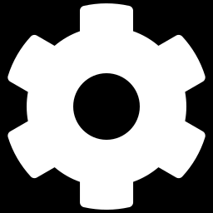
Classical vs. learned — race them
The notebook includes both. Find where color breaks.
Color thresholding
Your neural net
Fast, simple; great on plain blocks, breaks on real objects.
Learns shape and texture, not just color — handles the messy cases.
WED · COMPUTER VISION
41
Notes:
Have students find a case where color fails and their model wins — that's the 'aha' moment.

Slide 42
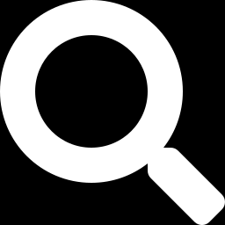
Check it per object
Overall accuracy can hide a class it's bad at.
Spot the weak class
“cylinder” lags — add more cylinder photos, from more angles, and retrain.
WED · COMPUTER VISION
42
Notes:
Per-class accuracy tells you exactly which object needs more/better data. This chart is illustrative.

Slide 43
See what your model looks at
A fast way to tell if it learned the object — or the background.
Attention heatmap
A sanity check
Highlight the pixels that drove the guess — they should land on the object.
If it fixates on your desk or hand, fix the photos — not the model.
WED · COMPUTER VISION
43
Notes:
Introduces attention/heatmap inspection as a debugging tool: if the model keys on the background or a hand, the fix is better photos, not a bigger model.

Slide 44
Reading your training curves
Watch train and validation accuracy together — the gap tells the story.
Healthy
Overfitting
Train and validation rise together and level off close. It really learned.
Train keeps climbing while validation flattens or dips — it's memorizing. Add data or augmentation.
WED · COMPUTER VISION
44
Notes:
A triage order for Friday's most common complaint. Fix the data before blaming the model.

Slide 45
05
Make It Good & Build
Notes:
Wrap-up + the lab.

Slide 46
Small data, big overfitting risk
With ~50 photos, memorizing is the main danger — here's what saves us.
Transfer learning
The frozen backbone already generalizes, so the tiny head can't overfit much.
Augmentation
More variety from the same photos.
Validation check
Watch accuracy on held-out photos, not just training ones.
WED · COMPUTER VISION
46
Notes:
Tie back to Tuesday's overfitting lesson; this is why we chose transfer learning for small data.

Slide 47
“My model is bad” — debug it
Almost always the data, not the model. Work down this list.
1
2
3
4
Check the data
Balance classes
Add augmentation
Tune threshold
mislabeled? blurry?
equal photos each
more variety
and the margin
WED · COMPUTER VISION
47
Notes:
A debug decision order: data quality, then class balance, then augmentation, then threshold/margin. Almost always it's the data.

Slide 48
When your recognizer will fail
Know the failure modes before Friday's demo.
Bad crop or lighting
A dark or half-cut photo looks like nothing it trained on.
Look-alike objects
Two similar shapes blur together — add more photos of that pair.
Something brand-new
It'll still guess on an object it never saw — that's what none + threshold are for.
WED · COMPUTER VISION
48
Notes:
Sets realistic expectations for Friday and ties each failure mode to its fix — better data, look-alike coverage, and the none-class + threshold + margin.

Slide 49
In today's lab
Open the Wednesday notebook.
Train
Test
Export
Fine-tune MobileNet on your own photos
Point your webcam at objects, live
Save it as ONNX for tomorrow's edge lab
WED · COMPUTER VISION
49
Notes:
The webcam test is the payoff — try objects it should and shouldn't recognize, including the none class.

Slide 50
Live test: point a camera at it
Recognize and label in real time — no arm required.
Vision-only mode
Your Friday safety net
Camera in, label and box on screen — the demo everyone can run.
If the arm misbehaves, vision-only still shows your model working.
WED · COMPUTER VISION
50
Notes:
Introduces vision-only mode — recognize-and-label with no arm. It's the universal demo, the Track B core deliverable, and the Track A backup if the arm misbehaves.

Slide 51
From recognizer to robot (Friday)
Where today's model plugs into the arm.
1
2
3
4
Camera + crop
Your model
Is it the target?
Arm picks
arm isolates the object
labels the crop
threshold + margin
only if it matches
WED · COMPUTER VISION
51
Notes:
The Friday pipeline: the arm crops, your classifier labels, is-target gates the pick. Vision-only mode runs the first three steps without moving the arm.

Slide 52
Export it: one portable file
Your trained model leaves the notebook as a single file.
One .onnx file
Tomorrow: shrink it
A portable format that runs without your notebook or a GPU.
Thursday you compress it for the Pi; Friday it drives the arm.
WED · COMPUTER VISION
52
Notes:
Bridges to Thursday and Friday: the Wednesday lab's last step writes recognizer.onnx, a portable file that runs without the notebook. Thursday shrinks it for the Pi.

Slide 53
Key terms today
Adds to Tuesday's cheat-sheet.
Pixel
Feature
Convolution
One color dot (R,G,B)
A pattern the net detects
Sliding a filter over an image
Filter / kernel
Feature map
CNN
A small pattern detector
Where a pattern was found
Convolutional neural network
Backbone
Head
Transfer learning
The pretrained feature extractor
The final layer you train
Reuse a trained network
Fine-tune
Augmentation
Class
Train briefly on new data
Make variants of your data
One object category
WED · COMPUTER VISION
53
Notes:
Leave up during the lab.

Slide 54
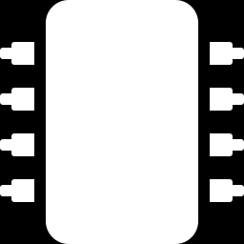
Tomorrow: make it run anywhere.
Next: shrinking your model to fit a tiny computer.
Notes:
Bridge to Thursday.

