Slide 1

Abundance profiling using sylph and ANI calculation using skani
Yun William Yu
(with Jim Shaw, Eoghan McIvor, and Nadia Iskandar)
2026-July-12 ISMB Metagenomics Tutorial

Slide 2
Structure of talk
Background on metagenomics and string sketching
Skani: metagenomic sequence comparison through sparse chaining [Shaw & Yu, 2023, Nature Methods]
Sylph: Statistical metagenomic profiling [Shaw & Yu, 2024, Nature Biotechnology]
Acknowledgements

Slide 3
Genomics sequencing problems
AAAACCCAGGGGTTTTAAAATTAAAACCCAGGGGTTTT…
cut many
times at random (Shotgun)
Genome assembly:
Piecing together the original superstring from the fragments.
Read 100-100,000 bases (bp)
GTTTTAAAATT
Shotgun sequencing: Given short, error-prone reads from random locations in a genome, determine origins.
Notes:
Anyway, how does sequencing a genome work? For the purposes of this discussion, we can think of a human genome as a string of length approximately 3 billion, built from an alphabet of 4 "base pairs", A, C, G, and T. The task of "sequencing" a genome is that of accurately reading that 3-billion base pair-long string.
Unfortunately, biologists can't directly read that string. Instead, they randomly cut up that string into substrings, and then an expensive "sequencing machine" tries to read them. Due to quirks of the chemistry underlying sequencing technology, however, most sequencing machines can only read about 100-100k base pairs at a time, and even then there's a lot of error in the resulting output. Thus, the basic problem is given short, error-prone reads from random locations in a genome, piece together an individual's full genome.
One sense of “determining” origins is to piece together the original sequence from these fragments, a process known as assembly.

Slide 4
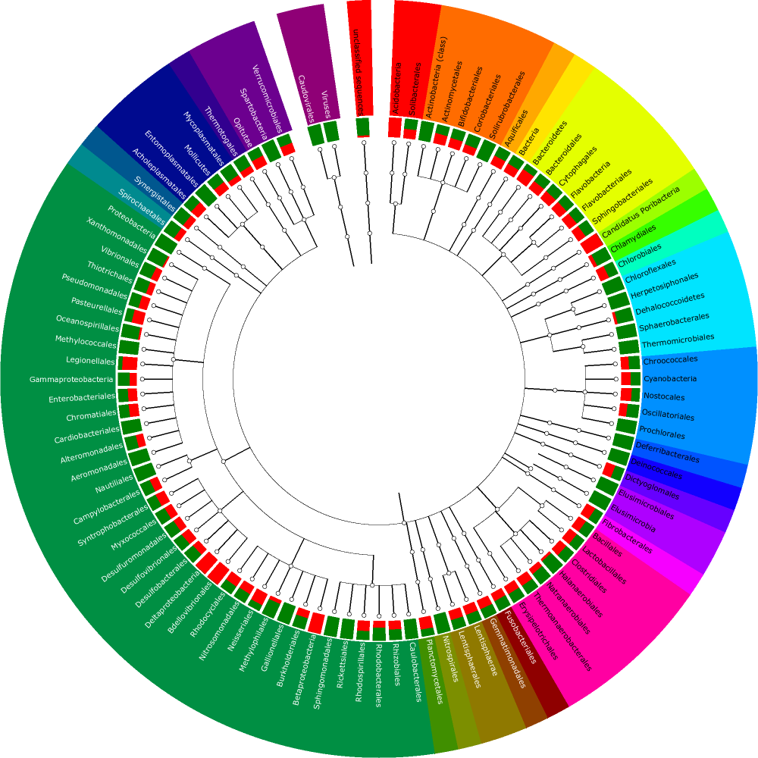
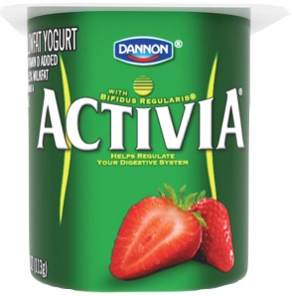
Metagenomics problems
Abundance
Environmental samples
Many different bacterial source genomes
Species
Read binning: Determine most likely source reference genome for reads..
Profiling: Determine the relative abundance of bacterial species present
Read sequences from many different species.
Metagenome assembly:
Piecing together the contigs from the fragments
Contig binning: Group together contigs into putative species
Species determination: Decide that a metagenome-assembled-genome (MAG) is from a particular species
Notes:
Many subproblems, such as the binning problem of first figuring out which genome the read came from, understanding the bacterial composition of the source, etc.

Slide 5
Read mapping / approximate substring search
Consider a string $$A$$ and a substring $$B$$ starting at position $$i$$. Given a random corruption $$\hat{B}$$ of $$B$$, recover $$i$$.
Reference Genome
Query Read
Notes:
This problem appears throughout computational biology, seen in everything from protein databases to small chemical molecules, but I’ll be focusing on just its instantiations in genomics.
One example of this, which we alluded to earlier in genomics, is that of read mapping. We’re trying to find all the locations in a reference genome that are similar to some query read.

Slide 6
Nearest neighbor / distance computation
Given a database of strings $$B_{1},…,B_{m}$$, and a query string $$A$$, find the database item that is most similar to $$A$$ (and its distance from $$A$$)
Genome Database
Query Genome
Notes:
Even more basic is the sequence alignment problem though, where given a query genome, I want to find genomes in a database that look similar.

Slide 7
Sequence alignment / edit distance
Alignment: how to find the best way to “match” two different but similar strings.
Target Sequence
5’ TAGAGGGGGGTAGAATAGGTGTAGCGGTAATGTAGAG 3’
Query Sequence
5’ TAGAGGTAGAATTCCAGGGTACGGTGAAATGCGTG 3’
Target Sequence
5’ TAGAGGGGGGTAGAAT---AGGTGTAGCGGT--AAT--GTAGAG 3’
|||||| |||||| ||| ||| |||| ||| || |
5’ TAGAGG----TAGAATTCCAGG-GTA-CGGTGAAATGCGT---G 3’
Query Sequence

Slide 8
Smith-Waterman local alignment
C | 0 | 0 | 1 | 0 | 0 | 3
A | 0 | 0 | 0 | 1 | 2 | 0
T | 0 | 0 | 0 | 1 | 0 | 0
C | 0 | 0 | 2 | 0 | 0 | 0
G | 0 | 1 | 0 | 0 | 0 | 0
A | 0 | 0 | 0 | 1 | 1 | 0
- | 0 | 0 | 0 | 0 | 0 | 0
 | - | G | C | A | A | C
Classical strategy is dynamic programming due to Smith and Waterman.
Correctly aligned letters give +1, substitutions -1, and indels -2 in this example.
Up = letter from bottom string Right = letter from left string Diagonal = both
Setting min=0 for local alignment (vs. global)
Number of edits approximates genetic divergence when normalized by length.
Quadratic time-complexity!
AGCTAC
GCAAC
GCTAC
|| ||
GCAAC

Slide 9
$$k$$-mers
$$k$$-mer: a substring of length $$k$$
Given a string $$S$$, break into $$k$$-mers for easier analysis
TACGGTACGGTACGG
TACGGTAC
ACGGTACG
→ 2
ACGGTACG
CGGTACGG
CGGTACGG
→ 2
GGTACGGT
GTACGGTA
GGTACGGT
→ 1
TACGGTAC
ACGGTACG
GTACGGTA
→ 1
CGGTACGG
TACGGTAC
→ 2
sequential
bag-of-words
with counts

Slide 10
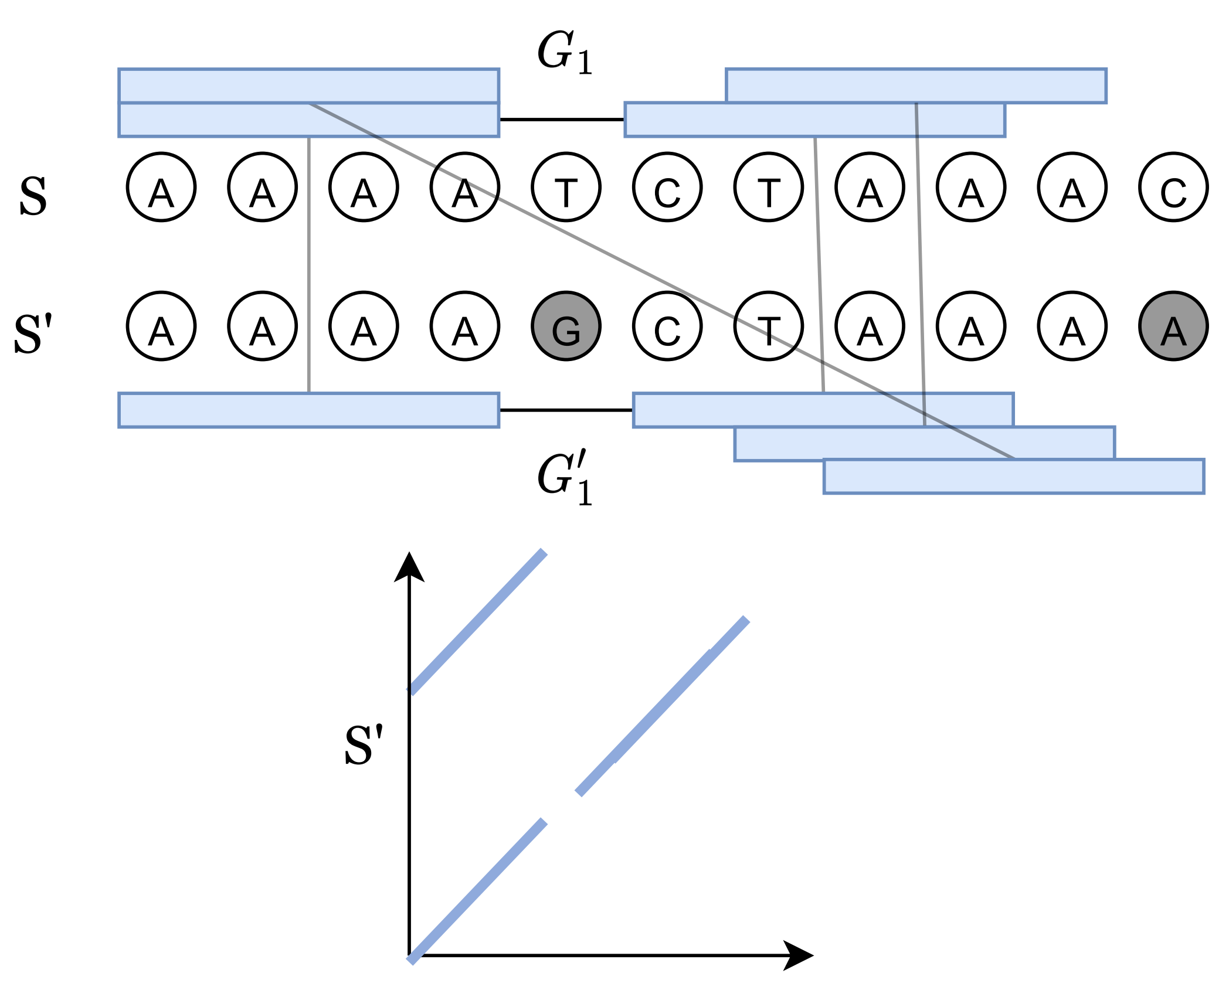
Seed-(chain)-extend
Seeding: Exact matches of k-mers allow jumping directly into promising portions of the alignment matrix.
Can take all k-mers to look for matches, or can try sketching them (e.g. with minimizers)

Slide 11
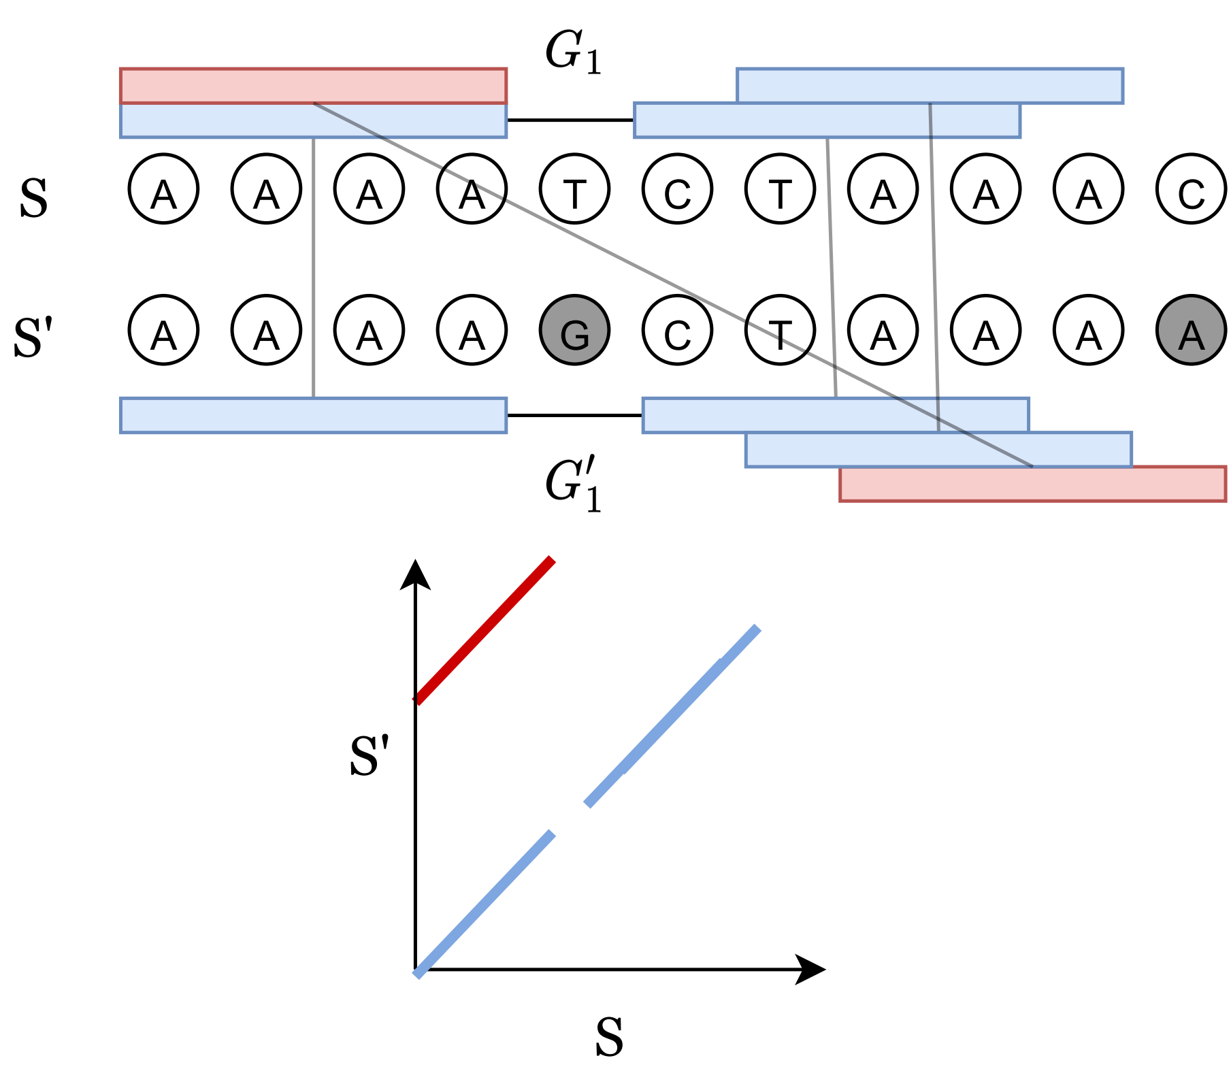
Optimal chains
Groups of anchors that can lead into each other are known as chains.
Longer chains typically result in a higher alignment score due to the many exact matches.

Slide 12
Extension
After finding reasonable chains, we can extend using dynamic programming through the gaps in the chain to get a full alignment.
Much faster than full DP on the strings, because only extension boxes need to be considered after a chain is found.
Possibly quadratic in worst case, but proven to have $$O\left(n^{1.16}\log{n}\right)$$ runtime in average case for <5% point mutation rates. [Shaw & Yu, 2023] [Gibson & Yu, 2025]
$$S′$$
Anchors
$$S$$
Extension

Slide 13
Subsampling (sketching) k-mers
AACGGAATTAACCCAAAGAA
Sampled
Lots of redundant information between adjacent k-mers, which are highly non-independent.
Sampling may or may not preserve sequential order.
MinHash (no ordering)
Minimizers (order preserved)
AACGGAAT
ACGGAATT
CGGAATTA
GGAATTAA
GAATTAAC
AATTAACC
ATTAACCC
TTAACCCA
TAACCCAA
AACCCAAA
ACCCAAAG
CCCAAAGA
CCAAAGAA
→ ACGGAATT
→ GAATTAAC
→ AATTAACC
→ ACCCAAAG

Slide 14
Divergence via k-mer spectrum shift
Given a random genome $$S$$ of length $$n$$, and $$S′$$ generated from $$S$$ by randomly substituting with divergence $$θ$$, recover $$θ$$.
Probability $$p={\left(1−θ\right)}^{k}$$ that a $$k$$-mer is retained, $$≈\frac{\left|S∩S^{′}\right|}{|S|}$$ (containment index).
Divergence $$θ=1−p^{\frac{1}{k}}$$.
In terms of Jaccard index [1902]: $$j=\frac{\left|S∩S^{′}\right|}{\left|S∪S^{′}\right|}$$
Divergence $$θ=−\frac{1}{k}\ln{\frac{2j}{1+j}}$$
$$S$$
$$S∩S′$$
$$S′$$
$$S∪S′$$
Notes:
Many of you will already be familiar with the Jaccard index of two sets. Jaccard index is the intersection over union cardinalities. Although it was originally defined to measure ecological diversity, these days it serves as a standard measure of set similarity in many applications. Exactly computing Jaccard index can be expensive because you have to deduplicate all the items of a combined list of both sets.

Slide 15

MinHash [Broder, 1997]
$$B$$
$$A$$
permutations
$$Prob\left(\min\left(A\right)=\min\left(B\right)\right)= \frac{\left|A∩B\right|}{\left|A∪B\right|}=J(A,B)$$
Can estimate Jaccard index from empirical probabilities!
Notes:
Accurately and quickly estimating it however, was solved in 1997 by Andrei Broder, who developed the MinHash probabilistic sketch data structure.
So how does MinHash work to compute Jaccard index.
Broder was working at Altavista. As some of you might remember, Altavista was one of the popular search engines of the time, before Google took over the world.
He wanted to solve the problem of near-duplicate web pages. If you’re a search engine, you want to return, say, the top 10 most relevant results to a user’s search query. But, often web pages get duplicated at different addresses with slight variations. Broder decided to compute the Jaccard index of the sets of phrases within the webpage to do near-duplicate detection.
How does it work?
Suppose we have two sets A and B, shown here, with some overlap.
We’ll do a random permutation, or random shuffling of the union and consider the leftmost item with each set A and B.
Notice that the chance that the minimum of $$A$$ and $$B$$ are the same is precisely the chance that out of the union, an element of the intersection is randomly selected to be the leftmost item.
Thus, the probability that the minhashes are the same is exactly the Jaccard index, and we can estimate Jaccard from the empirical probabilities.
Per usual, by repeating this $$k$$ times, the error in the average is on the order of 1𝑘.

Slide 16
MinHash [Broder, 1997]
$$B$$
$$A$$
permutations
Hash function
$$O\left(log\left(n\right)\right) bits$$
← Minimum Hash 1 for sets A and B
← Minimum Hash 2 for sets A and B
← Minimum Hash 3 for sets A and B
$$Prob\left(\min\left(A\right)=\min\left(B\right)\right)= \frac{\left|A∩B\right|}{\left|A∪B\right|}=J(A,B)$$
Can estimate Jaccard index from empirical probabilities!
Notes:
Permutations are hard to work with, unfortunately. So, instead of random permutations, we store random hashes. For each hash function, we’ll store the minimum values for sets A and B. Then, we just need to count the number of times those minimum values are the same between A and B to estimate Jaccard index.
Though we'll think of these hash functions as mapping onto the unit interval, hash functions need O(log(n)) bits to avoid collisions and approximate permutations. i.e. if you have fewer bits, then often, two objects in the set will map to the same value. In that scenario, equality of hashes no longer corresponds to equality of the hashed items, so the correspondence between hash functions and permutations breaks down.

Slide 17
Breakthrough in alignment-free analysis
MASH [Ondov et al, 2016] – MinHash genome distance estimation
Extremely popular technique (> 3000 citations)
Idea: use MinHash to generate sketches of 1000 k-mers for each of genomes $$A$$ and $$B;$$estimate divergence $$θ$$ using Jaccard index $$j$$.
Comparing sketches is very fast, and even all-to-all comparison of 100,000 genomes takes only hours.
Good accuracy for <15% sequence divergence for genus/species level comparisons.
Divergence assumes point mutations, so starts failing when dealing with large structural variation (e.g. mobile genetic elements, large repetitions and deletions)
$$j=J\left(A,B\right)=\frac{\left|A∩B\right|}{\left|A∪B\right|}$$
$$θ=−\frac{1}{k}\ln{\frac{2j}{1+j}}$$

Slide 18
Average Nucleotide Identity (ANI)
Average nucleotide identity (ANI) - % of nucleotides shared for orthologous regions
Common use cases: species delineation (95%), strain-level delineation (99%)
Taxonomy is often determined via ANI. Example:
GTDB (Parks et al 2018) produces a taxonomy based on ANI to determine bacterial + archaeal species
GTDB contains > 400,000 genomes clustered in 85,000 species
Notes:
There are of course other measures of genomic similarity.
For example, ANI is defined via % nucleotide shared for orthologous regions (originally the coding regions of orthologous genes).
95% ANI seemed to correspond to the 70% DNA-DNA hybridization cut-off value used for species delineations.

Slide 19
Minimizers [Schleimer et al 2003; Roberts et al 2004]
AACGGAATTAACCCAAAGAA
Hashed
Windowed Min
Unique Minimizers
AACGGAAT
ACGGAATT
CGGAATTA
GGAATTAA
GAATTAAC
AATTAACC
ATTAACCC
TTAACCCA
TAACCCAA
AACCCAAA
ACCCAAAG
CCCAAAGA
CCAAAGAA
→ 3538
→ 7825
→ 2402
→ 5712
→ 2745
→ 7043
→ 4516
→ 1010
→ 9081
→ 3689
→ 1521
→ 3321
→ 6348
2402
2402
2402
1010
1010
1010
1010
1010
1521
2402
1010
1521

Slide 20
Random minimizer properties
Formal definition. Parameters $$k,w$$, hash function $$h:Σ^{k}→ℕ$$.
For every window of size $$w+k−1$$ (i.e. of $$w$$ $$k$$-mers), find the $$k$$-mer with the smallest hash value.
The same $$k$$-mer will often be selected by adjacent windows.
Given a random minimizer of $$k$$-mers over a length $$w$$-window
(Locality) w-local because choice of $$k$$-mer depends on window $$w$$
(Density) $$≈\frac{2}{w+1}$$ by noticing that a new $$k$$-mer is at the beginning or end of a sequence of $$w+1$$ $$k$$-mers [Schleimer et al, 2003].
(Window guarantee) By definition, guarantee of $$w$$-window.

Slide 21
FracMinHash [Irber et al., 2022]
Idea: instead of choosing $$k$$-mers based on position, choose them based on the letters in the $$k$$-mer itself.
Parameter $$c$$. Hash function $$h:Σ^{k}→\left[0,1\right]$$.
For every $$k$$-mer $$x$$, select it if $$h\left(s\right)<\frac{1}{c}$$.
Properties:
(Locality) 1-local because choice of $$k$$-mer only depends the letters of the $$k$$-mer itself, and not any context around it.
(Density) $$≈\frac{1}{c}$$ by construction.
(Window guarantee) None.

Slide 22
Popularity of sketching methods
Modern (read) aligners:
Minimap2 [Li, 2018] uses minimizers.
LAST [Frith, Noe, Kucherov, 2020] uses minimally-overlapping words.
Strobealign [Sahlin, 2022] uses syncmers.
… almost every new aligner uses subsampling now
Modern assembly:
mDBG [Ekim, Berger, Chikhi, 2023] uses minimizer min-mers
LJA [Bankevich et al, 2022] uses minimizers
GoldRush [Wong et al, 2023] users minimizers.

Slide 23
Structure of talk
Background on metagenomics and string sketching
Skani: metagenomic sequence comparison through sparse chaining [Shaw & Yu, 2023, Nature Methods]
Sylph: Statistical metagenomic profiling [Shaw & Yu, 2024, Nature Biotechnology]
Acknowledgements

Slide 24
Average Nucleotide Identity (ANI)
ANI is the percent of shared nucleotides in the orthologous region.
orthologous regions identified
Slow but accurate
Fast but inaccurate
Alignment-based methods:
Blast-based (Ortho)ANIu
Mummer-based ANIm
Hybrid approximate mapping
FastANI based off Mashmap
Sketching minimizers for approximate mapping
Pure bag-of-words sketching
MinHash-based Mash
(does not restrict to aligned fraction)
Notes:
ANI measures nucleotide-level genomic similarity between two genomes by looking at nucleotide overlap in orthologous genes. Generally used for bacterial genomes, and correlated with earlier DNA-DNA hybridization studies.
ANI can be computed by alignment, such as the BLAST-based (Ortho)ANIu, or the Mummer-based ANIm. Typically, chunks of a genome are aligned, and then percent of nucleotide identity computed on orthologous chunks.
Mash [Ondov et al, 2016, Genome Biology] computes a Jaccard similarity between k-mer sets using MinHash, which can be correlated with ANI, but omits restrictions to aligned fraction.
FastANI [C Jain et al, 2018, NComms] is based off Mashmap [M Jain et al, 2018, Nbiotech] and uses approximate sequence mapping to get orthologous regions before computing nucleotide identity via sketching minimizers.

Slide 25
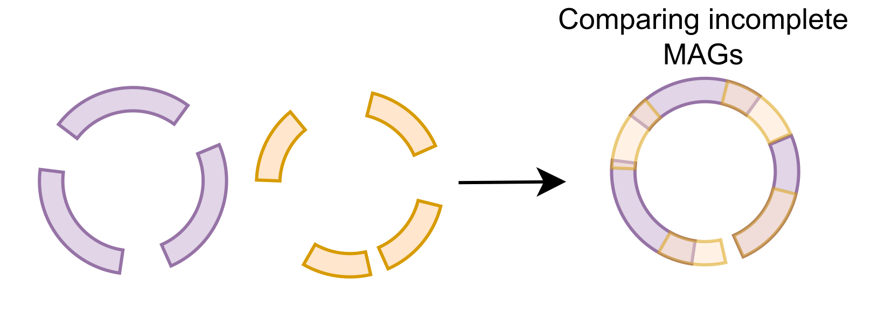
Metagenomic data is noisy
Metagenome-assembled genomes (MAGs) – assembled + binned from metagenomic data are noisy
Incomplete (missing sequences)
Contaminated (spurious sequences included)
Fragmented (small contigs, low N50)

Slide 26
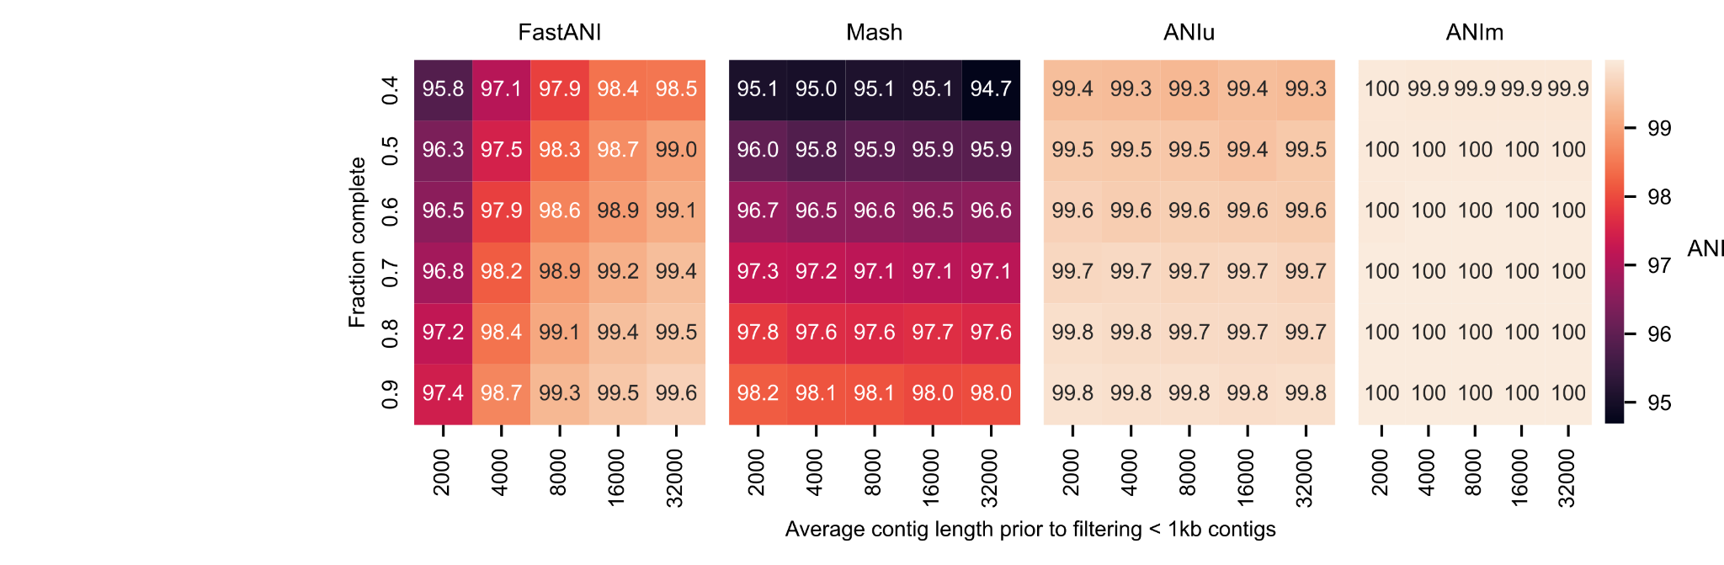
MAG noise biases ANI calculations

Slide 27
Minimizer bias [Belbasi et al, 2022, Bioinformatics]
Problem (quoted from abstract)
[The] minimizer Jaccard estimator is biased and inconsistent. […] this bias affects the accuracy of the widely used mashmap read mapping tool.
Partial solution
FastANI uses a relatively small window size for minimizers, which decreases sparsity, but manages to largely ameliorate the issue. FastANI, though slower than Mash, is still orders of magnitude faster than alignment-based methods.
Our solution: skani
We use FracMinHash and our own sparse chaining implementation, which avoids the issue entirely. This allows for extremely high sparsity, making skani >20x faster than FastANI with higher accuracy on low-quality MAGs (metagenome assembled genomes).

Slide 28
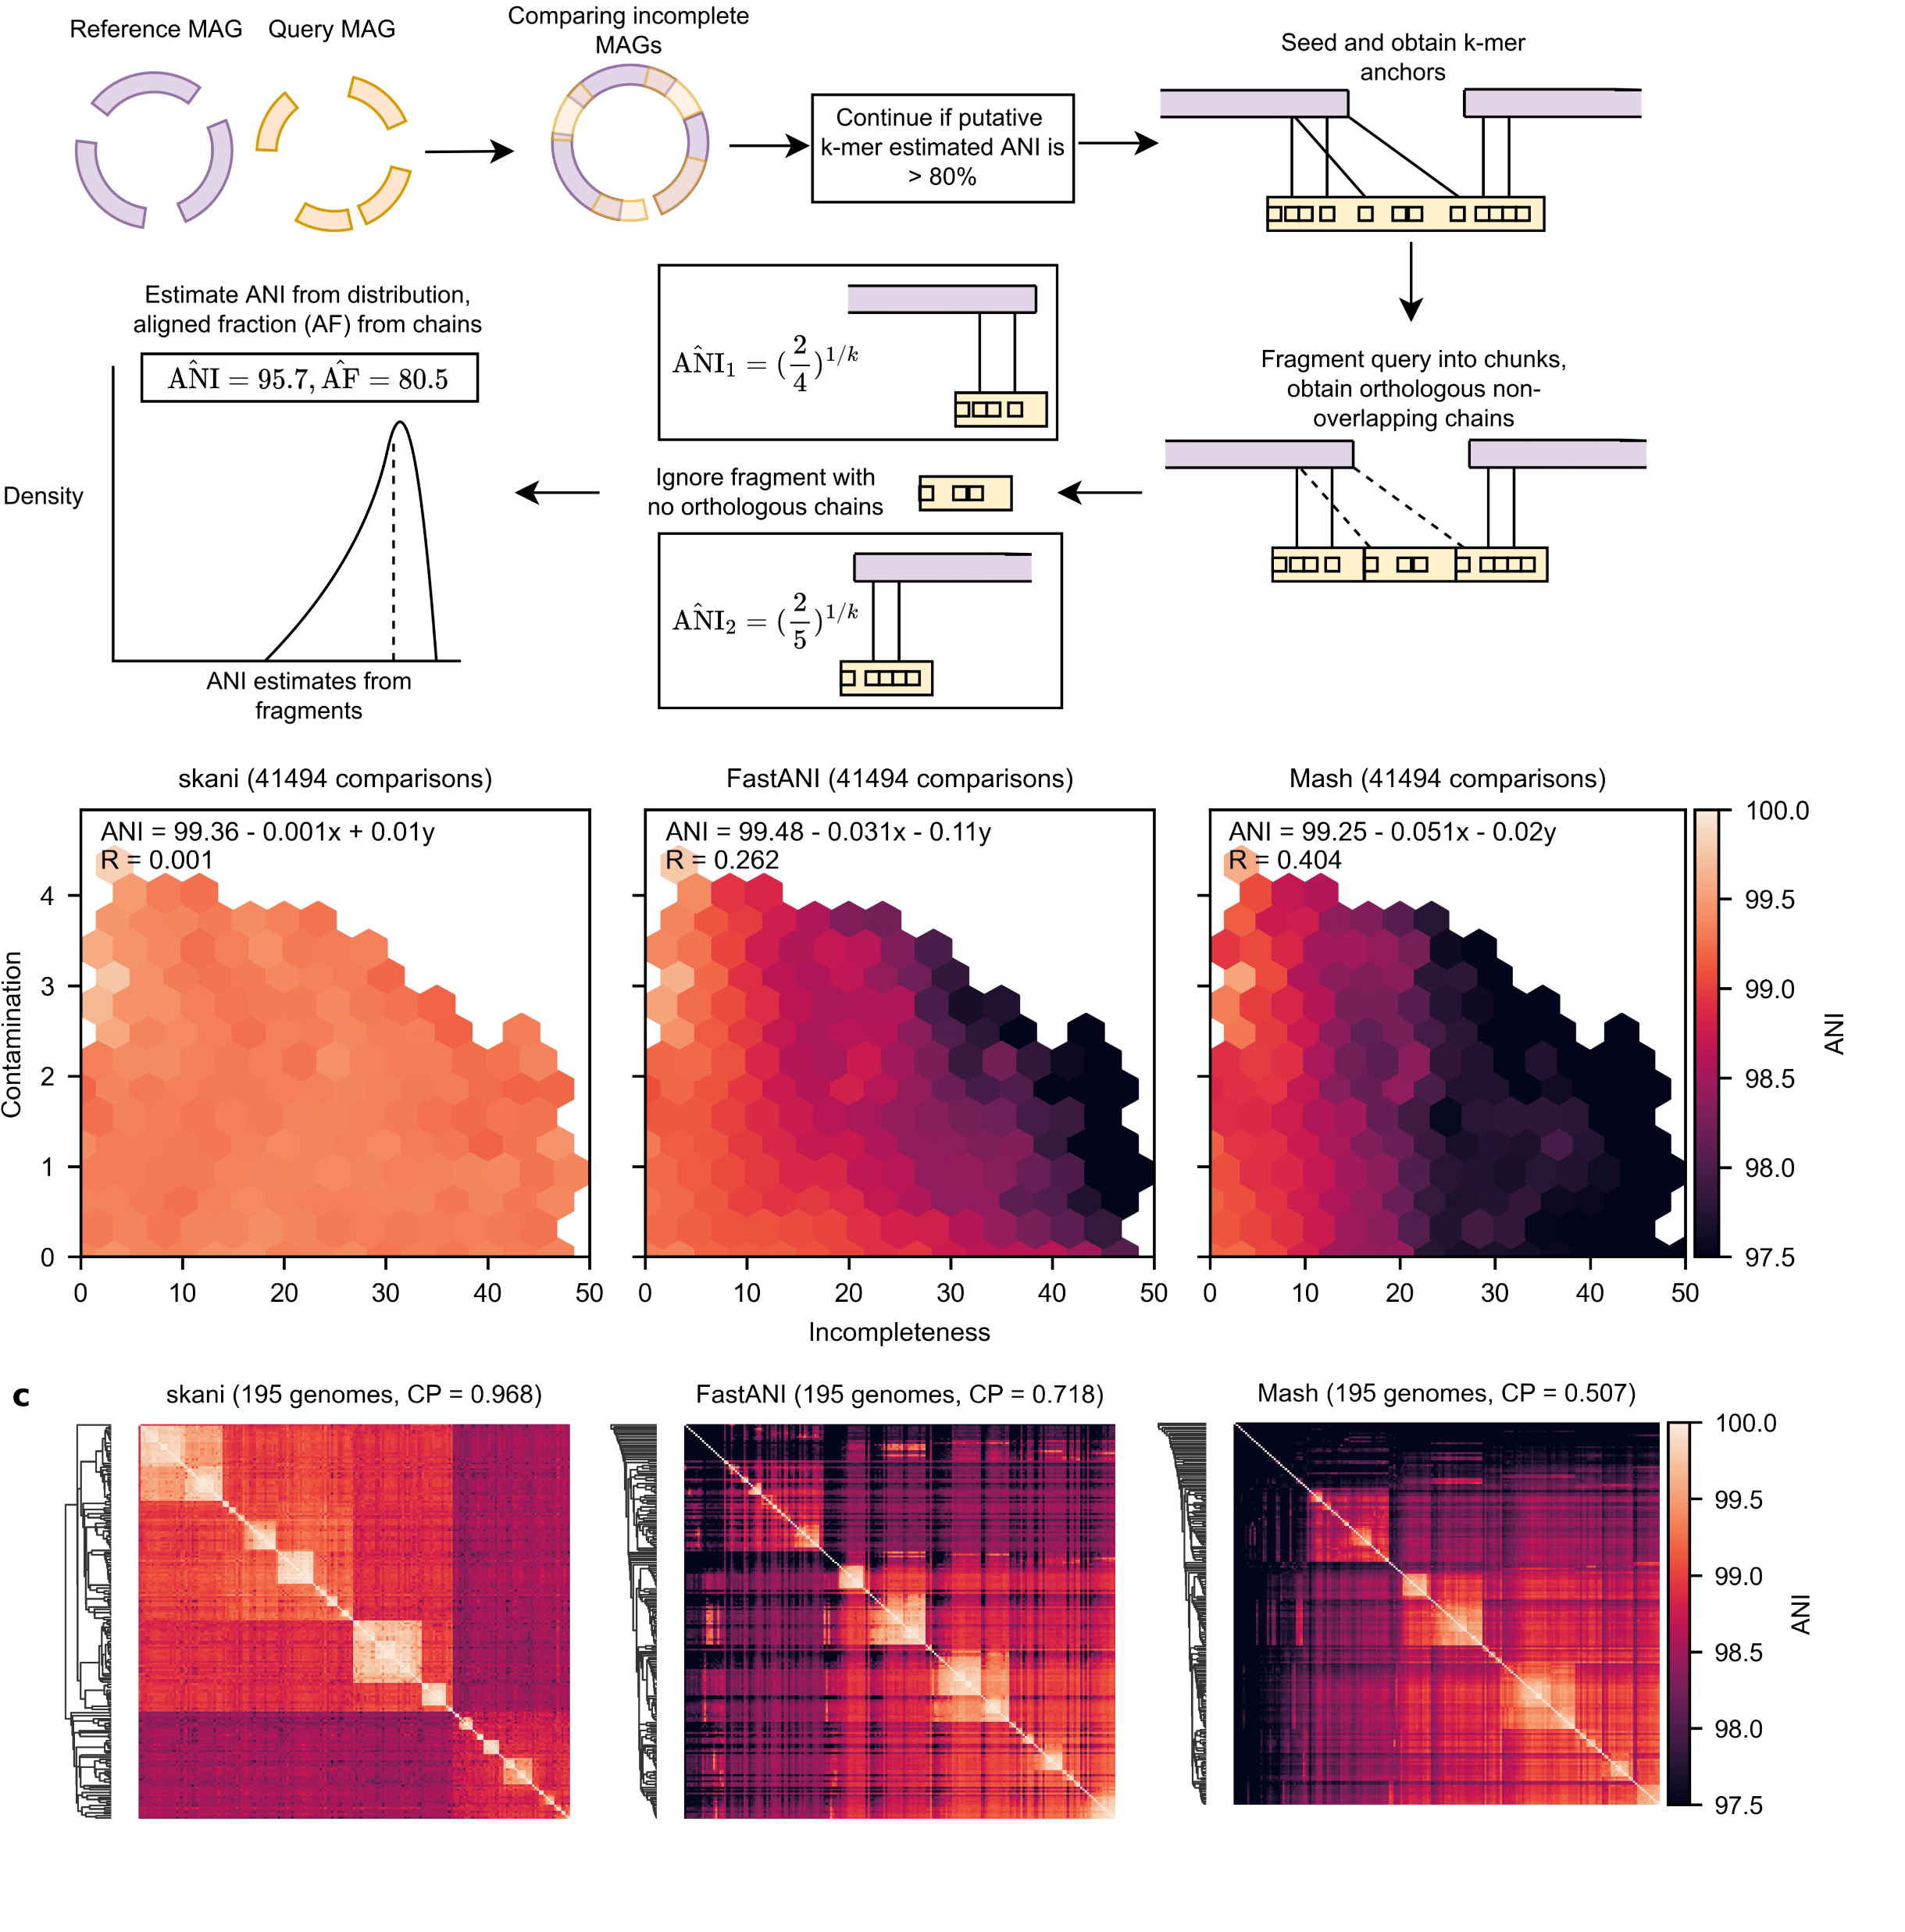
skani overview
Notes:
Some parameters
- Better scoring genome (total sequence length times mean contig length) used as reference.
- Initial screening via max-containment index on FracMinHash marker l-mers, for l=21 and density 1/1000.
- Sparse FracMinHash k-mer seed with k=15 and density 1/c, for c=125 by default, omitting top seeds that occur more than 2500/c times
- Final ANI estimation using a gradient boosted regression tree to debias the average from chains. Five features used are skani’s average and standard deviation on chain ANIs, the 90th percentile contig lengths, and the average k-mer chain length. Training was on disjoint set of MAGs than benchmarks.
Roughly speaking, ANI can be estimated by the number of matching k-mers, because each otherwise matching k-mer has k chances of becoming non-matching due to mutation.

Slide 29
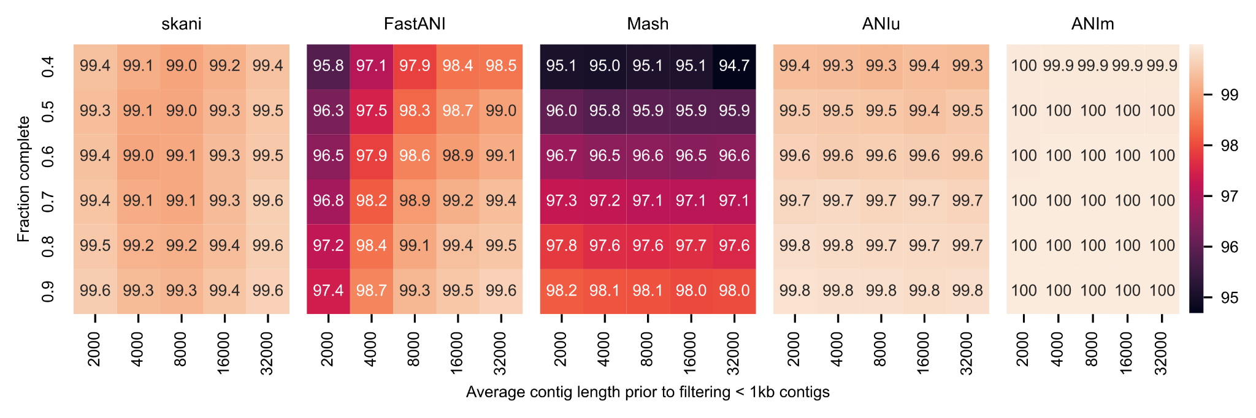
skani is more robust - simulated

Slide 30
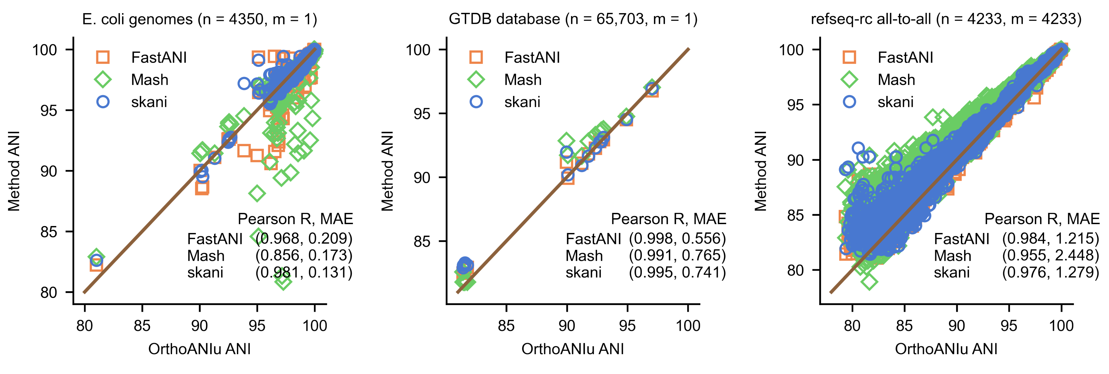
Correlation with BLAST-based OrthoANIu

Slide 31
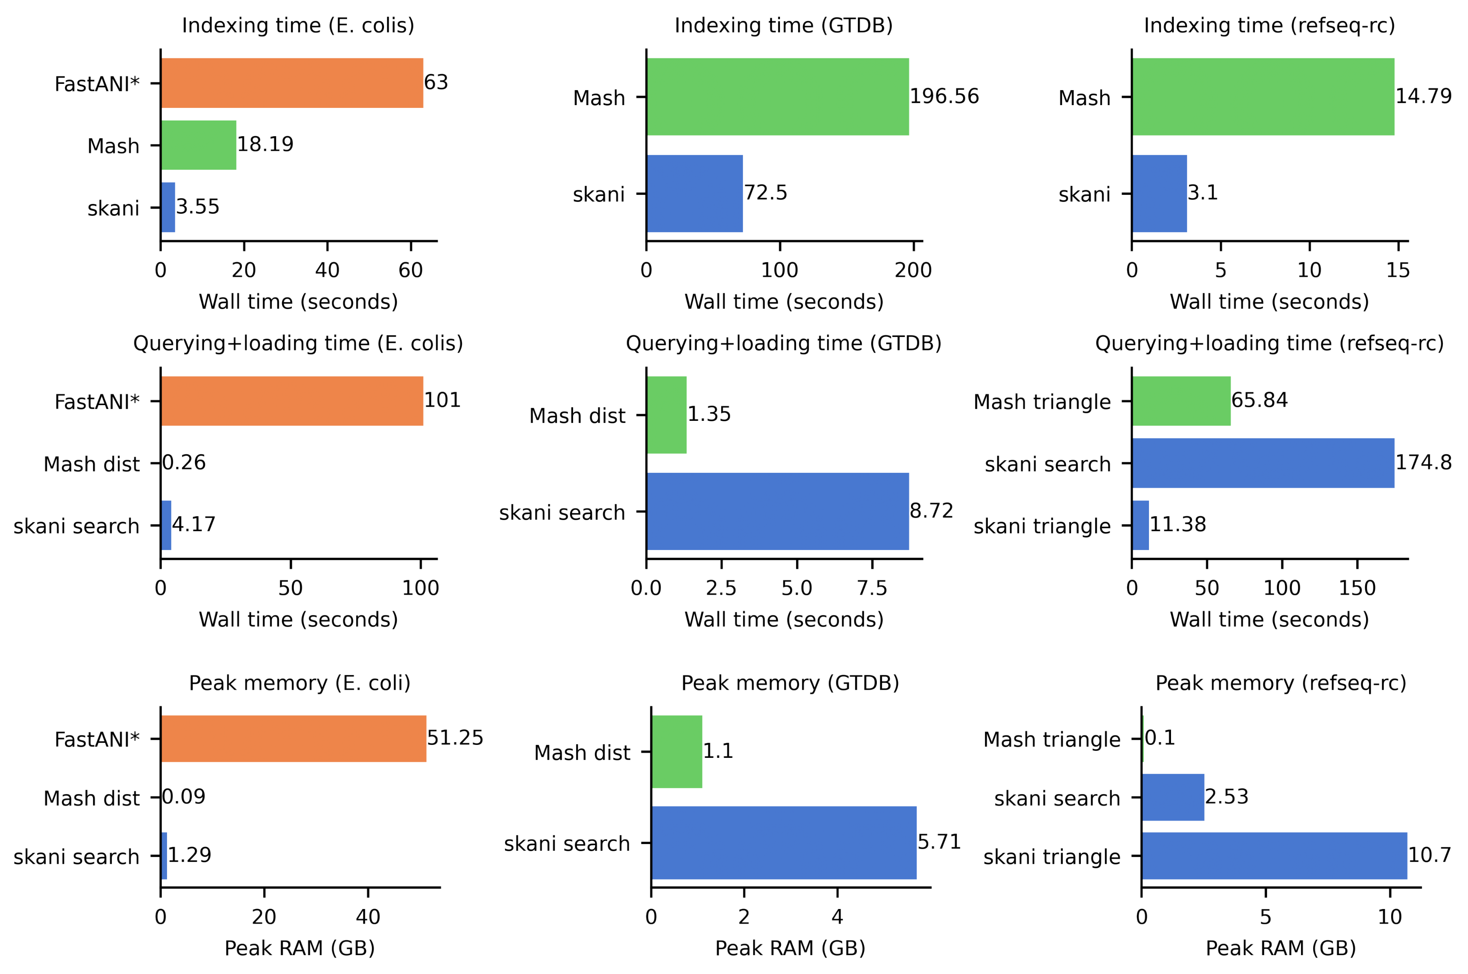
Time and memory benchmarks

Slide 32
ANI as a function of Incompleteness
We took all pairs of MAGs with >99% ANI according to ANIm from species-level bins from [Pasolli et al 2019, Cell] with between 25 and 50 genomes

Slide 33
Structure of talk
Background on genomics, alignment, and k-mer sketching
Average-case analysis of seed-chain-extend heuristic [Shaw & Yu, 2023, RECOMB/Genome Research]
Skani: metagenomic sequence comparison through sparse chaining [Shaw & Yu, 2023, Nature Methods]
Sylph: Statistical metagenomic profiling [Shaw & Yu, 2024, Nature Biotechnology]
Acknowledgements

Slide 34
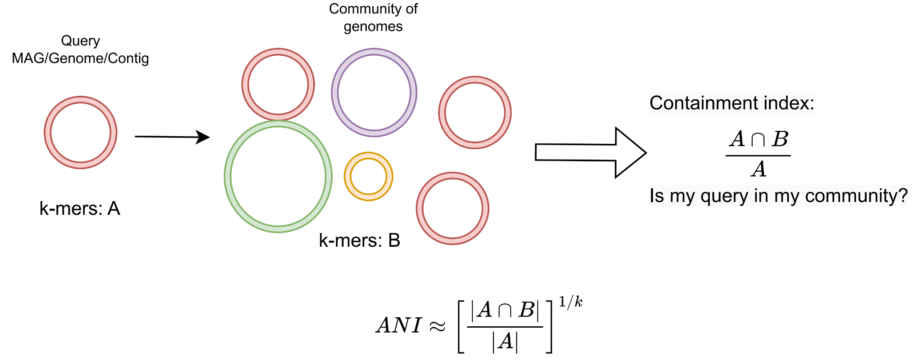
Metagenomic profiling
Relative abundance
Bacterial species

Slide 35
Metagenomic profiling via sequencing
Microbiome (metagenome) samples
Randomly sample substrings of DNA
Fragmented DNA in hard drive (reads)
Sequencing
What’s in my sample?
(easier than mapping or assembly)
Slide from Jim Shaw

Slide 36
Standard approach – read binning
Abundance
Environmental samples
Many different bacterial source genomes
Species
Profiling: Determine the relative abundance of bacterial species present
Read sequences from many different species.
Strategy: Assign each read from a sample to a species, and then count the reads.
Notes:
Many subproblems, such as the binning problem of first figuring out which genome the read came from, understanding the bacterial composition of the source, etc.

Slide 37
Sketching genome divergence, containment
Notes:
Note that instead of using the Jaccard index, which we used for pairs of genomes, we use containment index instead, to ask what fraction of my query is in the community.
Roughly speaking, ANI can be estimated by the number of matching k-mers, because each otherwise matching k-mer has k chances of becoming non-matching due to mutation.
Note that k must be large enough that we assume that if the query genome is not present, then very few of its k-mers will be present in the community, which of course only works if the query is sufficiently different from other genomes in the community.

Slide 38
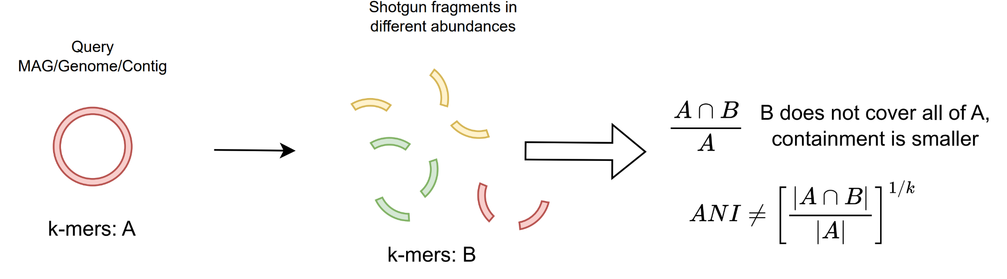
Sketching genome divergence - containment with reads

Slide 39
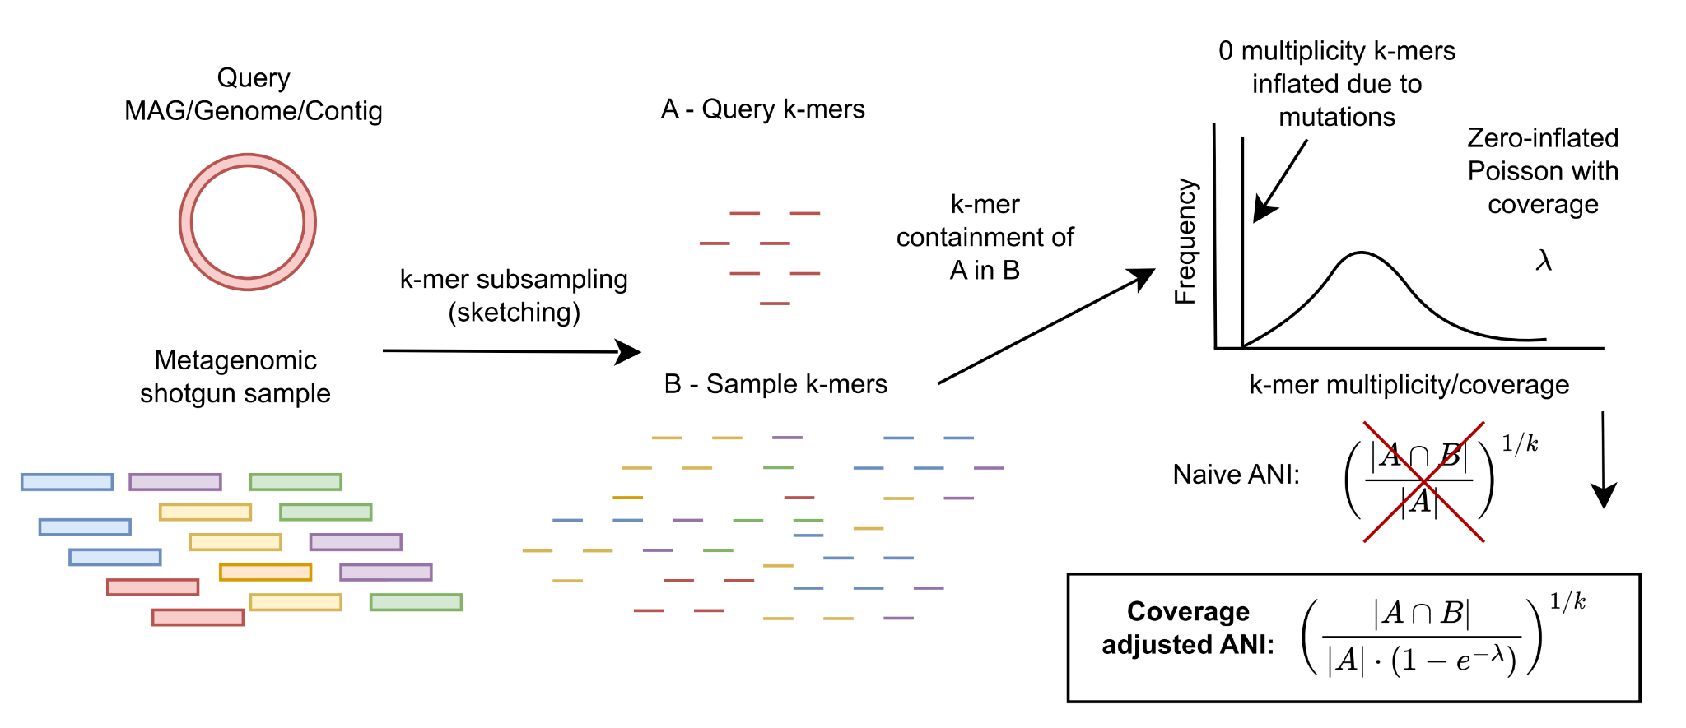
sylph: coverage-adjusted ANI estimation

Slide 40
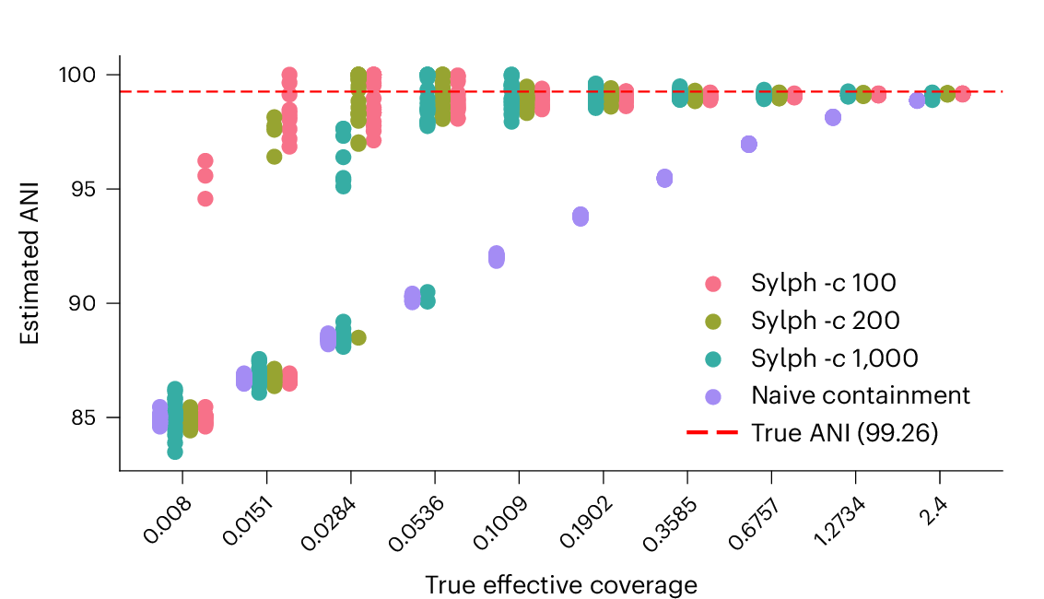
sylph corrects for ANI at low coverages
c is the subsampling rate (1/c k-mers sampled)
Notes:
Querying a genome against simulated reads at low coverages

Slide 41
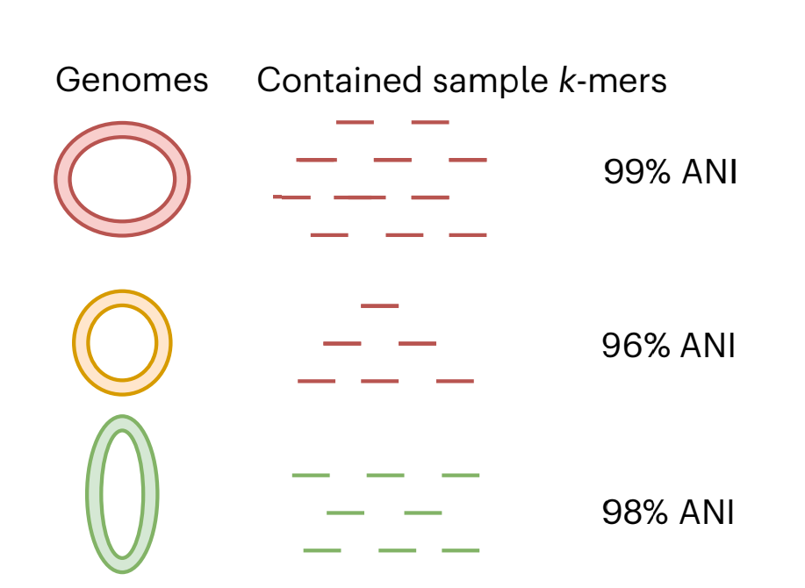
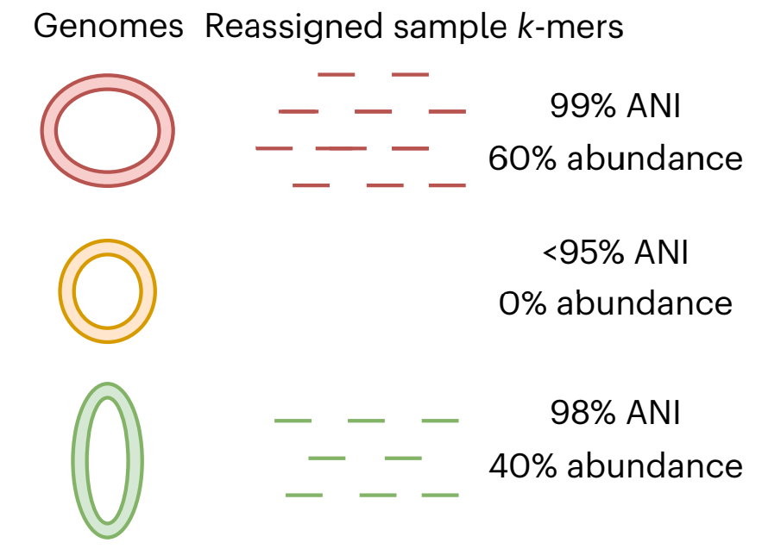
Profiling via k-mer multiplicites
We reassign k-mers via winner-take-all to their highest ANI match, and then use the k-mer multiplicities to compute species abundances.

Slide 42
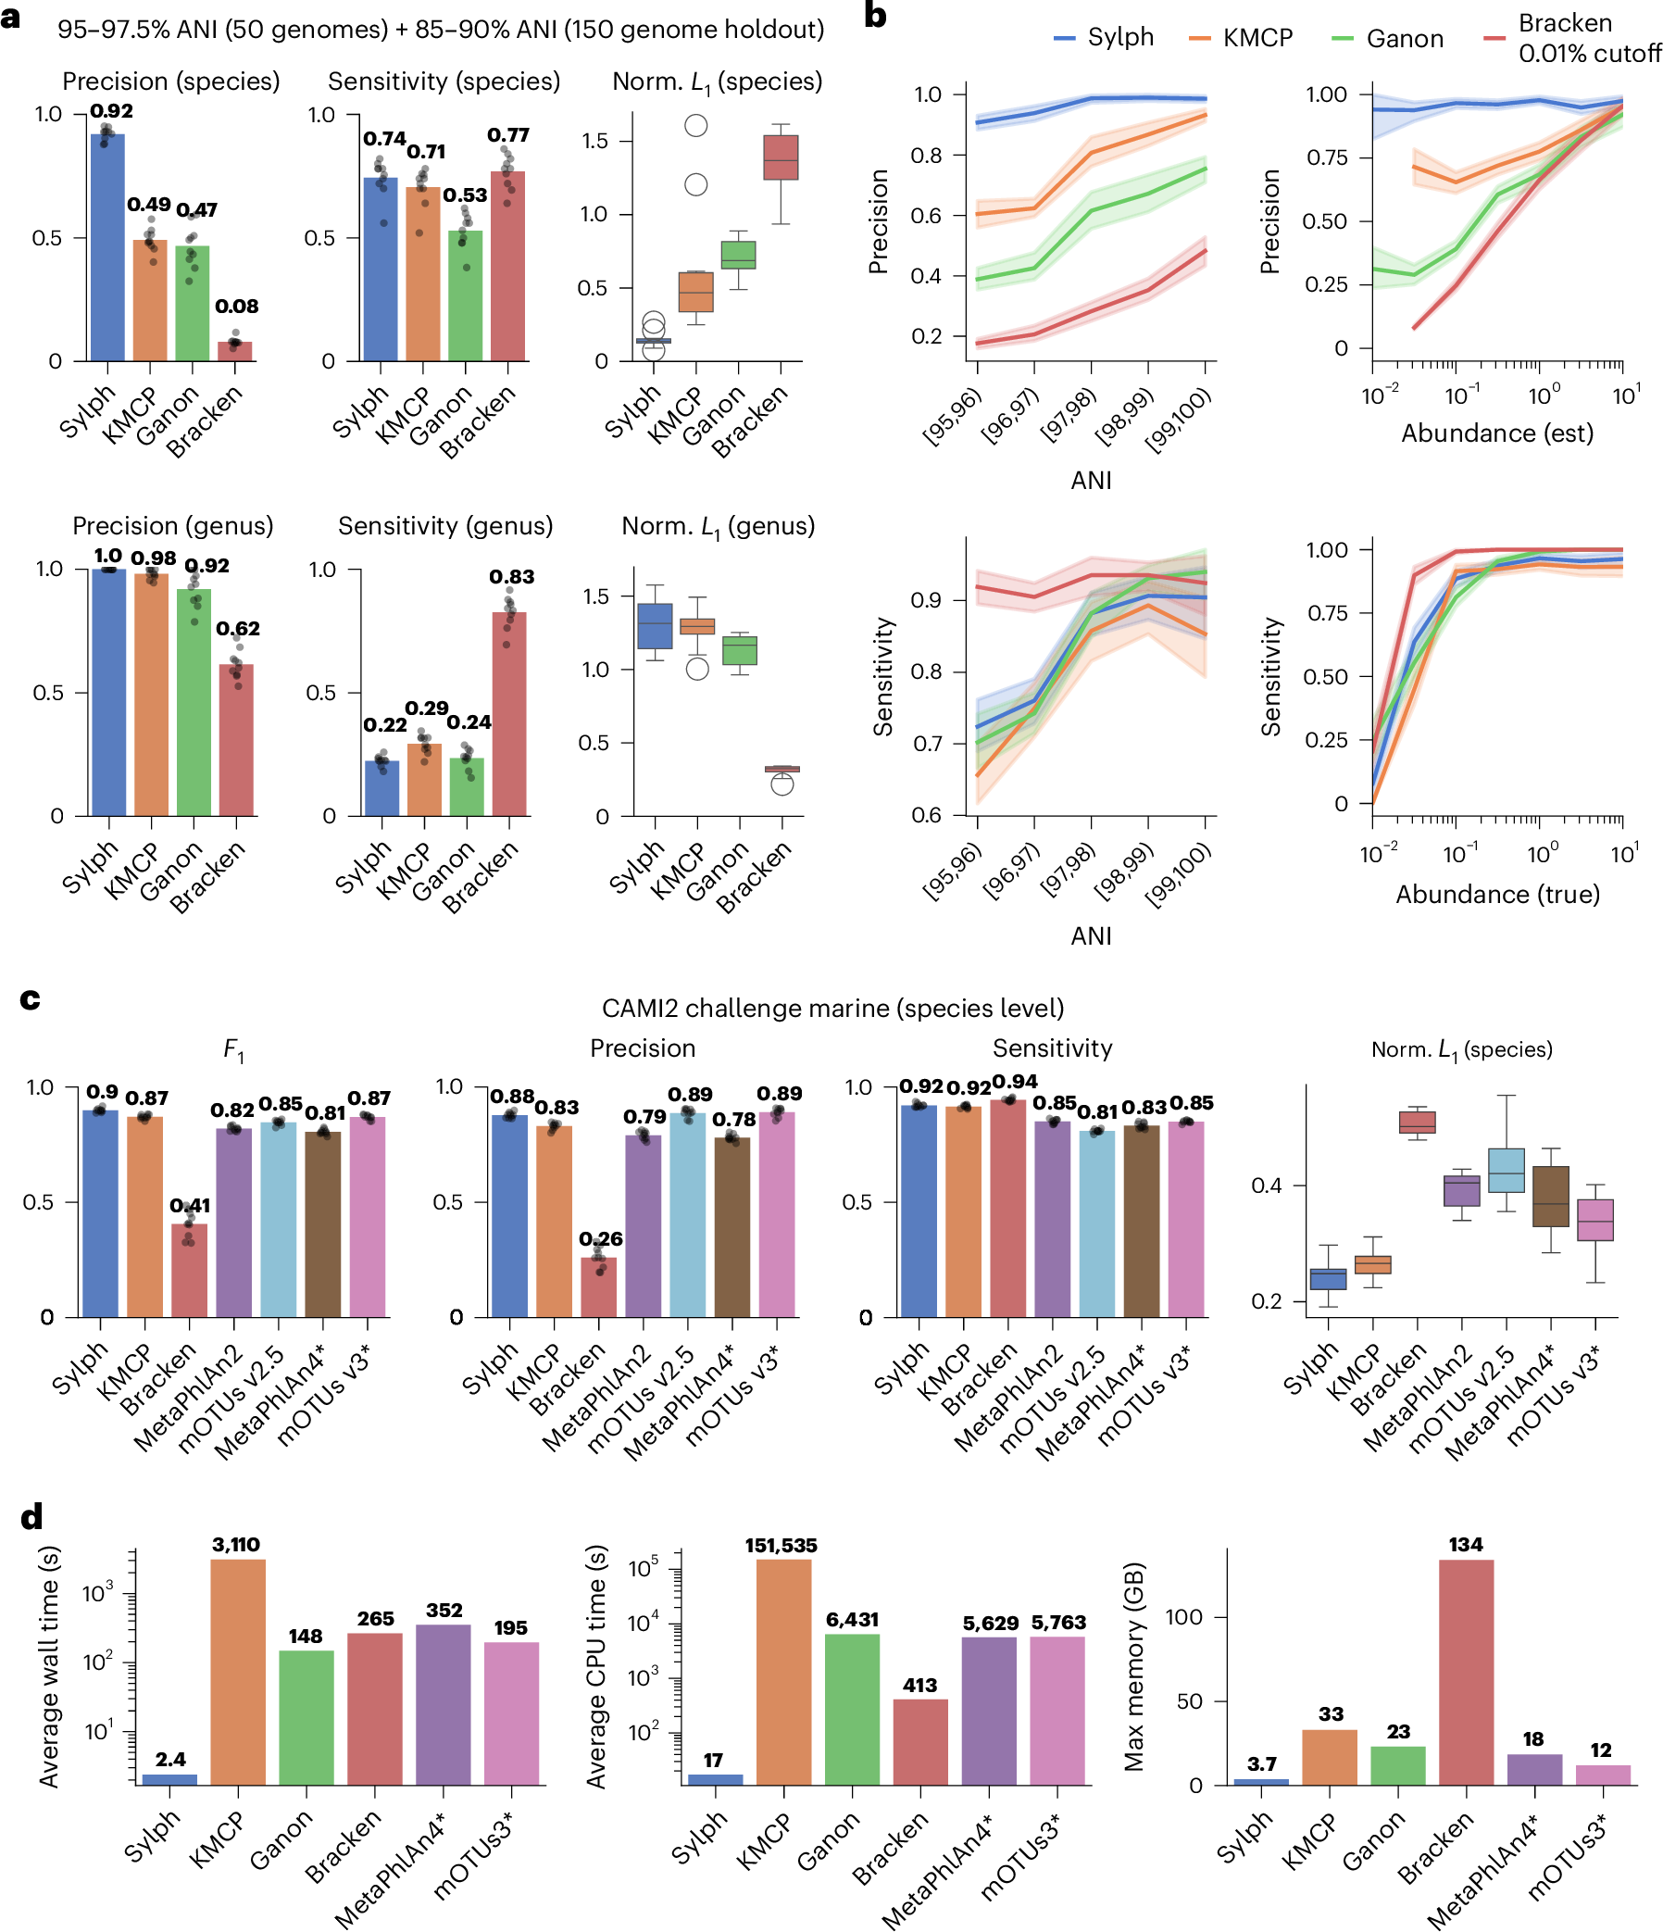
Sylph is much more resource-efficient

Slide 43
Sylph performs well on standard benchmarks
CAMI2 challenge marine (species level)
Determining presence/absence of species
Actual quantitative profiles
Notes:
Mash screen (Ondov et al. 2019) uses the naive containment ANI
MetaPhlAn4 (Blanco-Miguez et al. 2023) aligns all reads to bacterial database
Background: a) is 50 genomes with 95-97.5 % ANI to the reference database. 150 genomes are not present at species level. Results are considered only 50 present genomes except for the last column, which considers genus level abundance. b),c) have all 200 genomes within 95-100% ANI to the reference database
4th column: l1 abundance distance only for present species
So not considering 150 holdouts in a)
Metaphlan has a star because you can't build your own metaphlan database. but all genomes are in an old version of gtdb, which metaphlan should contain since metaphlan has correspondences to new version of gtdb. Nevertheless, the 95-97.5% ANI or 97.5-100% doesn't make sense for metaphlan since it is using a different database
Note that row a) does not contain metaphlan. This is because we can't do holdout s for metaphlan as it uses a different database.

Slide 44
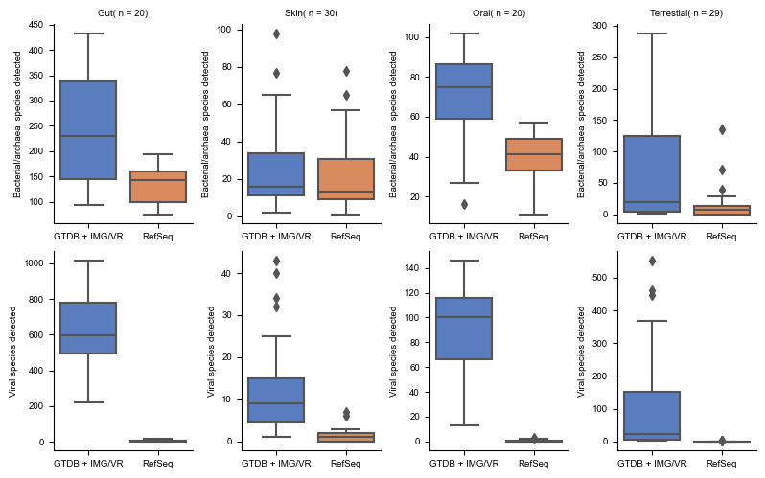
Detecting genomes in real datasets
sylph can take advantage of very large databases:
GTDB-R214 (85k prokaryotes)
IMG/VR (5 million viruses)
Refseq (17.5k prokaryotes, 15k viruses)
sylph uses 20 GB RAM, whereas Kraken would need >300 GB RAM for this data set.
Notes:
This is a real result: I tested a bunch of different real microbiomes for GTDB-R214 (85000 prokaryotes) and IMG/VR4(5 million viral genomes) versus RefSeq (~17,500 prokaryotes, 15k viruses). Sylph can take advantage of very large databases and detect more stuff. Kraken would take >300 GB RAM for this data set with default params. Sylph takes about 20 GB (edited)

Slide 45
Conclusion
Understanding properties of k-mer sketching allows us to augment and choose the appropriate tools for particular tasks.
For skani, we needed to avoid a biased Jaccard index estimator.
For sylph, we additionally needed to correct for zero count inflation when looking at containment index.

Slide 46
Structure of talk
Background on metagenomics and string sketching
Skani: metagenomic sequence comparison through sparse chaining [Shaw & Yu, 2023, Nature Methods]
Sylph: Statistical metagenomic profiling [Shaw & Yu, 2024, Nature Biotechnology]
Acknowledgements

Slide 47
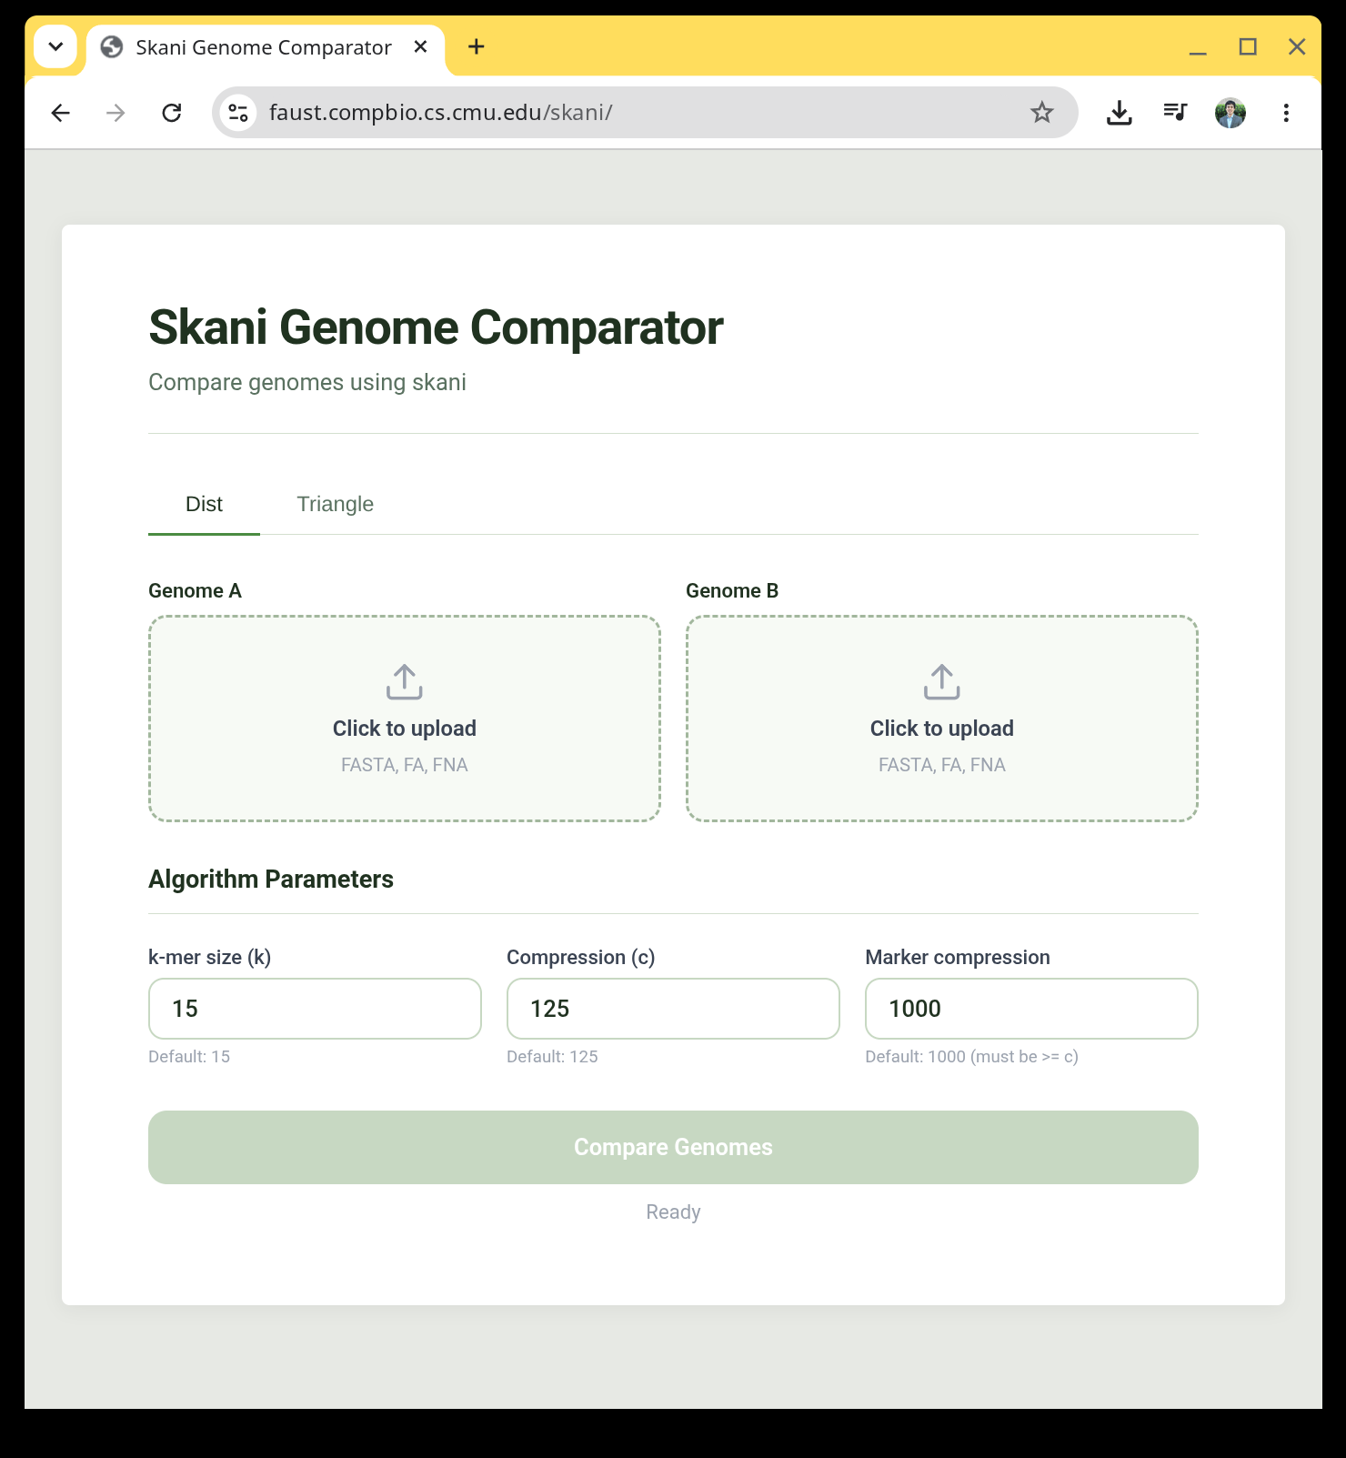
skani
Code / install:
https://github.com/bluenote-1577/skani
WebAssembly demo (beta):
https://faust.compbio.cs.cmu.edu/skani

Slide 48
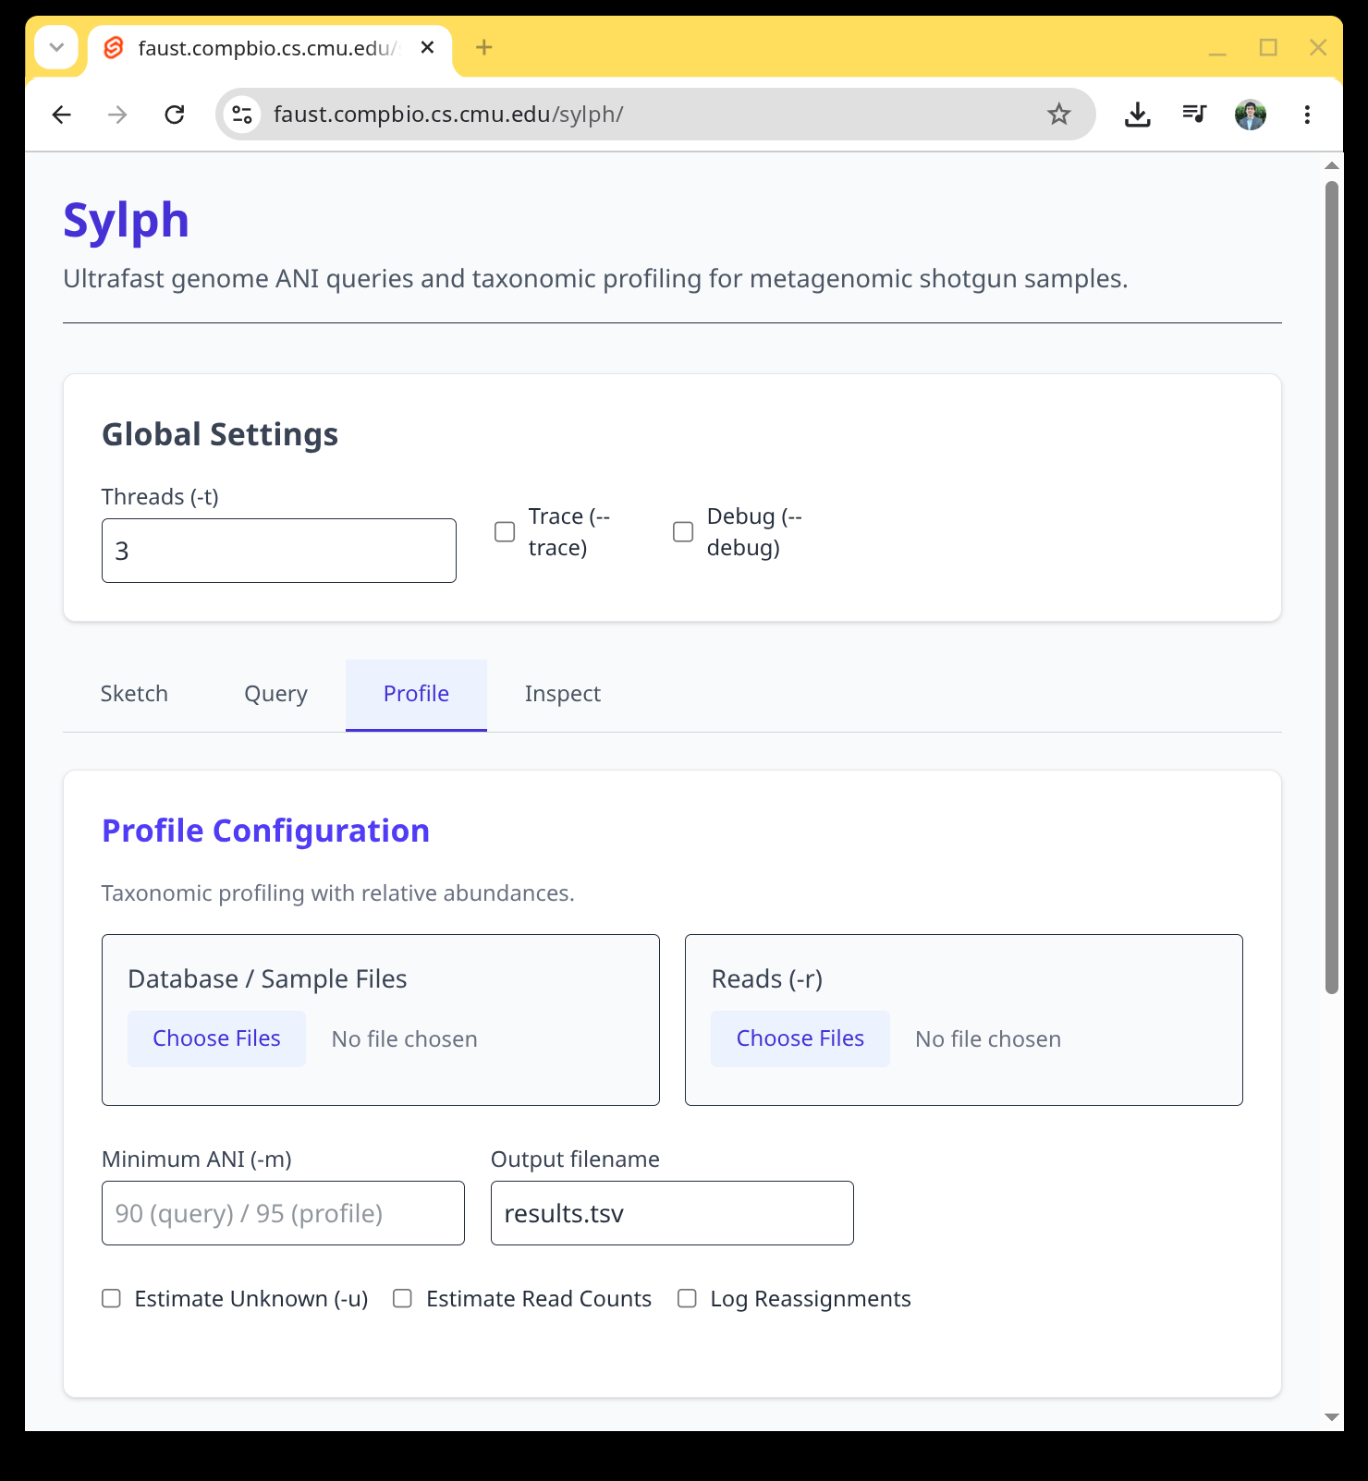
sylph
Code / install:
https://github.com/bluenote-1577/sylph
WebAssembly demo (beta):
https://faust.compbio.cs.cmu.edu/sylph/

Slide 49
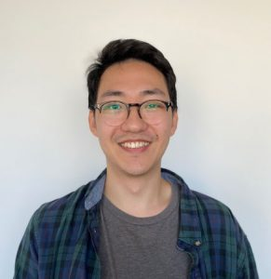
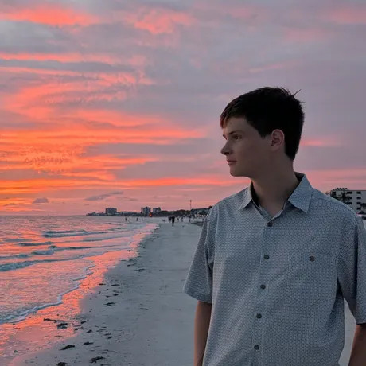
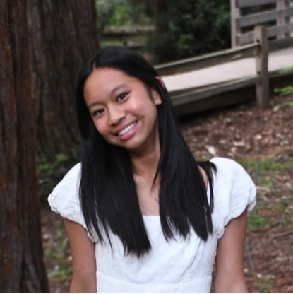


Acknowledgments
University of Toronto
Alister D’Costa
Kiran Deol
Luke Staniscia
Ziye (Rachel) Tao
Andrew Zheng
Carnegie Mellon
Grace Oualline
Xiaolei (Brian) Zhang
Molly Borowiak
Aidan Zhang
Navid Hasan
Jim Shaw PhD, U of Toronto Postdoc w/ Heng Li HMS
Eoghan McIvor Undergrad, CMU
Nadia Iskandar Undergrad, CMU

