Slide 1


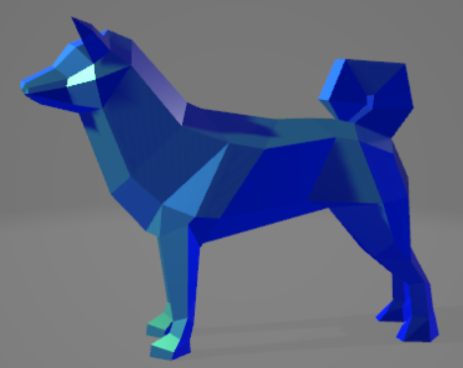


Terminal 3D Renderer
Sam Sandelin

Slide 2
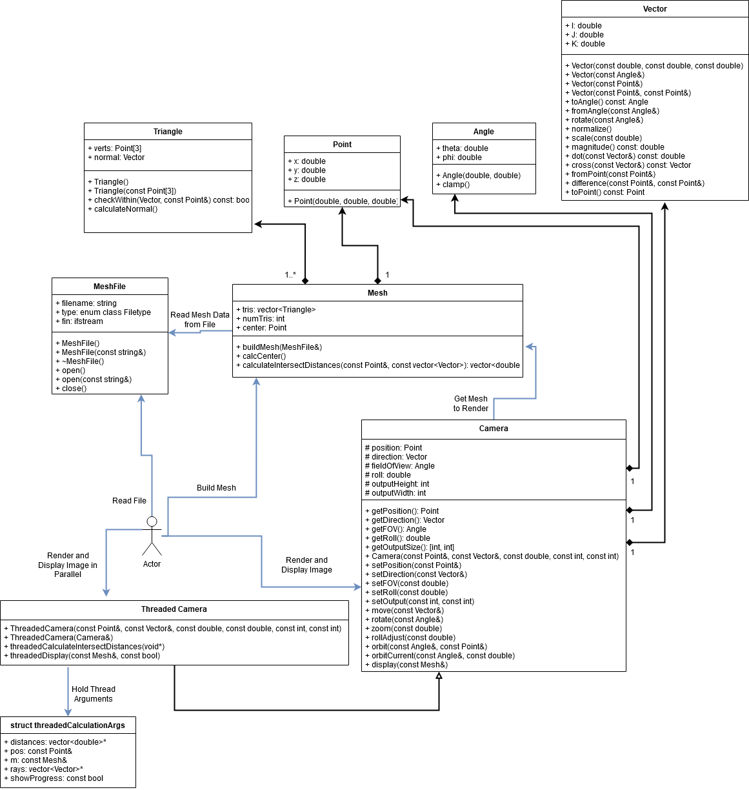
UML Diagram
z

Slide 3
Code Style
Files:
Code in .cpp files
Header files (.h) for almost every .cpp file
Naming:
Readability is prioritized
Name length is second priority
Index variables and iterators should be related to purpose
camelCase for variables and functions
CamelCase for classes
CAPS for defines
Precision:
Data used to hold information about the mesh or rendering should be doubles or higher precision
Otherwise, most common variable types are prioritized

Slide 4
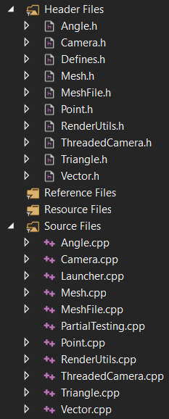
Multiple Files
z

Slide 5
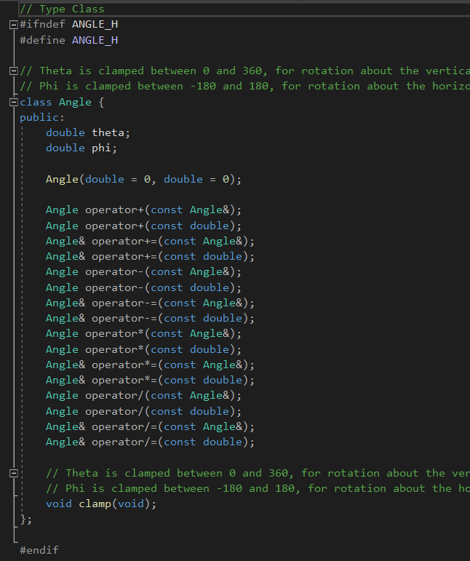
Class Definitions: Type
z

Slide 6
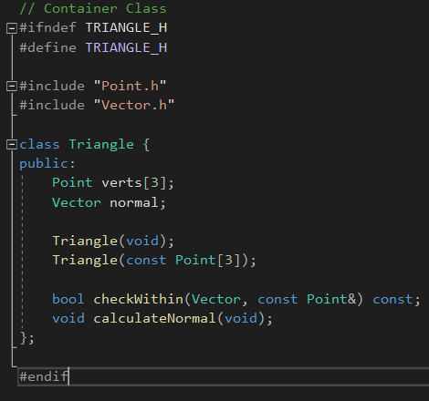
Class Definitions: Container
z

Slide 7
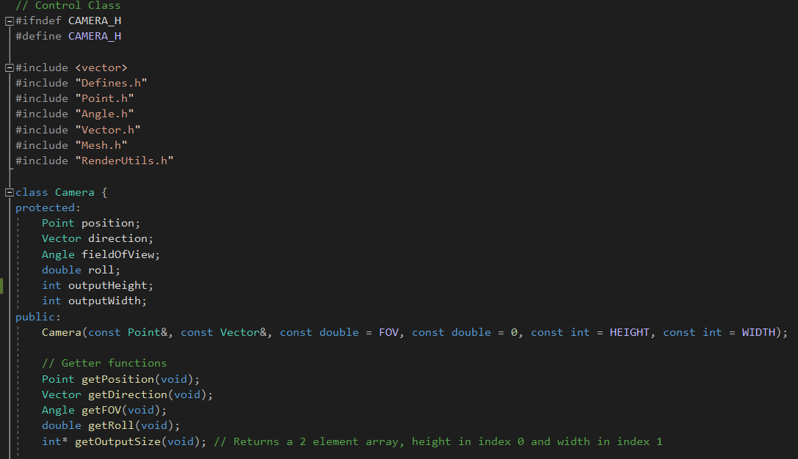
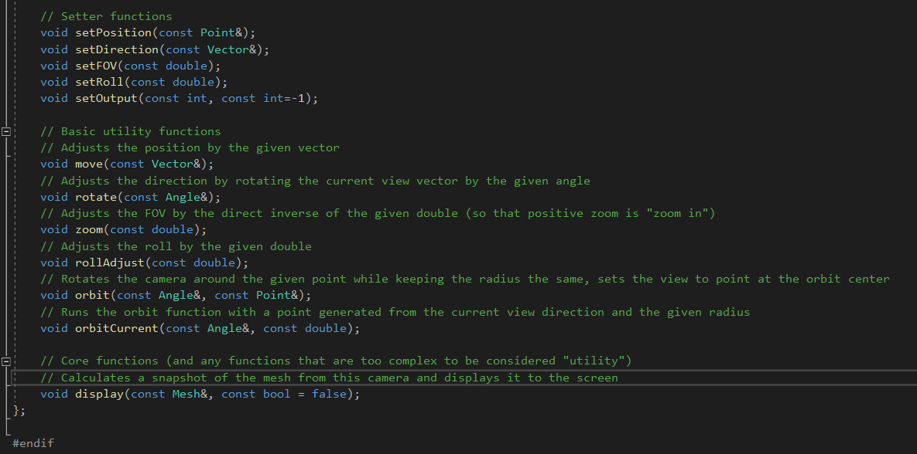
Class Definitions: Control
z

Slide 8
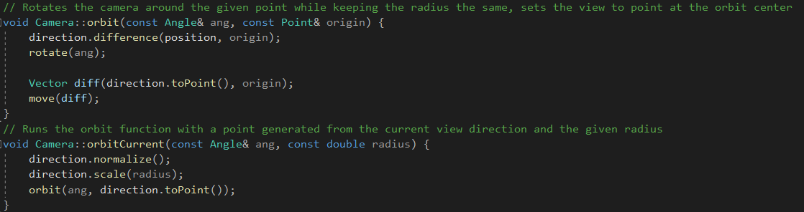
Functions
z

Slide 9
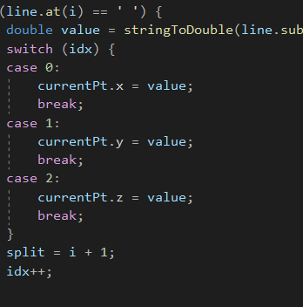
If statements
z

Slide 10
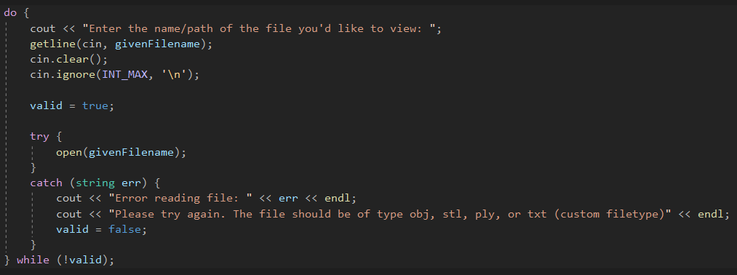
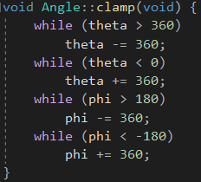

Loops
z

Slide 11
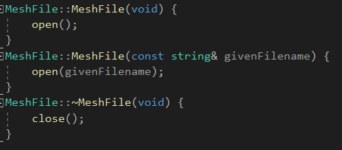
Constructors & Destructors
z

Slide 12
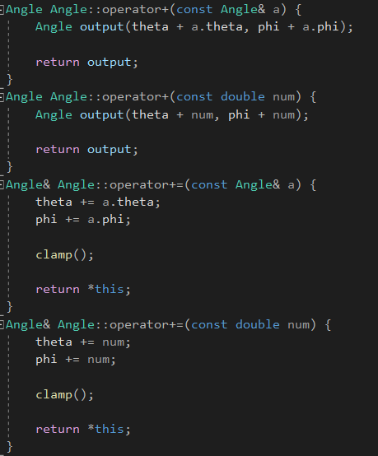
Operator Overloading
z

Slide 13
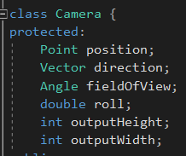
Object Composition
z

Slide 14

Inheritance
z

Slide 15
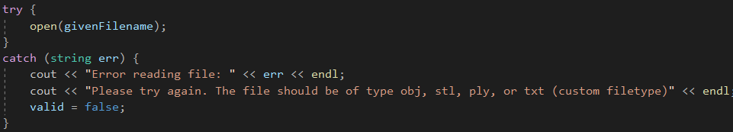
Exceptions
z

Slide 16
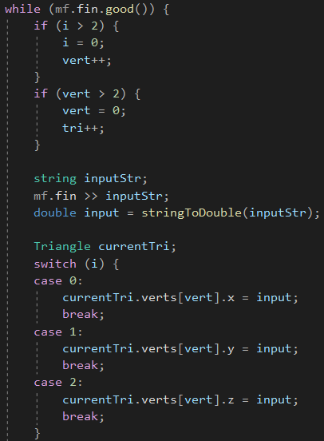
File I/O
z

Slide 17
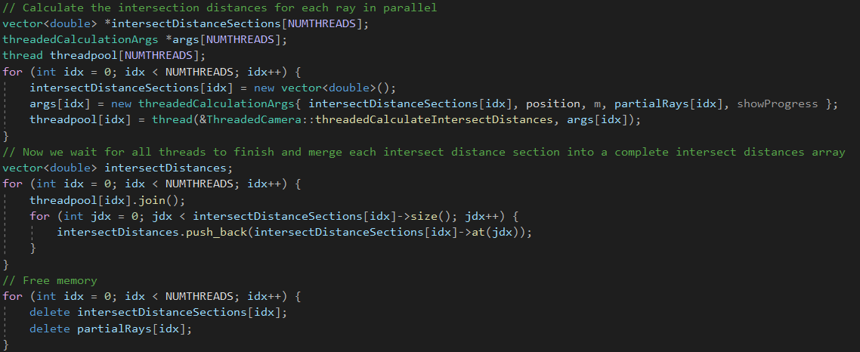
Multithreading
z

Slide 18
Hopefully the demonstration is done loading!
z

