Slide 1
Boa Meets Python: A Boa Dataset of Data Science Software in Python Language
Department of Computer Science
Sumon Biswas, Md Johirul Islam, Yijia Huang and Hridesh Rajan
http://boa.cs.iastate.edu
Notes:
Good afternoon everyone!
I am presenting a Github dataset for MSR that includes Python programs for analyzing data science software.

Slide 2

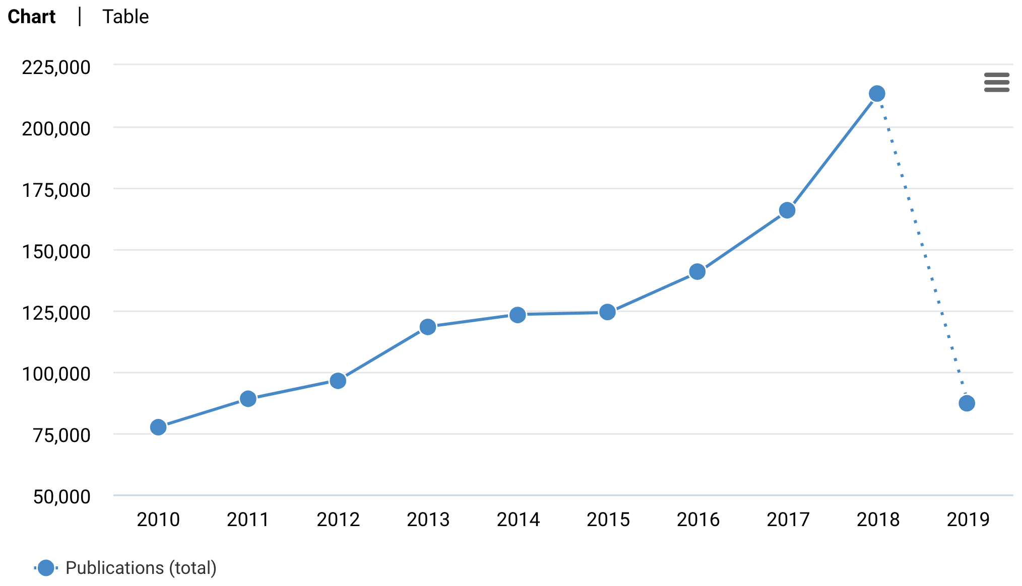
Data Science Everywhere
Trend of publications with topic “machine-learning”
Top 5 courses in in 2018
Stanford TensorFlow Tutorials
Deep Learning Specialization on Coursera
Creative Applications of Deep Learning with Tensorflow
Practical RL: A course in reinforcement learning in the wild
Data Science Coursera
* based on forks
https://app.dimensions.ai/discover/publication
https://github.blog/2018-03-20-top-10-courses-on-github
Department of Computer Science
Notes:
So, why data science programs?
Because, data science is everywhere now. The chart in the left shows the increasing number of publications with the topic “machine-learning”.
In the right we can see that the top 5 course repositories in Github. All are data science courses.

Slide 3
Data Science Everywhere
Data Science projects are growing very fast
Department of Computer Science
Notes:
Also, the number of open source data science repositories in Github is growing very rapidly.
In the left box you can see the top 10 topics in Github. Machine-learning is in the list.
And if you look at the list at the right box, the data science topics are in top 3.

Slide 4
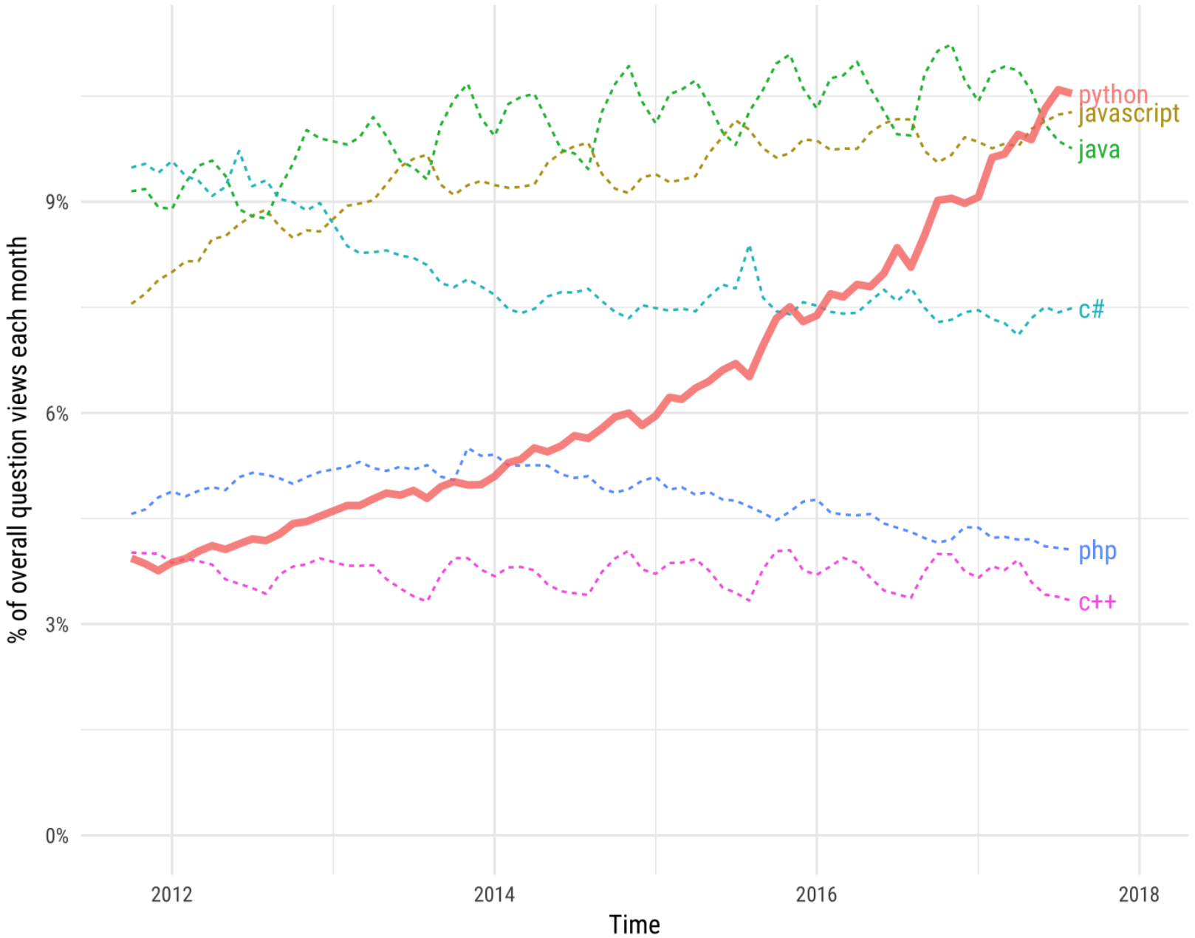
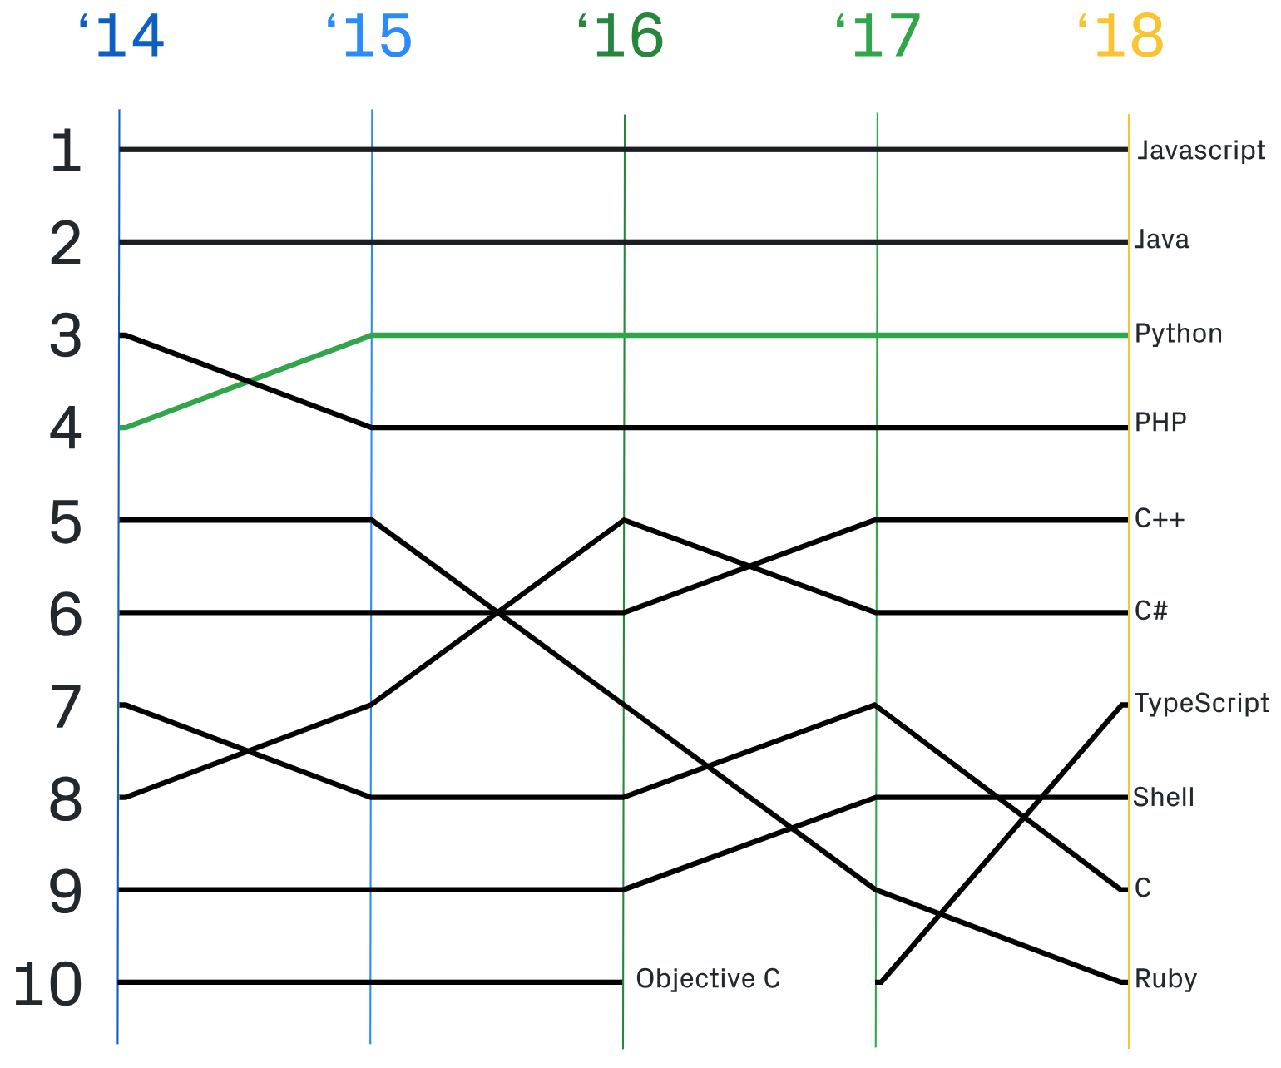
Python in Data Science
Top languages over time in GitHub
Growth of programming languages in StackOverflow
https://octoverse.github.com/projects
https://stackoverflow.blog/2017/09/06/incredible-growth-python/
Department of Computer Science
Notes:
Another important observation is, Python has become a very popular language in data science.
The left chart shows, Python is the 3rd top language is Github.
The right chart shows that Python is emerging as the most popular language in SO. This chart is based on the number of visit of SO pages in each month.

Slide 5
Motivation
Lots of Data Science (DS) software
Python is one of the most used languages in DS
Lots of packages, easy-to-learn
MSR have been very successful in software engineering
Availability of benchmarks has historically accelerated research on a topic
e.g., Allamanis and Sutton's Java, DaCapo [1], Qualitas [2], etc.
[1] S. M. Blackburn, R. Garner, C. Hoffmann, A. M. Khang, K. S. McKinley, R. Bentzur, A. Diwan, D. Feinberg, D. Frampton, S. Z. Guyer et al., “The DaCapo benchmarks: Java benchmarking development and analysis,” in ACM Sigplan Notices, vol. 41, no. 10. ACM, 2006
[2] E.Tempero,C.Anslow,J.Dietrich,T.Han,J.Li,M.Lumpe,H.Melton, and J. Noble, “The Qualitas corpus: A curated collection of Java code for empirical studies,” in Software Engineering Conference (APSEC), 2010 17th Asia Pacific. IEEE, 2010
Department of Computer Science
Notes:
Until this point, we are motivated that DS is everywhere, there are lots of DS open source repositories and Python is one of most used languages in DS.
At the same time, Mining Software Repository have been very successful in recent times for SE research. Some datasets like Dacapo, Quallitas also created new opportunity for MSR research. However, there is no dataset available to analyze DS software written in Python language.

Slide 6
Contributions
A large dataset for analyzing Python DS projects
Efficiently store the dataset in Hadoop sequence file
make it memory efficient and
parallelly accessible
Dataset is publicly available on Boa infrastructure
Department of Computer Science
Notes:
The 3 contributions of this paper are:
first, we have created a dataset that contains 1558 DS projects from Github that are written in Python,
second, for storing and analyzing efficiently, we have stored the dataset in Hadoop sequence,
third, the dataset Is available in Boa platform.

Slide 7
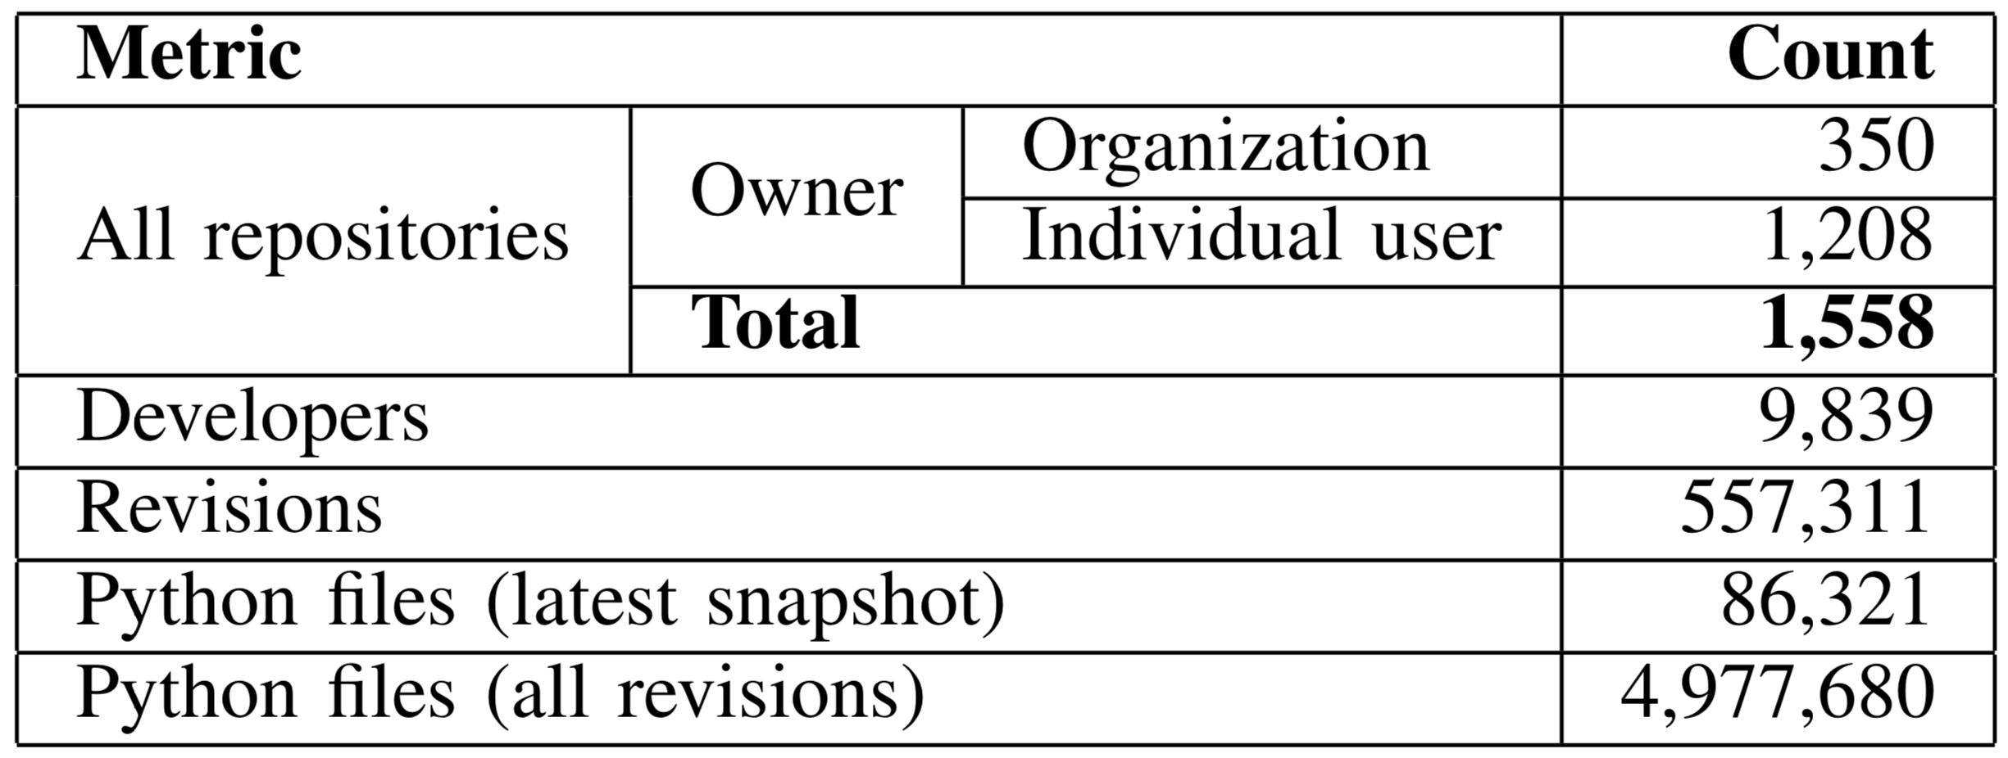
Dataset Metrics
Top rated projects: Tensorflow, Keras, Pandas, Spacy, Theano etc.
Projects use at least 33 DS libraries including Pytroch, Caffe, Keras, Tensorflow, XGBoost, NLTK etc.
Department of Computer Science
Notes:
This are the details of our dataset. The dataset includes metadata of the projects, snapshot of all the revisions and most importantly the parsed AST of the Python programs.
It contains 1558 repositories developed by about 10 thousands developers and maintained by both organizations and individual users.

Slide 8
Methodology
Department of Computer Science
Notes:
We have first collected all the original Python repositories from Github. Then we filtered DS repositories by using keyword search and library usage. Finally we selected high quality projects with more star count.

Slide 9
What to Do with the Dataset
Department of Computer Science
Notes:
There can be several applications of this dataset. We can learn from the existing projects and improve future ones, improve DS software engineering, manage software better, create apps like automatic bug detector and so on.

Slide 10
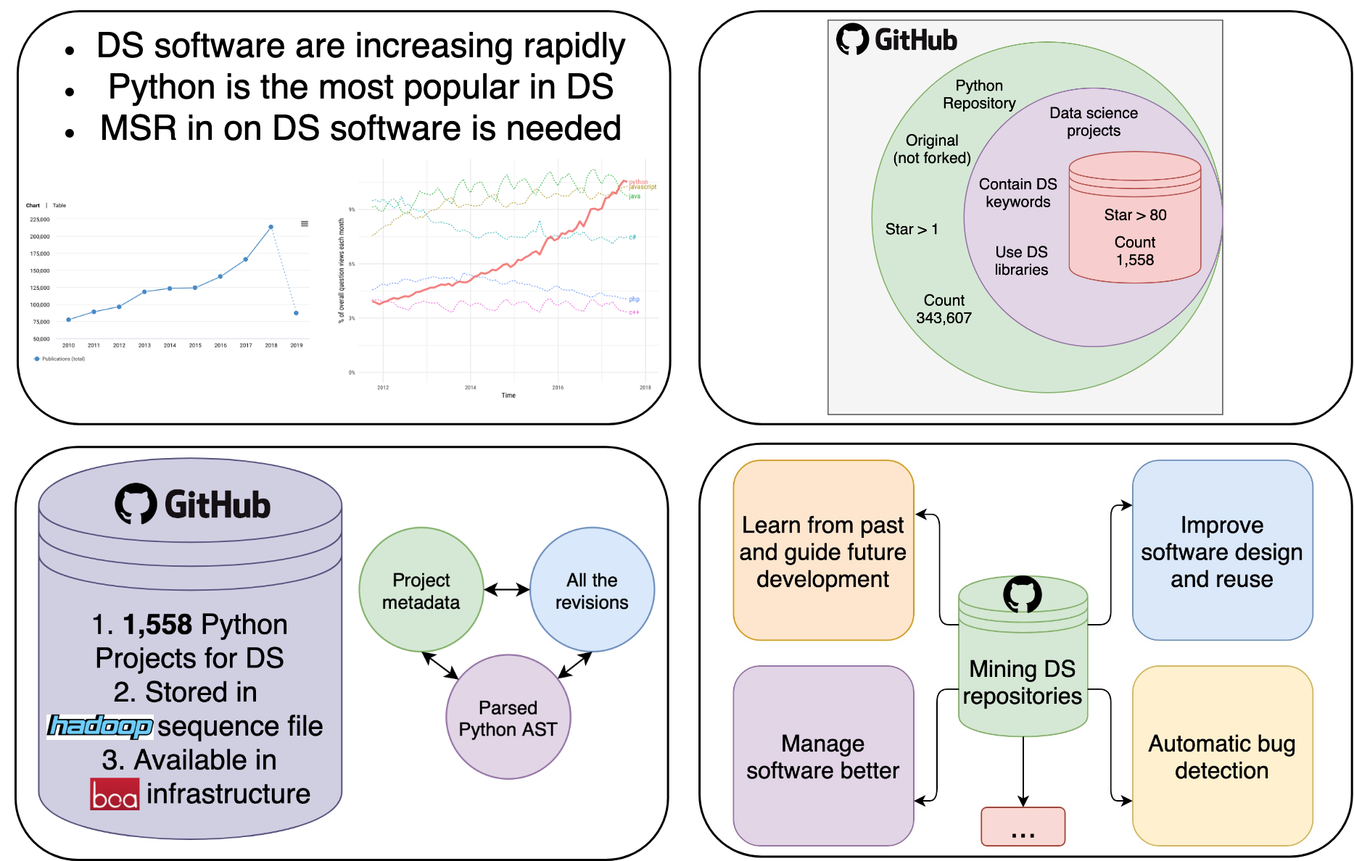
Summary
Department of Computer Science
Notes:
This is the summary of our work. We decided to create a dataset with DS software because they are growing a lot and there is not MSR dataset for that. We collected repositories from Github, parsed the programs into AST and stored all revisions with metadata in Boa infrastructure. This dataset will help to study the DS software engineering.

Slide 11
Appendix
Department of Computer Science

Slide 12
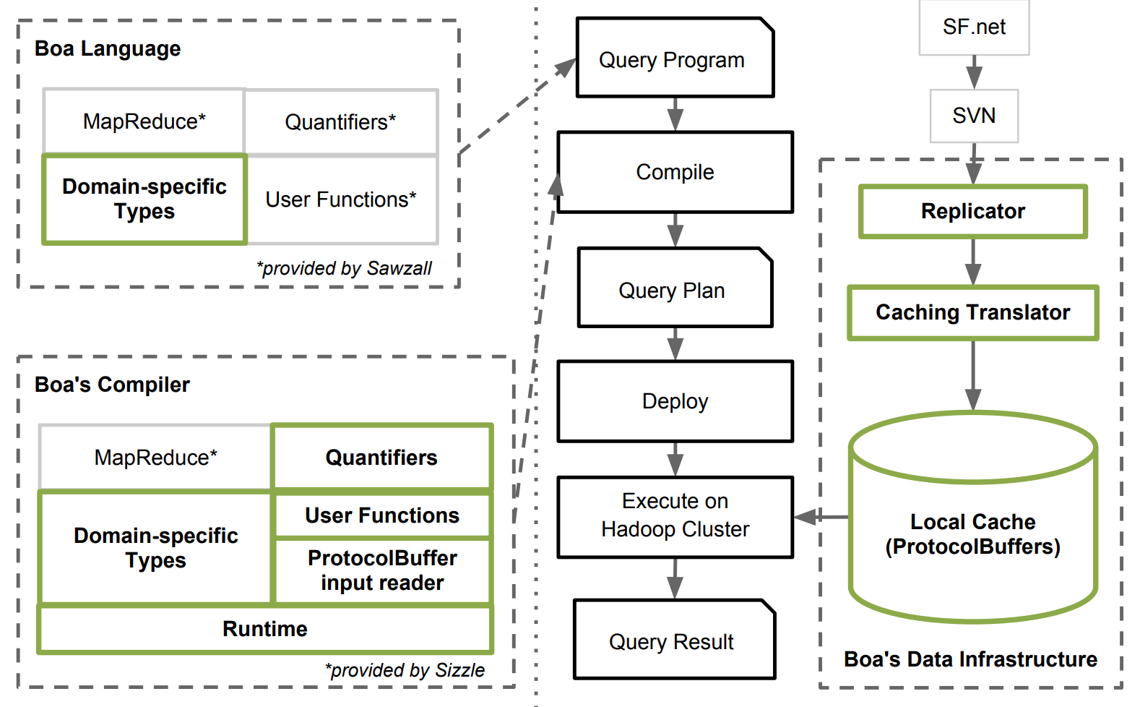
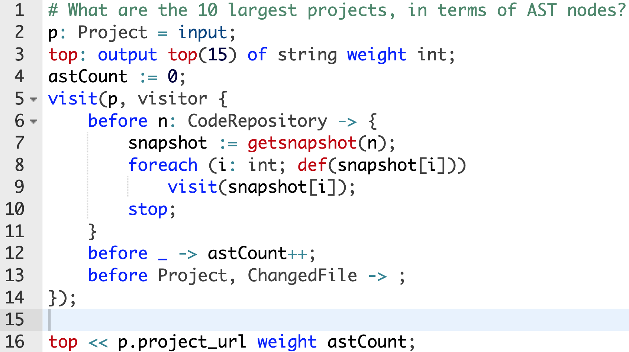
Boa - Mining Large Scale Software Repositories
Infrastructure
Domain-specific language
Robert Dyer, Hoan Anh Nguyen, Hridesh Rajan, and Tien N. Nguyen, "Boa: A Language and Infrastructure for Analyzing Ultra-Large-Scale Software Repositories", In the proceedings of the 35th International Conference on Software Engineering (ICSE 2013), May 22, 2013. San Francisco, CA.
Department of Computer Science

Slide 13
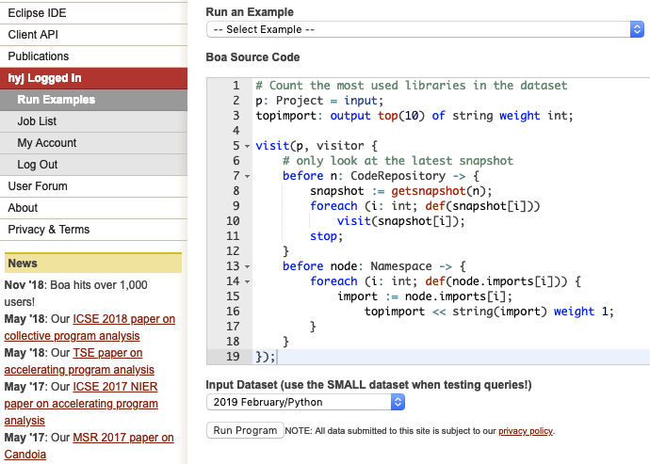
Boa Web Based Interface
http://boa.cs.iastate.edu
Department of Computer Science

Slide 14
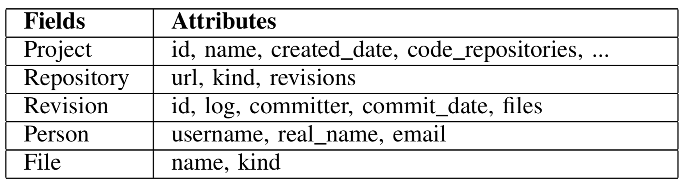
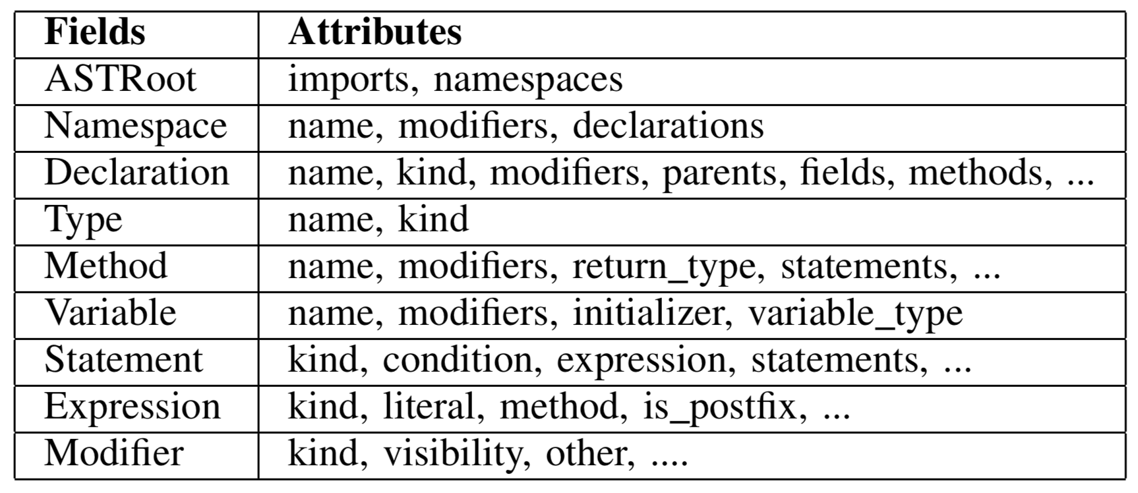
Data Schema
Department of Computer Science
Notes:
Project metadata
AST
Revisions

Slide 15
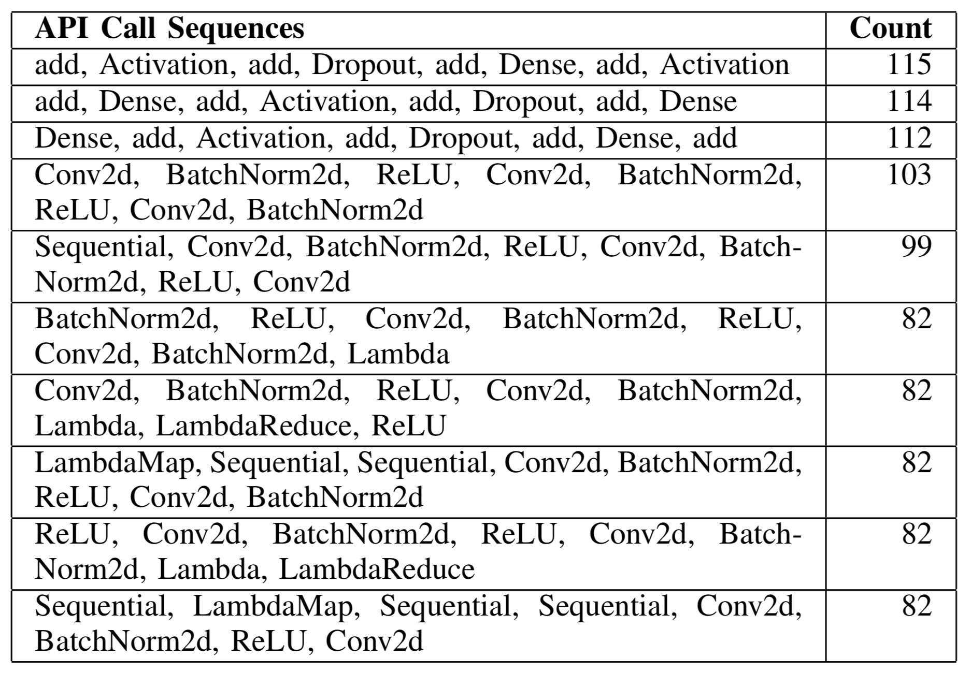
Applications - API usage study
Department of Computer Science

