Slide 1

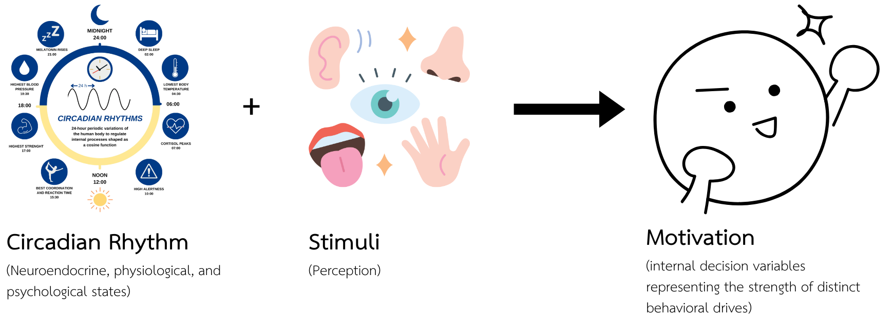
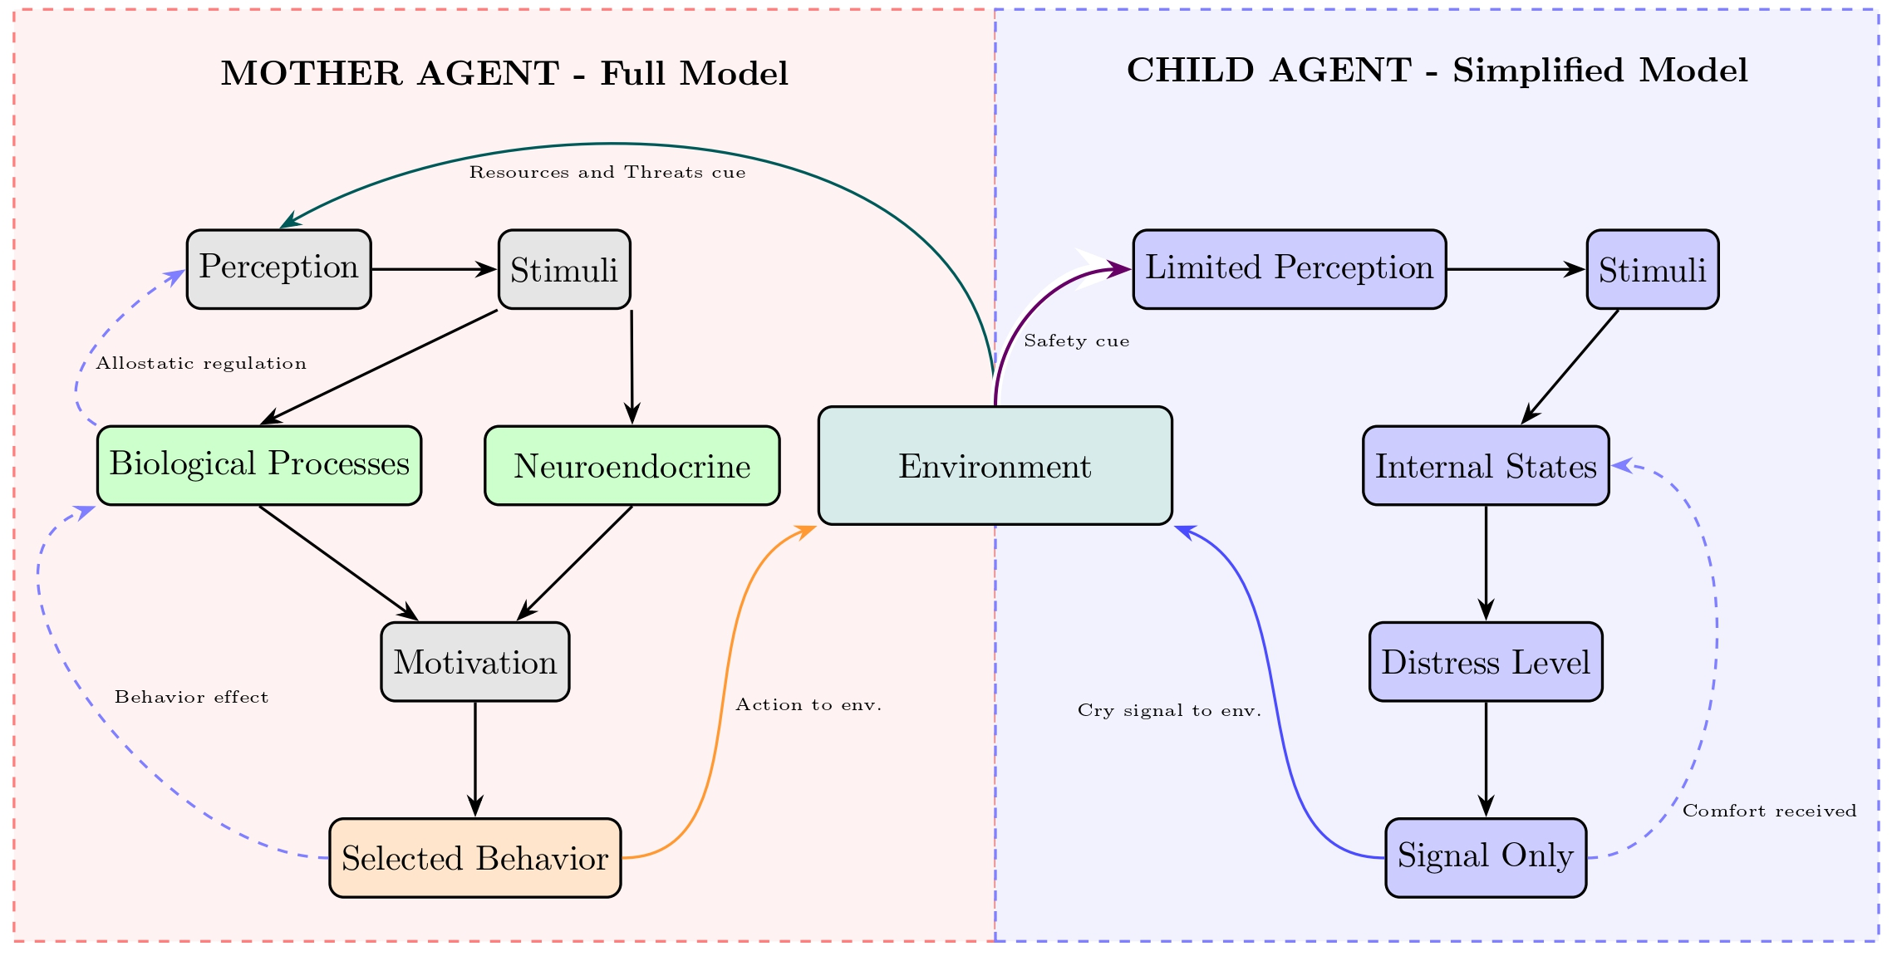
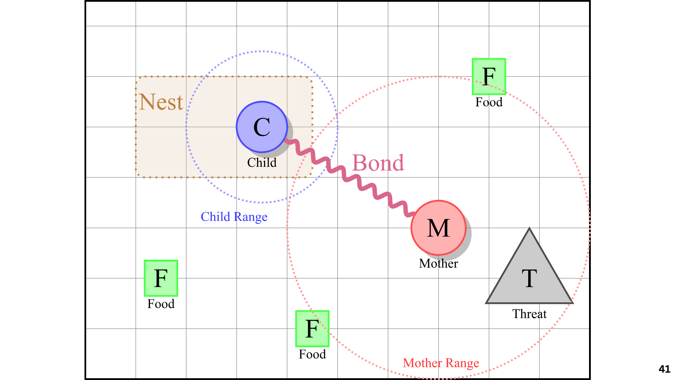
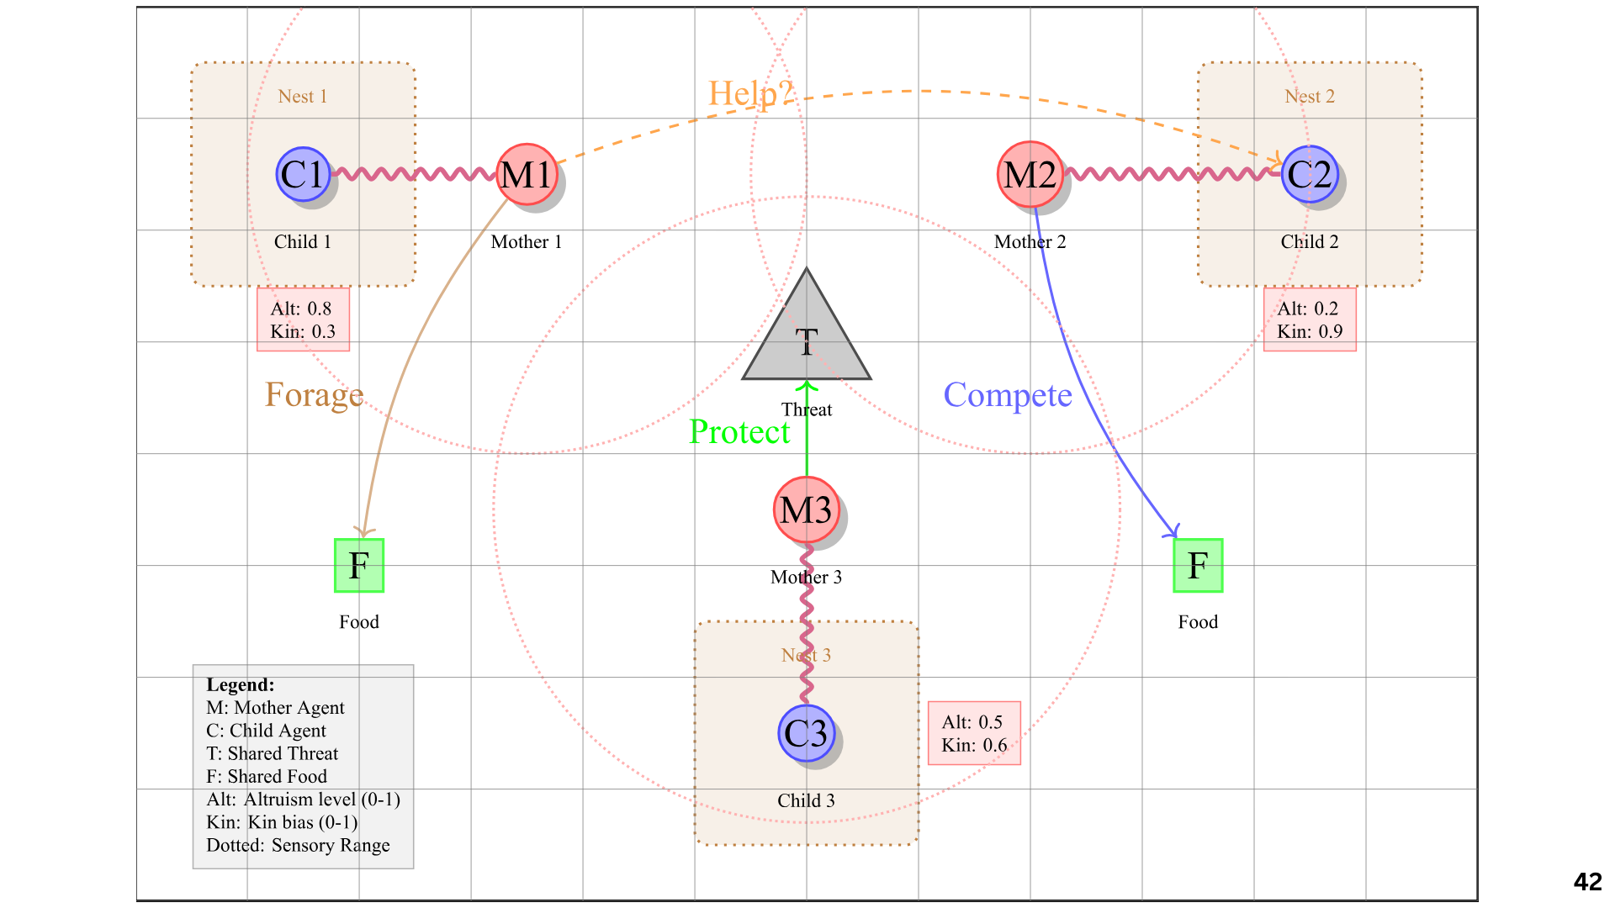
Author : Napat Aeimwiratchai | Email : napat.aeim@gmail.com | Tel : 088-871-5110
Advisor : Mr. Bawornsak Sakulkueakulsuk
Simulation of “Maternal Instinct”
Motivation Selection in an Organism
SCAN
ME!
Abstraction
Maternal care is a foundational form of altruism, yet the mechanisms by which prosocial strategies emerge and persist remain unclear. This thesis proposes a computational framework that integrates physiological, psychological, and neuroendocrine-inspired internal states dynamics within an evolutionary agent-based model to investigate the emergence of “maternal altruism”. Mother agents operate through a hierarchical cascade from genetic traits -> perception -> internal state modulation -> motivation -> action, in which maternal bond strength regulates stimulus interpretation through allostatic control. Child agents are immobile and communicate exclusively via distance-dependent distress signals, creating an asymmetric caregiving dynamic. Using spatial grid-world simulations with multiple family units, mothers inherit genetically encoded traits (altruism, kin bias, nurture threshold, threat sensitivity), and populations evolve under varying levels of resource availability, predation pressure, and population density.
Methodology
Objectives
To develop and analyze an evolutionary agent-based model that integrates physiological, psychological, and neuroendocrine-inspired states to explain how maternal altruistic caregiving emerges and persists under environmental pressures.
Current Progress
Implemented a mother & child agent architecture with coupled physiological, psychological, and neuroendocrine states, and validated adaptive motivation switching (Protect child, Care, Forage, Self-preservation) under varying threat and resource conditions.
Next Steps
Extend simulations across generations to quantitatively analyze the evolutionary stability of maternal caregiving strategies under varying environmental pressures.
Scenario Test

Slide 2
Email : napat.aeim@gmail.com | Tel : 088-871-5110 |
Author : Napat Aeimwiratchai
Advisor : Bawornsak Sakulkueakulsuk
Simulation of “Maternal Instinct”
Motivation Selection in an Organism
SCAN
ME!
Abstraction
Maternal care is a foundational form of altruism, yet the mechanisms by which prosocial strategies emerge and persist remain unclear. This thesis proposes a computational framework that integrates physiological, psychological, and neuroendocrine-inspired internal states dynamics within an evolutionary agent-based model to investigate the emergence of “maternal altruism”. Mother agents operate through a hierarchical cascade from genetic traits -> perception -> internal state modulation -> motivation -> action, in which maternal bond strength regulates stimulus interpretation through allostatic control. Child agents are immobile and communicate exclusively via distance-dependent distress signals, creating an asymmetric caregiving dynamic. Using spatial grid-world simulations with multiple family units, mothers inherit genetically encoded traits (altruism, kin bias, nurture threshold, threat sensitivity), and populations evolve under varying levels of resource availability, predation pressure, and population density.
Methodology
Objectives
To develop and analyze an evolutionary agent-based model that integrates physiological, psychological, and neuroendocrine-inspired states to explain how maternal altruistic caregiving emerges and persists under environmental pressures.
Current Progress
Implemented a mother & child agent architecture with coupled physiological, psychological, and neuroendocrine states, and validated adaptive motivation switching (Protect child, Care, Forage, Self-preservation) under varying threat and resource conditions.
Next Steps
Extend simulations across generations to quantitatively analyze the evolutionary stability of maternal caregiving strategies under varying environmental pressures.
Scenario Test

Slide 3
Email : napat.aeim@gmail.com | Tel : 088-871-5110 |
Author : Napat Aeimwiratchai
Advisor : Bawornsak Sakulkueakulsuk
Simulation of “Maternal Instinct”
Abstraction
Maternal care is a foundational form of altruism, yet the mechanisms by which prosocial strategies emerge and persist remain unclear. This thesis proposes a computational framework that integrates physiological, psychological, and neuroendocrine-inspired internal states dynamics within an evolutionary agent-based model to investigate the emergence of “maternal altruism”. Mother agents operate through a hierarchical cascade from genetic traits -> perception -> internal state modulation -> motivation -> action, in which maternal bond strength regulates stimulus interpretation through allostatic control. Child agents are immobile and communicate exclusively via distance-dependent distress signals, creating an asymmetric caregiving dynamic. Using spatial grid-world simulations with multiple family units, mothers inherit genetically encoded traits and populations evolve under varying levels of resource availability, predation pressure, and population density. This research explores how maternal caregiving strategies emerge through evolution rather than explicit programming, advancing understanding of cooperation, prosocial AI design, and AI safety.
SENIOR THESIS
Objectives
To develop and analyze an evolutionary agent-based model that integrates physiological, psychological, and neuroendocrine-inspired states to explain how maternal altruistic caregiving emerges and persists under environmental pressures.
Methodology
Motivation Selection in an Organism
Scenario Test
Current Progress
Implemented a mother & child agent architecture with coupled physiological, psychological, and neuroendocrine states, and validated adaptive motivation switching (Protect child, Care, Forage, Self-preservation) under varying threat and resource conditions.
Next Steps
Extend simulations across generations to quantitatively analyze the evolutionary stability of maternal caregiving strategies under varying environmental pressures.

