Slide 1
Capstone 2: Predicting a player’s OPS
Joe Boardman

Slide 2
Executive Summary
MLB Player evaluators are always looking for ways to better Predict offensive value for the future. A predictive model could save a team millions by recommending one player over another.
Final model achieved 17.4% lower error than using prior year OPS to predict

Slide 3
Data Wrangling
Only included the years 1985-2015
Filtered out seasons with fewer than 200 ABs
Shifted data to include 2 prior seasons within each record
Feature Engineering
Sustainabile vs Unsustainable

Slide 4
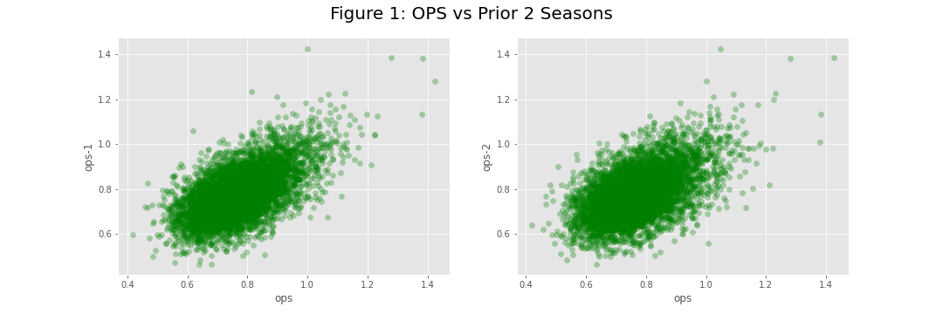
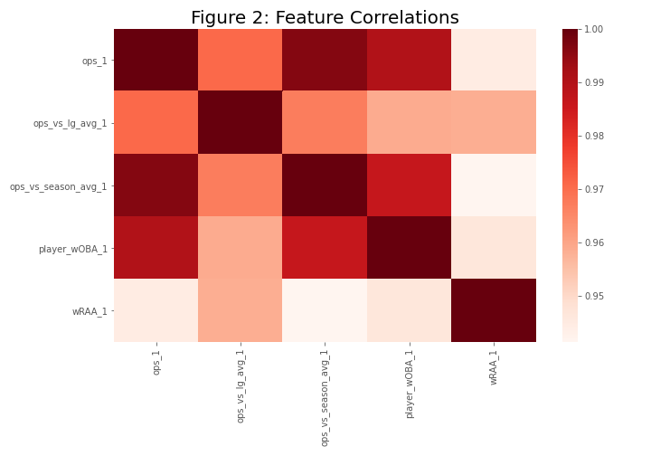
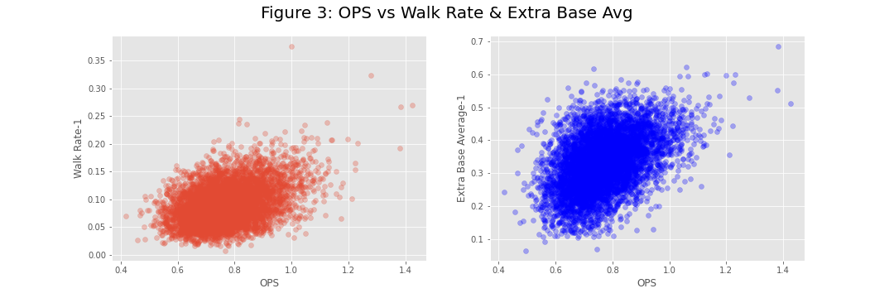
Exploratory Data Analysis

Slide 5
Modeling
Linear Regression
Random Forest Regressor
Gradient Boosting Regressor

Slide 6
Cross Validation
K-Fold Cross Validation for Linear Regression
Mean Cross Val R-squared: 0.475
Prediction R-squared: 0.463
GridSearchCV for Random Forest and Gradient Boosting Regressors
Random Forest improved R-squared by 0.02, MAE by 0.001
Gradient Boosting Improved R-squared by 0.02, MAE by 0.0002

Slide 7

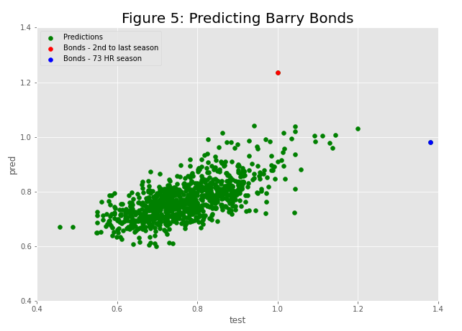
Results
Gradient Boosting Model was the best performer
17.4% better than using prior year OPS to predict
Major driver of variance were breakout seasons or players in final years of career

Slide 8
Takeaways
Difficult Problem to Solve
Impacted by Steroid Era

Slide 9
Explore Further
Similar model with more advanced satatistics (exit velocity, launch angle, etc)
Using stats from college and minor leagues to predict breakout players
Predict a players Wins Above Replacement over future years (i.e. length of a potential contract)

Slide 10
Questions?

