Slide 1
Capstone 3: Increase Customer Satisfaction with Machine learning
Joe Boardman

Slide 2
Problem
Complaint classification at big banks to improve customer satisfaction

Slide 3
Result
Effective multi-class classification model achieving a 0.94 AUC score
Topic modeling to uncover a more accurate root cause for complaint
Customer Service issues, etc

Slide 4
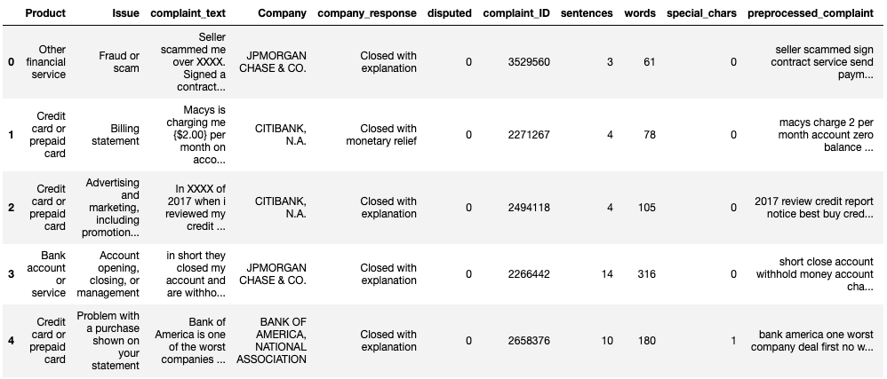
Data
Consumer Financial Protection Bureau (CFPB) complaint database
Focused only on 4 large American banks
JP Morgan Chase
Bank of America
Wells Fargo
Citibank
600k records

Slide 5
Data cleaning
Filtered records without written complaint
Sampled from full dataset to only include 4 banks
Left with 77k rows
Consolidated products to solve redundancy
Checked for duplicates and removed if necessary

Slide 6
Text Preprocessing
Word tokenization
Lemmatization
Removal of stop words
Convert back to a string

Slide 7
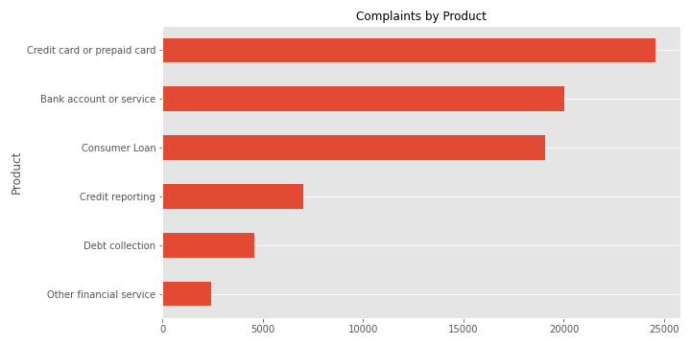
Exploratory Data Analysis

Slide 8
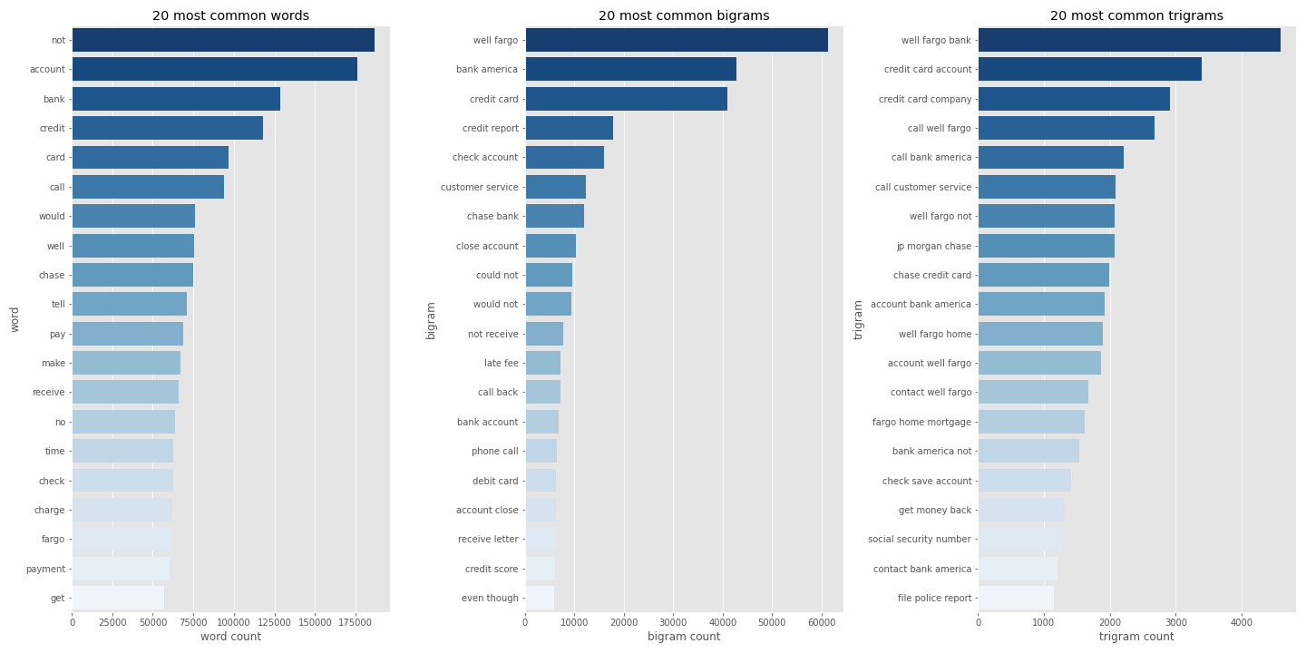
Exploratory Data Analysis

Slide 9
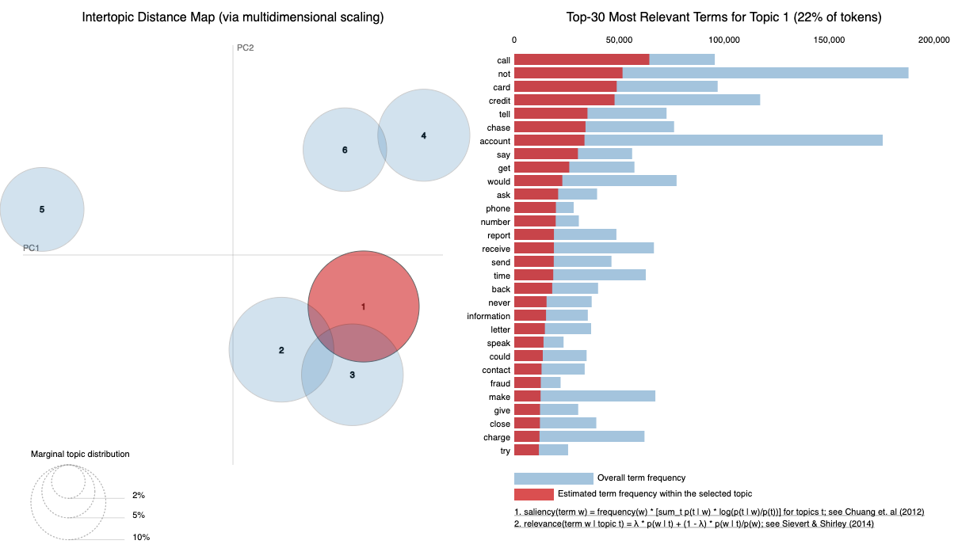
Topic modeling

Slide 10
Models Used
Random Forest
Multinomial Naïve Bayes
Logistic Regression

Slide 11
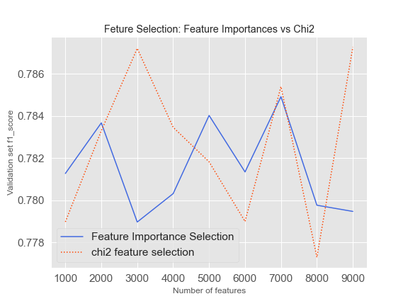
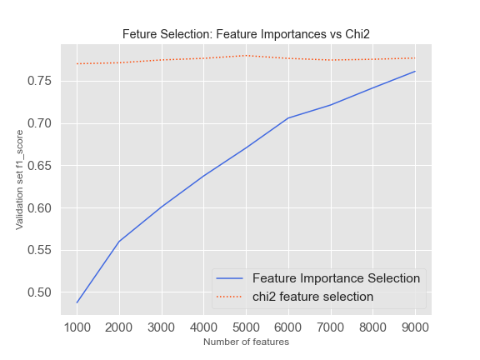
Feature Selection
Chi-squared vs Feature Importances
Random Forest
Naïve Bayes

Slide 12
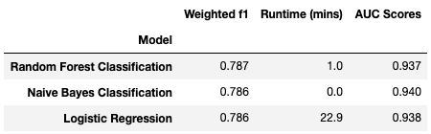
Evaluation
My recommendation would be to use Naïve Bayes
Similar performance to Random Forest and Logistic Regression
Very computationally efficient

Slide 13
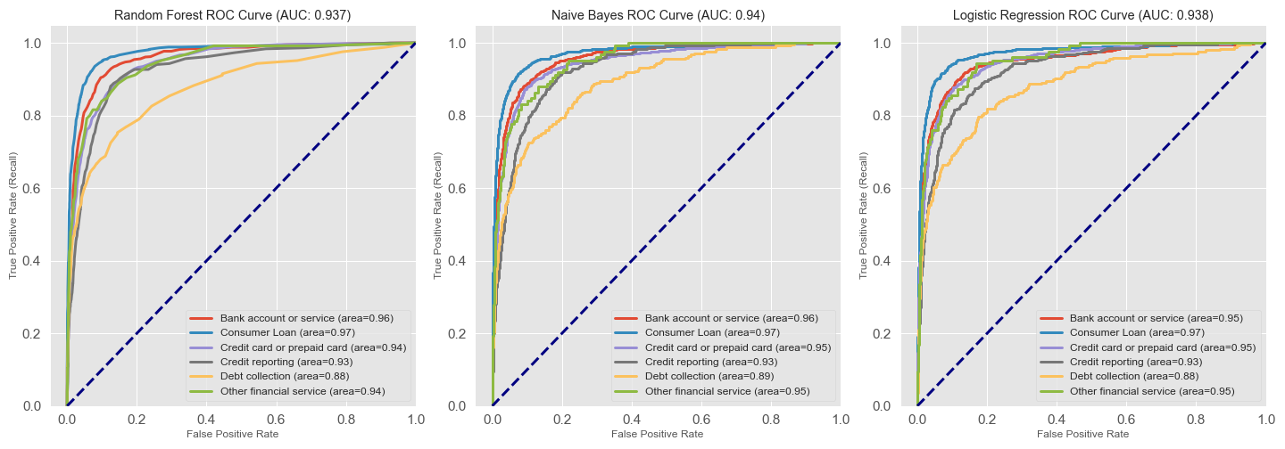
Evaluation

Slide 14
Value to Customer
Effectively identify product alignment of complaint
Compare with the assigned topic to understand a possible other driver

Slide 15
Explore further
Neural Network
Try more techniques to involve Sentiment Analysis

Slide 16
Questions?

