Slide 1
Q3 FY26 business review
Board of directors | 14 October 2026
Alder Outdoor. All figures are invented for the Boardplot examples.

Slide 2
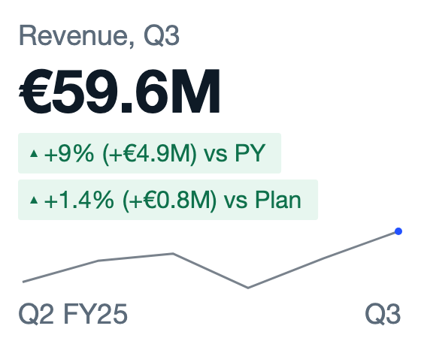
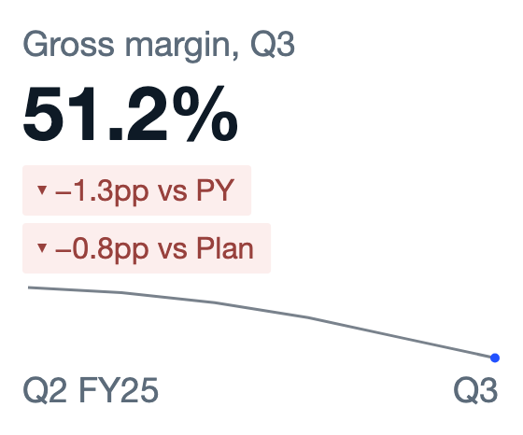
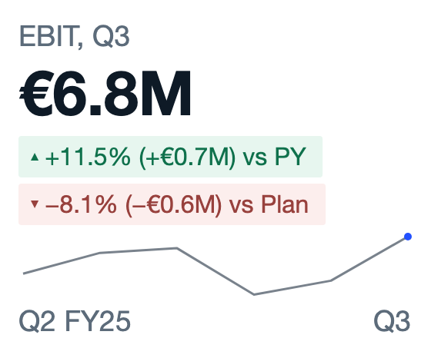
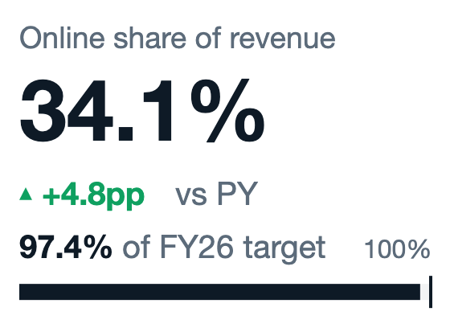
EXECUTIVE SUMMARY
Revenue is 9% above last year and ahead of plan; margin and costs need attention
Growth comes from volume, price and the new bike packs
Online grew 27%. Dropping climbing hardware cost €1.1m of revenue.
Gross margin fell 1.3 points to 51.2%
Freight, duties and a richer marketing push grew faster than revenue.
Two transformation workstreams are off track
Sourcing in Asia and the central warehouse need a decision before the roll-out.
Alder Outdoor | Q3 FY26 business review
2

Slide 3
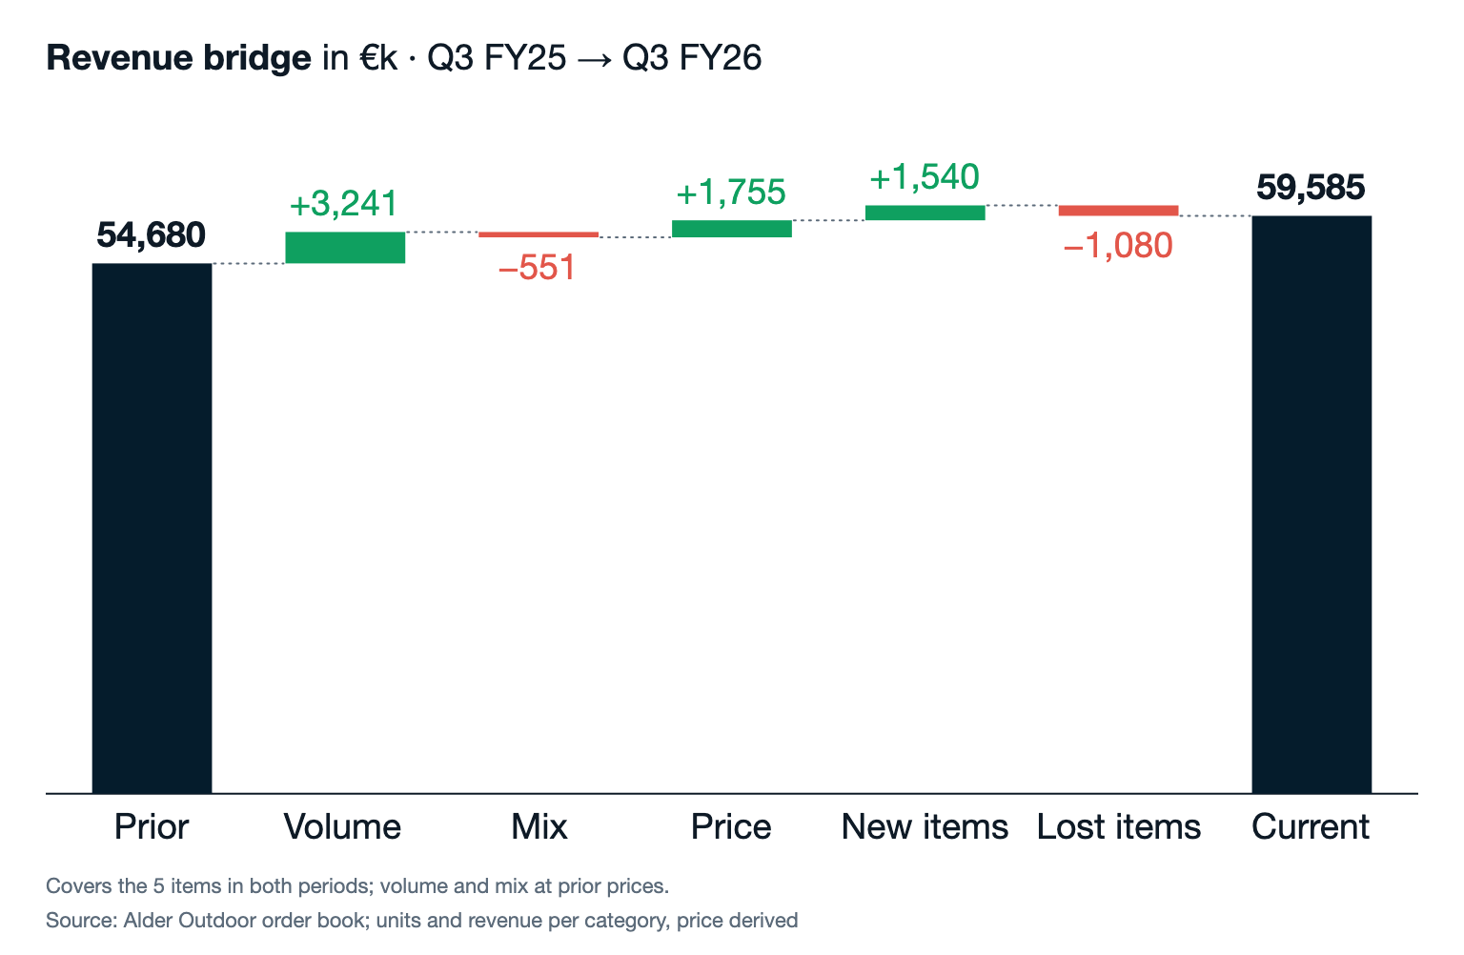
REVENUE
Q3 revenue grew €4.9m: volume added €3.2m and price €1.8m
What it means
1
More units of tents, backpacks, footwear and accessories carry the growth. Apparel lost volume to discounters.
2
Price increases on tents and footwear held without a volume loss.
3
Bike packs, launched in May, bring €1.5m a quarter and replace the dropped climbing range.
Alder Outdoor | Q3 FY26 business review
3

Slide 4
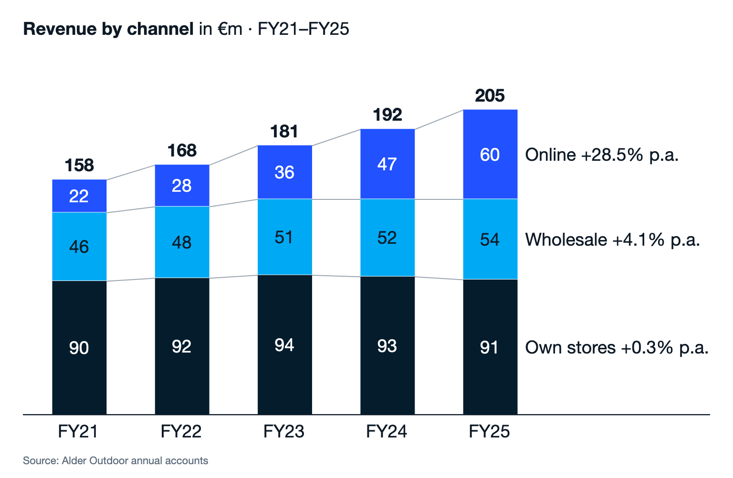
CHANNELS
Online grew 28.5% a year since FY21 and brought four fifths of the group's growth
What it means
1
Online nearly tripled from €22m to €60m in four years.
2
Own stores have been flat since FY22. Each store needs a clear role next to online.
3
Wholesale grows slowly but stays profitable. Keep the key accounts.
Alder Outdoor | Q3 FY26 business review
4

Slide 5
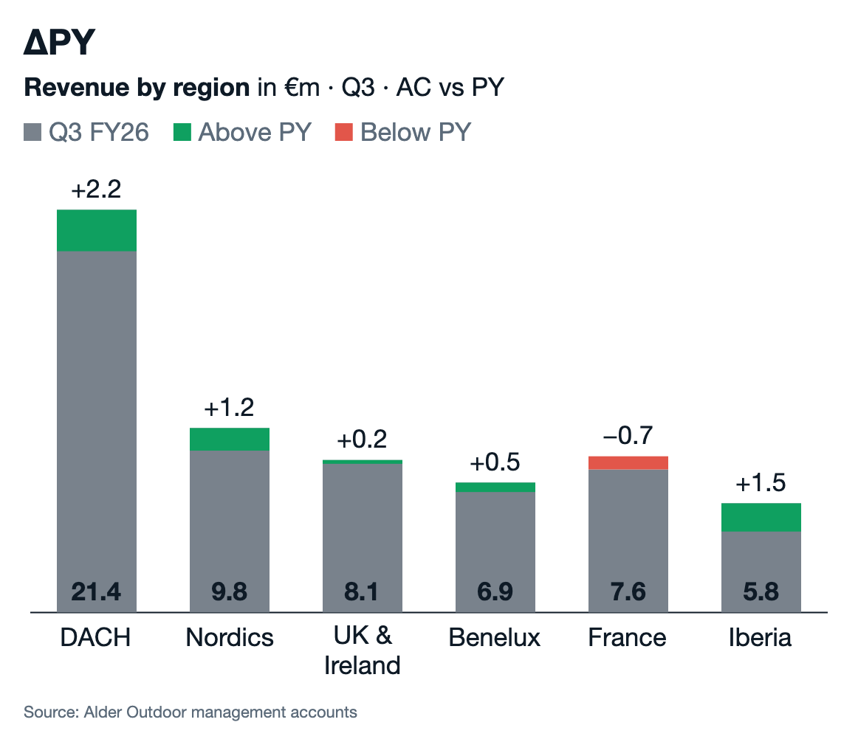
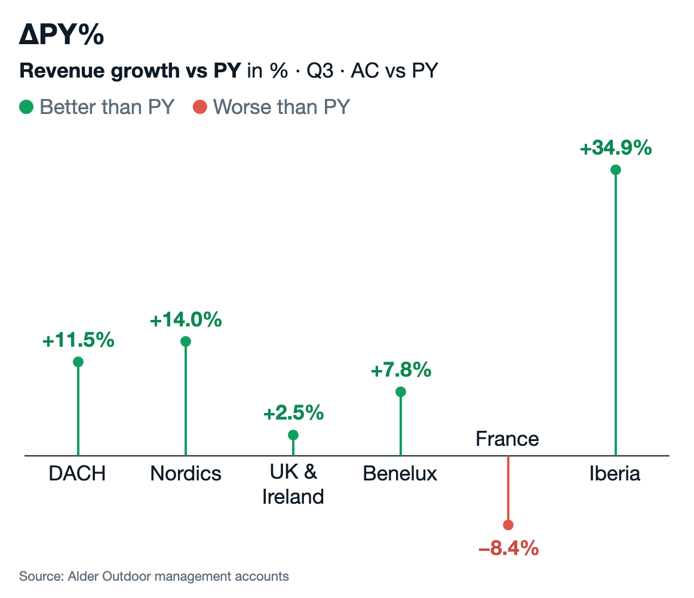
REGIONS
DACH and Iberia lead the regional growth; France fell 8% and is the only region below last year
Alder Outdoor | Q3 FY26 business review
5

Slide 6
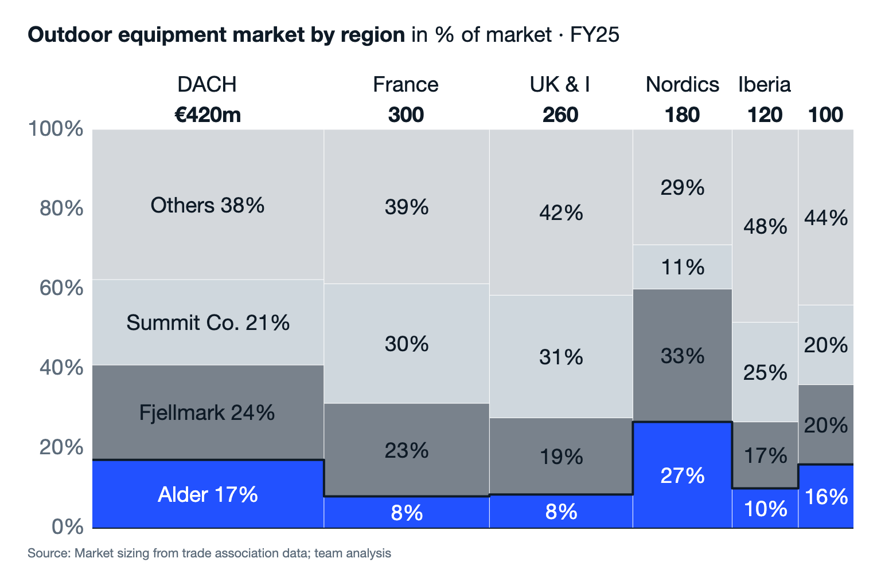
MARKET
Alder leads the Nordics with 27% share but holds less than 10% in France and the UK
What it means
1
In the Nordics, 27% share gives Alder pricing power. Protect it.
2
France and the UK are large markets where Alder has 8%. Growth there needs online first.
3
Summit Co. leads in the three largest markets.
Alder Outdoor | Q3 FY26 business review
6

Slide 7
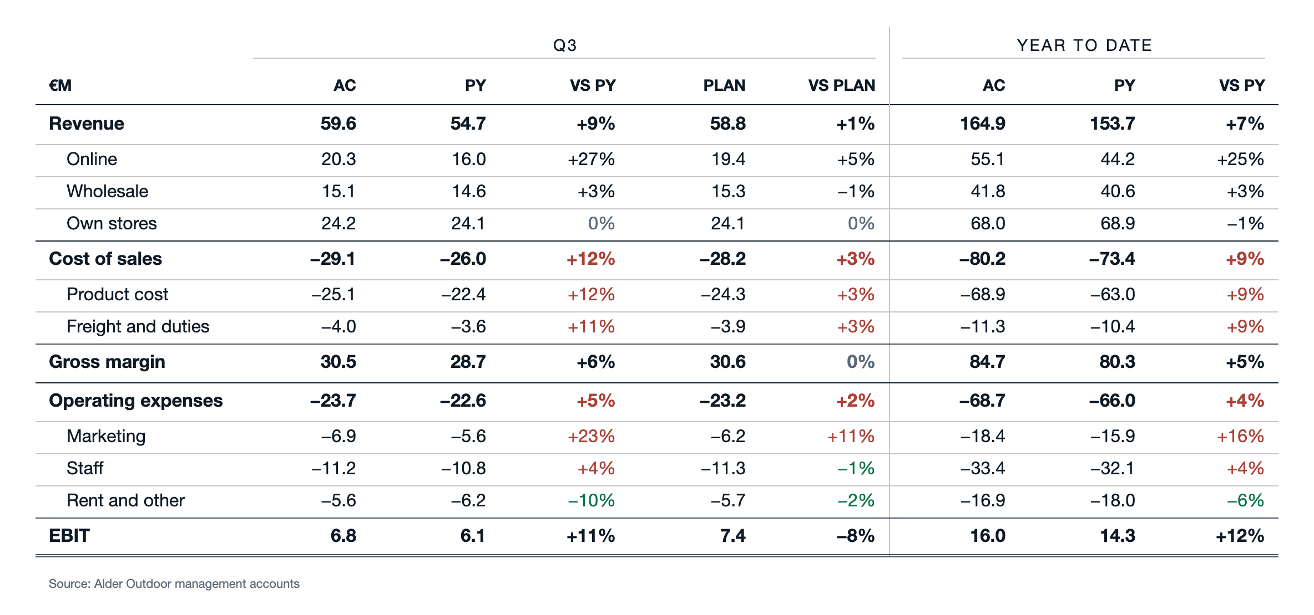
PROFIT AND LOSS
EBIT rose 11% to €6.8m but missed plan by 8%: product cost, freight and marketing grew faster than revenue
Alder Outdoor | Q3 FY26 business review
7

Slide 8
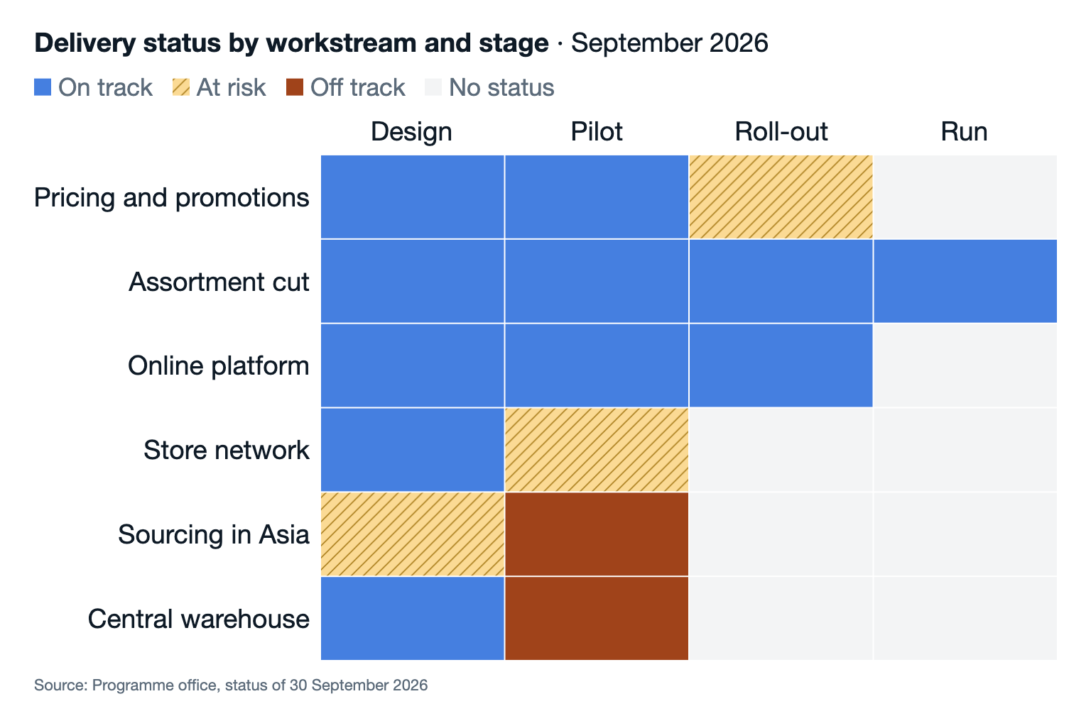
TRANSFORMATION
Sourcing in Asia and the central warehouse are off track in their pilots
What it means
1
Sourcing: the second supplier failed the quality audit. Decide on a third supplier by November.
2
Warehouse: the pilot runs 6 weeks late. The roll-out moves to Q2 FY27.
3
Pricing: the roll-out is at risk while store staff wait for training.
Alder Outdoor | Q3 FY26 business review
8

