Slide 1
Consumer CPUs - A Case Study
Adipa Wijayathilaka
Abdulmohsen Bin Rabah
Faris Alyamani
Abdulkarim al Johani

Slide 2
The Central Processing Unit (CPU)
Microcontrollers
Timeline (History)

Slide 3
The Central Processing Unit (CPU)
Computer machine refers to the electronic circuitry that executes all the calculations and the instructions of computer software.

Slide 4
Microcontrollers
What is Microprocessor?
A Microprocessor is a multipurpose, programmable logic device that reads binary instruction from a storage device called memory accepts binary data as input and processes data to according to those instruction and provides result as output.

Slide 5
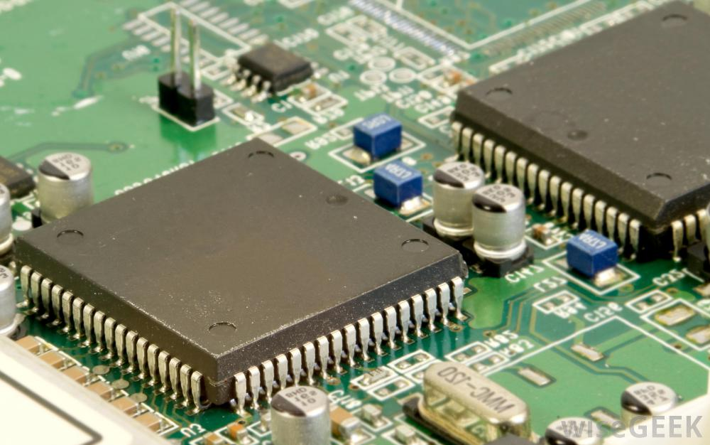
Microcontrollers
Microcontroller as the name suggests, are small controllers. They are like single chip computers that often embedded into others systems to function as processing/controlling.
A microcontroller has a CPU in addition to fixed amount of RAM, ROM and I/O parts and a timer on a single chip
The fixed amount of on-chip RAM, ROM, timer and I/O parts in microcontrollers makes them ideal for many applications in which cost and space are less.

Slide 6
Microprocessors
Different types
CPU
Used for general purpose application
Number of instructions are high
It is costly
It is large in size
Microcontroller
Used for special purpose application
Few instruction can do functions
It is cheap
It is small in size

Slide 7
Timeline (History)
Computing like a lot of other modern technologies is closely related to war
WWII

Slide 8
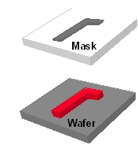
Photolithography

Slide 9
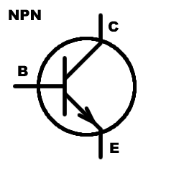

Slide 10
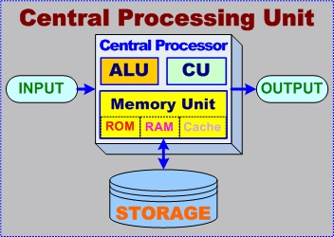

Slide 11
Clock Speed
IPC
TDP

Slide 12
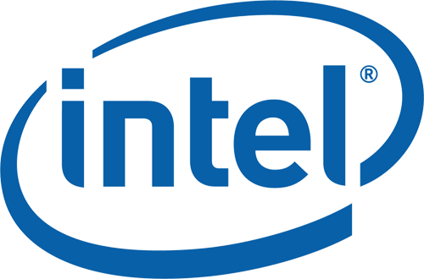
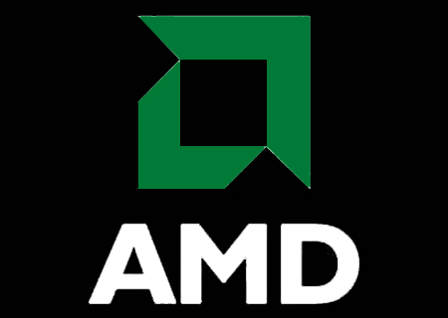

Slide 13


Slide 14
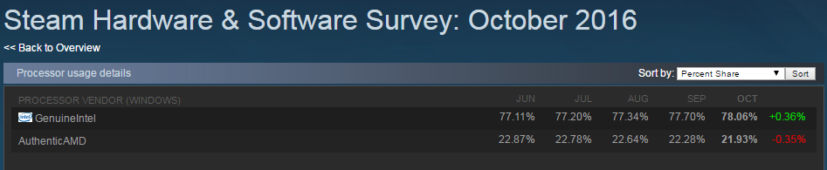
Intel 78%
AMD 22%

Slide 15


Slide 16
Kaby Lake

Slide 17
Moving away from Silicon

