Slide 1

Smart Door Lock HSLU - IOT
Boas Meier, Niklas Tanner, Lukas Mettler, Tobias Heller
Rotkreuz, 05.02.2022

Slide 2
Table of Contents
01
USECASE
02
SOLUTION
03
NEXT STEPS
04
DEMO
Why is a smart door lock needed?
How did we solve it and what were the biggest challenges?
What are our next steps?
How does our product work?

Slide 3
01
USECASE

Slide 4



Features
Door lock
Door bell
Security
Lock, Unlock
Remote access
Ringing
Remote Push
Alarms, Intrusion
Suspicious Activities
Remote Push

Slide 5



User Interfaces
Web Application
Mobile App
Human Machine
Interface
State of door
Previous actions
Remote actions
Open with NFC
Receive notifications
Unlock remotely
LED Red / Green
Button
Notes:
LED
NFC Chip Ok: Kurz Grün oder Rot
Wenn Tür geöffnet: Leuchtet Grün

Slide 6
02
SOLUTION

Slide 7
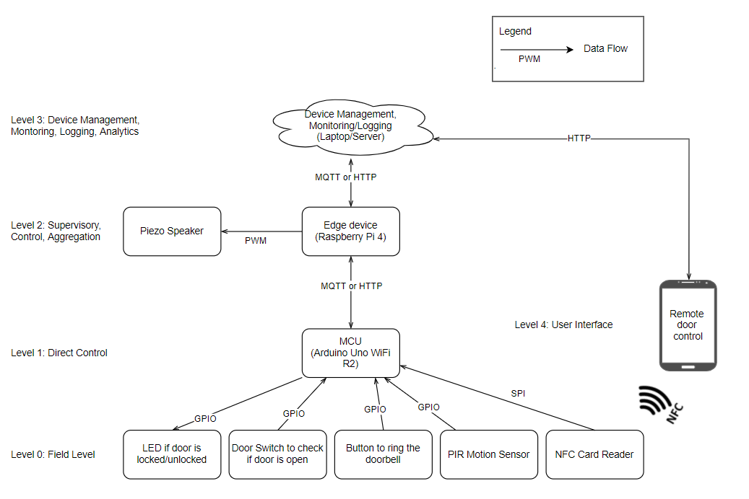
System overview

Slide 8
11
Number of main software components

Slide 9
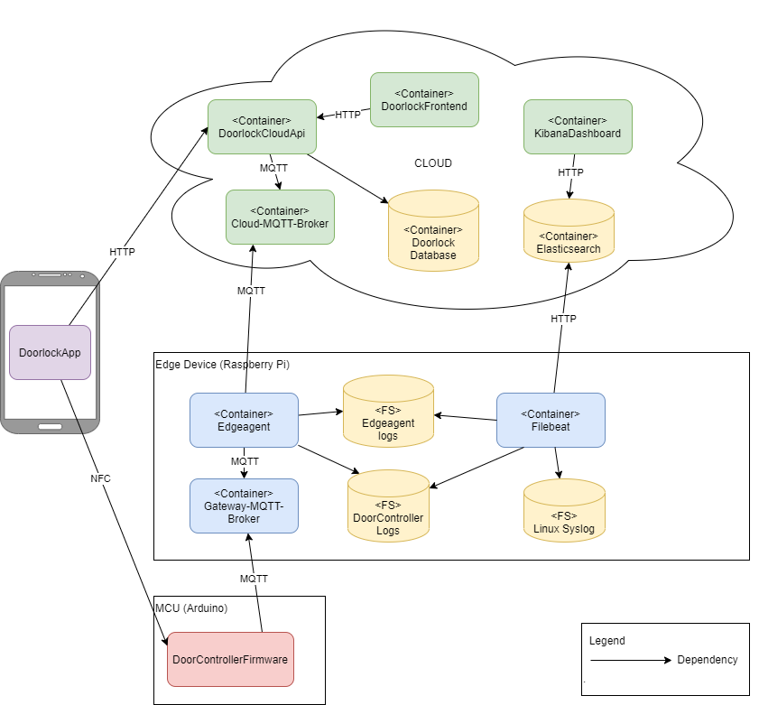

Slide 10
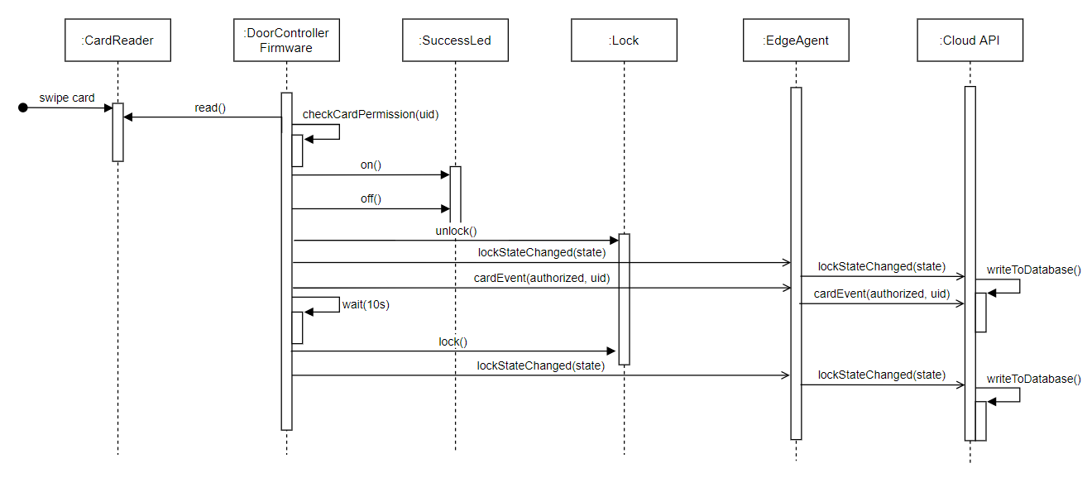
Functional Software Architecture
Notes:
But how do they interact?

Slide 11
But what if it doesn’t?

Slide 12
Elastic Stack
Elasticsearch, Kibana and Integrations
Notes:
What is the Elastic Stack?
Definition of Components
What it is for…
How it works in our Environment

Slide 13
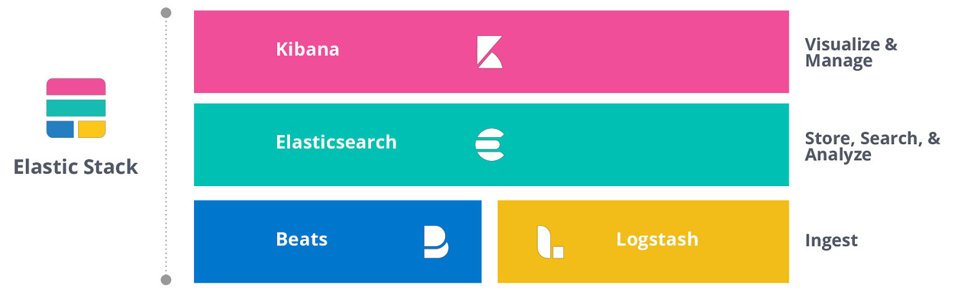
What is the Elastic Stack?

Slide 14
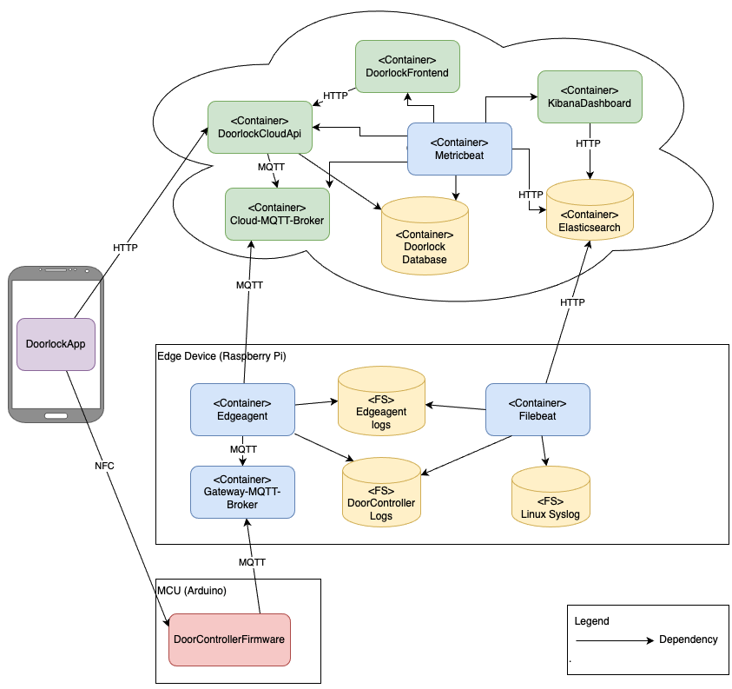
What we use it for
Log collection at Edge Device (Edge Agent, Door Controller, Edge Device itself (filesystem logs))
Log collection (metric data) at Cloud / Backend (all containers)
Why?
Monitoring
Transparency
Troubleshooting

Slide 15
Technical challenges
And how we solved them

Slide 16
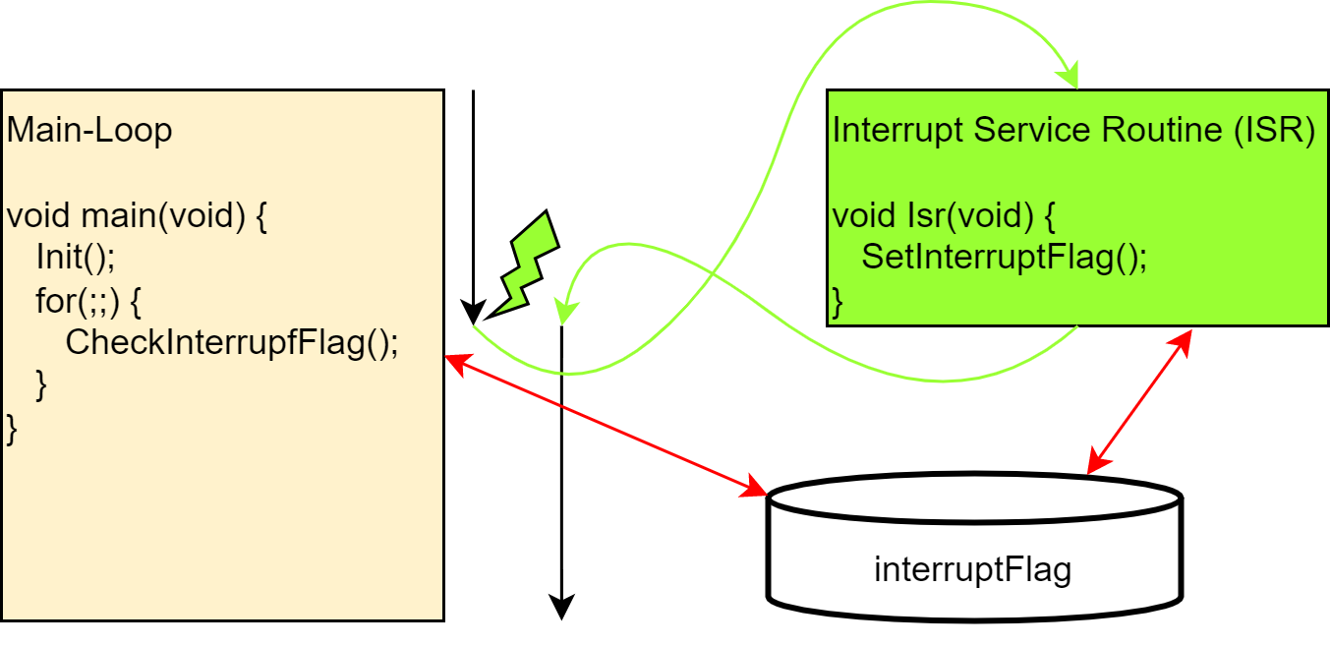
Interrupts and Reentrancy
Super-Loop vs. Event-Loop vs. RTOS
Mqtt messages and GPIO signals trigger interrupts
Actual work is done in main-loop and not inside ISR -> Set an interrupt flag (event)
Notes:
No RTOS because we don’t need to do many things in parallel
No Super-Loop because we don’t want to miss any signals
Event-Loop program is controlled over Interrupts and Events
To keep interrupt latency small we only set a flag inside the ISR and process the interrupt in the main-loop
Problem: Interrupt Flag is accessed from main-loop and from ISR -> possibility for Race Conditions

Slide 17
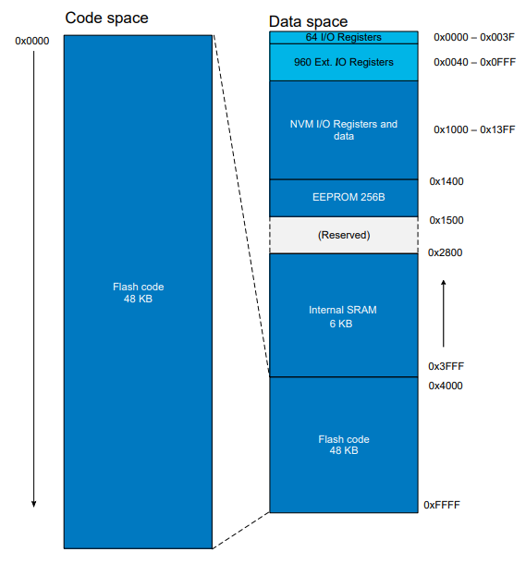
Interrupts and Reentrancy
ATmega4808 Memory Map
Use byte for atomic access, since Arduino Uno Wifi Rev2 usese an 8-bit mcu (ATmega4809).
static volatile byte interruptFlag = 0;
Use volatile to tell the compiler to not optimize any line of code containing the interruptFlag.
8 bit
Source: https://ww1.microchip.com/downloads/en/DeviceDoc/ATmega4808-09-DataSheet-DS40002173C.pdf (p.39)
Notes:
Solution: Access to Interrupt Flag needs to be reentrant -> Use of Critical Sections or use 8-bit type (e.g. byte) because an 8-bit microprocessor (ATmega4809) is used. Acceess to 8-bit types are atomic (done in one instruction)
Problem: Compiler somehow optimizes away interrupt flag, since its only incremented from inside the ISR.
Solution: Use volatile keyword to tell the compiler to not optimize any line of code which contains the interrupt flag

Slide 18
Interrupts and Reentrancy
Disbale Interrupts
#include <util/atomic.h>
void PahoMqttClient::handleMqttMessage() {
int n = QUEUE_SIZE;
ATOMIC_BLOCK(ATOMIC_RESTORESTATE) {
if(mqttMessagePointerQueue[0] != -1) {
MqttMessageHandler::handleMessage(mqttMessagePointerQueue[0]->getTopic(),
mqttMessagePointerQueue[0]->getMessage());
for(int i=0; i<n-2; i++) {
mqttMessagePointerQueue[i] = mqttMessagePointerQueue[i+1];
}
mqttMessagePointerQueue[n-1] = (MqttMessage*) -1;
}
}
}
Critical Section
Enable Interrupts again

Slide 19
03
NEXT STEPS

Slide 20
Next steps
Features
Improved App (Android & iOS)
Camera Streaming
Security (IAM, IDS/IPS, TLS, …)
Zero-Touch Deployment

Slide 21
04
DEMO
Notes:
Währenddessen WEB GUI und

Slide 22

Local unlock with card

Slide 23
Local unlock with phone

Slide 24


Ring and remote unlock with phone

Slide 25


Suspicious activity with rejected card
Notes:
Bewegungssensor erst jetzt anhängen
Becher abdecken

Slide 26


Intrusion with alarm

Slide 27
Remote unlock with web interface
Notes:
- Web Interface zeigen

Slide 28


Filtering with Kibana

Slide 29
Questions?

