Slide 1
Data Visualization
Choosing the Right Visualization
Data Sciences Institute, University of Toronto

Slide 2
We’re going to…
Explore Chapter 3 (On Rational, Scientific, Objective Viewpoints from Mythical, Imaginary, Impossible Standpoints) of D’Ignazio and Klein (2020). Data Feminism. MIT Press.
Discuss how ideas of neutrality and objectivity apply to data visualization
Understand how different elements and types of data visualization are generally perceived, and use this understanding to decide what kind of visualization we should use for a particular situation
Notes:
NOTES
The book cited is open access; the specific chapter is hyperlinked
REFERENCES
D’Ignazio, C., & Klein, L. (2020). 3. On Rational, Scientific, Objective Viewpoints from Mythical, Imaginary, Impossible Standpoints. In Data Feminism. MIT Press. https://data-feminism.mitpress.mit.edu/pub/5evfe9yd/release/5

Slide 3
So far, we have learned how to make and modify different types of data visualizations
How do we decide which of these types of data visualization to use, and when?
If we are accurately and honestly displaying our data, does the type of visualization even matter?

Slide 4
Activity: Searching for objectivity in data visualization

Slide 5
Activity
We will explore two data visualizations, each showing similar datasets with different techniques
For each visualization, discuss the following questions:
What information can we learn from this visualization?
Is this an example of objective, neutral data visualization? Why or why not?
Notes:
In small groups or as a class

Slide 6
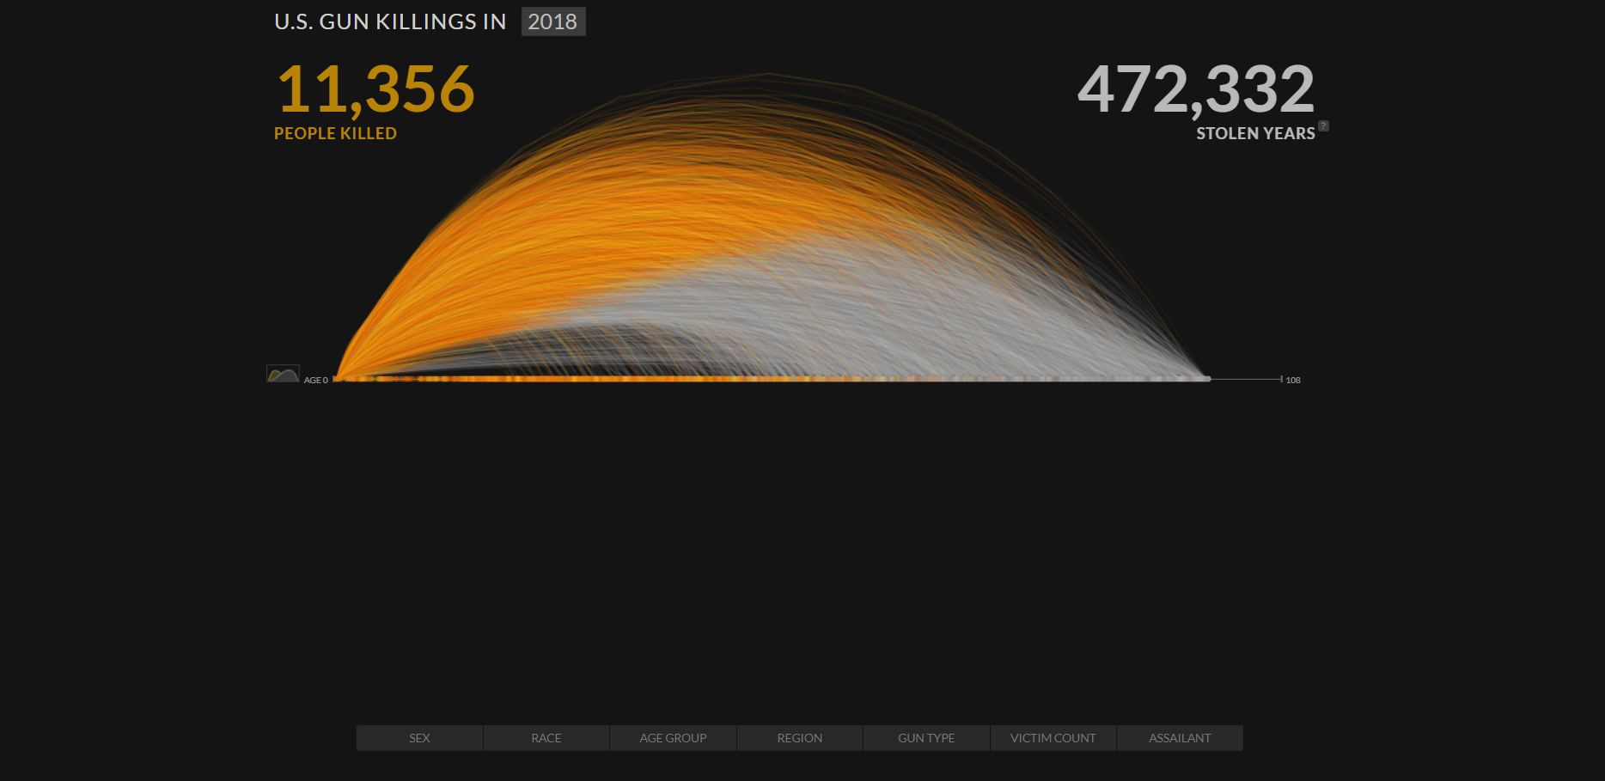
Visualization #1: US Gun Killings in 2018
(Click image to visit interactive webpage)
Notes:
There are links on the site to sources and methodology
https://guns.periscopic.com/

Slide 7
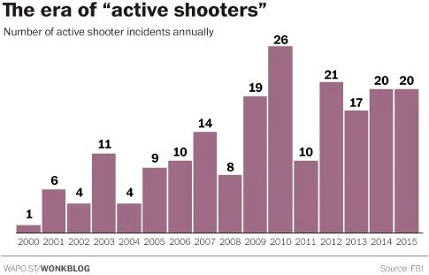
Visualization #2: Washington Post Active Shooters graphic
Notes:
The source of the underlying data is shown underneath the graph

Slide 8
Visualization #1: US Gun Killings in 2018
Periscopic’s animated visualization shows the expected years of life lost to gun violence in the United States in 2018
It emphasizes an emotion: a sense of loss
This visualization has been criticized as “actively [shaping] data to support a cause” (in this case, highlighting a lack of gun control in the United States)
(D’Ignazio & Klein, 2020)
Notes:
For after discussion

Slide 9
Visualization #2: Washington Post Active Shooters graphic
The next visualization shows a related dataset (about gun violence in the United States)
Viewers will likely reach a similar conclusion as in Visualization #1, but this plot is intended to present “a deliberately neutral emotional field, a blank page in effect, upon which viewers are more free to choose their own response to the information”
(D’Ignazio & Klein, 2020)

Slide 10
What qualities or visual elements of Visualization #2 help to make it a “blank page”?

Slide 11
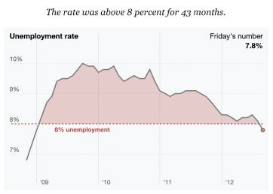
A blank page
Some of the same design elements from our ‘blank page’ Visualization #2 can be seen in this New York Times visualization of the September 2012 Jobs Report
The clean, 2D layout is designed to avoid conveying an emotional narrative to the audience
(D’Ignazio & Klein, 2020)

Slide 12
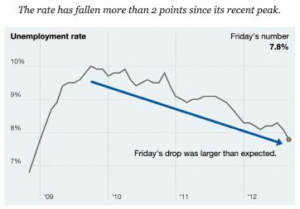
A blank page… right?
A.
B.
The Jobs Report graphic was published alongside another image:
(D’Ignazio & Klein, 2020)

Slide 13
A blank page
A.
B.
Images A and B were designed to show the exact same data from the perspectives of Republicans and Democrats, respectively
Image A emphasizes the unemployment rate staying above 8%, while Image B emphasizes the rate’s decline
Neither is technically dishonest!

Slide 14
Supporting a cause
Periscopic’s Gun Killings visualization won several year-end information visualization awards
This visualization is not neutral, and conveys an emotional narrative to the audience…
…But this visualization is not dishonest either!
(D’Ignazio & Klein, 2020)

Slide 15
So where does this leave us in our search for neutral, objective data visualization?

Slide 16
Can data visualization be neutral?

Slide 17
Short answer:
NO!

Slide 18
“The constraints of truth leave a very wide space for interpretation…”
(Stray, 2016)
Notes:
As we saw in our examples, even if our underlying data are strictly accurate and honest, we have lots of room to make our data visualizations support a narrative or particular set of conclusions, subtly or obviously
REFERENCES:
Stray, J. (2016). The Curious Journalist’s Guide to Data. Columbia Journalism Review. https://www.cjr.org/tow_center_reports/the_curious_journalists_guide_to_data.php/

Slide 19
Data visualizations as rhetorical objects
Rhetoric is the act of communicating effectively and persuasively
From D’Ignazio and Klein (2020),
“Any communicating object that reflects choices about the selection and representation of reality is a rhetorical object. Whether or not it is rhetorical (it always is) has nothing to do with whether or not it is true (it may or may not be).”
That is, we make choices about how to visualize our data, so these visualizations are not neutral…
…BUT data visualizations can be factual without being neutral
Notes:
Even if we are trying to remain as neutral and objective as possible, the act of visualizing data is ultimately an act of interpretation - we make CHOICES about what to show and how to show it, thus
Data visualizations are ultimately rhetorical objects

Slide 20
Data visualization as an interpretative, rhetorical act is not necessarily a bad thing, but one that we should be aware of.

Slide 21
Recall
Three important qualities of data visualization:
Is the visualization pleasing to look at? → Aesthetic
Does the visualization accurately and honestly present data? → Substantive
Can we understand what message the maker of the visualization is attempting to convey? → Perceptual
(Healy, 2018)
Notes:
In our intro we briefly explored three important qualities of data visualization
In our reproducibility lesson we talked about how applying principles of reproducibility to our data visualization practices can support substantive data visualization
This lesson focuses on perceptual qualities of data visualization - data visualizations are inherently rhetorical objects, so we should think about how to use that rhetoric effectively

Slide 22
Two data visualizations can share the same substantive qualities while, intentionally or not, being perceived completely differently
When we are aware of the choices we make while creating data visualizations, we can design data visualizations that are suited to the situation at hand (perceptual qualities) without sacrificing honesty and accuracy (substantive qualities)

Slide 23
What do we want our data visualization to do?
Notes:
To do this, firstly, we need to develop an understanding of the situation

Slide 24
Intended purpose
Persuading
Comparison
Evaluating
Exploring
Notes:
Our first step is to clearly articulate (even to ourselves!) what the intended purpose of our data visualization is
Including
Persuasion -> trying to use our data visualization to convince someone of some position
Comparison -> between results vs targets, changes over time, comparison between groups and sample populations
Evaluating -> Displaying experimental results or business outcomes (eg. sales)
Exploring -> attempting to make sense of complex or poorly understood datasets

Slide 25
Intended audience
Age
Education
Expertise
Accessibility
Notes:
Age
Education (an elementary schooler probably won’t understand error bars; an English major might have trouble interpreting a plot of biomedical lab results)
Subject matter expertise (do we need descriptive labels or not? Will people understand acronyms and units?)
Accessibility needs (colours, contrast, font size - more on accessible design in particular coming up in a later submodule)

Slide 26
Intended medium
Print
Web
Poster
Presentation
Notes:
Will the visual need to stand alone, or will there be accompanying text? Will you be there to explain it to everyone who sees it?
Print (academic journal or book, newspaper/magazine; think about colour versus grayscale printing, always check for journal specific formatting requirements)
Webpage (blog? Formal publication? Twitter thread? Is the visualization interactive or stationary?)
Poster (size? In person or virtual? Only visualization or are there many?)
Presentation (slide show? In person or pandemic-Zoom call style?)

Slide 27
Different purpose, different results
Notes:
Depending on the intended purpose, audience, and medium, each of our two earlier example visualizations could be the ‘better’ choice

Slide 28
How is our data visualization perceived?
Notes:
Once we understand what we’re trying to show, to whom, and via what medium, we have targets to inform the design choices we make for our visualization
We can use existing knowledge and research about how data visualizations are perceived to make the best design choices to meet our particular goals

Slide 29
Taking advantage of cognitive psychology
In general, data visualization takes advantage of human cognition to help us understand data more intuitively than we can if it is presented to us as a list or a table (Li, 2020)
By learning about how humans tend to process visual information, we can communicate more effectively with our graphs. For example…
Gestalt principles (Gestalt is German for shape) are a set of cognitive theories for how people tend to organize visual information; and are commonly used in UX design and data visualization (Wong, 2010)
Notes:
cognition
REFERENCES:
Li, Q. (2020). Overview of Data Visualization. Embodying Data, 17–47. https://doi.org/10.1007/978-981-15-5069-0_2
Padilla, L. M., Creem-Regehr, S. H., Hegarty, M., & Stefanucci, J. K. (2018). Decision making with visualizations: A cognitive framework across disciplines. Cognitive Research: Principles and Implications, 3, 29. https://doi.org/10.1186/s41235-018-0120-9
Wong, B. (2010). Gestalt principles (Part 1). Nature Methods, 7(11), 863–863. https://doi.org/10.1038/nmeth1110-863

Slide 30
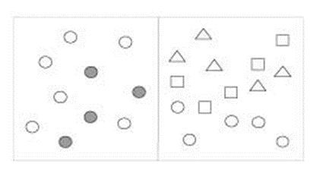
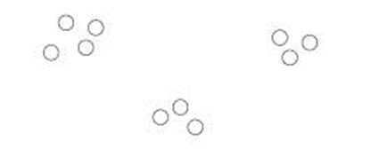
Gestalt principles
Proximity
Similarity
Objects that are close together are perceived as belonging to a group
Similar objects are grouped, regardless of proximity
Notes:
REFERENCES:
Images from https://www.interaction-design.org/literature/book/the-encyclopedia-of-human-computer-interaction-2nd-ed/data-visualization-for-human-perception

Slide 31
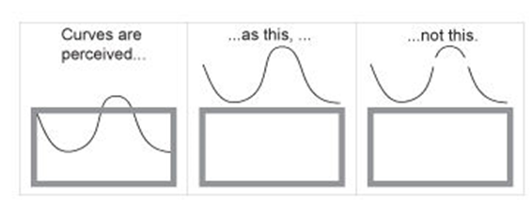

Gestalt principles
Continuity
Closure
Aligned objects or objects that appear to continue are perceived as a group
Open structures are perceived as closed/complete (our brains fill in the gaps)
Notes:
REFERENCES:
Images from https://www.interaction-design.org/literature/book/the-encyclopedia-of-human-computer-interaction-2nd-ed/data-visualization-for-human-perception

Slide 32
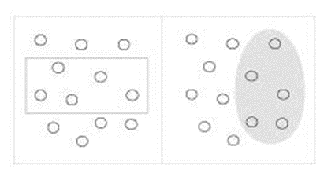
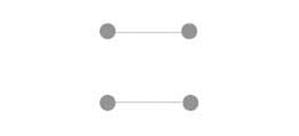
Gestalt principles
Enclosure
Connection
Objects with a boundary around them are perceived as a group
Connected objects are perceived as related/as a group
Notes:
REFERENCES:
Images from https://www.interaction-design.org/literature/book/the-encyclopedia-of-human-computer-interaction-2nd-ed/data-visualization-for-human-perception

Slide 33
Cognitive load
It can also be helpful to consider cognitive load, or the amount of work required to take in new information
Cognitive load can be divided into:
Intrinsic (the intrinsic complexity of the new information)
Germane (the audience’s familiarity with the information)
Extraneous (complexity from how the information is presented)
In a data visualization context, extraneous cognitive load is most within our control
(Leppink, 2017)
Notes:
REFERENCES:
Leppink, J. (2017). Cognitive load theory: Practical implications and an important challenge. Journal of Taibah University Medical Sciences, 12(5), 385–391. https://doi.org/10.1016/j.jtumed.2017.05.003

Slide 34
Cognitive load
Elements of a visualization that can affect cognitive load include:
Familiar vs. Rare chart types → rare types increase cognitive load
Accurate vs. Approximate interpretation → relational values or areas (approximate) increase cognitive load compared to absolute values or position (accurate)
Concise vs. Detailed composition → more visual elements increases cognitive load
Explanatory vs. Exploratory composition → a chart that the audience navigates alone increases cognitive load compared to a chart that they are guided through step-by-step
(Sibinga & Waldron, 2021)
Notes:
REFERENCES:
Sibinga, E., & Waldron, E. (2021, September 30). Cognitive Load as a Guide: 12 Spectrums to Improve Your Data Visualizations, Nightingale. Nightingale. https://nightingaledvs.com/cognitive-load-as-a-guide-12-spectrums-to-improve-your-data-visualizations/

Slide 35
Perceived factual basis
Sociologists Kennedy et al. (2016) find that adherence to four conventions of data visualization reinforces the perceived objectivity and factual basis of a visualization:
Two-dimensional image
Clean layouts
Geometric shapes and lines
Inclusion of data sources at the bottom of the image
(Kennedy et al., 2016)
Notes:
REFERENCES:
Kennedy, H., Hill, R. L., Aiello, G., & Allen, W. (2016). The work that visualisation conventions do. Information, Communication & Society, 19(6), 715–735. https://doi.org/10.1080/1369118X.2016.1153126

Slide 36
Provenance rhetoric
Citing the source(s) of our data is not only best practice (reproducibility!), but also helps people to trust our data visualizations more
Provenance rhetoric is the idea that the inclusion of a data source with our graphic signals “transparency and trustworthiness” to the audience
This increases the persuasiveness of the visualization, since viewers are more likely to believe what they see
(Hullman & Diakopoulos, 2011)
Notes:
REFERENCES:
Hullman, J., & Diakopoulos, N. (2011). Visualization Rhetoric: Framing Effects in Narrative Visualization. IEEE Transactions on Visualization and Computer Graphics, 17(12), 2231–2240. https://doi.org/10.1109/TVCG.2011.255

Slide 37
Resources for choosing data visualization types

Slide 38
Decision making tools
There are resources available online that incorporate visualization purpose and cognitive principles into reference guides to help us decide the most suitable data visualization in a given situation
Notes:
REFERENCES:

Slide 39
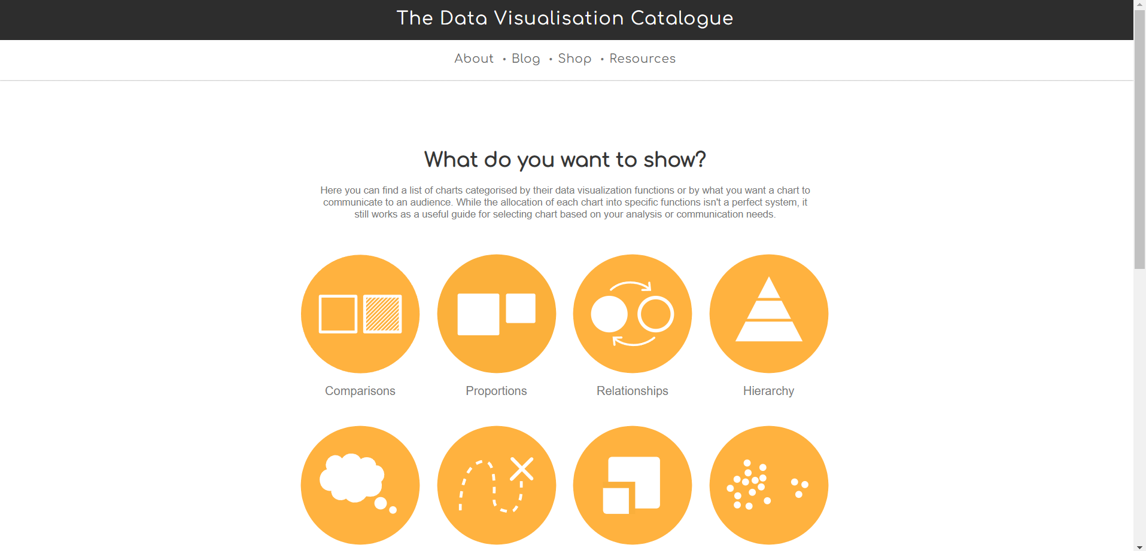
The Data Visualization Catalogue
Notes:
For example, the data visualization catalogue by Severino Ribecca (http://www.severinoribecca.one/) offers a non-code based, point-and-click interface for exploring different kinds of graphs based on intended purpose
REFERENCES:
https://datavizcatalogue.com/search.html

Slide 40
Financial Times Visual Vocabulary
The Financial Times Visual Vocabulary help sheet is available in both interactive (online PowerBI dashboard) and PDF versions
In both forms, the Visual Vocabulary offers a list of potential functions of visualizations, and several corresponding chart types and examples for each
Notes:
REFERENCES:
Interactive version https://community.powerbi.com/t5/Data-Stories-Gallery/FT-Visual-Vocabulary-Power-BI-Edition/td-p/584460
Stationary version https://github.com/Financial-Times/chart-doctor/blob/main/visual-vocabulary/poster.png

Slide 41
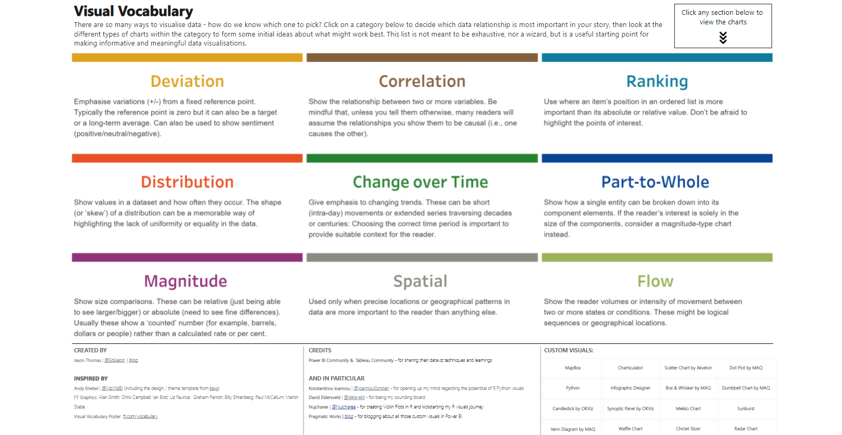
Financial Times Visual Vocabulary
Notes:
REFERENCES:

Slide 42
Next...
Subplots, multiple axes, and combining elements in matplotlib

