Slide 1
Data Visualization
Customizing Our Plots
Data Sciences Institute, University of Toronto

Slide 2
Today we will...
Make more modifications to our plots using Matplotlib, including
Legends
Annotations (text, shapes, and labels)
Axis Labels
Styles

Slide 3
Legends

Slide 4
Set up
Just like before, let’s start by loading our libraries and making some sample data
import numpy as np
import matplotlib.pyplot as plt
import pandas as pd
import scipy
import PIL
import requests
np.random.seed(613)
x = np.arange(50)
y1 = np.random.randint(0, 100,50)
y2 = np.random.randint(0, 100,50)

Slide 5
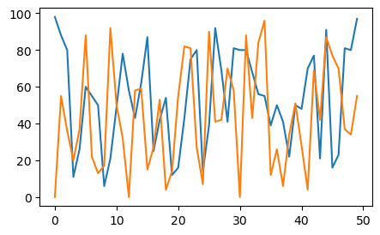
Activity: Recall
Using what we learned in lesson 2, can you make a line plot with both of our y variables on the same axes?

Slide 6
Activity: Recall
Using what we learned in lesson 2, can you make a line plot with both of our y variables on the same axes?
fig, ax = plt.subplots(figsize=(5, 3))
ax.plot(x,y1)
ax.plot(x,y2)
fig.show()

Slide 7
Adding a legend
To add a legend, we:
Add a ‘label’ argument to each plot object
Call ‘legend’ and specify our legend location
fig, ax = plt.subplots(figsize=(5, 3))
ax.plot(x,y1, label = "Person 1")
ax.plot(x,y2, label = "Person 2")
ax.legend(loc='lower right')
fig.show()

Slide 8
Modifying our legend
By adding arguments to our legend object, we can change different elements of our legend
fig, ax = plt.subplots(figsize=(5, 3))
ax.plot(x,y1, label = "Person 1")
ax.plot(x,y2, label = "Person 2")
ax.legend(loc='lower right',
frameon = True, #add frame around the legend
fontsize = 12, #change font size
ncol = 2, #specify number of columns
shadow = True)
fig.show()

Slide 9
Moving the legend outside of the plot area
We can position the legend outside of our plot by
Specifying legend location as before
Specifying where we want to anchor that location on our figure using bbox_to_anchor
fig, ax = plt.subplots(figsize=(5, 3))
ax.plot(x,y1, label = "Person 1")
ax.plot(x,y2, label = "Person 2")
ax.legend(loc=‘upper left’,
bbox_to_anchor=(1, 1))
fig.show()

Slide 10
Text and Annotations

Slide 11
Annotations with the text() function
Let’s start by putting our data into a scatter plot this time
Then use the text() function to specify coordinates and text
fig, ax = plt.subplots(figsize=(5, 3))
ax.scatter(x,y1, label = "Person 1")
ax.scatter(x,y2, label = "Person 2")
ax.legend(loc='lower right')
ax.text(10, 95, "This value is important!")
fig.show()

Slide 12
Modifying text annotations
Just like before, we can modify our text annotation by adding arguments
ax.text(10, 95, "This value is important!",
ha='center', ##alignment of text
color = 'red', ##modify font colour
size = 20) ##modify font size
fig.show()

Slide 13
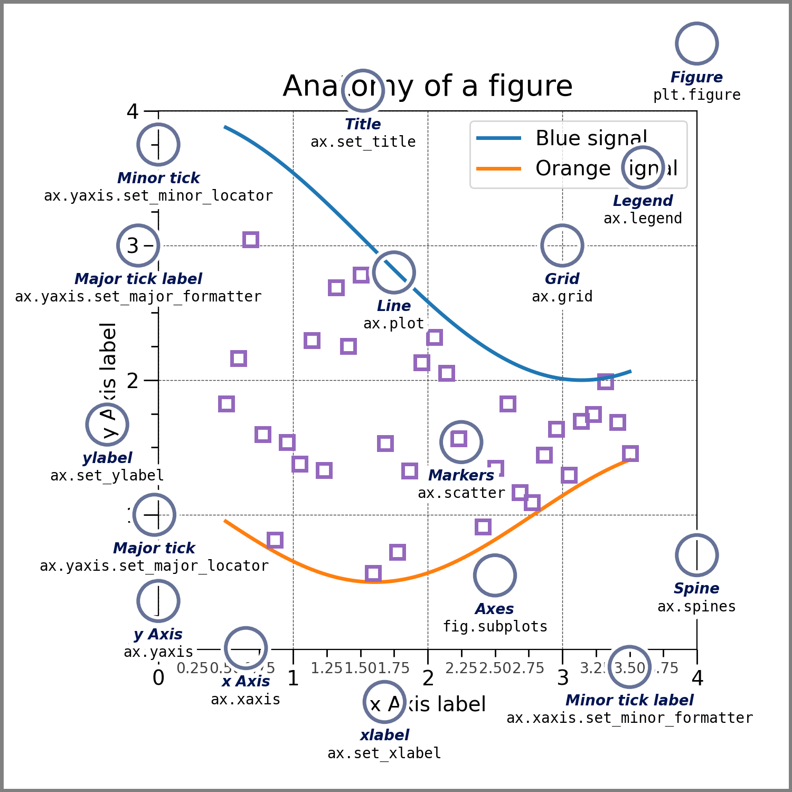
Positioning text annotations
Just now, we located our text annotation using the coordinates of data points
If we want our annotation linked to a fixed spot, we can locate it at a specific location on our axes or the figure itself (recall our matplotlib terminology)

Slide 14
Positioning text annotations
We can do this using transforms
Start by making a simple, empty set of axes
Then we can position our annotation with reference to the data (like before), the axes, or the figure (referencing axis/figure dimensions)
fig, ax = plt.subplots()
ax.axis([0, 10, 0, 10])
ax.text(1, 5, ". Data: (1, 5)", transform=ax.transData)
ax.text(0.5, 0.1, ". Axes: (0.5, 0.1)", transform=ax.transAxes)
ax.text(0.2, 0.2, ". Figure: (0.2, 0.2)", transform=fig.transFigure)

Slide 15
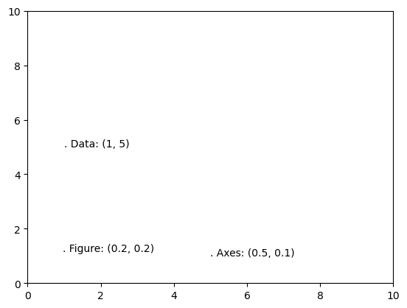
Positioning text annotations
ax.text(1, 5, ". Data: (1, 5)", transform=ax.transData)
ax.text(0.5, 0.1, ". Axes: (0.5, 0.1)", transform=ax.transAxes)
ax.text(0.2, 0.2, ". Figure: (0.2, 0.2)", transform=fig.transFigure)

Slide 16
Annotating with arrows
We can use the annotate() function to annotate with arrows and text (e.g. to focus at a specific point)
We have to specify the location to point at and the location where we want our text
fig, ax = plt.subplots(figsize=(5, 3))
ax.scatter(x,y1, label = "Person 1")
ax.scatter(x,y2, label = "Person 2")
ax.legend(loc='lower right')
ax.annotate('This is important!', xy=(10, 95), xytext=(20, 94),
arrowprops=dict(facecolor='black', shrink=0.05))
fig.show()

Slide 17
Modifying arrows
Use the arrowprops argument to adjust our arrow style and colour
Matplotlib documentation describes possible arrow styles (https://matplotlib.org/3.1.1/api/_as_gen/matplotlib.pyplot.annotate.html)
Try "->", "<->", "-[", "fancy"
ax.annotate('This is important!’,
xy=(10, 95), xytext=(20, 94),
arrowprops=dict(arrowstyle = "wedge",
color = "hotpink"))
fig.show()

Slide 18
Axis Labels

Slide 19
Removing tick marks and labels
We can remove tick marks or labels from our axis like so:
Use locator to remove ticks and labels
Use formatter to remove only labels
fig, ax = plt.subplots(figsize=(5, 3))
ax.scatter(x,y1, label = "Person 1")
ax.scatter(x,y2, label = "Person 2")
ax.legend(loc='lower right')
ax.yaxis.set_major_locator(plt.NullLocator()) ax.xaxis.set_major_formatter(plt.NullFormatter())

Slide 20
Limiting tick marks
We can also define a maximum number of ticks we want on our axis
fig, ax = plt.subplots(figsize=(5, 3))
ax.scatter(x,y1, label = "Person 1")
ax.scatter(x,y2, label = "Person 2")
ax.legend(loc='lower right')
ax.xaxis.set_major_locator(plt.MaxNLocator(3))

Slide 21
Tick mark intervals
We can set tick marks at a particular interval (in this case, 5) using MultipleLocator
fig, ax = plt.subplots(figsize=(5, 3))
ax.scatter(x,y1, label = "Person 1")
ax.scatter(x,y2, label = "Person 2")
ax.legend(loc='lower right')
ax.xaxis.set_major_locator(plt.MultipleLocator(5))

Slide 22
Rotating axis labels
To rotate axis labels and horizontal alignment, use xticks()
Try modifying fontsize and font as well
fig, ax = plt.subplots(figsize=(5, 3))
ax.scatter(x,y1, label = "Person 1")
ax.scatter(x,y2, label = "Person 2")
ax.legend(loc='lower right’)
plt.xticks(rotation=45, ha='right')

Slide 23
Activity: Modifying axis title fonts
Can you use what we did in a previous lesson to modify our x axis title?
We want a serif font with indigo colour, and for the axis title to be “Shiny New X Axis!”
Use plt.xlabel()
HINT: Recall fontdict

Slide 24
Activity: Modifying axis title fonts
Can you use what we did in a previous lesson to modify our x axis title?
We want a serif font with indigo colour, and for the axis title to be “Shiny New X Axis!”
Use plt.xlabel()
HINT: Recall fontdict
font1 = {'family':'serif','color':'indigo'}
fig, ax = plt.subplots(figsize=(5, 3))
ax.scatter(x,y1, label = "Person 1")
ax.scatter(x,y2, label = "Person 2")
ax.legend(loc='lower right')
plt.xlabel('Shiny New X Axis!', fontsize=18, fontdict = font1)

Slide 25
Styles

Slide 26
What are styles
Styles are a convenient way to change many aesthetic dimensions of our plots at the same time
To view available pre-made styles, use:
To use a style, just type the following before you make your figure:
plt.style.available
plt.style.use('fivethirtyeight')

Slide 27
What are styles
Try using different styles and see how they change your plot!
plt.style.use('fivethirtyeight’)
np.random.seed(613)
x = np.arange(50)
y1 = np.random.randint(0, 100,50)
y2 = np.random.randint(0, 100,50)
fig, ax = plt.subplots(figsize=(5, 3))
ax.plot(x,y1)
ax.plot(x,y2)
fig.show()

Slide 28
Assignment 2

Slide 29
Next...
How do we choose the right data visualization for a given situation?
What does it mean for data visualization to be ‘objective’?
Perceptual qualities of data viz

