Slide 1
Data Visualization
Beyond Matplotlib
Data Sciences Institute, University of Toronto

Slide 2
Today we will...
Learn about other packages to use for data visualization in Python, such as:
Seaborn
Plotly (for interactive viz)
Wordclouds and Venn Diagrams
Discuss when to use (and when not to use) interactive data visualization

Slide 3
Seaborn

Slide 4
What is seaborn?
A data viz package built on top of matplotlib
REALLY SIMILAR to matplotlib (phew!) but takes care of some semantic mapping for us
Recall: mapping is deciding which aspects of our dataset correspond to which visual elements on our plots

Slide 5
Install and load packages
After installing seaborn, we can load all the packages we’ll be using in this lesson
import seaborn as sns
import numpy as np
import matplotlib.pyplot as plt
import pandas as pd
import scipy
import PIL
import requests

Slide 6
Load data
We’re going to work with the ‘tips’ sample dataset, which is available as part of the seaborn (sns) package
This dataset contains information about tips at a restaurant, including meal time, party size, gender of customer, total bill amount, and tip amount
tips = sns.load_dataset("tips")
print(tips)

Slide 7
Basic plot
Let’s make a simple line plot of tip amount vs total bill
sns.lineplot(data=tips, ##choose our dataset
x='total_bill', ##define our x variable
y='tip') ##define our y variable

Slide 8
Use premade styles
We can use premade styles to alter the appearance of our plot
Try other preset styles like ‘darkgrid’, ‘whitegrid’, ‘dark’, ‘white’, ‘ticks’, then make our line plot again – how has it changed?
sns.set_style('whitegrid')

Slide 9
Add title and axis labels
Seaborn can do many of the same things as matplotlib, like adding labels We do this using the set. function
tipgraph = sns.lineplot(data=tips,
x='total_bill',
y='tip')
tipgraph.set(title='Tips vs. Total Bill',
xlabel='Total Bill ($)',
ylabel='Tip Amount ($)')

Slide 10
Modify aesthetic elements
Like in base matplotlib, we can use the subplots function to change figure size
fig = plt.subplots(figsize=(10, 3))

Slide 11
Modify aesthetic elements
We can also change colour, marker style, and line style
tipgraph = sns.lineplot(data=tips,
x='total_bill',
y='tip',
color = 'hotpink',
linestyle = '--',
linewidth = 3,
marker = 'o',
markerfacecolor = 'indigo')

Slide 12
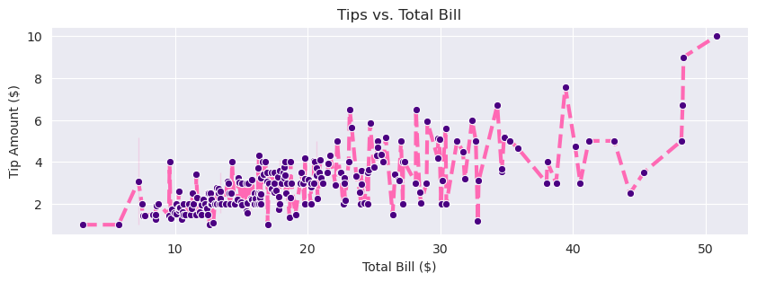
Modify aesthetic elements

Slide 13
BUT why is seaborn actually an improvement?

Slide 14
Add multiple variables
Seaborn makes it very easy to represent multiple variables with different visual elements of our graph
tipgraph = sns.scatterplot(data=tips, x='total_bill',
y='tip’, style = 'time', hue =
'day’, palette = ['purple’, 'hotpink', 'deepskyblue’, 'yellowgreen'])
tipgraph.set(title='Tips vs. Total Bill',
xlabel='Total Bill ($)',
ylabel='Tip Amount ($)')

Slide 15
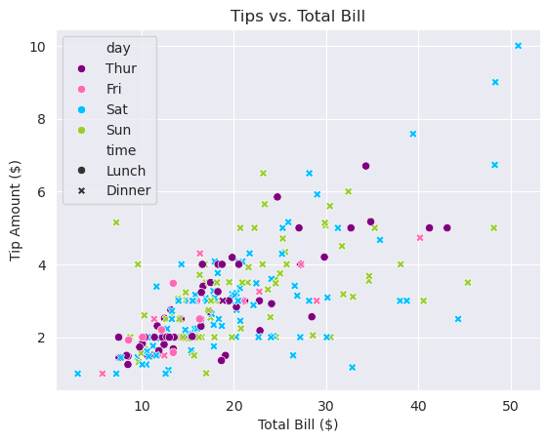
Add multiple variables

Slide 16
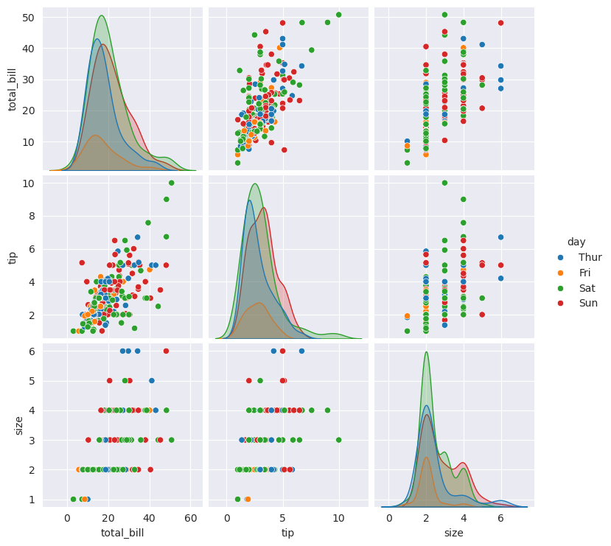
Pairplot
pairplot is another convenient way to compare variables
sns.pairplot(
data = tips,
hue = 'day')

Slide 17
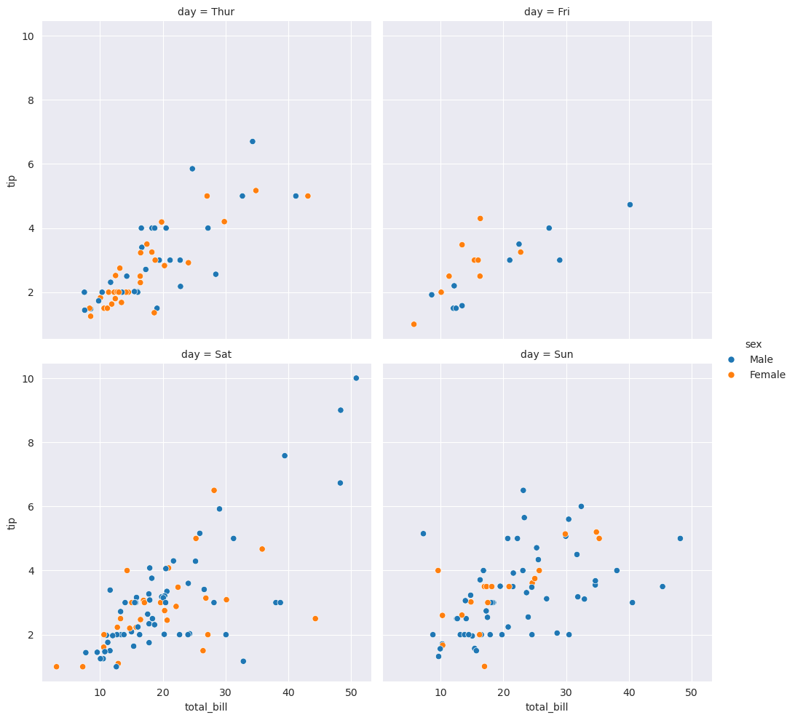
Relplot
relplot also lets us explore specific levels within variables
daysplot = sns.relplot(
data=tips,
x="total_bill",
y="tip",
hue="sex",
col="day",
kind="scatter",
col_wrap=2)
Activity: Comment this snippet of code and describe what each new element is doing

Slide 18
Seaborn resources:
Datacamp has a seaborn cheatsheet that covers the basics: https://images.datacamp.com/image/upload/v1676302629/Marketing/Blog/Seaborn_Cheat_Sheet.pdf
Or look at the seaborn gallery: http://seaborn.pydata.org/examples/index.html

Slide 19
Case Study: Gender bias in teaching evaluations
Notes:
NOTES:

Slide 20
How does faculty gender impact course evaluations?
The gender of instructors (perceived or actual) influences how they are scored by students on teaching and course evaluations, with student evaluations tending to be significantly biased in favour of men and against women, even when all else is equal
The bias in these student evaluations can adversely impact the ability of female scholars to be “full-time tenure-track, to hold tenured positions, to attain higher leadership roles in academia, and to earn the same salary as males in the same positions”
(Chavez & Mitchell, 2020; MacNell et al., 2015)
Notes:
NOTES:
The studies here focus on binary gender variables (male/female) and do not account for non-binary professors and course instructors; Medeiros, M., Forest, B., & Öhberg, P. (2020). The Case for Non-Binary Gender Questions in Surveys. PS: Political Science & Politics, 53(1), 128–135. https://doi.org/10.1017/S1049096519001203 raise the question of whether or not the inclusion of a non-binary/other option for gender questions on surveys may alter individuals’ evaluation of the survey
REFERENCES:
Rivera, L. A., & Tilcsik, A. (2019). Scaling Down Inequality: Rating Scales, Gender Bias, and the Architecture of Evaluation. American Sociological Review, 84(2), 248–274. https://doi.org/10.1177/0003122419833601
Chávez, K., & Mitchell, K. M. W. (2020). Exploring Bias in Student Evaluations: Gender, Race, and Ethnicity. PS: Political Science & Politics, 53(2), 270–274. https://doi.org/10.1017/S1049096519001744
MacNell, L., Driscoll, A., & Hunt, A. N. (2015). What’s in a Name: Exposing Gender Bias in Student Ratings of Teaching. Innovative Higher Education, 40(4), 291–303. https://doi.org/10.1007/s10755-014-9313-4

Slide 21
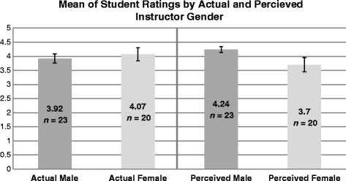
Mean of Student Ratings by Actual and Perceived Instructor Gender (MacNell et al., 2015)
Notes:
NOTES:
This plot, taken from one of the studies cited on the previous slide, visualizes some data about student ratings of male and female course instructors for an online, asynchronous course (where they could be led to believe that a female instructor was male, and vice versa)
This graph resembles a lot of the other graphs we’ve made and evaluated during this module, and does a pretty good job (shows error intervals; data labels, clear font; grayscale likely because of journal formatting standards)
Opportunity for discussion/opinions
REFERENCES
MacNell, L., Driscoll, A., & Hunt, A. N. (2015). What’s in a Name: Exposing Gender Bias in Student Ratings of Teaching. Innovative Higher Education, 40(4), 291–303. https://doi.org/10.1007/s10755-014-9313-4

Slide 22
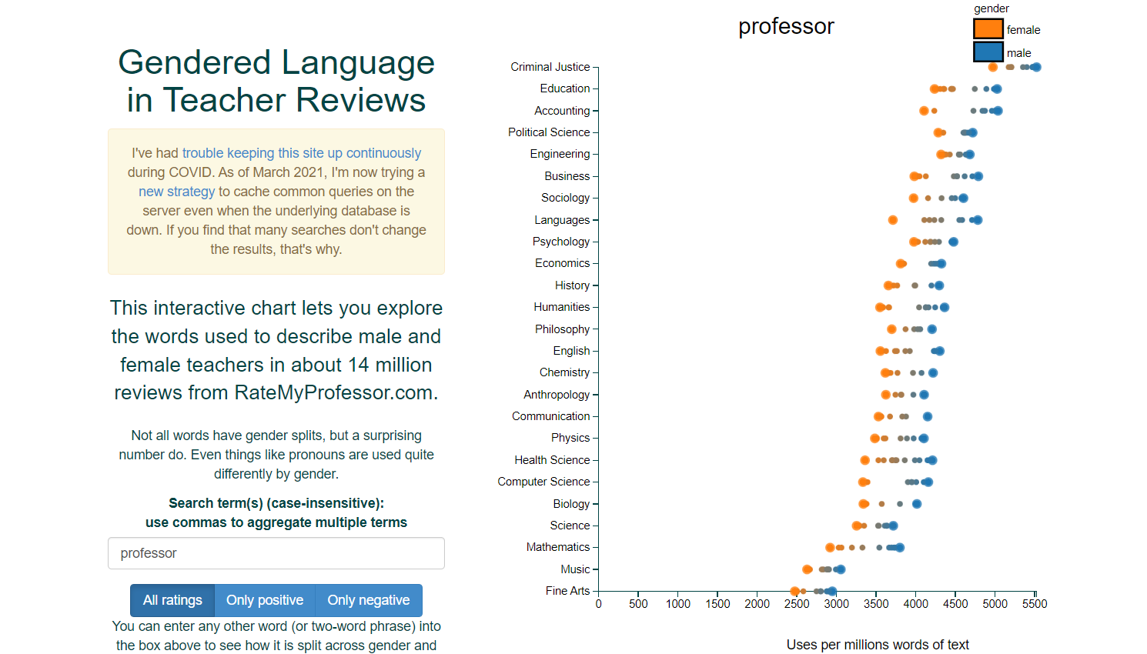
Gendered Language in Teacher Reviews (Schmidt, 2015)
(Click to go to dynamic visualization)
Notes:
NOTES:
Have students open the link to view/interact with the viz
This image isn’t from a peer-reviewed journal, but is an interactive/dynamic visualization that allows you to view the relative prevalence of certain words or phrases in reviews of male and female course instructors on RateMyProfessor.com
Try entering in some key words (try ‘sweet’, ‘genius’, ‘funny’)
REFERENCES
Schmidt, B. (2015). Gendered Language in Teaching Evaluations. Gender and Teacher Reviews. http://benschmidt.org/profGender/#
For more background on the viz and inclusions/exclusions, see: http://benschmidt.org/2015/02/06/rate-my-professor/

Slide 23
Activity: Comparing data visualizations
Let’s discuss the two examples.
How are they different? What does each visualization ‘do’?
What are the pros and cons of each?
Notes:
NOTES:

Slide 24
Static vs. dynamic data visualization
Notes:
NOTES:

Slide 25
Defining static vs. dynamic data visualization
Static data visualization
An image-based chart or infographic (think PDF, PNG, JPG)
A snapshot of data
Most of what we have seen so far in this course
Dynamic data visualization
Interactive applications or web pages that allow users to modify or filter a data visualization
Multiple data stories in one
Notes:
NOTES:
REFERENCES:

Slide 26
Benefits of dynamic data visualizations
Dynamic data visualizations
Can provide information that cannot be obtained from static charts
Are useful for viewing individual-level data
Allow audiences to explore the data in-depth, supporting transparency and reproducibility
Can increase interest and engagement in research outputs
(Weissgerber et al., 2016)
Notes:
NOTES:
REFERENCES:
Weissgerber, T. L., Garovic, V. D., Savic, M., Winham, S. J., & Milic, N. M. (2016). From Static to Interactive: Transforming Data Visualization to Improve Transparency. PLOS Biology, 14(6), e1002484. https://doi.org/10.1371/journal.pbio.1002484

Slide 27
Costs of dynamic data visualizations
Dynamic data visualizations
Make it more challenging to tell a single clear story or communicate a clear message
Can be confusing or overwhelming for audiences
Present access and sharing challenges (e.g. an image can be viewed in print, online, on mobile, but a dynamic viz might need to be hosted on a particular platform or software)

Slide 28
Designing dynamic data visualizations
Notes:
NOTES:

Slide 29
Considerations
Best practices for data visualization and accessibility still apply, but we also need to consider unique elements of dynamic data visualizations. For example:
Are the interactive elements easy to navigate?
Are the interactive elements accessible?
How much time will your audience have to interact with the data visualization?
Important: Do interactive features actually help your data visualization serve your purpose?
Notes:
NOTES:
Are the interactive elements easy to navigate? - people have to be able to actually use the viz and figure out how to make the changes
Are interactive elements accessible? - think about spacing out buttons, how large of a space people have to click on something, do people know what all the buttons/filters mean
How much time? - If people will have 30 seconds to interact with your viz (e.g. on a computer display at a conference) the interactive options will have to be simple and limited, vs. if you’re making a web page that they can spend as long as they want playing around with
Important - dynamic data visualizations are really cool! But don’t fall into the ‘coolness trap’ of making complex, dynamic data viz just because you can. Sometimes, simpler is better - for example, if you need your graph to quickly display data to make a point, a premade static image will probably be more effective

Slide 30
Elements of dynamic data visualizations
We can conceptualize changes to our dynamic data visualizations in terms of how they affect two visual elements of our plots:
Spatial elements → Position and quantity (e.g. number of data points on a plot, scales of axes)
Retinal elements → Size, brightness, rotation, patterning, shape, and colour
We need to consider: in our dynamic data visualizations, will spatial and retinal elements be fixed or mutable? Can they be created and deleted based on user interaction? Can their meanings change?
(Cottam et al., 2012)
Notes:
NOTES:
REFERENCES:
Cottam, J. A., Lumsdaine, A., & Weaver, C. (2012). Watch this: A taxonomy for dynamic data visualization. 2012 IEEE Conference on Visual Analytics Science and Technology (VAST), 193–202. https://doi.org/10.1109/VAST.2012.6400552

Slide 31
Types of changes
Identity-preserving | Maintain associations between visual elements and underlying data Some part of a representation stays constant (eg. keeping the relative position of data points constant) Important for comparing across time/snapshots
Transitional | Maintain some associations, and limit changes to known values New elements may be added or changed Balance flexibility with the ability to compare over short period of time/small changes between snapshots
Immediate | Generally do not preserve associations Create and delete elements, alter scales, remaps variables every time a new ‘snapshot’ is created Does not allow for comparison across time/snapshots
(Cottam et al., 2012)
Notes:
NOTES:
We can decide the ways we want our dynamic data visualization to change based on what we want to accomplish
This falls under perceptual characteristics of data viz! Thinking about how our choices will affect how people perceive our graphs.
Each of these types of change has benefits and drawbacks; think about cognitive load, processing power/complexity of implementation
REFERENCES:
Cottam, J. A., Lumsdaine, A., & Weaver, C. (2012). Watch this: A taxonomy for dynamic data visualization. 2012 IEEE Conference on Visual Analytics Science and Technology (VAST), 193–202. https://doi.org/10.1109/VAST.2012.6400552

Slide 32
Activity: Types of changes
Return to our earlier example of gendered language from RateMyProfessor.com
What types of changes occur when we interact with this dynamic data visualization?
Which spatial and retinal elements stay constant? Which change?
If you were redesigning this viz, would you choose to make different changes? Why or why not?
Notes:
NOTES:
Things of interest - axes and scales change, which could be confusing/make comparison between snapshots hard; colours for men vs women stay constant, which is useful for easily understanding what we’re looking at
REFERENCES:
http://benschmidt.org/profGender/#%7B%22database%22%3A%22RMP%22%2C%22plotType%22%3A%22pointchart%22%2C%22method%22%3A%22return_json%22%2C%22search_limits%22%3A%7B%22word%22%3A%5B%22professor%22%5D%2C%22department__id%22%3A%7B%22%24lte%22%3A25%7D%7D%2C%22aesthetic%22%3A%7B%22x%22%3A%22WordsPerMillion%22%2C%22y%22%3A%22department%22%2C%22color%22%3A%22gender%22%7D%2C%22counttype%22%3A%5B%22WordsPerMillion%22%5D%2C%22groups%22%3A%5B%22department%22%2C%22gender%22%5D%2C%22testGroup%22%3A%22D%22%7D

Slide 33
Plotly

Slide 34
Setting up
First, let’s import our package and make some sample data
import plotly.graph_objects as go ##'go' is 'graph objects’
x1 = np.array(["Luffy", "Zoro", "Nami", "Usopp", "Sanji"])
y1 = np.array([110, 180, 240, 99, 220])

Slide 35
Making our plot
Plotly syntax is different from matplotlib/seaborn
First, make our figure
Next, choose our plot type (bar) and our data
graph = go.Figure()
graph.add_trace(go.Bar(x=x1, y=y1))

Slide 36
Making our plot
Next, update our layout to include titles
Finally, show our plot!
graph.update_layout(
title="Pirate Scores",
xaxis_title="Pirates",
yaxis_title="Score")
graph.show()

Slide 37
Plotly features
If we hover over the bars on our plot, we get automatic data labels
If we click and drag over a portion of our plot, we can zoom in
Double click to zoom back out
We can click and drag on our axis to scroll
In the upper-right menu:
Save as PNG
Pan/zoom
Box/Lasso select

Slide 38
Exporting plotly graphs
We can also save plotly graphs as HTML files and embed them in our webpages!
graph.write_html("../../folders/pirategraph.html")

Slide 39
Customizing plotly graphs
graph = go.Figure()
graph.add_trace(go.Scatter(x=x1, y=y1, mode='markers', ##we want points for a scatter plot
marker=dict(
size=15, ##point size
color='hotpink', ##point colour
opacity=1, ##point transparency/alpha
line=dict(width=5, color='purple') ##point outline
)))
graph.update_layout(
title='Interactive Pirate Plot',
xaxis_title='Pirates',
yaxis_title='Scores',
width=500, height=500)

Slide 40
Wordclouds and venn diagrams

Slide 41
Why use code for qualitative viz?

Slide 42
Making wordclouds
Import the wordcloud package and load our sample dataset of movie quotes
from wordcloud import WordCloud
df = pd.read_csv("https://raw.githubusercontent.com/prasertcbs/basic-dataset/master/movie_quotes.csv",
on_bad_lines='skip')
df

Slide 43
Making wordclouds
We’ll make a simple word cloud using the ‘quote’ variable
##join all our text from each row from our quote column into a string
text = " ".join(each for each in df.quote)
##generate our wordcloud image
wordcloud = WordCloud(background_color="white",
colormap = 'inferno').generate(text)
##use matplotlib syntax to put our image in a figure
fig, ax = plt.subplots(figsize=(7, 3))
ax.imshow(wordcloud, ##remember 'imshow' from when we added pictures to our matplotlib axes
interpolation='bilinear') ##this line helps smooth our image
ax.axis("off")
plt.show()

Slide 44
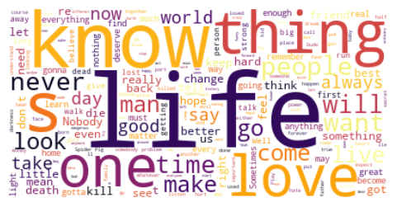
Making wordclouds

Slide 45
Making venn diagrams
We can use the matplotlib_venn extension to make venn diagrams
First import the package
Then define our sets
from matplotlib_venn import venn2, venn2_circles, venn2_unweighted
A = set(["apple", "banana", "watermelon"])
B = set(["pumpkin", "blueberry", "apple", "key lime"])

Slide 46
Making venn diagrams
Next, assign our sets to each circle and modify the appearance
diagram = venn2_unweighted([A, B],
set_labels = ('Fruits', 'Pies'),
set_colors=("blue", "red"),
alpha=0.5)
plt.show()

Slide 47
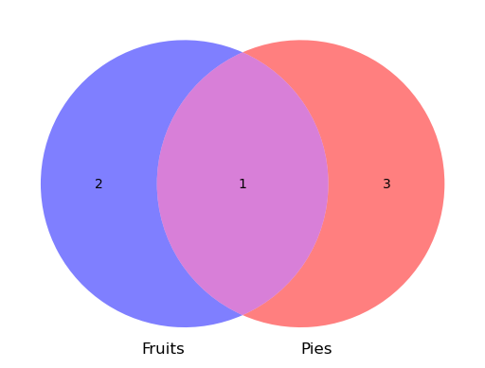
Making venn diagrams
By default, our output will only show counts of how many items are in each set

Slide 48
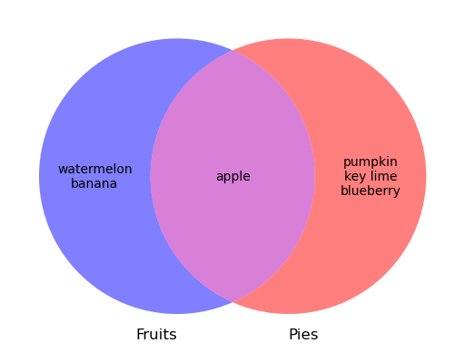
Modifying venn diagrams
diagram.get_label_by_id("10").set_text("\n".join(A - B))
diagram.get_label_by_id("11").set_text("\n".join(A & B))
diagram.get_label_by_id("01").set_text("\n".join(B - A))
*The numbers in our brackets come from the documentation

