Slide 1
Data Visualization
Subplots and Combining Visualizations
Data Sciences Institute, University of Toronto

Slide 2
Today we will...
Learn about subplot notation in matplotlib
Put multiple visualizations on the same axes objects
Show errors
Adjust figure layout
Add images to plots

Slide 3
Subplots

Slide 4
Recall: How does matplotlib work?
A figure is like a container that holds a set of axes
The axes is our actual plot or graph
A figure can hold multiple axes (like subplots)
Every visual element of our plots – colour, legends, axis titles and scales, text – is called an artist and belongs to an axes (not to a figure)

Slide 5
Setting up
Let’s start by loading our libraries and generating some new sample data
import numpy as np
import matplotlib.pyplot as plt
import pandas as pd
import scipy
import PIL
import requests
np.random.seed(613)
x1 = np.arange(50)
y1 = np.random.randint(0, 75,50)
x2 = np.array(["Luffy", "Zoro", "Nami", "Usopp", "Sanji"])
y2 = np.array([110, 180, 240, 99, 220])

Slide 6
Introducing subplots
In past lessons, to define our figure and its one axes, we would type:
Now we want to have two plots next to each other, so we just have to define multiple axes and their relative positions:
fig, ax = plt.subplots(figsize=(5, 3))
fig, (ax1, ax2) = plt.subplots(ncols=2,
nrows=1,
figsize=(7, 3))

Slide 7
Introducing subplots (cont.)
Then we can use our new figure, with its two axes, and define the types of viz that we want to see in each
fig, (ax1, ax2) = plt.subplots(ncols=2,
nrows=1,
figsize=(7, 3))
ax1.scatter(x1,y1)
ax2.bar(x2,y2)
fig.show()

Slide 8
Activity: Customizing our plots
Refer to past slides and class activities to customize the subplots we just made
Think about adding titles or annotations, or modifying colour, marker type, and fonts – differently for each subplot
Share your resulting images in the chat!

Slide 9
Subplots without a grid arrangement?
We can also arrange the subplots within our figure by using plt.subplot_mosaic()
Each axes in our subplot_mosaic() function has a ‘label’
fig, someaxes = plt.subplot_mosaic([['ax1', 'ax3'],
['ax2', 'ax3']],
figsize=(7, 4))
for label, ax in someaxes.items():
ax.text(0.5, 0.5, f'This is {label!r}',
fontsize=14,
ha = 'center',
transform=ax.transAxes)

Slide 10
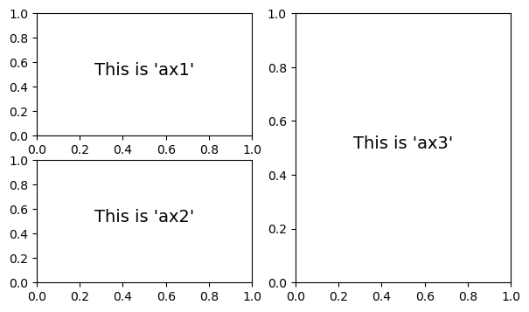
Subplots without a grid arrangement?
fig, someaxes = plt.subplot_mosaic([['ax1', 'ax3'],
['ax2', 'ax3']],
figsize=(7, 4))
for label, ax in someaxes.items():
ax.text(0.5, 0.5, f'This is {label!r}',
fontsize=14,
ha = 'center',
transform=ax.transAxes)

Slide 11
Subplots without a grid arrangement - Data
Once we’ve made our mosaic, we can add data to each of our subplots the same way we did before! Just reference each axes label in our someaxes list:
fig, someaxes = plt.subplot_mosaic([['ax1', 'ax3'],
['ax2', 'ax3']],
figsize=(7, 4))
someaxes["ax1"].scatter(x1,y1)
someaxes["ax2"].bar(x2,y2)
someaxes["ax3"].plot(x1,y1)
plt.show()

Slide 12
Modify figure layout

Slide 13
Layouts
Let’s try adding some very large x axis titles to our previous plot
fig, someaxes = plt.subplot_mosaic([['ax1', 'ax3'],
['ax2', 'ax3']],
figsize=(7, 4)) someaxes["ax1"].scatter(x1,y1)
someaxes["ax2"].bar(x2,y2)
someaxes["ax3"].plot(x1,y1)
someaxes["ax1"].set_xlabel('A Big Label', fontsize=18)
someaxes["ax2"].set_xlabel('Another Label', fontsize=18)
someaxes["ax3"].set_xlabel('Label 2: 2 Fast 2 Furious', fontsize=18)
plt.show()

Slide 14
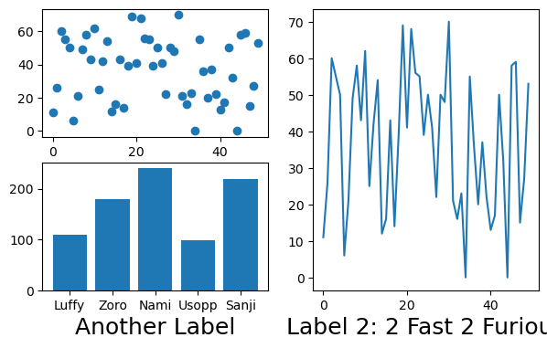
Layouts
The axis title for our scatter plot doesn’t appear, and the axis title for our line plot is cut off!

Slide 15
Layouts
We can use layouts to make sure that our subplots fit neatly in our figure area
There are two main kinds of layout we consider:
Tight layout adjusts subplots so tick labels, axis labels, and titles don't overlap or leave the figure area
Constrained layout works similarly except it also fits things like legends or colorbars

Slide 16
Layouts
First let’s see how a constrained layout changes our plot:
fig, someaxes = plt.subplot_mosaic([['ax1', 'ax3'],
['ax2', 'ax3']],
figsize=(7, 4),
layout = "constrained") someaxes["ax1"].scatter(x1,y1)
someaxes["ax2"].bar(x2,y2)
someaxes["ax3"].plot(x1,y1)
someaxes["ax1"].set_xlabel('A Big Label', fontsize=18)
someaxes["ax2"].set_xlabel('Another Label', fontsize=18)
someaxes["ax3"].set_xlabel('Label 2: 2 Fast 2 Furious', fontsize=18)
plt.show()

Slide 17
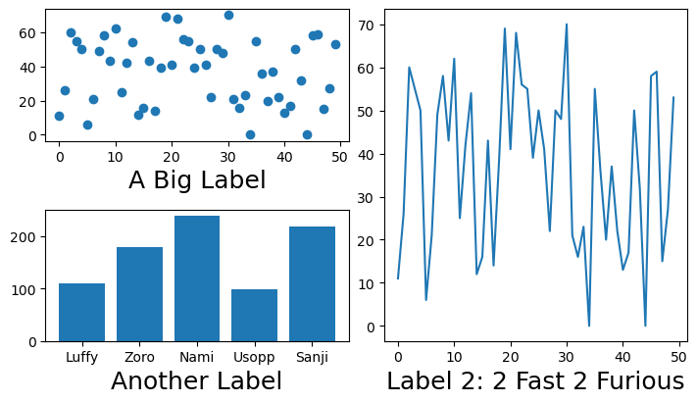
Layouts Comparison
No layout specified
Constrained layout

Slide 18
Multiple viz on one axes

Slide 19
Multiple viz on one axes object
Super easy: just call multiple plot methods on the same axes
##first make our sample data
x = np.array(["Luffy", "Zoro", "Nami", "Usopp", "Sanji"])
y1 = np.array([110, 180, 240, 99, 220])
y2 = np.array([170, 100, 90, 120, 50])
##define our figure and axes (just one this time)
fig, ax = plt.subplots(figsize=(7, 3))
##now call both bar and plot elements to the same axes (ax)
ax.bar(x, y1,
color = "indigo")
ax.plot(x, y2,
color = "red")

Slide 20
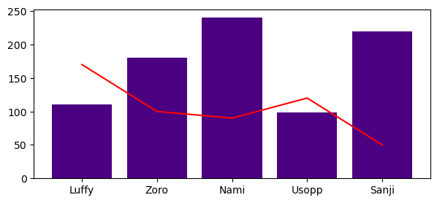
Multiple viz on one axes object
Annotations, shapes, etc. can be added as usual!

Slide 21
Add error information

Slide 22
Adding error information
First, calculate standard deviation of our data
Then plot our line as before
y2_sd = np.std(y2)
fig, ax = plt.subplots(figsize=(7, 3))
ax.plot(x, y2, color = "red")

Slide 23
Adding error information
Then use errorbar() to add in our error line (standard deviation in this case, but could be whatever value you calculated)
yerr specifies that we’re plotting vertical error bars
fmt makes sure we’re not plotting the actual data points, only the error
ax.errorbar(x, #our x values
y2, #our y values
yerr = y2_sd,
fmt = "none")

Slide 24
Customizing errorbar appearance
fig, ax = plt.subplots(figsize=(7, 3))
ax.plot(x, y2,
color = "red")
ax.errorbar(x,
y2,
yerr = y2_sd,
fmt = "none",
ecolor = "indigo",
elinewidth = 4,
capsize = 6,
capthick = 4)

Slide 25
Errorevery
If we don’t want to see error bars for every single point, we can specify intervals using errorevery
ax.errorbar(x,
y2,
yerr = y2_sd,
fmt = "none",
ecolor = "indigo",
elinewidth = 4,
capsize = 6,
capthick = 4,
errorevery = 2)

Slide 26
Add images to plots

Slide 27
Notes:
You know enough at this point to do this! It’s not ~necessary~ but it’s a nice thing to know and can be a nice touch when we’re doing data viz in public communications settings.

Slide 28
Using images from the internet
First let’s load our libraries
Then get our image from the internet
from PIL import Image ##to open images
import requests ##to get images from URLs
from io import BytesIO ##to store images
response = requests.get('https://upload.wikimedia.org/wikipedia/en/c/cb/Monkey_D_Luffy.png')
image_file = BytesIO(response.content)
image = Image.open(image_file)

Slide 29
Adding an image to a plot
Now make a basic line plot (reusing our data)
Then overlay a new axis (‘ax_image’) on our figure (on top of ‘ax’) to act as a container for our image
fig, ax = plt.subplots(figsize=(7, 3))
ax.plot(x, y2, color = "red")
ax_image = fig.add_axes([0.1, ##x coordinate (ON FIGURE, NOT AXES)
0.11, ##y coordinate (ON FIGURE, NOT AXES)
0.15, ##image width
0.35] ##image height)

Slide 30
Adding an image to a plot
Then add imshow() to add the image we prepared before
fig, ax = plt.subplots(figsize=(7, 3))
ax.plot(x, y2,
color = "red")
ax_image = fig.add_axes([0.1, 0.11, 0.15, 0.35])
ax_image.imshow(image)
ax_image.axis('off’)
plt.show()

Slide 31
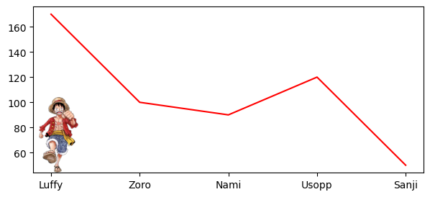
Adding images to our plots

Slide 32
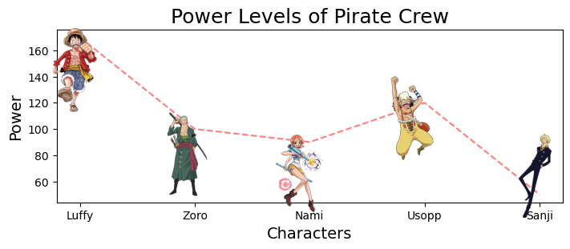
What can we make?

Slide 33
Next...
Accessible data visualization, including
Colour
Text
Image description and alt. text

