Slide 1
Data Visualization
Getting Started
Data Sciences Institute, University of Toronto

Slide 2
Prerequisites
You have installed the numpy, matplotlib, pandas, scipy, PIL, and requests libraries in Python

Slide 3
Today we will...
Learn about matplotlib
Produce our first data viz in Python
Begin to modify elements of our data viz, including
Colour
Line type
Marker size
Apply our visualization evaluation skills to matplotlib images

Slide 4
matplotlib

Slide 5
What is matplotlib?
An open source package for data visualization in Python
Developed in 2003 to emulate Matlab software
One package, a LOT of different types of data visualizations
Notes:
The R Graph Gallery (https://www.r-graph-gallery.com/all-graphs.html) is a great source with sample visualizations (and corresponding code) that can be made with ggplot and its extensions
Click on images to see their respective pages in the ggplot gallery
To cite ggplot: H. Wickham, 2016. ggplot2: Elegant Graphics for Data Analysis. Springer-Verlag New York.

Slide 6
How does matplotlib work?
A figure is like a container that holds a set of axes
The axes is our actual plot or graph
A figure can hold multiple axes (like subplots)
Every visual element of our plots – colour, legends, axis titles and scales, text – is called an artist and belongs to an axes (not to a figure)

Slide 7
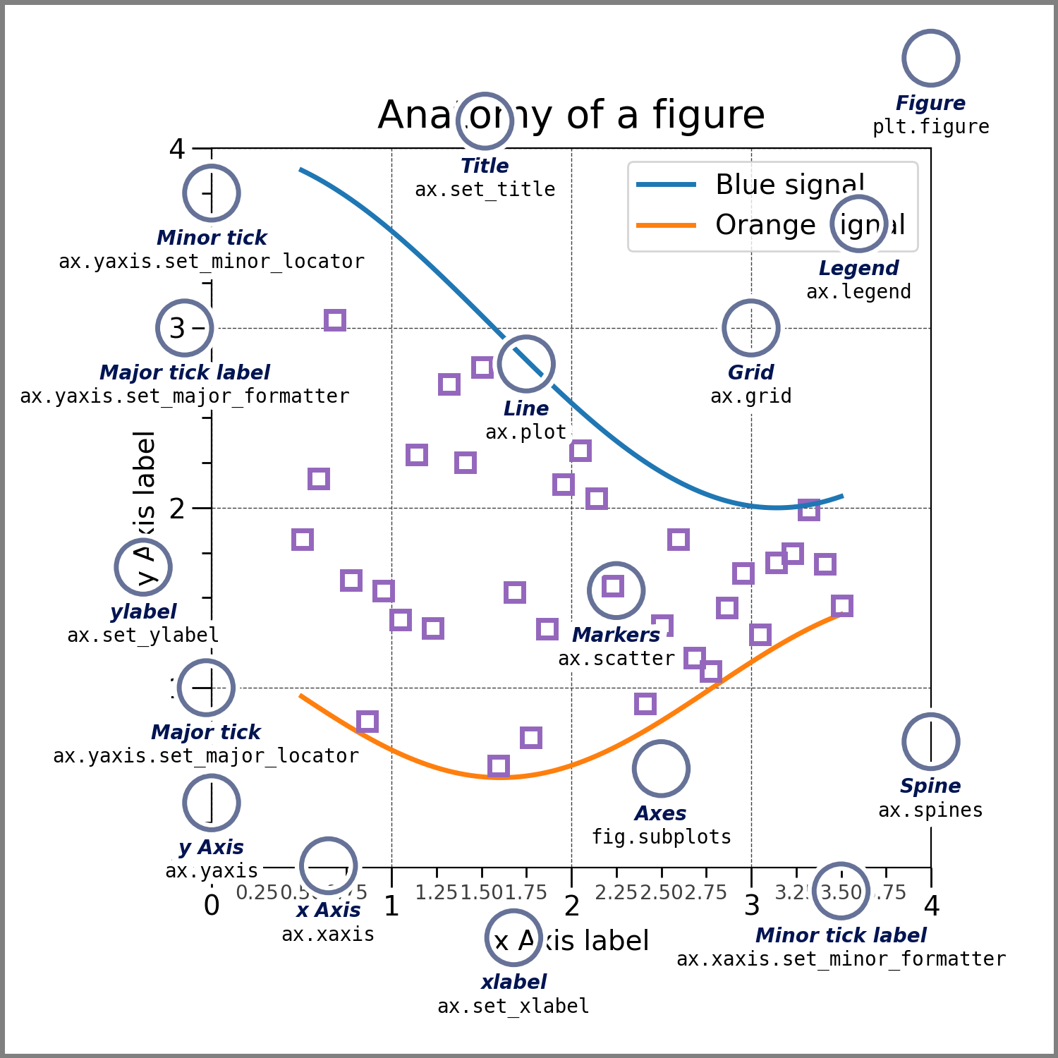
Notes:
https://matplotlib.org/stable/_images/anatomy.png

Slide 8
This entire thing is a figure
Notes:
https://matplotlib.org/stable/_images/anatomy.png

Slide 9
The plot is called our axes*
*NOT the same thing as the x and y axes on our graph
Notes:
https://matplotlib.org/stable/_images/anatomy.png

Slide 10
Making a figure with matplotlib

Slide 11
Making a basic figure with matplotlib
First, let’s load our libraries
import numpy as np
import matplotlib.pyplot as plt
import pandas as pd
import scipy
import PIL
import requests

Slide 12
Making a basic figure with matplotlib
Next, make some sample data so that we have something to plot!
Then make our basic scatterplot (we’ll break it down after!)
np.random.seed(613)
x = np.arange(50)
y = np.random.randint(0, 100,50)
fig, ax = plt.subplots(figsize=(5, 3))
ax.scatter(x,y)

Slide 13
Making a basic figure with matplotlib
Let’s try modifying our graph
We want to keep our figure and axis definition the same
So we only edit our axis object
fig, ax = plt.subplots(figsize=(5, 3))
ax.bar(x,y)

Slide 14
Making a basic figure with matplotlib
We can also make a line plot
fig, ax = plt.subplots(figsize=(5, 3))
ax.plot(x,y)

Slide 15
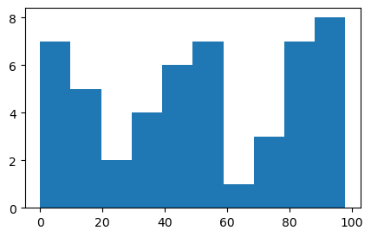
Activity: Try it out
Can you modify our existing code to produce a histogram?
Hint: try ‘hist’ for our axis type

Slide 16
Activity: Try it out
Let’s try modifying our graph
fig, ax = plt.subplots(figsize=(5, 3))
ax.hist(y)

Slide 17
Plot Labels

Slide 18
Adding axis labels and titles
Let’s add to the last plot we made
ax.set_title('Total growth over time')
ax.set_ylabel('Total growth')
ax.set_xlabel('Years since start')
fig.tight_layout()

Slide 19
Modifying labels and titles
We can modify our labels and titles’ appearance by using font dictionaries (‘fontdict’)
First, make a dictionary with the properties we want for our labels
font1 = {'family':'sans-serif','color':'blue','size':20}
font2 = {'family':'monospace','color':'green','size':14}

Slide 20
Modifying labels and titles
Then we’ll add fontdict arguments to our previous lineplot
fig, ax = plt.subplots(figsize=(5, 3))
ax.plot(x,y)
ax.set_title('Total growth over time', fontdict = font1)
ax.set_ylabel('Total growth', fontdict = font2)
ax.set_xlabel('Years since start', fontdict = font2)
fig.tight_layout()

Slide 21
Moving labels and titles
We can move our lables with the loc argument
fig, ax = plt.subplots(figsize=(5, 3))
ax.plot(x,y)
ax.set_title('Total growth over time', fontdict = font1, loc = 'left')
ax.set_ylabel('Total growth', fontdict = font2)
ax.set_xlabel('Years since start', fontdict = font2)
fig.tight_layout()

Slide 22
Customizing plot appearance

Slide 23
Modifying data points
Remake our basic scatterplot, but this time add color and marker arguments (NOTE: American spelling)
fig, ax = plt.subplots(figsize=(5, 3))
ax.scatter(x,
y,
marker='*',
color = "indigo")
fig.show()

Slide 24
Modifying data points
We can also adjust the style and width of the line connecting our points
fig, ax = plt.subplots(figsize=(5, 3))
ax.plot(x,y,marker='*', color = 'indigo', linestyle = '--', linewidth = 2)
fig.show()

Slide 25
Modifying data points: Colour
We can modify colour using named colors
https://matplotlib.org/stable/gallery/color/named_colors.html#sphx-glr-gallery-color-named-colors-py
Or we can use hex codes
fig, ax = plt.subplots(figsize=(5, 3))
ax.plot(x,y,marker='*', color = '#7425b9’, linestyle = '--', linewidth = 2)
fig.show()

Slide 26
Modifying data points
Let’s customize our plot further
ax.plot(x,y,marker='*',
markersize = 12,
color = '#7425b9',
linestyle = '--',
linewidth = 2,
markeredgecolor = '#fa9359',
markerfacecolor = '#fa9359' )

Slide 27
Grid lines
We can add grid lines to our axis object using .grid()
Activity: Can you modify the appearance (colour, width, linestyle) of our grid lines using what we learned before?
ax.grid(axis = 'y')

Slide 28
Grid lines
We can add grid lines to our axis object using .grid()
Activity: Can you modify the appearance (colour, width, linestyle) of our grid lines using what we learned before?
ax.grid(axis = 'y')
ax.grid(axis = ‘y’, color = "blue", linewidth = 2, linestyle = '-.')

Slide 29
Resources: Matplotlib Cheatsheets
https://s3.amazonaws.com/assets.datacamp.com/blog_assets/Python_Matplotlib_Cheat_Sheet.pdf
https://github.com/matplotlib/cheatsheets (with beginner, intermediate, and general tips versions)
We haven’t covered most of what’s on the cheatsheets yet, but keep them for your reference!

Slide 30
Activity: Exploring matplotlib

Slide 31
Activity
Visit the Python Graph Gallery at https://python-graph-gallery.com/all-charts/
Select one of the visualization types that you find most interesting
For your visualization of choice:
Copy the provided code and attempt to replicate the output in Python. NOTE: You may have to install packages.
Recall the aesthetic, substantive, and perceptual qualities of data visualizations. Does your visualization of choice succeed in each area?

Slide 32
Next...
What is reproducible data visualization?
How can we incorporate ideas about reproducibility into our data visualization practices? (Ethics)

