Slide 1

Ad Blocker Extension
By Boaz Alemseged
CoSC 412

Slide 2
My Extension
I have created an adblocker browser extension for Google Chrome.
This works for the most recent version of Google Chrome (version 87.0.4280.88)
It blocks ads displayed on the page aswell as onClick event popups
It is versetile and simple to use.
Does not collect user data

Slide 3
How it works
Use of Google Chrome API
Compiled a list of blocked domains
Blocks ads based on criterea I created and through list of blocked domains.

Slide 4
What I Used
JavaScript, HTML, and CSS
EasyList
Chromium Developer Documentation
Github

Slide 5
Challenges
No prior experience to JavaScript or HTML
Never have created an extension
Switching to chromium browser from Mozilla Firefox
Publishing extension
Whitelist

Slide 6
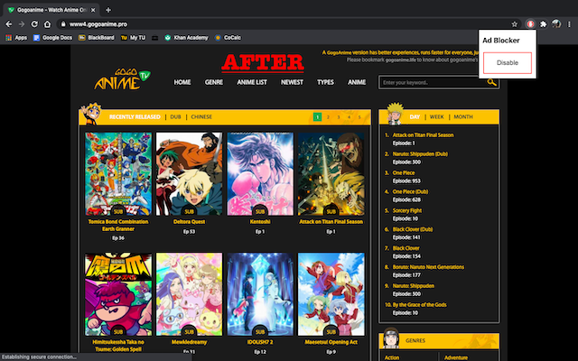
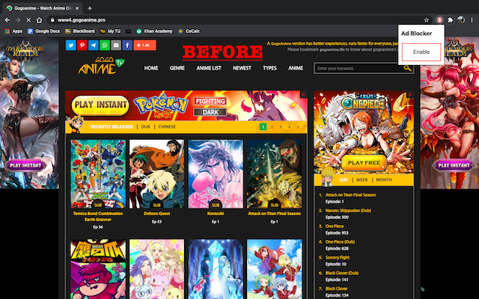
Ad Blocker Images

Slide 7
DEMO

