Slide 1
Scrapping Amazon: Extraction of product data from Amazon Reviews
Boaz Bibi
311599120
TUTORIAL WORK - 67537

Slide 2


Introduction
Our goal: database of items
Hopefully in program-friendly representation
Solution: mining common-sense information from the internet

Slide 3



Introduction
Starting with Amazon due to size and ease of access (both reviews and the official product information)
Using python libraries to analyze adjectives that are used to describe the product

Slide 4

Workflow
scrapper.py
'easy': 1092, 'sturdy': 669, 'small': 482, 'table': 440, 'little': 434, 'assemble': 360, 'top': 203, 'other': 194, 'heavy': 169, 'cheap': 164, ‘good': 147,
…
engine.py
analyzer.py

Slide 5



Scrapping
Python’s Requests library to get the HTML
LXML Library to analyze the source

Slide 6
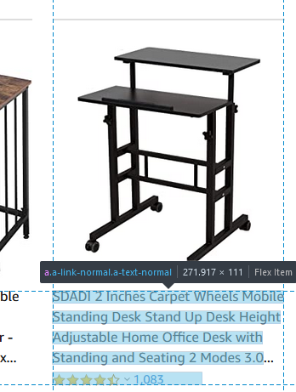
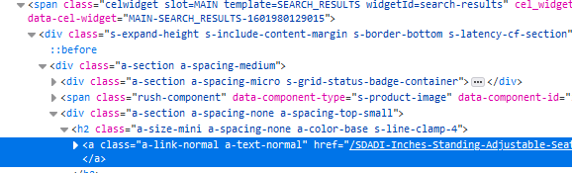
Product’s URL
Search URL template: https://www.amazon.com/s?k={SEARCH_TERM}&i={CATEGORY}&page={PAGE_NUM}
Using the classes of the HTML elements the get the desired texts
In source

Slide 7
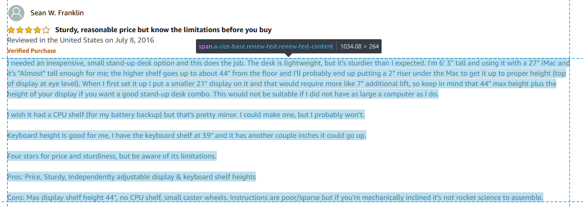
Review Text
Substituting ‘dp’ with ‘reviews’ to get reviews URL:
https://www.amazon.com/SDADI-Inches-Standing-Adjustable-Seating/dp/...
https://www.amazon.com/SDADI-Inches-Standing-Adjustable-Seating/reviews/...
Again, using LXML to fish for class information

Slide 8
Saving the Data
In JSON file:
{
“PRODUCT1_URL": {
"Product Info": {
"Bullets": [
"",
],
"Product Description": ""
},
"Reviews": ["", "", "", ""]
},
“PRODUCT2_URL": {
"Product Info": {
..
}

Slide 9
Analyzing Data
Preprocessing (punctuations etc.)
Finding the adjectives
Counting the adjectives

Slide 10
Engines
3 NLP Engines for classification:
Spacy, NLTK, Stanza
For our purposes (PoS analysis), no major differences
Several possible voting processes

Slide 11
Remarks on the Results
A lot of words that describe size
A lot of words that describe subjective experience (‘nice’, ‘easy’, ‘great’ etc.)
Solution – using blacklist of common words to ignore.
(We do want to keep size information though)

Slide 12
Testing the Results
Taking adjectives that appeared in high frequency in only one item
Mixing them, and letting human to categorize them again
Checking the agreement between the humans to themselves and to the scrapper

Slide 13
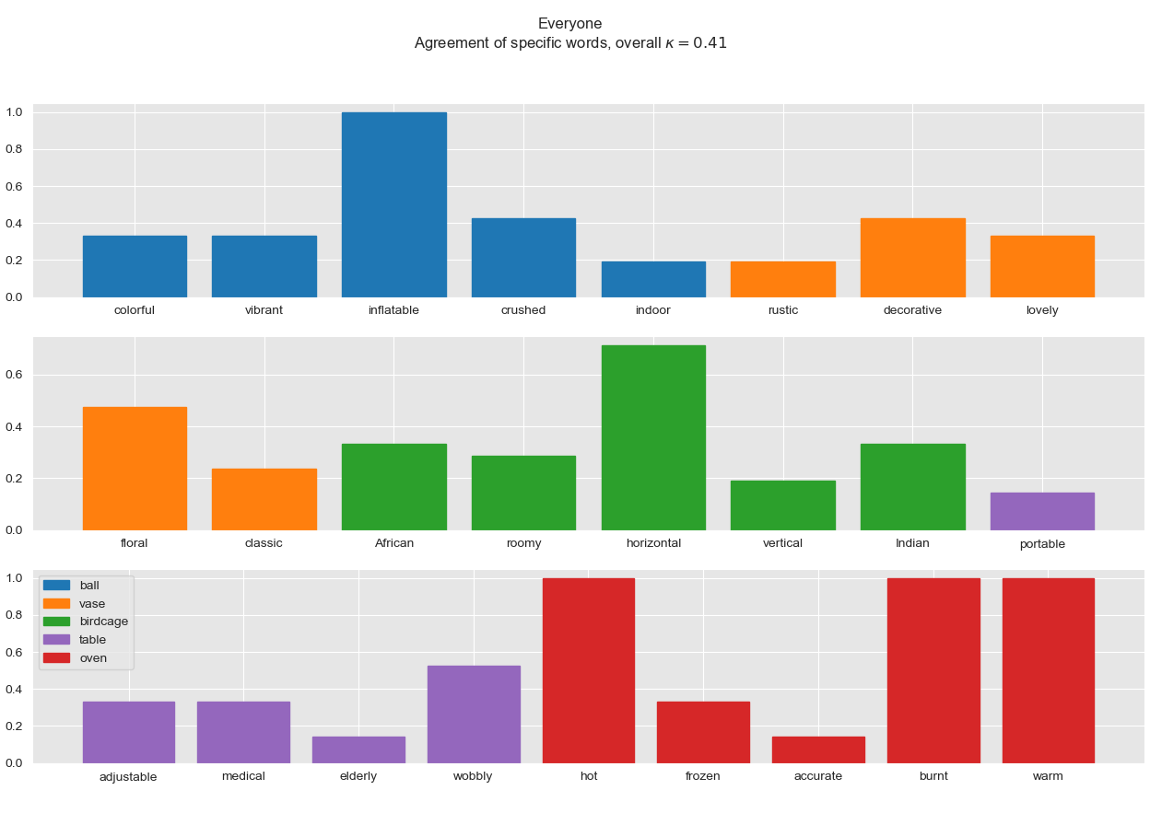
Agreements - All

Slide 14
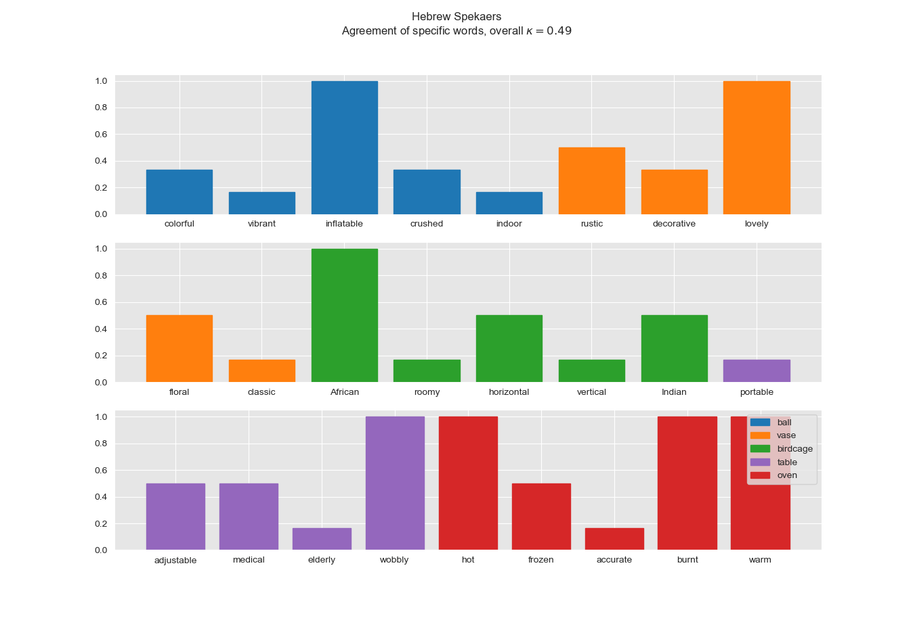
Hebrew Speakers

Slide 15
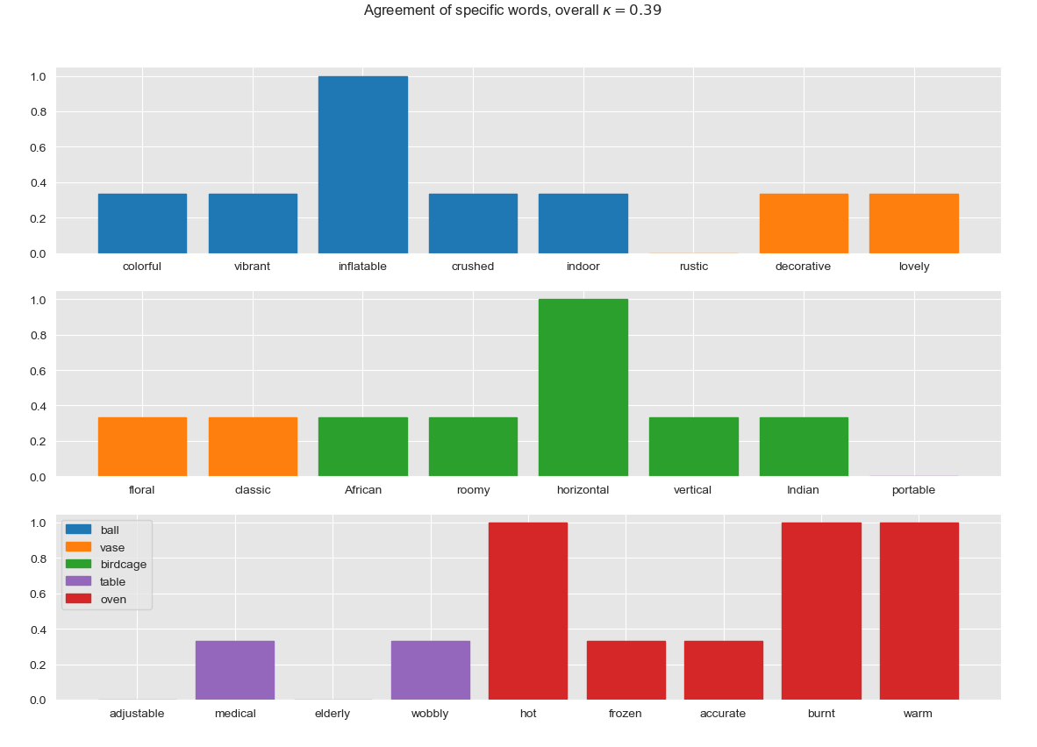
English Speakers

Slide 16
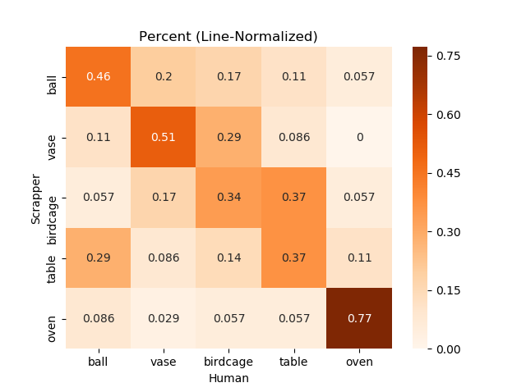
Confusion Matrix

Slide 17
Analyzing Results
Some adjectives seems to be very descriptive of the item, others do not.
This is different for different item (compare ‘oven’ to ‘vase’)

Slide 18
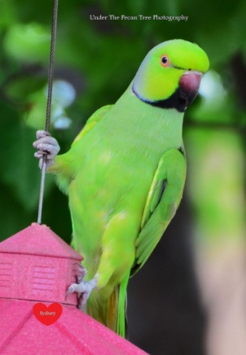
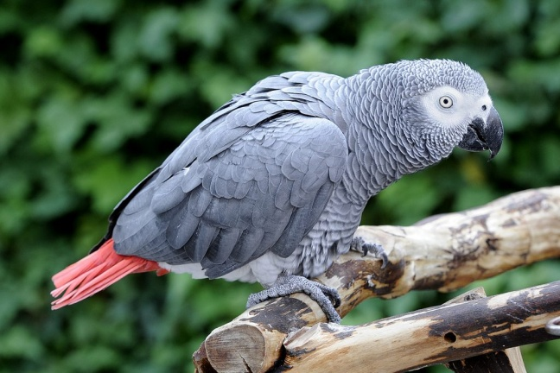
Interesting Specific Words
“Indian” and “African” are types of birds, and very common in “Birdcage”.
“elderly” is in “table”: buying for relatives
Those are good examples of noise that is hard to remove.
Indian Ringneck
African Grey

Slide 19
Concluding Remarks
Generally looks like OK results
Basic Word2Vec similarity of the found words doesn’t seem to be high
Human testing showed mixed results
Could be useful, maybe used to enhance a different model
Lots of noise!

Slide 20
Future Directions
Larger and more datasets (AWS, Wiki)
Learning an ‘item vector’ (like word vector but for physical objects)
Focusing on specific adjectives we know are related to usability

Slide 21
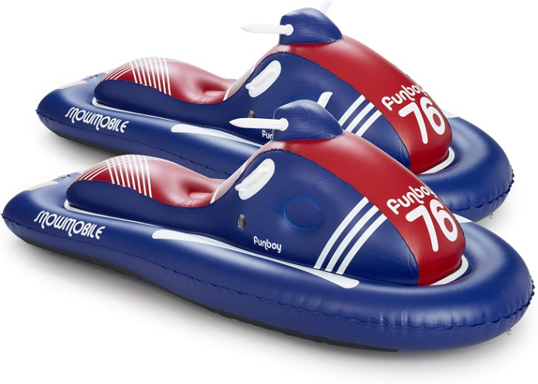
Future Directions
Using the method from the article “Accelerating Innovation Through Analogy Mining” we might be able to use amazon to match “mechanism” adjectives to “purpose” adjectives.
Inflatable => Easy to Carry
Mechanism => Purpose

