Slide 1
Car Accidents Severity Factors
Applied Data Science Capstone by IBM/Coursera (Week 2)
By Boaz Ben Dov

Slide 2
Problem
Where should state authorities focus their efforts to decrease car accidents severity= which factors effect the accidents severity the most.

Slide 3
Data
Data Set: Seattle government data of 194,673 collisions between 01/01/2014 to 20/05/2020.
Target Variable: Collison severity= property damage or injury
The independents variables:
External Factors- Weather, light
Drivers state- Under influence
Collison course- how many vehicles/pedestrians involved, what type of vehicles, where and how the car got hit.
Collison Location- Interchange, mid-block, specific location (prone to accidents).

Slide 4
Methodology
The car severity factors will be identified and quantified by using logistic regression model with target variable is high severity = 1 or low severity=0.
Model data will be standardized so we can use the variables coefficients to determine their importance.
Recursive Feature Elimination (RFE) algorithm will be used to find the best model features.
Balancing data using Synthetic Minority Oversampling Technique (SMOTE).

Slide 5
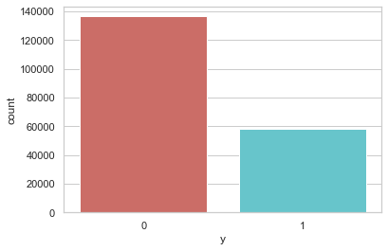
Variables
Target variable:
136,485
70.1%
58,188
29.9%

Slide 6
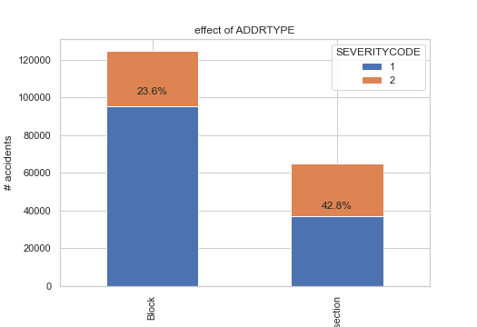
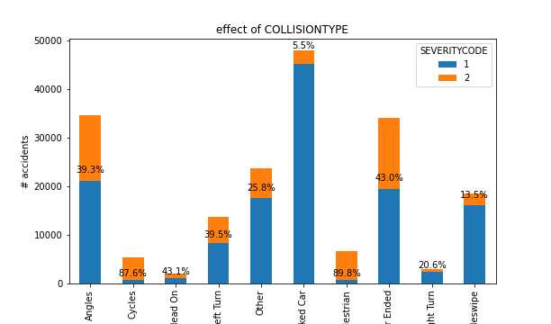
Variables
Some explanatory variables visualizations and their relation with target variable:

Slide 7
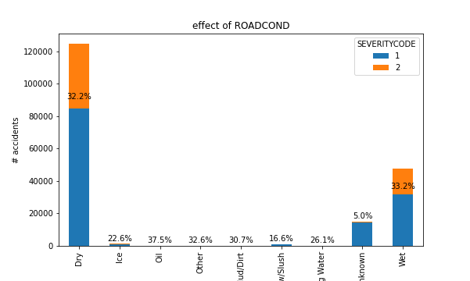
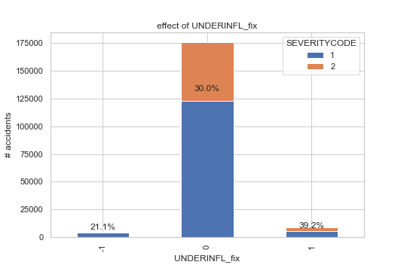
Variables
Some explanatory variables visualizations and their relation with target variable (cont.):

Slide 8
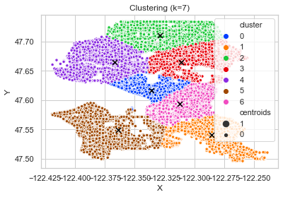
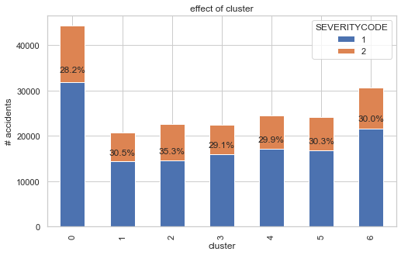
Variables
Creating geographical clusters of accidents coordinates (using k-means) to use as variable:

Slide 9
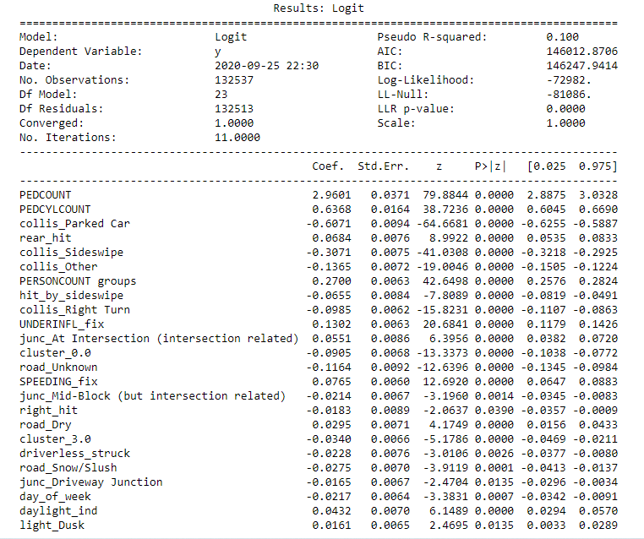
Results
The logistic regression produce this results:

Slide 10
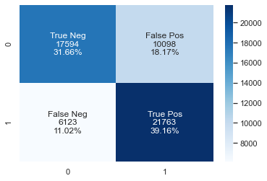
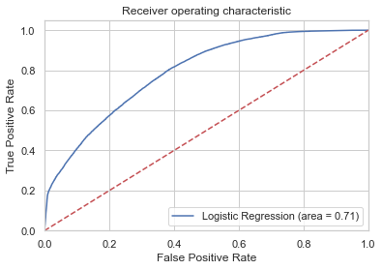
Results
Confusion Matrix:
Classification Report:
ROC curve:
 | Precision | Recall | F1-score | Support
0 | 0.74 | 0.64 | 0.68 | 27,692
1 | 0.68 | 0.78 | 0.73 | 27,886

Slide 11
Discussion
Model variables sorted by the absolute value of the coefficients and explained:
variable | coef | abs(coef) | Description
PEDCOUNT | 2.9601 | 2.9601 | The more pedestrians are involved the severity rate increase
PEDCYLCOUNT | 0.6368 | 0.6368 | The more bicycles are involved the severity rate increase
collis_Parked Car | -0.6071 | 0.6071 | Collision with parked car decrease the severity rate
collis_Sideswipe | -0.3071 | 0.3071 | Sideswipe collision decrease severity rate
PERSONCOUNT groups | 0.27 | 0.27 | The more people are involved in the collision, the severity rate increase
collis_Other | -0.1365 | 0.1365 | "Other" collision decrease severity rate- further understanding of this variable is needed
UNDERINFL_fix | 0.1302 | 0.1302 | Collision under influence of drugs and alcohol increase the severity rate
road_Unknown | -0.1164 | 0.1164 | unknown road condition decrease severity rate- further understanding of this variable is needed
collis_Right Turn | -0.0985 | 0.0985 | Collision while making right turn decrease the severity rate
cluster_0.0 | -0.0905 | 0.0905 | Collision in geographic cluster 0 increase the severity rate
SPEEDING_fix | 0.0765 | 0.0765 | Collision while speeding increase the severity rate
rear_hit | 0.0684 | 0.0684 | Collision in rear increase severity rate
hit_by_sideswipe | -0.0655 | 0.0655 | Collision hit by sideswipe decrease severity rate
junc_At Intersection (intersection related) | 0.0551 | 0.0551 | Collision at intersection increase the severity rate
daylight_ind | 0.0432 | 0.0432 | Collision when daylight increase the severity rate
cluster_3.0 | -0.034 | 0.034 | Collision in geographic cluster 3 decrease the severity rate
road_Dry | 0.0295 | 0.0295 | Collision on a dry road increase the severity rate
road_Snow/Slush | -0.0275 | 0.0275 | Collision on a snowed road decrease the severity rate
driverless_struck | -0.0228 | 0.0228 | Driverless collision decrease the severity rate
day_of_week | -0.0217 | 0.0217 | As value of day of week higher (1-7) the severity rate decrease
junc_Mid-Block (but intersection related) | -0.0214 | 0.0214 | Collision on mid-block decrease severity rate
right_hit | -0.0183 | 0.0183 | Collision on right side decrease severity rate
junc_Driveway Junction | -0.0165 | 0.0165 | Collision on driveway decrease severity rate
light_Dusk | 0.0161 | 0.0161 | Collision when dusk increase severity rate

Slide 12
Discussion
what effects accidents severity the most is when pedestrians and bicycles are involved. Authorities should probably invest more efforts finding solutions for keeping them safe (perhaps more bicycle roads and lowering speeding limits within populated areas).
Moderate effect on severity rate can be achieved by decreasing speeding and driving under influence.
Other variables either shows small effect or behind the control of state authorities in my opinion.

Slide 13
Discussion
what effects accidents severity the most is when pedestrians and bicycles are involved. Authorities should probably invest more efforts finding solutions for keeping them safe (perhaps more bicycle roads and lowering speeding limits within populated areas).
Moderate effect on severity rate can be achieved by decreasing speeding and driving under influence.
Other variables either shows small effect or behind the control of state authorities in my opinion.

Slide 14
Conclusion
Unfortunately this project didn't deliver the best results measures
More data on the drivers (like age, gender, driving experience, driving record) and on the vehicles (like safety rate and safety features) could have help us to build a better model.
Judging by this model results, state authorities should focus their efforts on keeping pedestrians and cyclists safe if they want to decrease their accidents severity rate.
Though the geographic clustering didn't produce much effect on the severity rate, I think it will be worth the while to create a more comprehensive geographic model to try to understand what factors effect accidents severity rate the most on each area.

