Slide 1
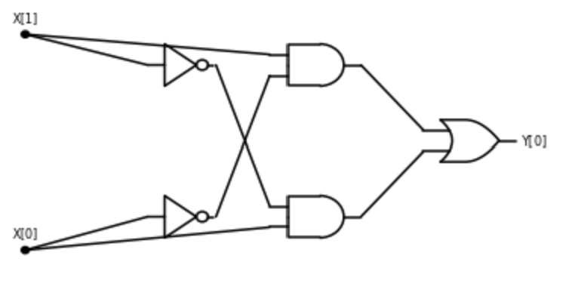
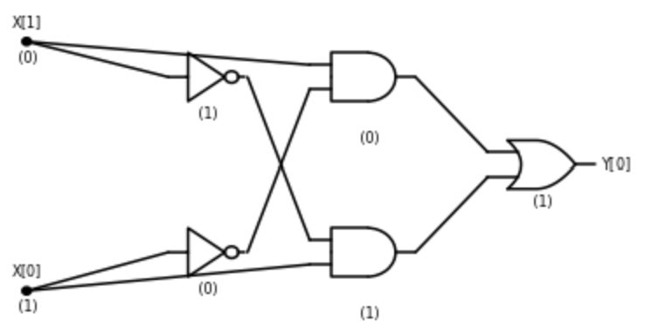



Inputs:
Gates:
Output gate(s):
$AND$ gate
$NOT$ gate
$OR$ gate
wire

Slide 2
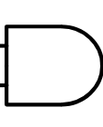
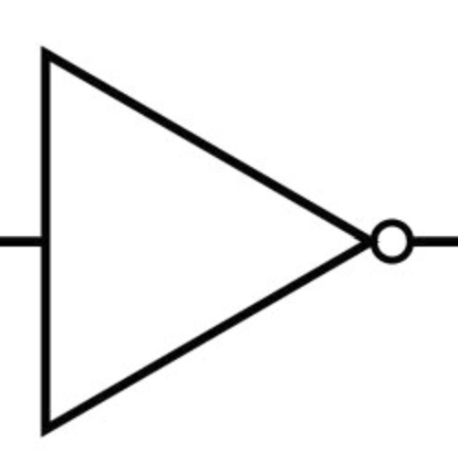
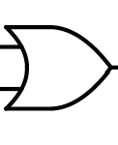



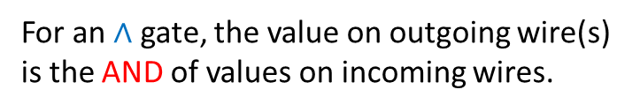
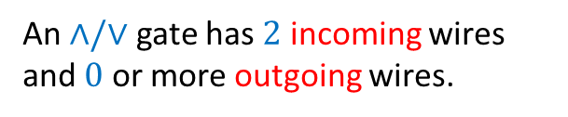






Inputs:
Gates:
Output gates:
$$X[0]$$
$$Y[0]$$
$$X[1]$$
$$Y[1]$$
$$X[2]$$
…
$n$ inputs
$m$ outputs
1
0
…
0
0
$Y[$m-1$]$
$X[$n-1$]$
An $∧/∨$ gate has $2$ incoming wires and $0$ or more outgoing wires.
For an $∧$ gate, the value on outgoing wire(s) is the AND of values on incoming wires.

Slide 3
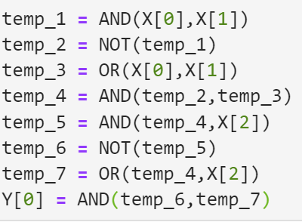
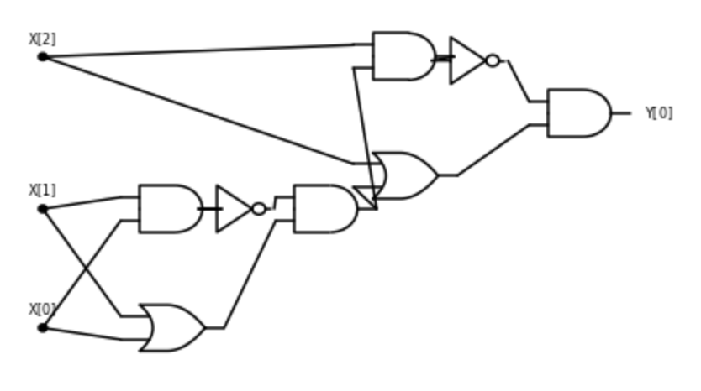

Slide 4
