Slide 1
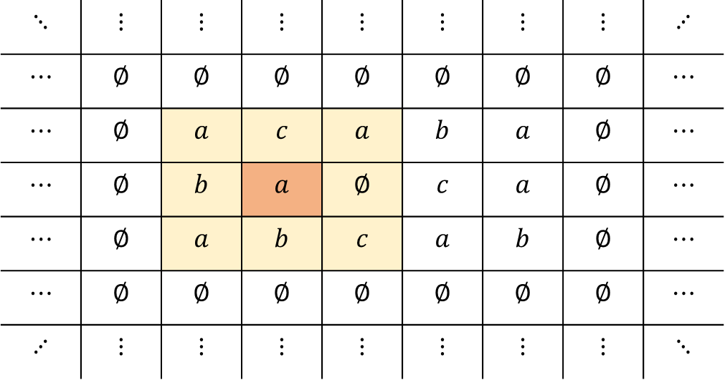
2 dimensional cellular automaton:
$$⋱$$ | $$⋮$$ | $$⋮$$ | $$⋮$$ | $$⋮$$ | $$⋮$$ | $$⋮$$ | $$⋮$$ | $$⋰$$
$$⋯$$ | $$∅$$ | $$∅$$ | $$∅$$ | $$∅$$ | $$∅$$ | $$∅$$ | $$∅$$ | $$⋯$$
$$⋯$$ | $$∅$$ | $$a$$ | $$c$$ | $$a$$ | $$b$$ | $$a$$ | $$∅$$ | $$⋯$$
$$⋯$$ | $$∅$$ | $$b$$ | $$a$$ | $$∅$$ | $$c$$ | $$a$$ | $$∅$$ | $$⋯$$
$$⋯$$ | $$∅$$ | $$a$$ | $$b$$ | $$c$$ | $$a$$ | $$b$$ | $$∅$$ | $$⋯$$
$$⋯$$ | $$∅$$ | $$∅$$ | $$∅$$ | $$∅$$ | $$∅$$ | $$∅$$ | $$∅$$ | $$⋯$$
$$⋰$$ | $$⋮$$ | $$⋮$$ | $$⋮$$ | $$⋮$$ | $$⋮$$ | $$⋮$$ | $$⋮$$ | $$⋱$$
1 dimensional cellular automaton:
$$⋯$$ | $$∅$$ | $$a$$ | $$c$$ | $$a$$ | $$b$$ | $$a$$ | $$∅$$ | $$⋯$$

Slide 2
$$⋯$$ | $$∅$$ | $$a$$ | $$c$$ | $$a$$ | $$b$$ | $$a$$ | $$∅$$ | $$⋯$$

Slide 3
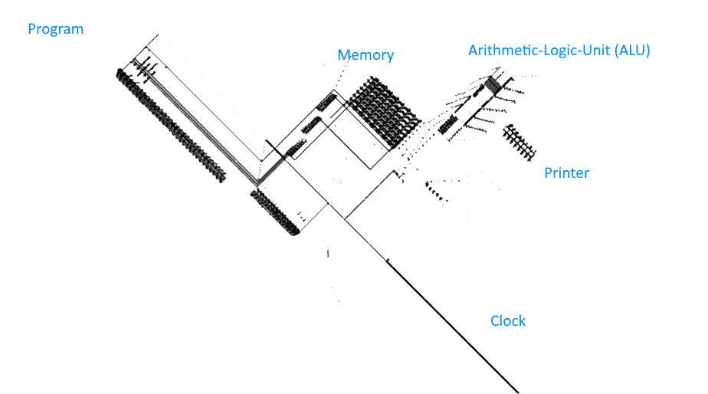

Slide 4
