Slide 1
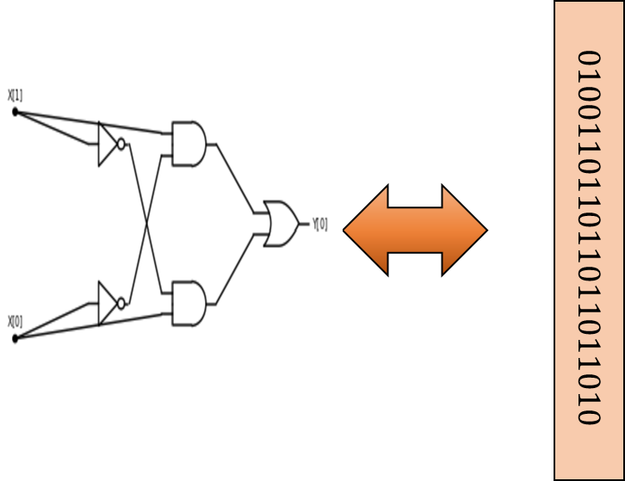
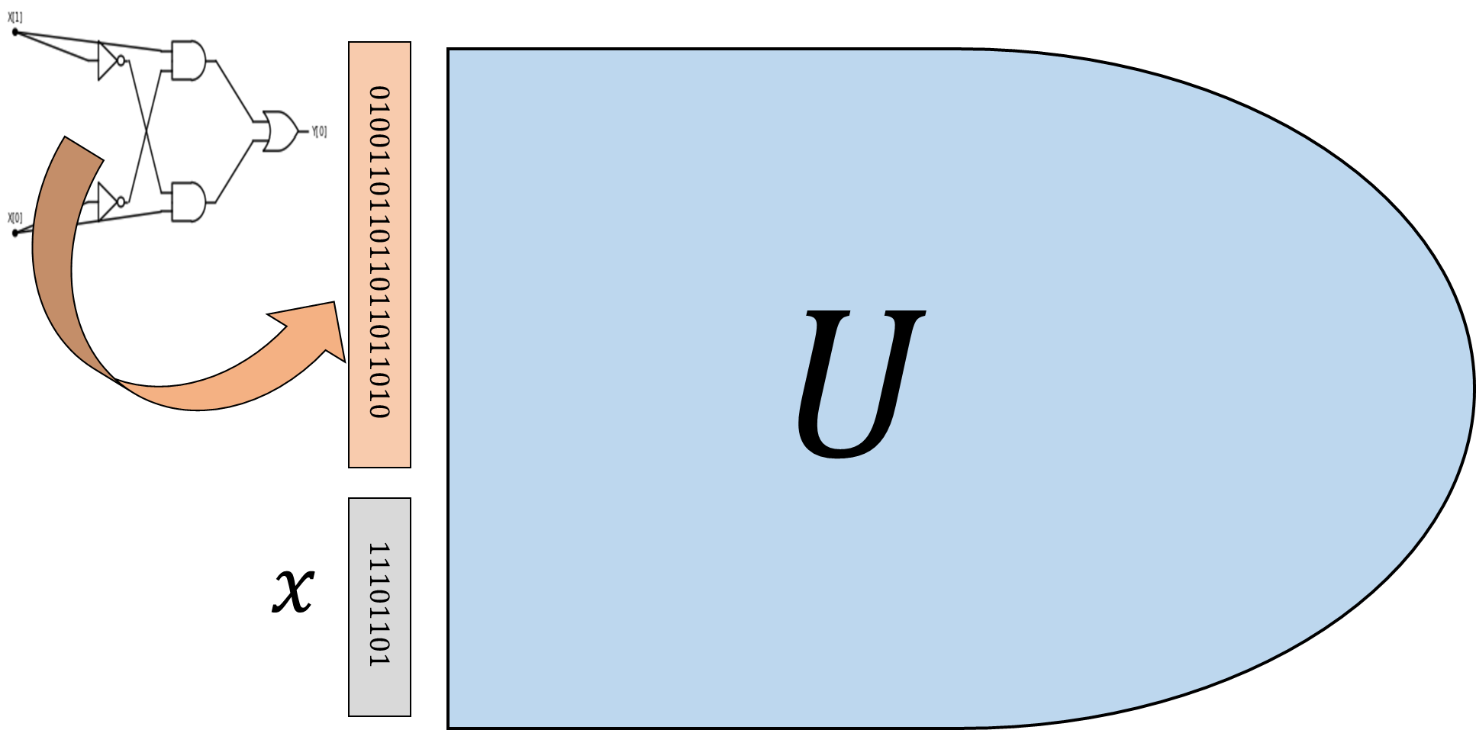
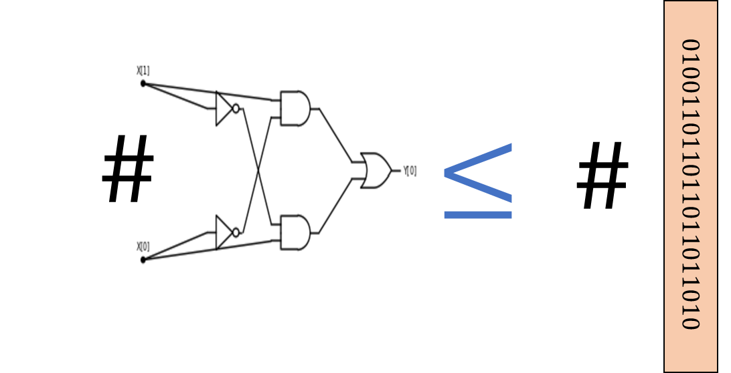
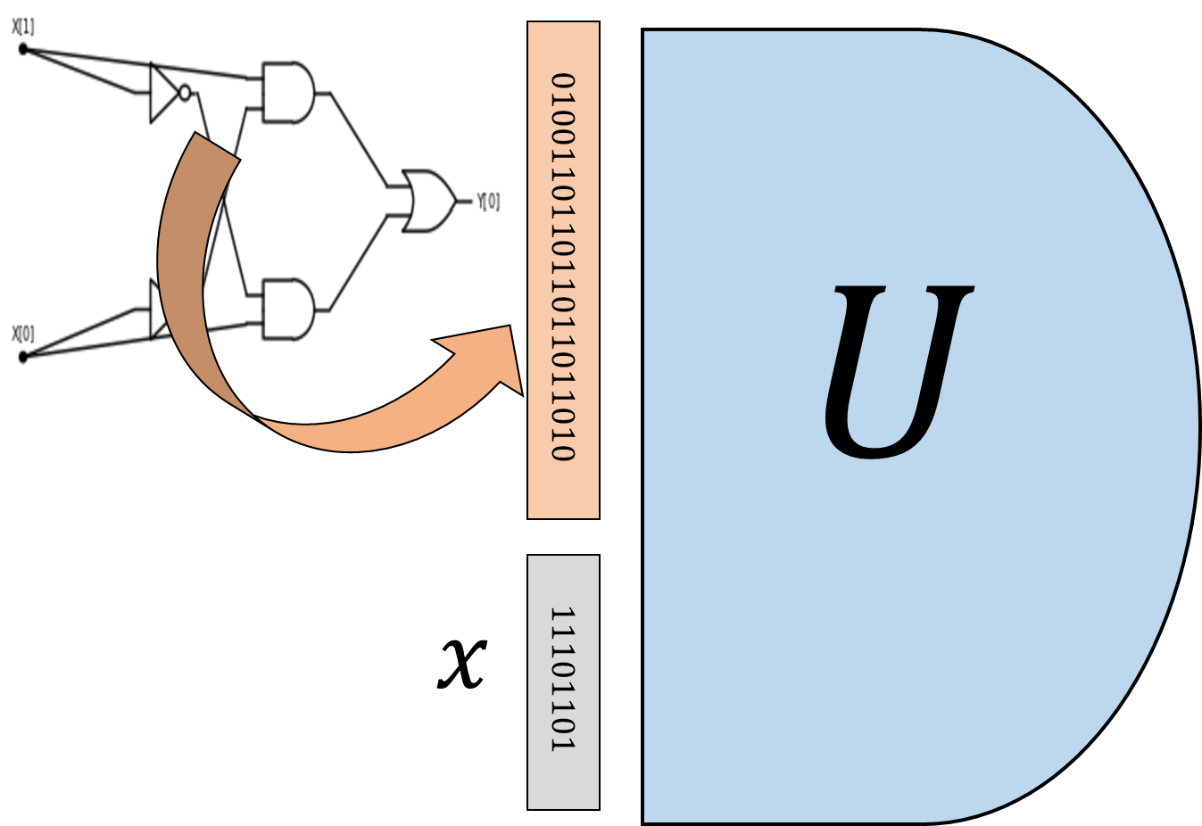
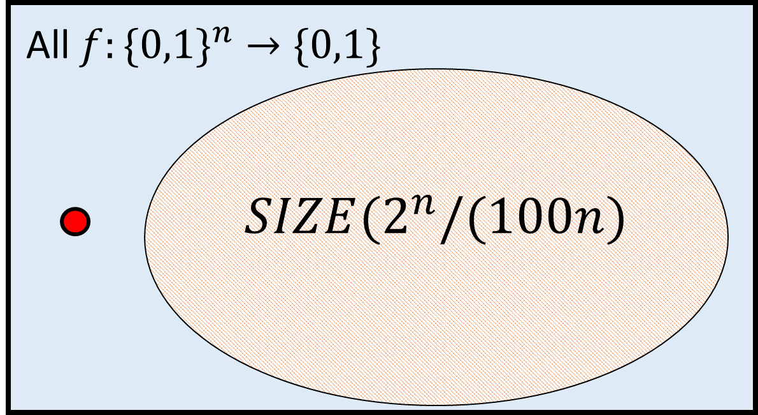
Representing programs/circuits as strings
(immediate)
Bounded universal circuit/program evaluator
Counting number of programs/circuits
(more work)
“NAND-CIRC interpreter in NAND-CIRC”
Efficient Bounded universal circuit/program evaluator
Lower bound: Some functions require exponentially-sized circuits/programs

Slide 2
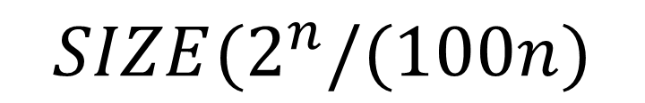

All $f:\{0,1\}^{n}→\{0,1\}$
$$SIZE(2^{n}/(100n)$$

