Slide 1
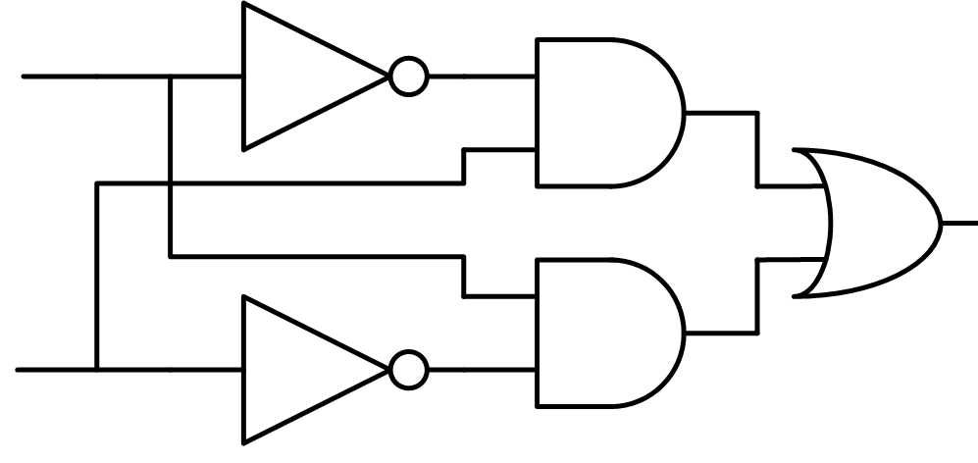
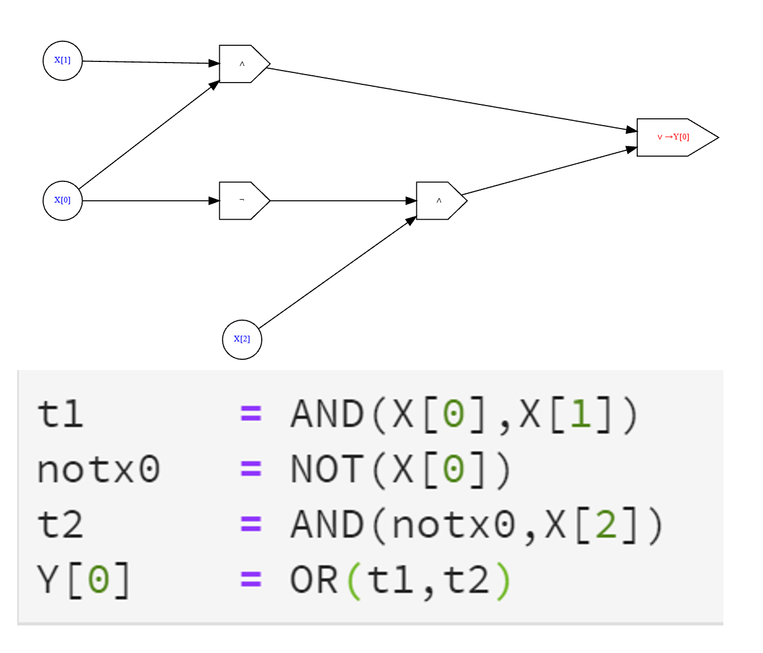
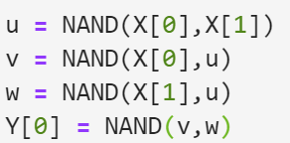
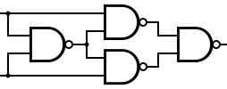

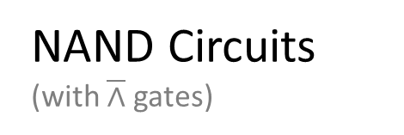
Boolean Circuits (with $∧,∨,¬$ gates)
AON-CIRC straightline programs (with AND, OR, NOT operations)
NAND-CIRC straightline programs (with NAND operation)
NAND Circuits (with $\overline{∧}$ gates)
…

Slide 2
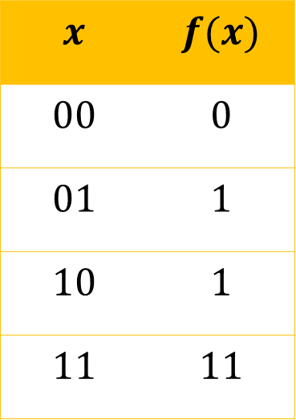
What
How
$$x$$ | $$f(x)$$
$$00$$ | $$0$$
$$01$$ | $$1$$
$$10$$ | $$1$$
$$11$$ | $$11$$
Finite functions
Computational models: Circuits, straight-line programs

