Slide 1
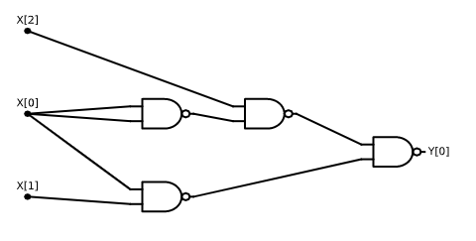









$$G$$
$$NANDSAT$$
$$SUBSETSUM$$
$$112321,5645868,34664,34543,…$$
$$F$$
$$3SAT$$
$$LONGPATH$$
$$\left(x_{0}∨{\overline{x}}_{2}∨x_{7}\right)∧\left(x_{5}∨x_{2}∨{\overline{x}}_{12}\right)∧⋯$$
$$ISET$$
$$01EQ$$
$x_{1}+x_{7}+x_{3}=3$, $x_{7}+x_{8}=2$, $…$

Slide 2
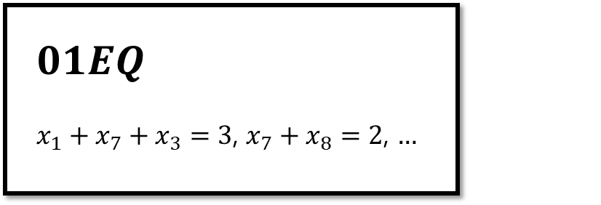
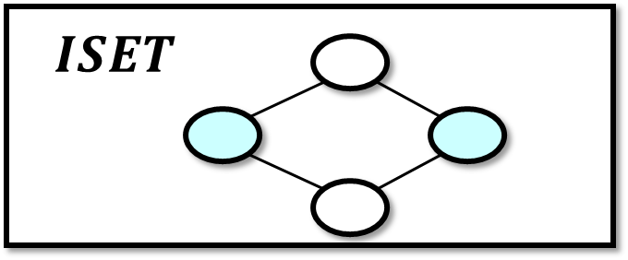
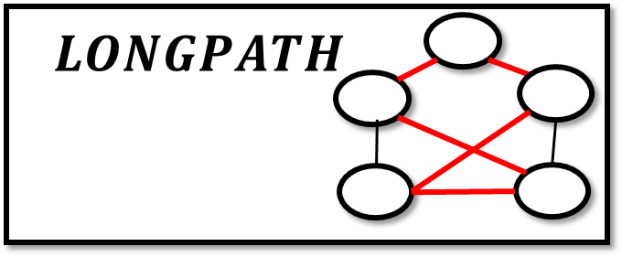
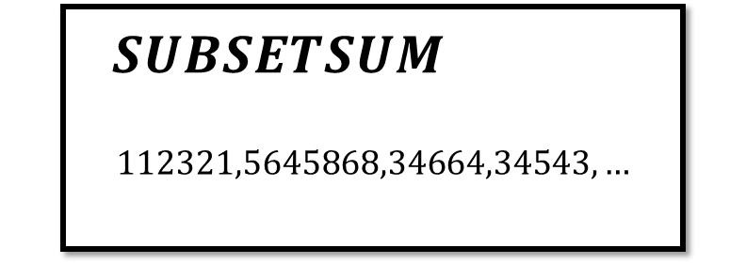



…
$$NANDSAT$$
$$3NAND$$
$$\left(x_{4}=NAND\left(x_{2},x_{3}\right)\right)∧\left(x_{8}=NAND\left(x_{4},x_{5}\right)\right)∧⋯$$
$$3SAT$$
$$\left(x_{0}∨{\overline{x}}_{2}∨x_{7}\right)∧\left(x_{5}∨x_{2}∨{\overline{x}}_{12}\right)∧(x_{9}∧x_{2}∧{\overline{x}}_{0})⋯$$

Slide 3
