Slide 1
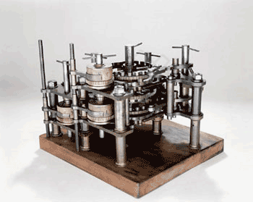
Introduction to Theoretical
Computer
Science
Boaz Barak

