Slide 1







$$n$$
$$k$$
$$n−k$$
$$x=ab$$
$$a_{0}$$ | $$a_{1}$$ | $$…$$ | $$a_{k−1}$$ | $$b_{0}$$ | $$b_{1}$$ | $$b_{2}$$ | $$⋯$$ | $$⋯$$ | $$b_{n−k−1}$$
$$f(a0^{n−k})$$ | $$f\left(a0^{n−k−1}1\right)$$ | $$⋯$$ | $$⋯$$ | $$⋯$$ | $$f(ab)$$ | $⋯$ | $$⋯$$ | $$f(a1^{n−k})$$
$$g(a)$$
$$f\left(ab\right)=g{\left(a\right)}_{b}$$
$$2^{n−k}$$

Slide 2



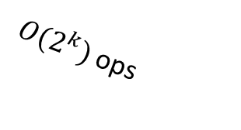
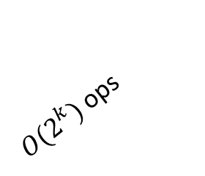

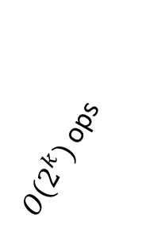

$$k$$
$$a_{0}$$ | $$a_{1}$$ | $$…$$ | $$a_{k−1}$$
${O(2}^{k})$ ops
${O(2}^{k})$ ops
${O(2}^{k})$ ops
$O(1)$ ops
$O(1)$ ops
$$g_{0\left(a\right)}$$ | $$g_{1\left(a\right)}$$ | $$g_{2\left(a\right)}$$ | $$⋯$$ | $$g_{27}(a)$$ | $⋯$ | $$⋯$$ | $$g_{N−1}(a)$$
$$N$$

