Slide 1






Cellular automata / configurations
Encode strings as integers
MRDP Theorem
$$QMS$$
$$QIS$$
$$DIO$$
$$HALT$$
$$CAHALT$$
$$PUZZLE$$
(quantified mixed statements)
(quantified integer statements)
(Diophantine equations)
is uncomputable
is uncomputable
is uncomputable
is uncomputable
is uncomputable
is uncomputable
Immediate
Immediate
Gödel’s Incompleteness Theorem for statements about Turing Machines
Gödel’s Incompleteness Theorem for quantified integer statements

Slide 2

Cellular automata / configurations
Encode strings as integers
MRDP Theorem
$$HALTONZERO$$
$$QMS$$
$$QIS$$
$$DIO$$
(quantified mixed statements)
(quantified integer statements)
(Diophantine equations)
is uncomputable
is uncomputable
is uncomputable
is uncomputable
Immediate
Gödel’s Incompleteness Theorem for statements about Turing Machines
Immediate
Gödel’s Incompleteness Theorem for quantified integer statements

Slide 3










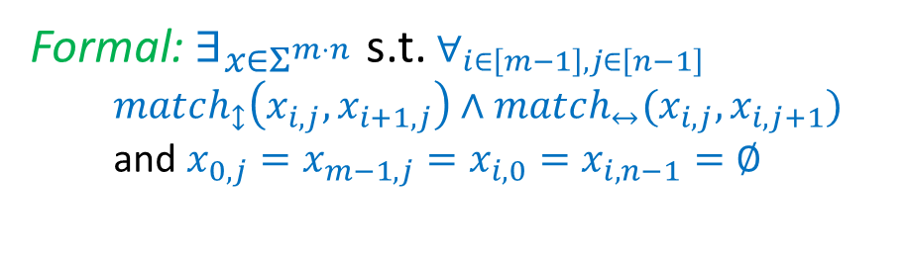




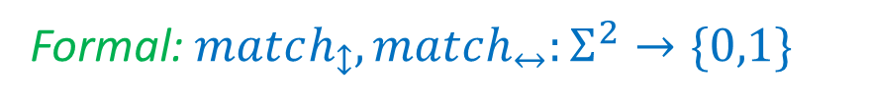
















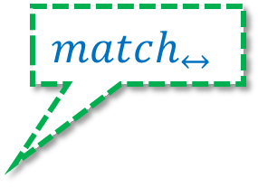






Input: , , , …
Formal: $match_{↕},match_{↔}:Σ^{2}→\{0,1\}$
$$x_{0,0}$$
$$x_{0,1}$$
$$x_{0,2}$$
$$⋯$$
$$x_{0,n−2}$$
$$x_{0,n−1}$$
Output:
$$x_{1,0}$$
$$x_{1,1}$$
$$x_{1,2}$$
$$⋯$$
$$x_{1,n−2}$$
$$x_{1,n−1}$$
$1$ iff $∃$
$$match_{↔}$$
Formal: $∃_{x∈Σ^{m⋅n}}$ s.t. $∀_{i∈\left[m−1\right], j∈\left[n−1\right]}$
$match_{↕}\left(x_{i,j},x_{i+1,j}\right)∧match_{↔}(x_{i,j},x_{i,j+1})$
and $x_{0,j}=x_{m−1,j}=x_{i,0}=x_{i,n−1}=∅$
$$⋯$$
$$⋯$$
$$⋯$$
$$⋯$$
$$x_{i−1,j}$$
$$x_{i,j−1}$$
$$x_{i,j}$$
$$x_{i,j+1}$$
$$x_{i+1,j}$$
$$match_{↕}$$
$$x_{m−2,1}$$
$$⋯$$
$$x_{m−2,n−2}$$
$$x_{m−1,0}$$
$$x_{m−1,n−1}$$
$$⋯$$

Slide 4
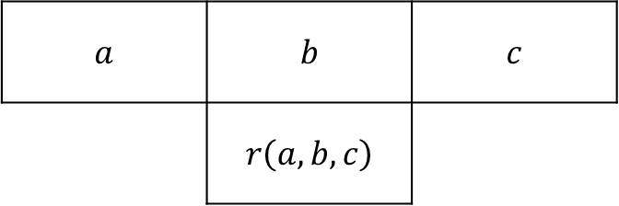
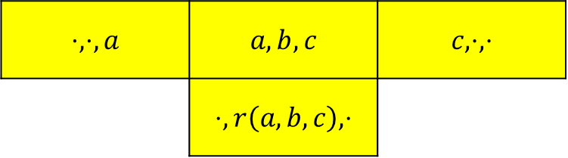
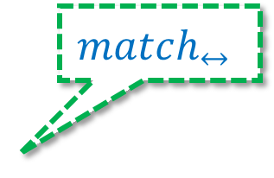

Automaton rule
Puzzle matching criteria
$$match_{↔}$$
$$a$$ | $$b$$ | $$c$$
 | $$r\left(a,b,c\right)$$
$$⋅,⋅,a$$ | $$a,b,c$$ | $$c,⋅,⋅$$
 | $$⋅,r\left(a,b,c\right),⋅$$
$$match_{↕}$$

