Slide 1
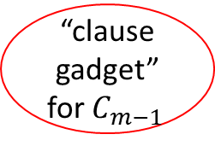
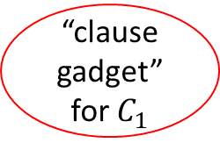
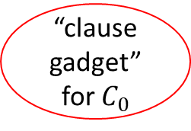
start
“clause gadget” for $C_{0}$
“variable gadget” for $x_{0}$
“clause gadget” for $C_{1}$
“variable gadget” for $x_{1}$
…
…
“variable gadget” for $x_{0}$
“clause gadget” for $C_{m−1 }$
end

Slide 2






















start
1
$$x_{0}:$$
$$x_{0}^{0}$$
$$x_{0}^{1}$$
$$x_{0}^{2}$$
$$x_{0}^{3}$$
0
$$x_{1}:$$
$$x_{1}^{0}$$
$$x_{1}^{1}$$
$$x_{1}^{2}$$
$$x_{1}^{3}$$
$C_{0}$=$x_{0}∨¬x_{2}∨x_{3}$
$C_{1}$=$¬x_{0}∨x_{1}∨{¬x}_{3}$
$$x_{2}:$$
$$x_{2}^{0}$$
$$x_{2}^{1}$$
$$x_{2}^{2}$$
$$x_{2}^{3}$$
$$x_{3}:$$
$$x_{3}^{0}$$
$$x_{3}^{1}$$
$$x_{3}^{2}$$
$$x_{3}^{3}$$
end

Slide 3

start
$$x=1010$$
1
$$x_{0}:$$
$$x_{0}^{0}$$
$$x_{0}^{1}$$
$$x_{0}^{2}$$
$$x_{0}^{3}$$
0
$$x_{1}:$$
$$x_{1}^{0}$$
$$x_{1}^{1}$$
$$x_{1}^{2}$$
$$x_{1}^{3}$$
$C_{0}$=$x_{0}∨¬x_{2}∨x_{3}$
$C_{1}$=$¬x_{0}∨x_{1}∨{¬x}_{3}$
$$x_{2}:$$
$$x_{2}^{0}$$
$$x_{2}^{1}$$
$$x_{2}^{2}$$
$$x_{2}^{3}$$
$$x_{3}:$$
$$x_{3}^{0}$$
$$x_{3}^{1}$$
$$x_{3}^{2}$$
$$x_{3}^{3}$$
end

Slide 4








$$u$$
$$v$$
$$u_{in}$$
$$u_{mid }$$
$$u_{out }$$
$$v_{in}$$
$$v_{mid }$$
$$v_{out }$$

Slide 5
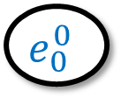
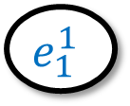
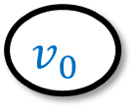
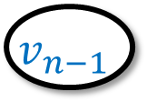
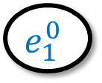



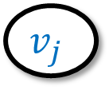


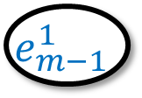


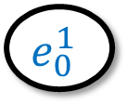

$$s^{∗}$$
$n$ vertices
$$v_{0}$$
$$v_{1}$$
…
$$v_{i}$$
$$v_{j}$$
…
$$v_{n−1}$$
$2m$ vertices
$$e_{0}^{0}$$
$$e_{0}^{1}$$
$$e_{1}^{0}$$
$$e_{1}^{1}$$
$$e_{1}^{0}$$
$$e_{1}^{1}$$
$$e_{m−1}^{0}$$
$$e_{m−1}^{1}$$

Slide 6
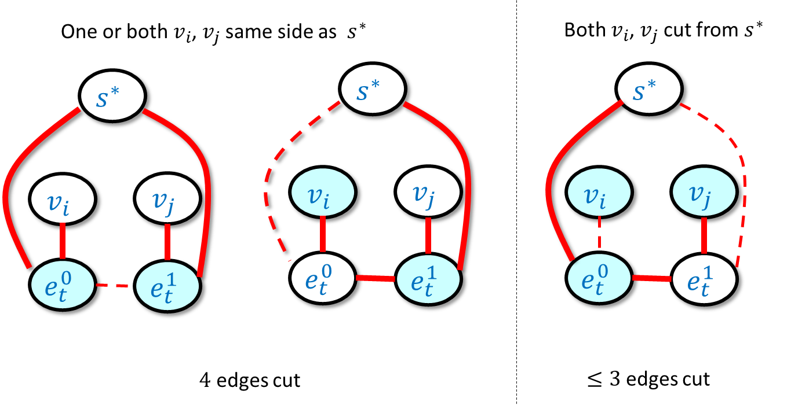

Slide 7
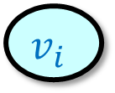

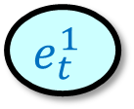



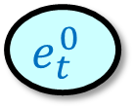



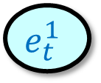






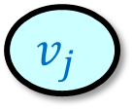

One or both $v_{i}$, $v_{j}$ same side as $s^{∗}$
Both $v_{i}$, $v_{j}$ cut from $s^{∗}$
$$s^{∗}$$
$$s^{∗}$$
$$s^{∗}$$
$$v_{i}$$
$$v_{j}$$
$$v_{i}$$
$$v_{j}$$
$$v_{i}$$
$$v_{j}$$
$$e_{t}^{0}$$
$$e_{t}^{1}$$
$$e_{t}^{0}$$
$$e_{t}^{1}$$
$$e_{t}^{0}$$
$$e_{t}^{1}$$
$4$ edges cut
$≤3$ edges cut

Slide 8
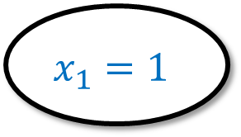
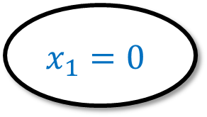
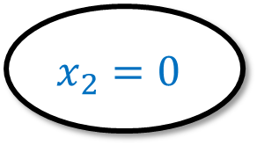
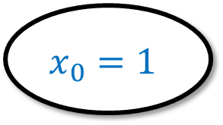

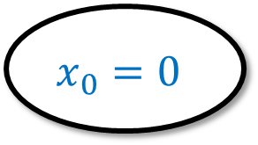



$$x_{0}=0$$
$$x_{0}=1$$
$$x_{1}=1$$
$$x_{2}=0$$
$$x_{1}=1$$
$$x_{1}=0$$
$$x_{2}=1$$
$$x_{2}=1$$
$$x_{3}=0$$

Slide 9
