Slide 1





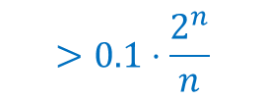




gap $≤10n$
$$f_{0}$$
$$f_{1}$$
$$f_{2}$$
$$f_{i−1}$$
$$f_{i}$$
$$f_{2^{n}}$$
$$>0.1⋅\frac{2^{n}}{n}$$
$$<10n$$
$$≤s$$

